Slide 1
My research topics related to surface plasmon
Topic I
Manufacturable Symmetry Control in Nanophotonic Light-Trapping Structures to Surpass the
Lambertian Limit
Topic II
Hot electron detector
Notes:
1

Slide 2
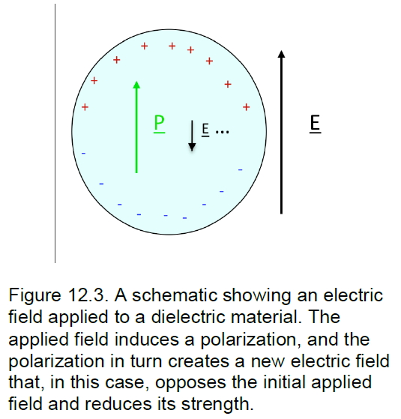
Dielectric constant
The electric field from a single point charge of q
→ Dielectric screening
Dielectric constant is not really a constant
High frequency, air =1 water =1.7 c-Si=15,
compare with conductors (Au,Ag)= infinity

Slide 3
Surface Plasmon
Electron density wave propagation along an interface of a metal-dielectric material.
k2
Scattering condition
k1
G
Reciprocal lattice, b1 = 2pi / a1, b2= 2pi / a2

Slide 4
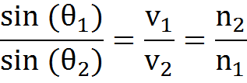
Lambertian Limit
Snell’s law
Total internal reflection
https://en.wikipedia.org/wiki/Snell%27s_law
Notes:
4

Slide 5
Lambertian Limit
Snell’s law
→The light trapping effect based on ray optics can be quantified
and analyzed
Total internal reflection
https://en.wikipedia.org/wiki/Snell%27s_law
Notes:
5

Slide 6
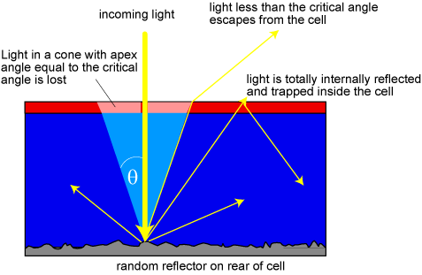
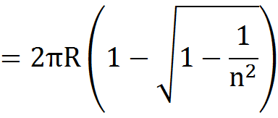
Lambertian Limit
Assumptions
Internal angular randomization
Integrate over surface and volume
Balance inflow and out flow
Consider based on ray optics
Length scale >> λ
◊ geometric optics
Solid angle is function of n²
Take Energy balance (inflow and out flow)
Intensity enhanced by the factor of 4n²
[E. Yablonovitch,. et al., J. Opt. Soc. Am., 72 899 (1982)]
Notes:
6

Slide 7
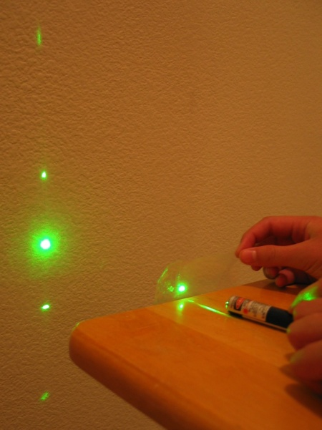
Lambertian Limit
With nanophotonics,
Assumptions
Internal angular randomization
Integrate over surface and volume
Balance inflow and out flow
Consider based on ray optics
<
where structure dimension λ
~
Lay optics is no more applicable
and light can get a momentum
from the structure.
Solid angle is function of n²
Take Energy balance (inflow and out flow)
Intensity enhanced by the factor of 4n²
[http://www.nano.utexas.edu/cd-diffraction-patterns-2/]
[E. Yablonovitch,. et al., J. Opt. Soc. Am., 72 899 (1982)]
Notes:
7

Slide 8
Lambertian Limit
Assumptions
Internal angular randomization
Integrate over surface and volume
Balance inflow and out flow
Consider based on ray optics
We can carefully design the
structure by using manufacturable
method for surpassing this
Lambertian limit
Light
Solid angle is function of n²
Take Energy balance (inflow and out flow)
Intensity enhanced by the factor of 4n²
[E. Yablonovitch,. et al., J. Opt. Soc. Am., 72 899 (1982)]
Notes:
8

Slide 9
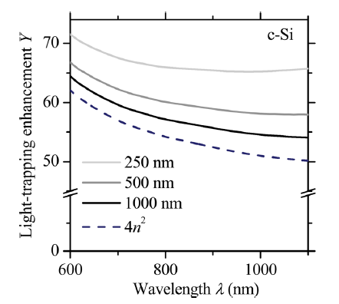
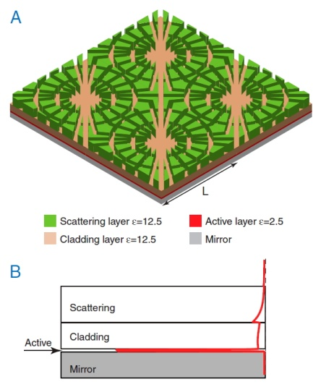
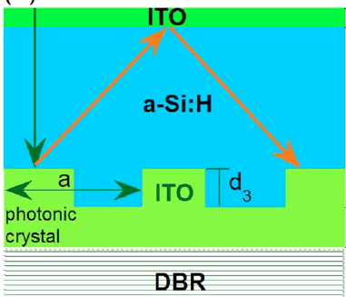
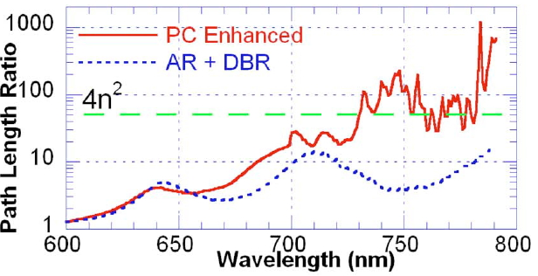
Super-Lambertian Limit
[E. A. Schiff et al., JAP, (2011)]
[M. C. Dennis. et al., Nano Lett, (2012)]
[Z. Yu. et al., PNAS (2015)]
Plasmonic resonator
High index
guided mode
[D. Zhou. et al., JAP, (2008)]
Light trapping limit with SPPs
Diffraction grating
Notes:
9
The active layer is sandwitched by high index meterials

Slide 10
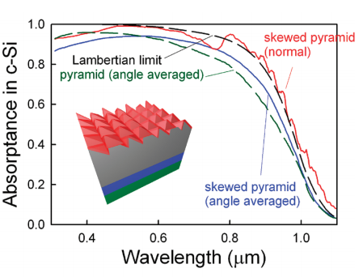
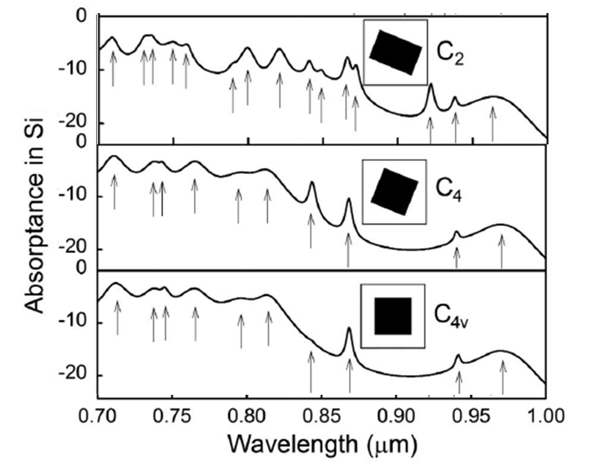
Symmetry control on periodic nanophotonic structures
Si
[S. E. Han et al., Nano Lett. (2010)]
[T. Cai & S. E. Han, JOSA B. (2015)]
More number of mode can couple to the light by
(1) mode splitting (2) creation of new resonances
The absorptance closely follow the Lambertian limit over entire
range of spectrum
Directly applicable to the photovoltaic devices
Notes:
10

Slide 11
Objective
Lambertian limit can be exceeded in nanophotonic regime
However, it has not been demonstrated how to integrate the super-lambertian scheme into practical photovoltaic devices
Present research will focus on,
Manufacturable, cost-effective fabrication of nanophotonic structures
Exceeding the Lambertian limit by symmetry breaking of plasmonic structures
3. Directly applicable to photovoltaic devices
Notes:
11

Slide 12
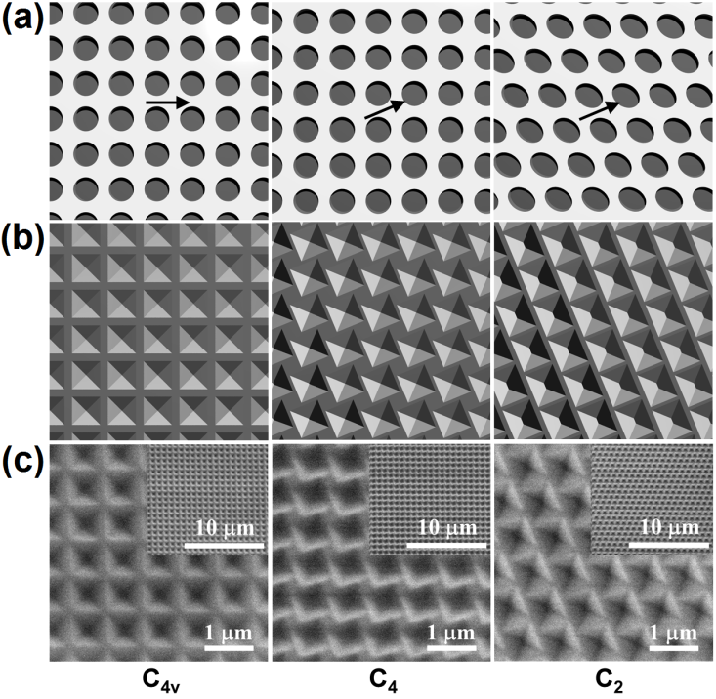
Symmetry-breaking in periodic nanostructures
by wet etching on Si surfaces
Arrows indicate [110] direction of c-Si
Misaligning etch mask w.r.t. the
c-Si [110]
Expected structures after etching and mask removal
Experimental structures

Slide 13
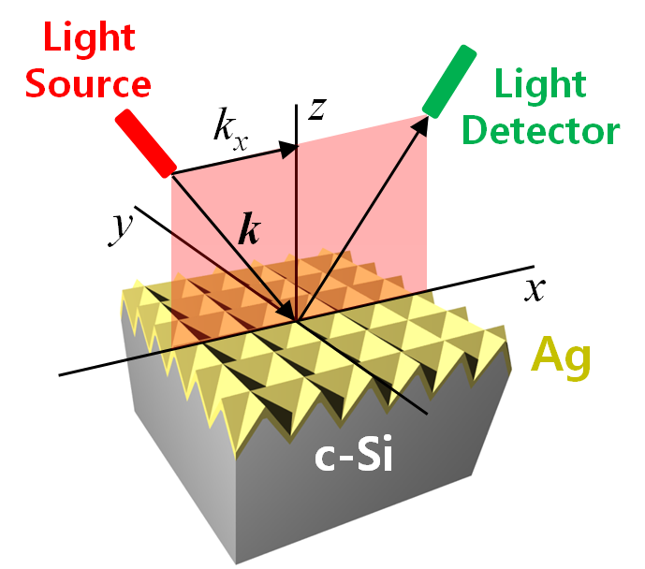
How SPPs behave with different symmetries: band structure
SPP band structure determination based
on reflectance

Slide 14
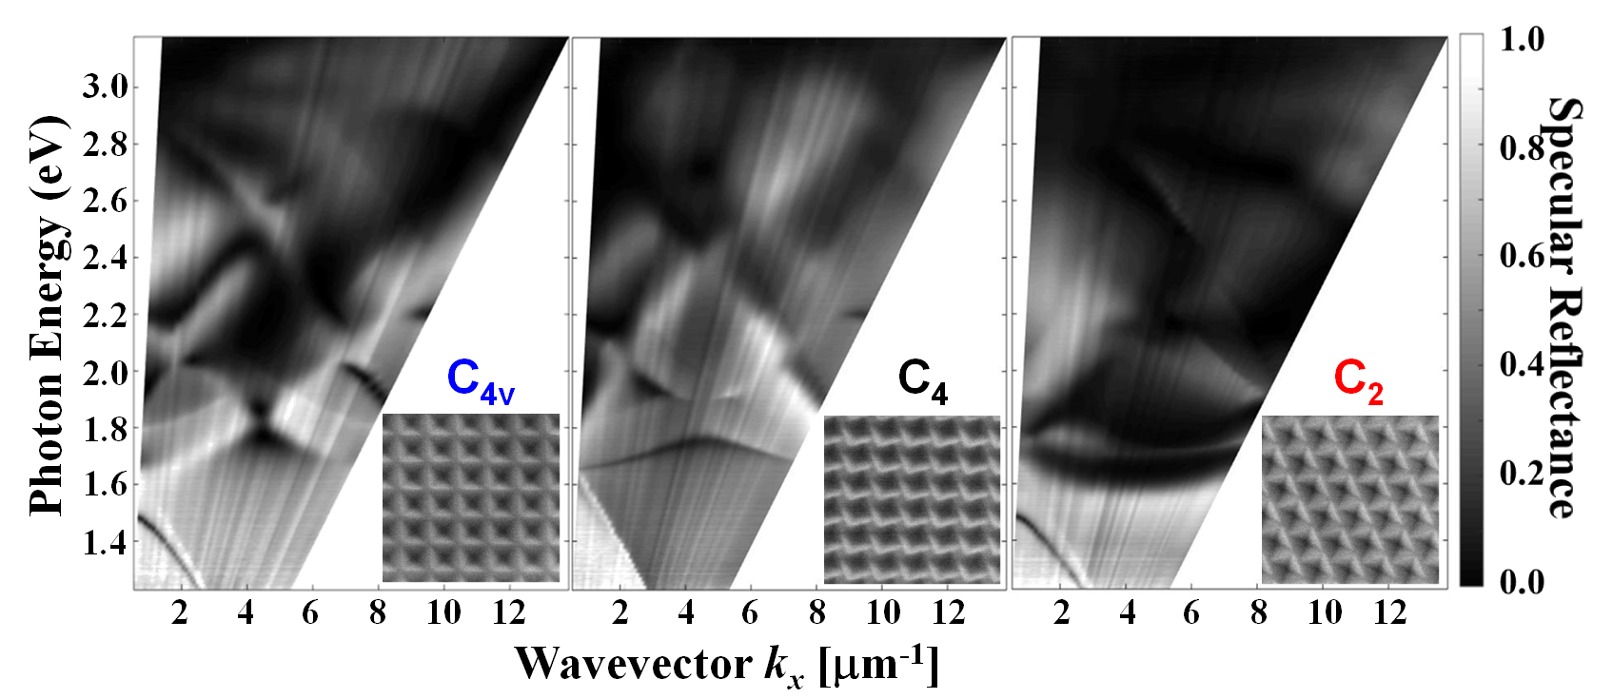
Measured band structure
C_{4v} and C₄ bear some similarity in terms of peak positions.
C₄ shows stronger coupling to light than C_{4v} near normal incidence
Further symmetry reduction from C₄ to C₂,decreases absorption near normal incidence.

Slide 15
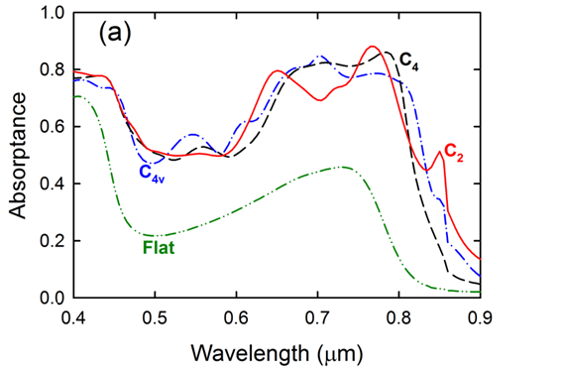
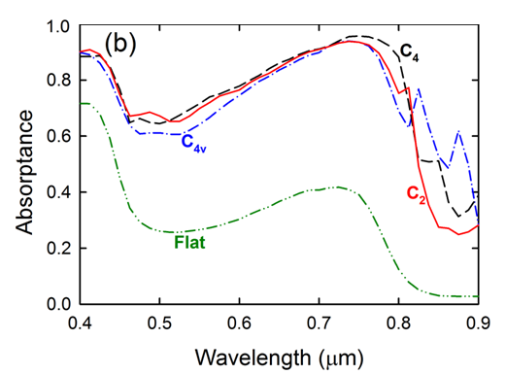
Light trapping in thin films
Experiment
Simulation
Compared to a flat sample, the structured surfaces show strongly
enhanced absorption over the entire spectrum of interest
Experiment and calculation agree with each other in major aspects

Slide 16
Comparison to the Lambertian limit
Samples | Absorption*
C_{4v} | 0.582
C₄ | 0.600
C₂ | 0.588
Flat | 0.244
* Spectral averaged from 400 nm to 900 nm
Absorption of the C₄ symmetry structure surpasses the Lambertian limit over most of the spectrum of interest.

Slide 17
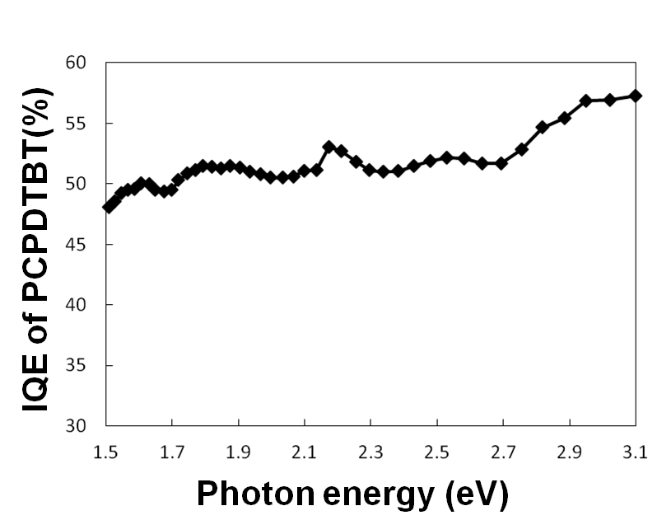
Enhancement in short circuit current
[Grancini, G. et al., Nat. Matter., 12 594 (2013)]
Samples | Jsc [mA/cm²]
C₄ | 9.87
Flat | 3.91
Enhanced by 2.5 times of Jsc

Slide 18
Conclusions
-Symmetry can be controlled by manufacturable and cost-effective
wet etching techniques
-The Lambertian limit can be surpassed by symmetry control
-Expected enhancement factor in short circuit current in organic solar cells is 2.5

Slide 19
My research topics related to surface plasmon
Topic I
Manufacturable Symmetry Control in Nanophotonic Light-Trapping Structures to Surpass the
Lambertian Limit
Topic II
Hot electron detector
Notes:
19

Slide 20
Hot electron study
Hot electron detector
IR detector → low band gap materials such as InGaAs, InSb, or HgCdTe.
→ They are expensive and not abundant.
Decay of surface plasmons
1) Radiative decay while emitting photons
2) Non-radiative decay¹⁾ – parasitic process, limits the plasmonic devices
Much effort has been devoted to suppress this
However, recent research has shown that this hot electrons can be harnessed for an application of photo detection.
1) [J. G. Endriz et al., Physical Rev. Lett. 24 (1970)]

Slide 21
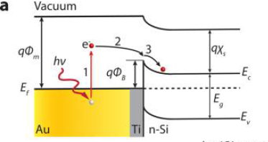
Hot electron study
In order to make a hot electron detector,
Manipulating the interface between Si and metal (Schottky barrier or
ohmic contact) to make an appropriate potential gradient
Use of thin metal layer, allowing the hot electrons to diffuse to the
semiconductor interface before thermalization
3) Maximize the number of hot electrons by using our structure and symmetry control technique

Slide 22
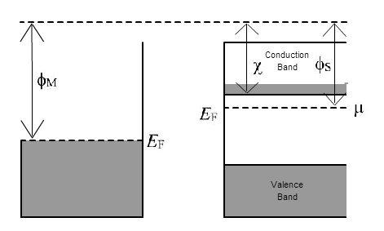
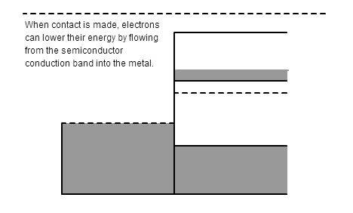
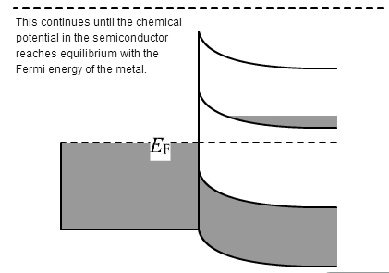
Hot electron study
In order to make a hot electron detector,
Manipulating the interface between Si and metal (Schottky barrier or
ohmic contact ) to make an appropriate potential gradient
Thin layer of metal (Ti/Au), n-type Si and ohmic contact on the other end
Ti : appropriate work function, barrier = 0.5 eV and help conformal coating
N type Si : proper potential gradient, not a high doping for SC
Au ohmic contact : should serve as back reflector, light trapping

Slide 23
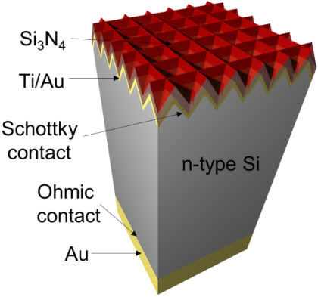
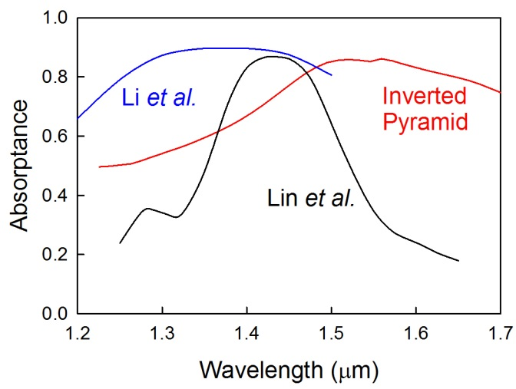
Hot electron study
3) Maximize the number of hot electrons by using our structure fabrication method and symmetry control technique
[Li et al., Nano Lett. 14 (2014)]
[Liu et al., Nano Lett. 10 (2010)]
We still don’t know the efficiency of hot electron transfer
Absorption → hot electron will diffuse into Si or thermalize

Slide 24
Hot electron study: Characterization
DROK® High Accuracy 5 Digits Amperage Measure Milli ammeters +/-0-1.9999mA Digital Current Meter
DROK® High Accuracy 2V Digital Voltmeter +/-0-1.9999V Red LED Voltage Tester 0.001V Resolution
VOC = 0.35 eV
Require an IR source

