Slide 1
Lecture 9
Correction! (Shout out of thanks to Seok!)
To get the wave equation for v when C₁₃≠ C₁₂, it is NOT OK to just do a cyclic permutation. That’s because saying C₁₃≠ C₁₂ gets rid of the cubic symmetry.
If you go back to F=ma, or
you can find the correct expression. (Perhaps not surprisingly, there is NO effect of C₁₃ on wave propagation along [110] with displacement in the xy plane.)

Slide 2
Lecture 9
Explanation.
What does it mean to talk about the “amplitude” of a phonon?
Analogy: what does it mean to talk about the amplitude of a harmonic oscillator in an energy eigenstate? How much does it oscillate?

Slide 3
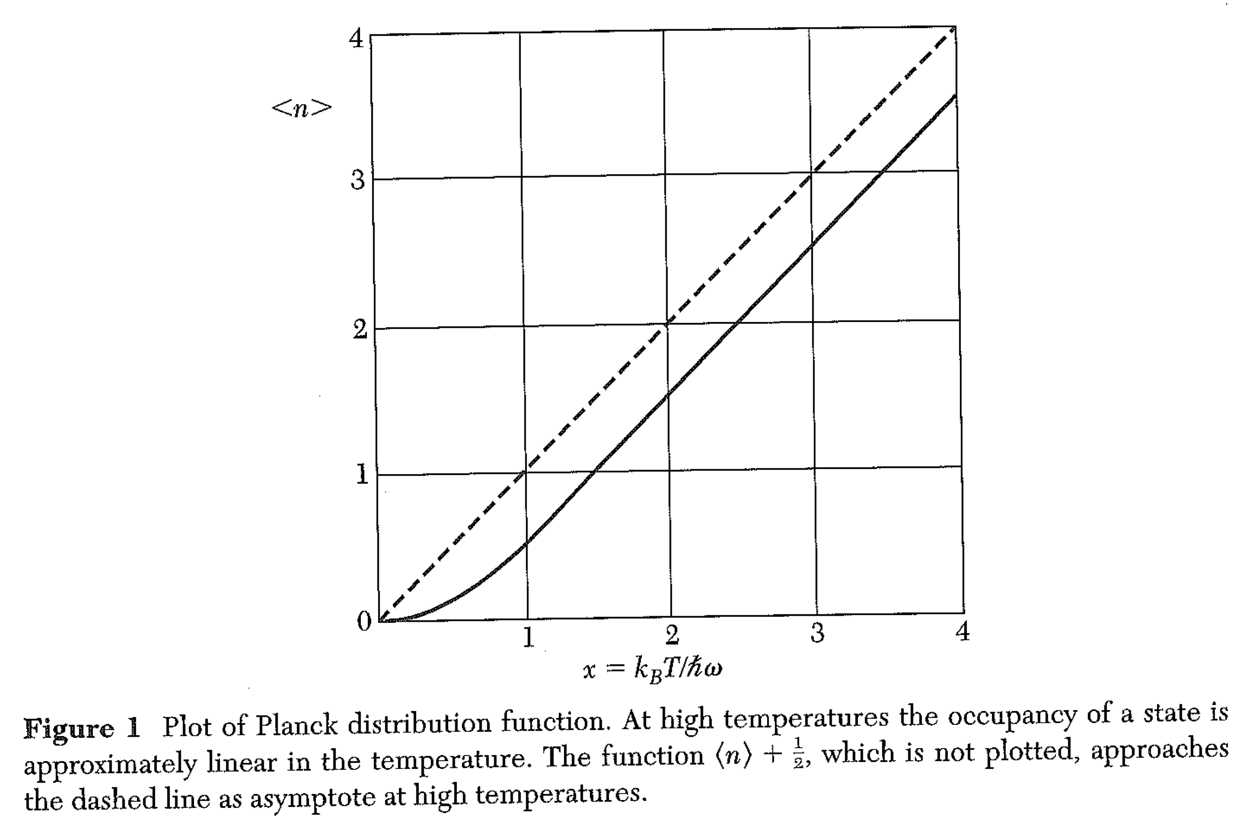
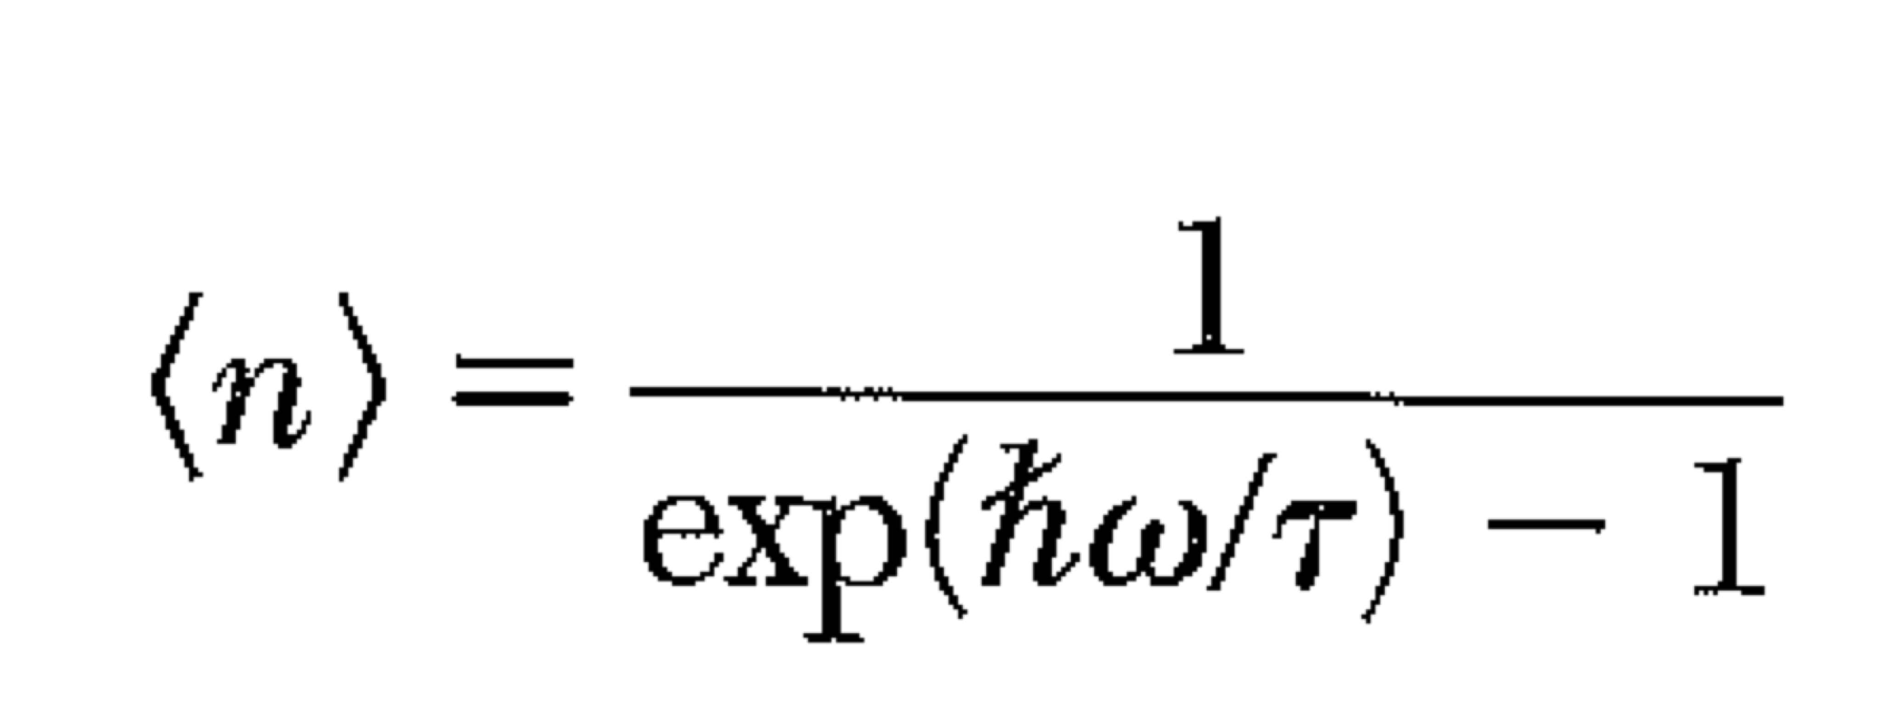
Thermal properties of phonons The contribution of lattice vibrations to the heat capacity

Slide 4
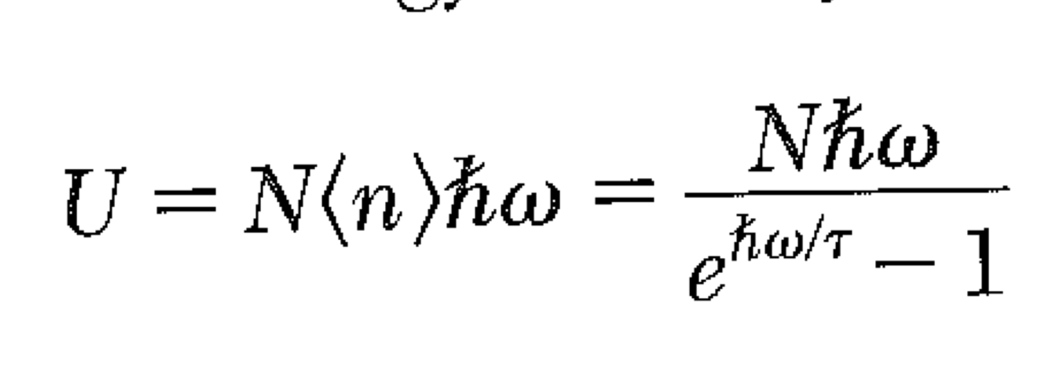
Einstein Model N identical harmonic oscillators

Slide 5
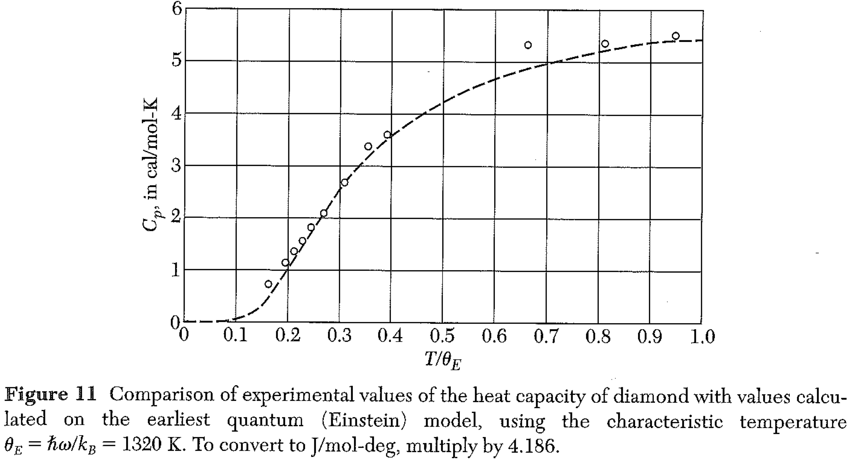
Einstein Model -- N identical harmonic oscillators
Heat capacity goes to zero as T goes to zero.
This is a quantum effect.
At high T, U ~ kT per degree of freedom.

Slide 6
Einstein Model -- N identical harmonic oscillators
The data doesn’t quite fit…
This isn’t experimental error.
A more realistic model of a solid would take into account that some vibrations are long wavelength, low frequency. The vibrations have a distribution of frequencies, and thus energies.

Slide 7
“Density of States”
How many vibrations have frequencies between ω and ω+δω?
If we knew this, we could calculate the heat capacity.

Slide 8
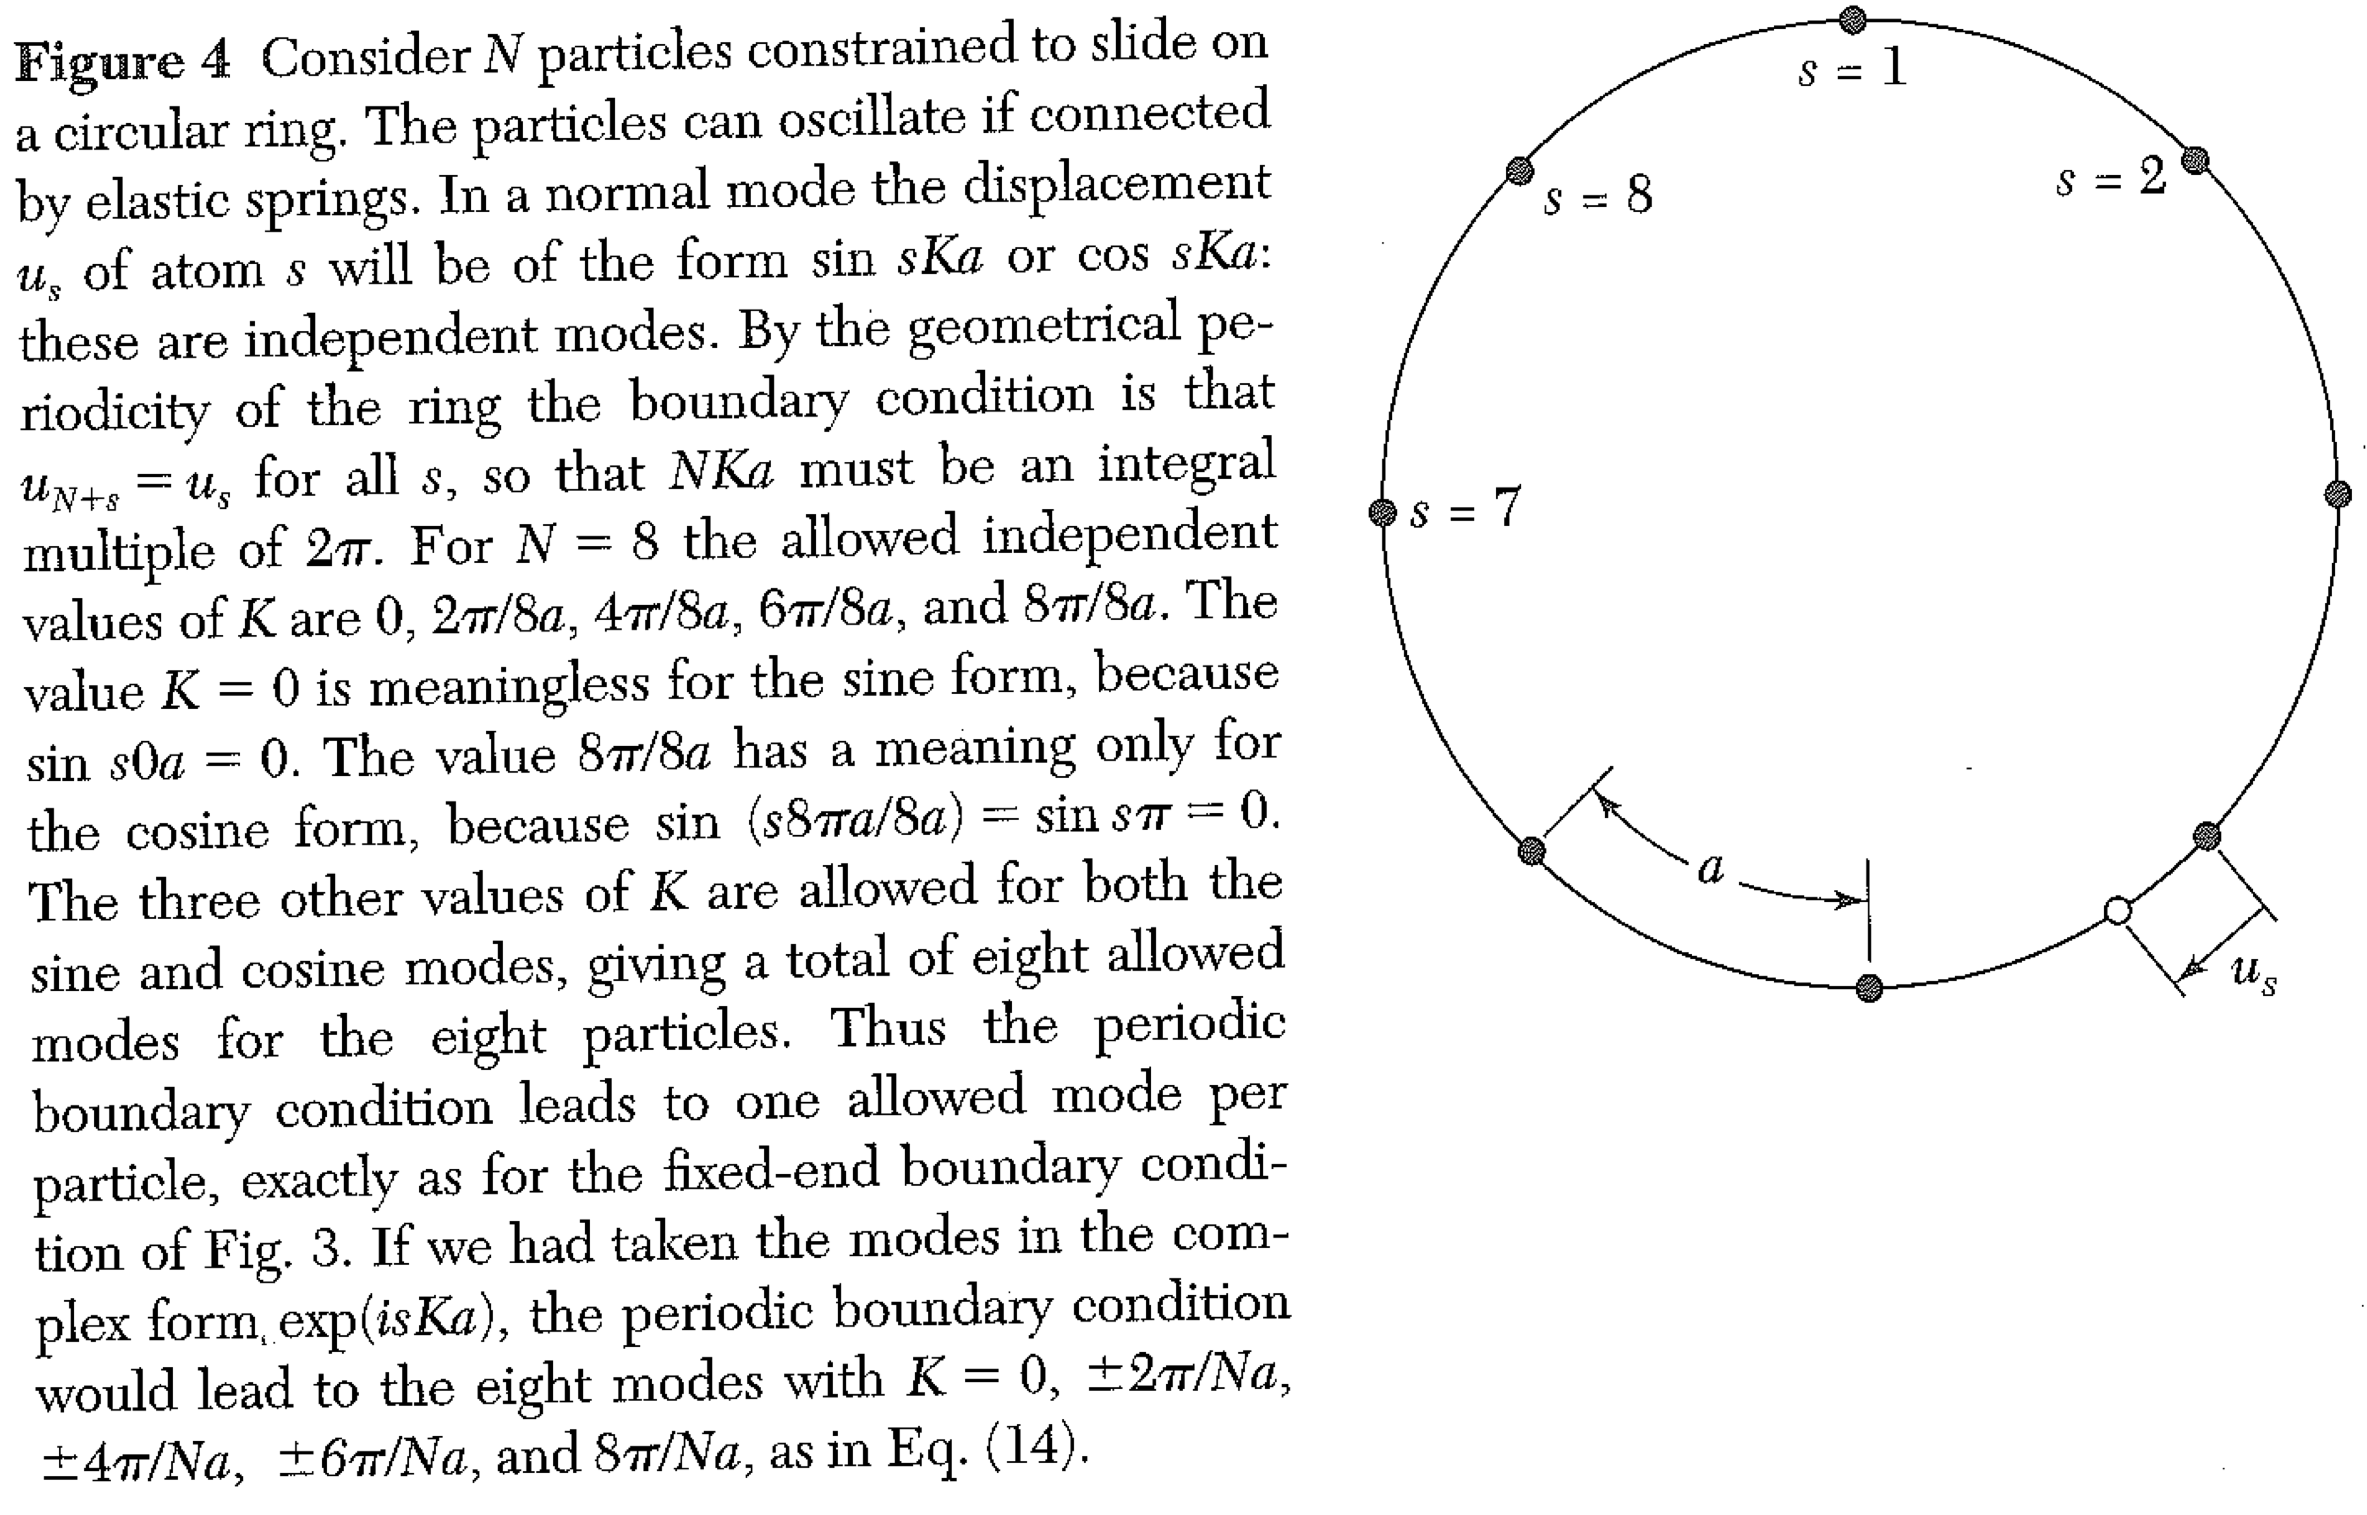
Density of states in 1 D

Slide 9
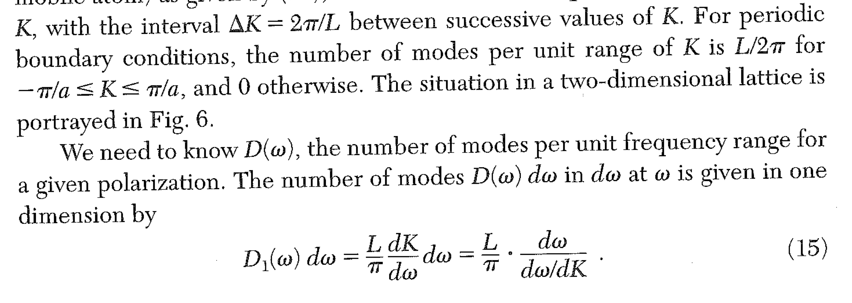
Density of states in 1 D
Note factor of 2!

Slide 10
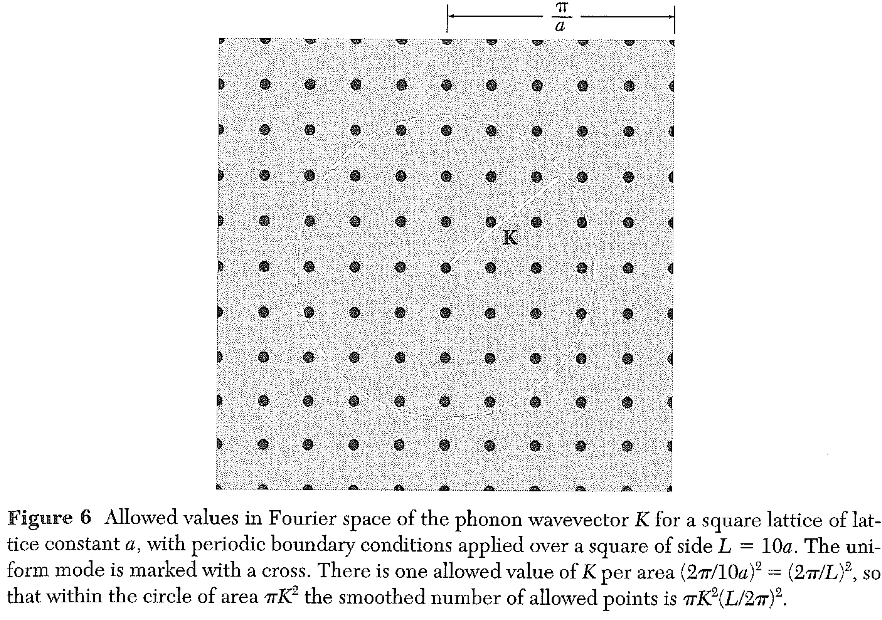
2D

Slide 11
3D

Slide 12
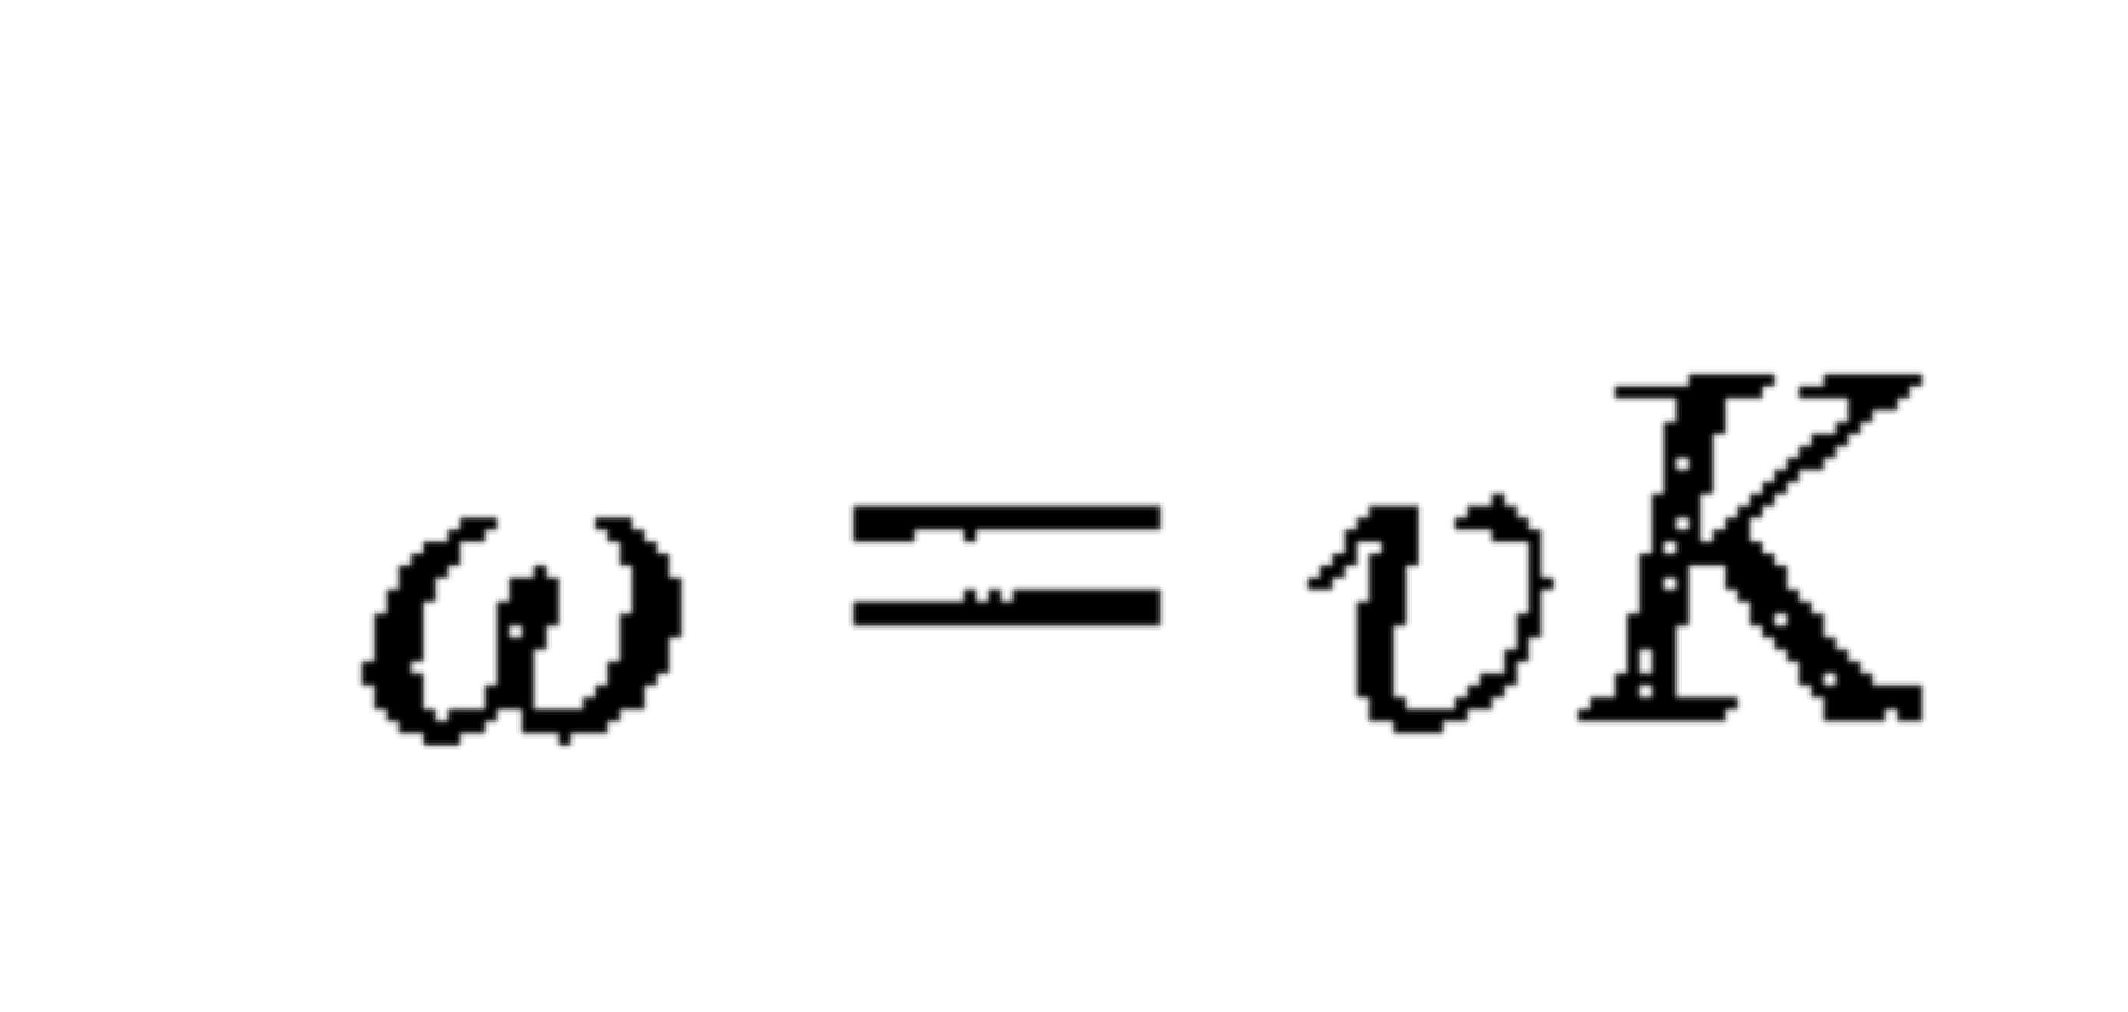
Simplest possible modification of Einstein model Debye -- all waves have same speed.
We might expect this model to work well at low temperature.
Then, only low frequency, long wavelength phonons can be excited.
BUT: we need to have a cutoff on ω. We will chose it so that we have the correct total number N of states.
3 polarizations

Slide 13
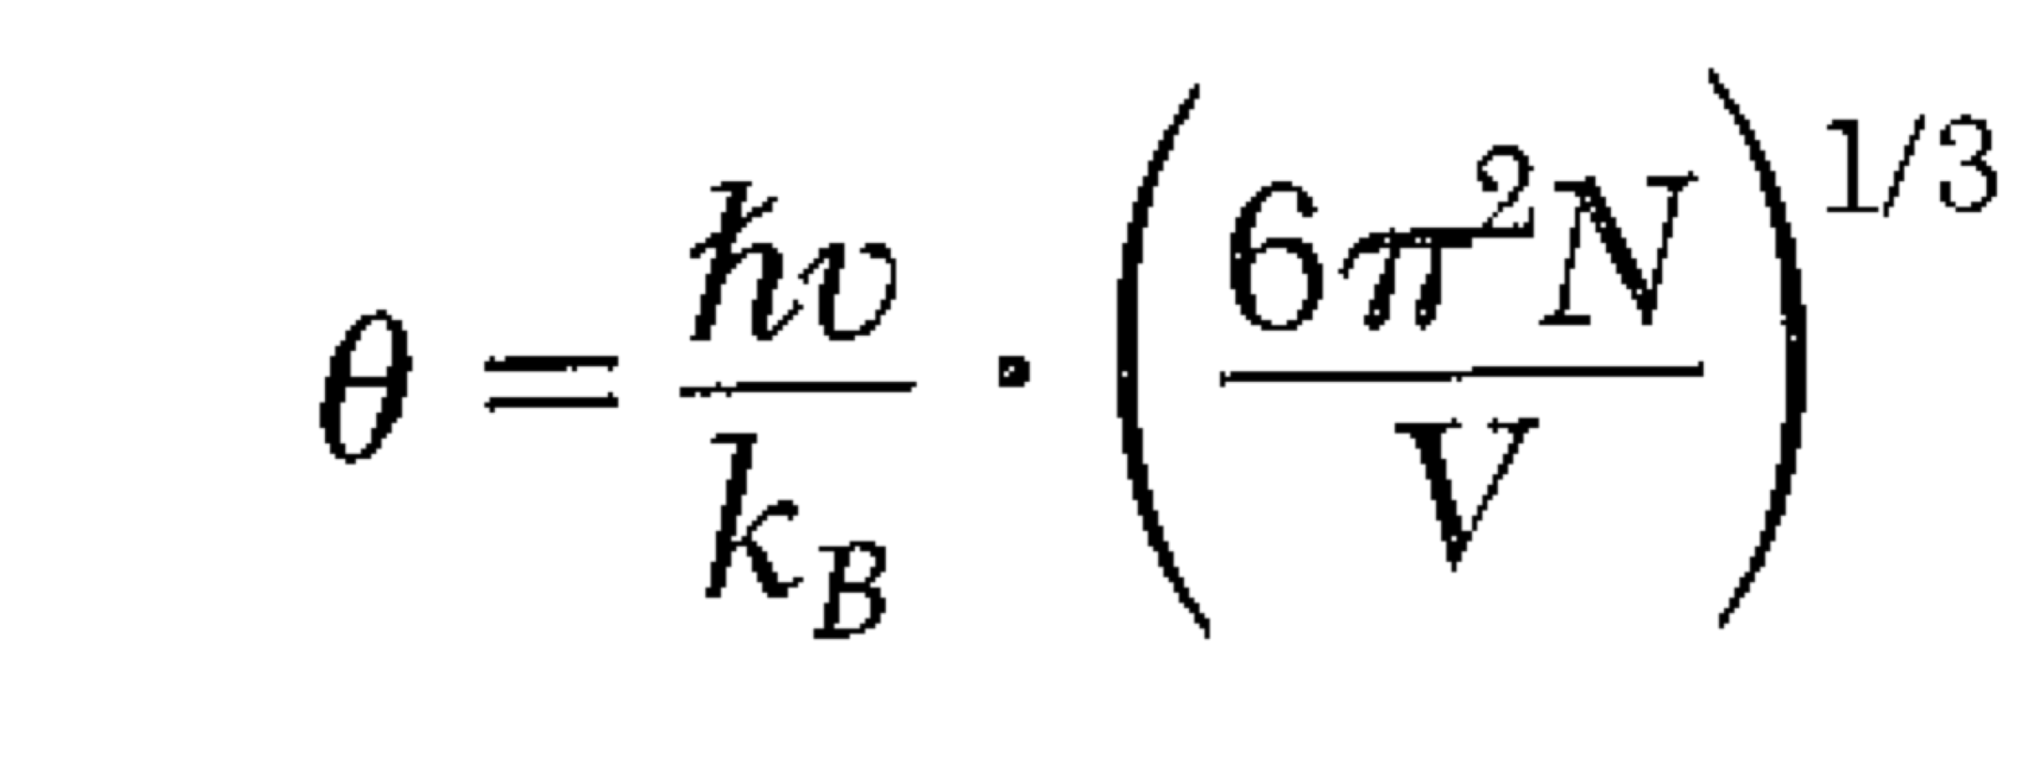
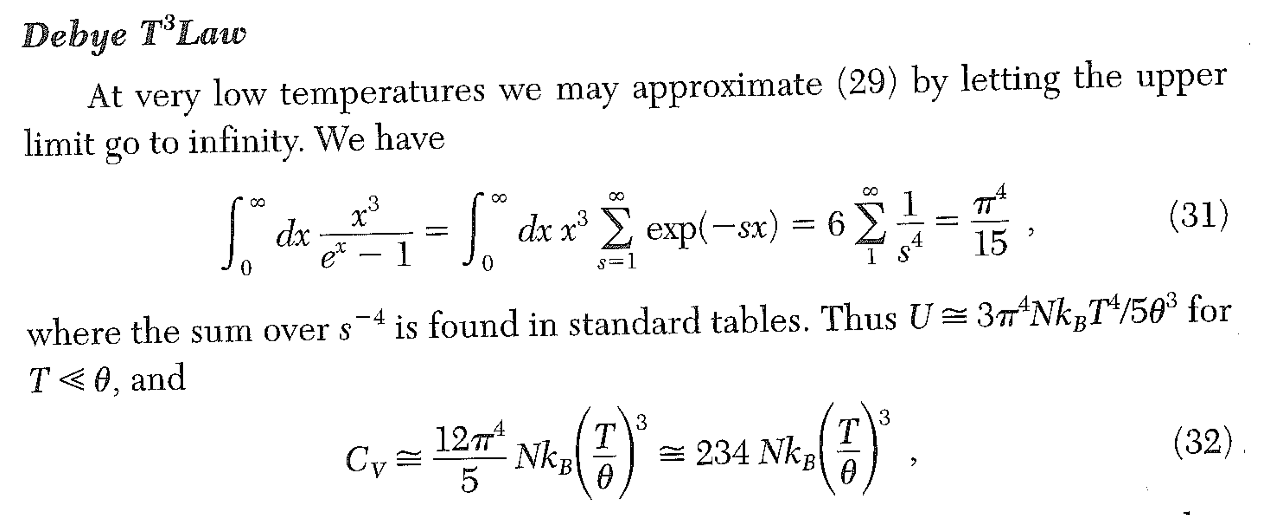
Debye Model

Slide 14
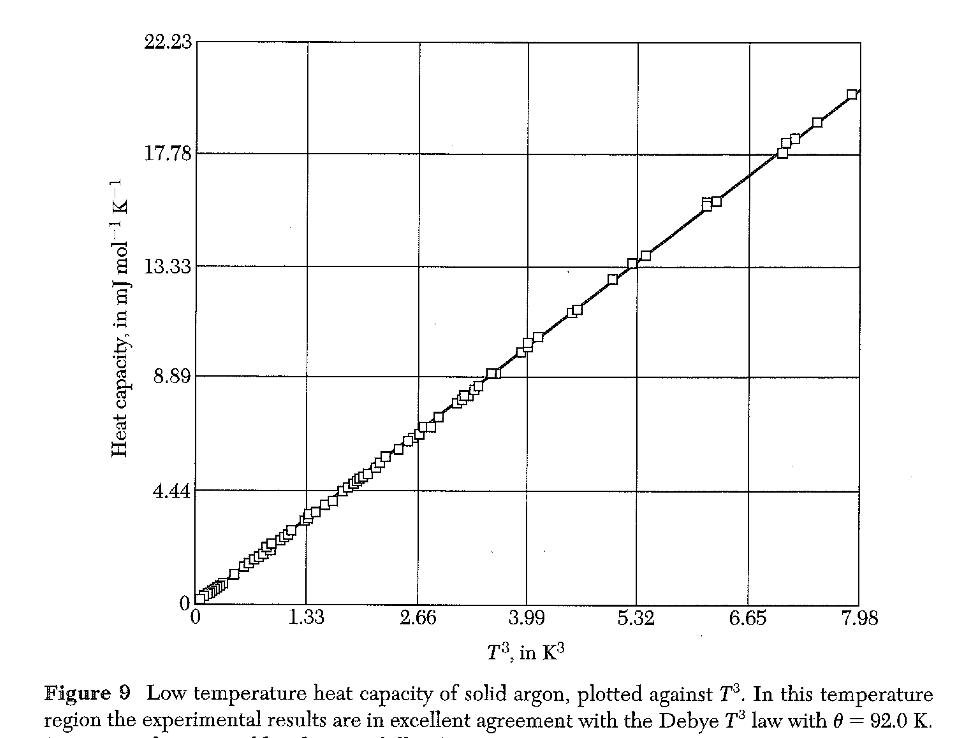
Debye Model

Slide 15
Summary of key idea:
In a linear, square, or cubic lattice, phonon states (wavevectors K) are uniformly spaced in “k-space”… on a lattice of points separated by L/2π
The different wavevectors will have different frequencies. For statistical mechanics, the energy of a state determines its “occupancy.” So we need to know how many states have a given frequency = energy. That is the density of states.
For any given density of states D(ω), we can “turn the crank” using stat mech to find the energy in the phonons, and thus the lattice heat capacity.
(If you are given the density of states, it doesn’t matter what the underlying lattice is.)

Slide 16
Lecture 10 Midterm exam on Chapters 1-8 Thursday March 24? I plan to hand out the problems before the break. You will need to rework the problems in class, with an appropriate equation sheet.
In a linear, square, or cubic lattice, phonon states (wavevectors K) are uniformly spaced in “k-space”… on a lattice of points separated by L/2π
What is the density of states for the 1D monatomic chain model?
Solve for K(ω) and compute dK/dω
The number of states between ω and ω+Δω = ΔΚ L /π
L = size of the crystal. Draw a sketch and find D₁.
What are the units of the density of phonon states, D(ω) ?

Slide 17
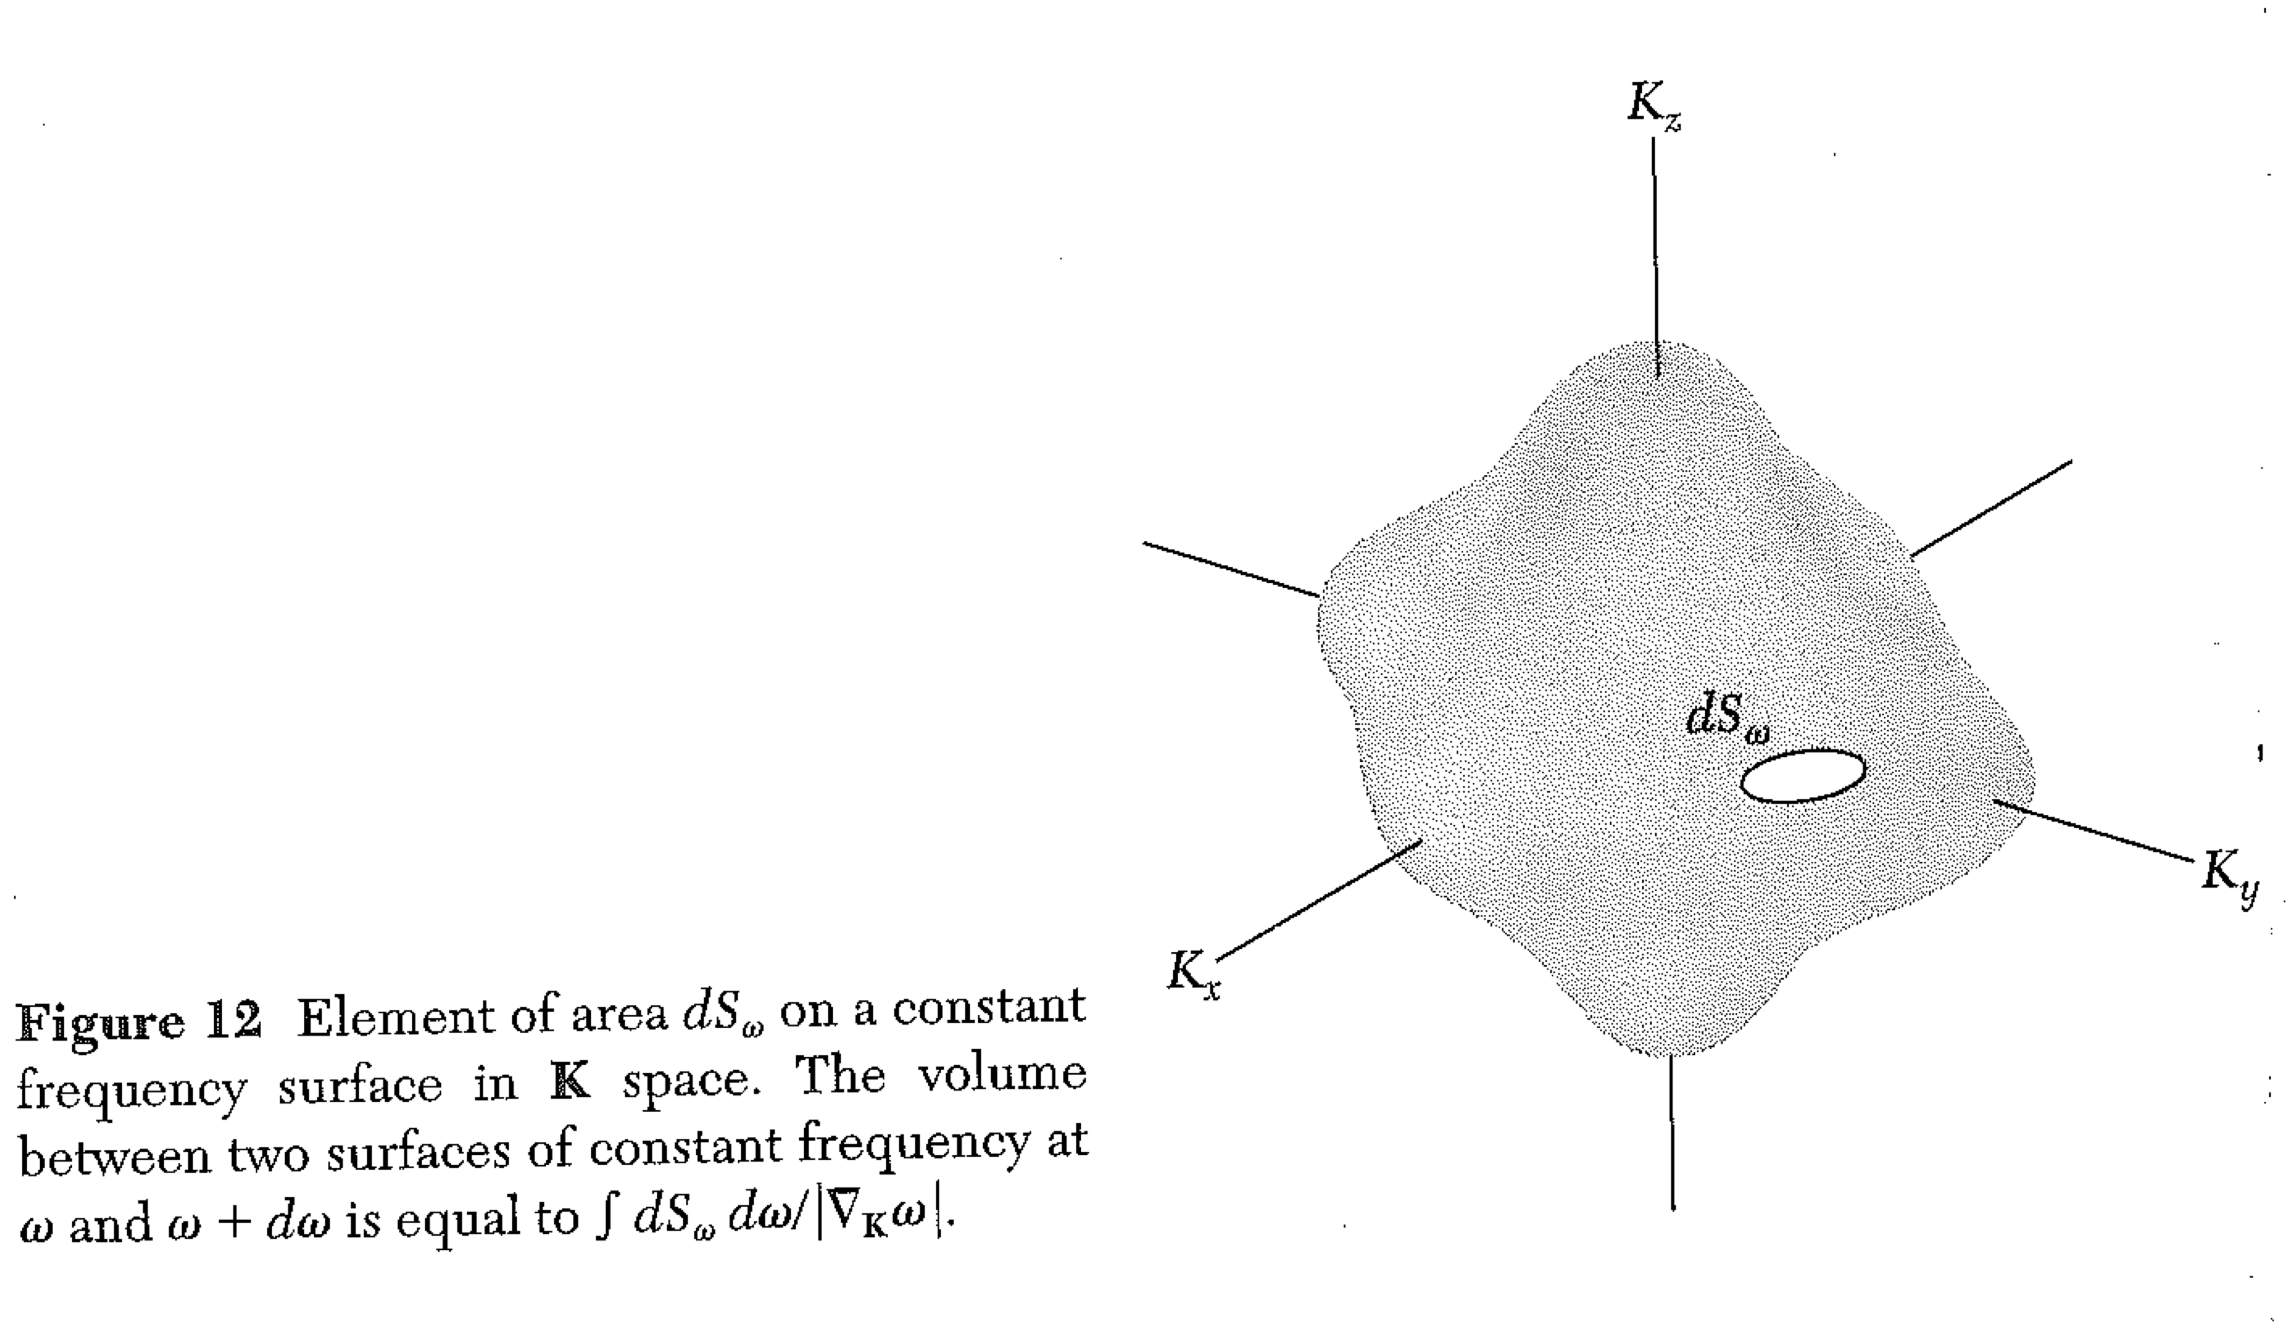
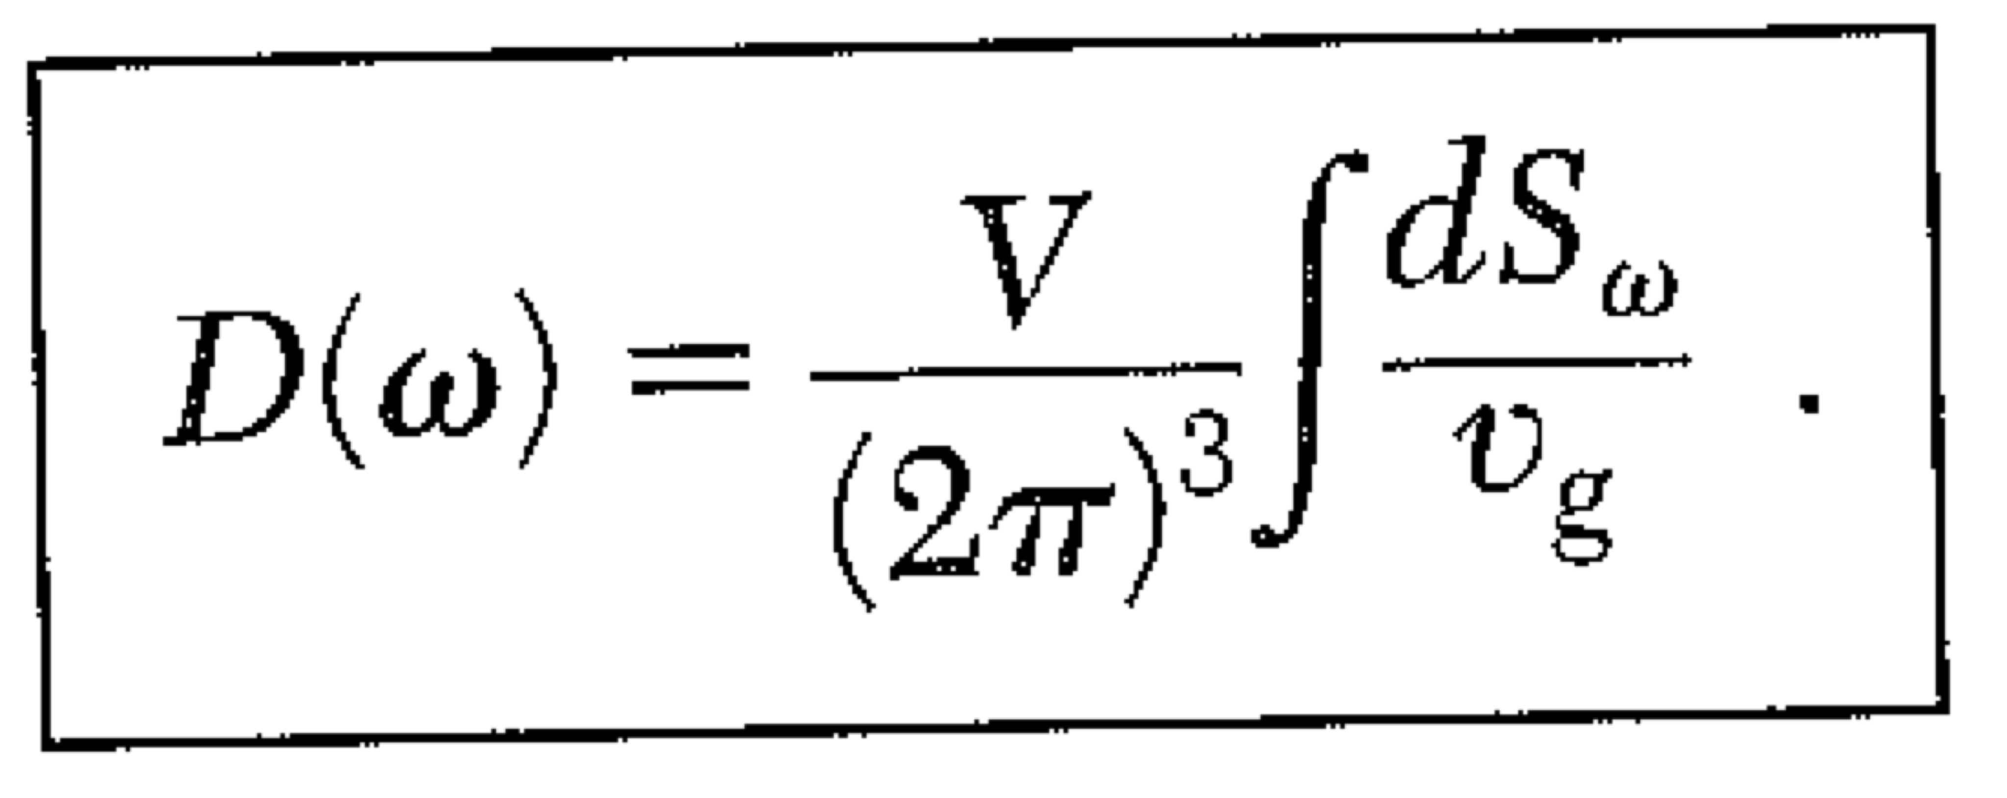
Ans: D(ω) is in seconds.
What if a crystal isn’t cubic?
That will change the normal modes. However, the density of normal modes in k-space stays the same. (Think about simply taking k-space and shearing it to get a non-cubic lattice.)
There are always (L/2π)³ modes per unit volume of k-space. Bigger crystal, more modes. (You add longer wavelength modes.)
So the general calculation of density of states can be computed (formally) …

Slide 18
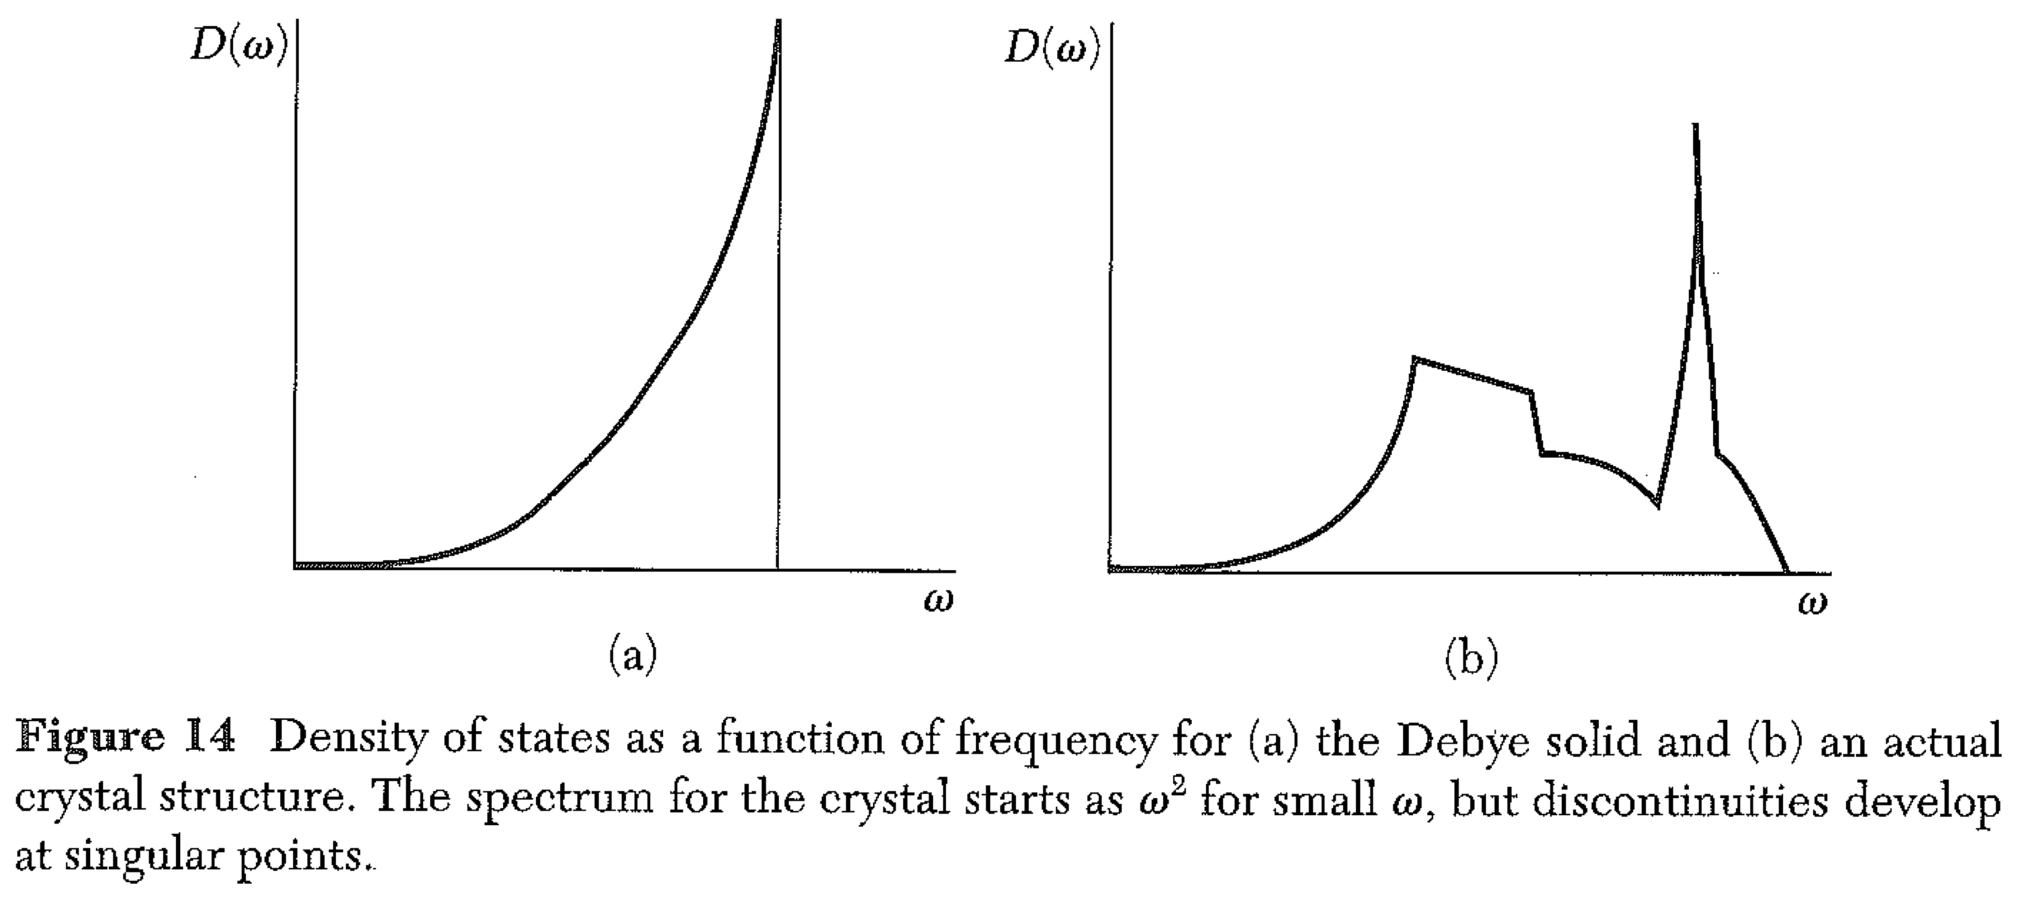
The density of states usually diverges when the group velocity goes to zero. (“Van Hove” singularities)
The internal energy U is still continuous, since it is an integral over D.
Note that the Debye density of states increases quadratically with frequency
or quadratically with k (which is proportional to freq.)

Slide 19
More calculations
What is the density of states for a 3D crystal for the optical phonons? We take
Solve for K(ω) and compute dK/dω
2. There is one state for every (2π/L)³ in K-space.

Slide 20
More calculations Note that the surface of constant ω need not be a sphere! Let’s discuss an odd 2D crystal….

Slide 21
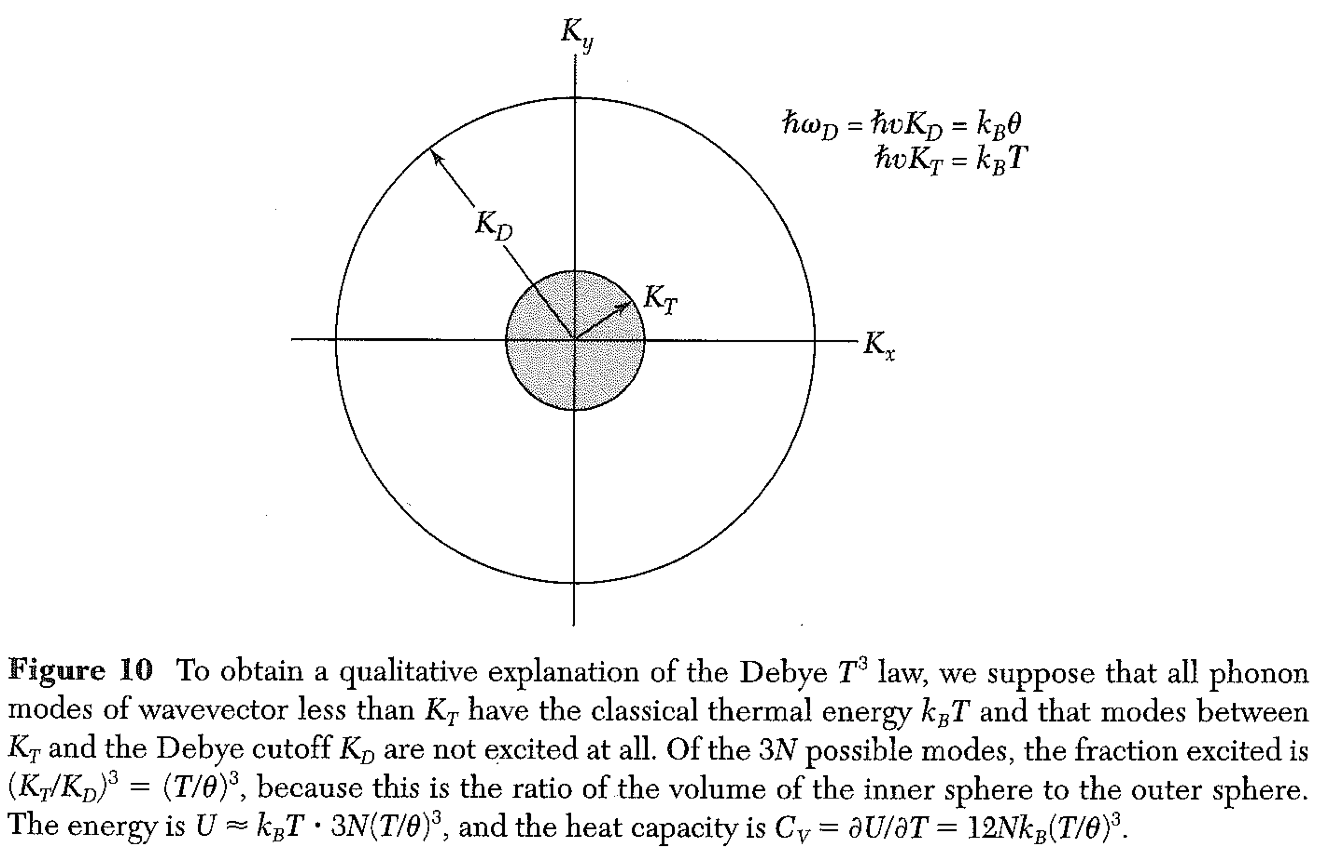
An intuitive picture for the Debye T³ law

Slide 22
We have considered the phonons to be perfect “normal modes”, or perfect eigenstates. (“Stationary” states… like the harmonic oscillator… the atom has a displacement, if you measure it. An atom has momentum, if you measure it.) But if you leave it alone, the phonon lasts forever. “Harmonic model” Other consequences:
None of these are true, because the interatomic potential is NOT purely harmonic.

Slide 23
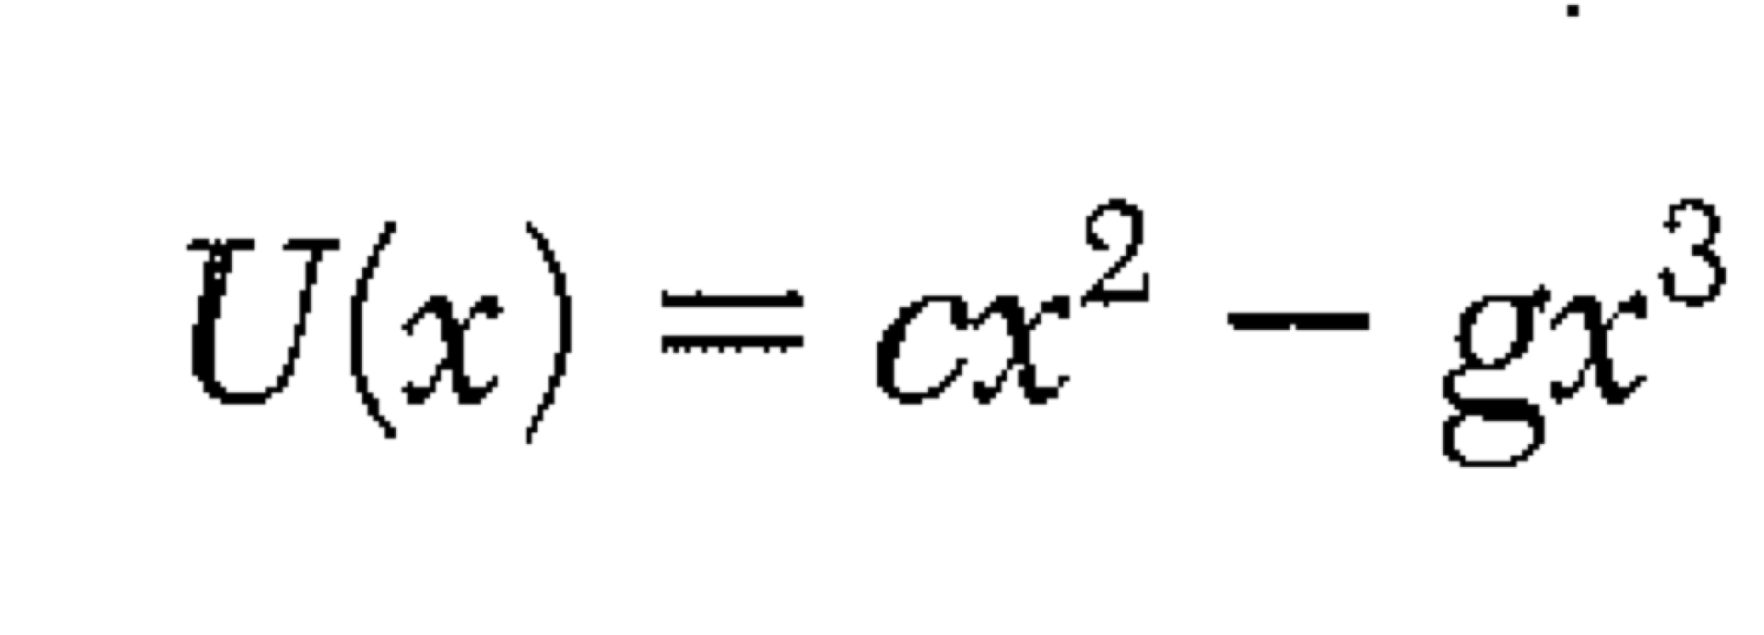
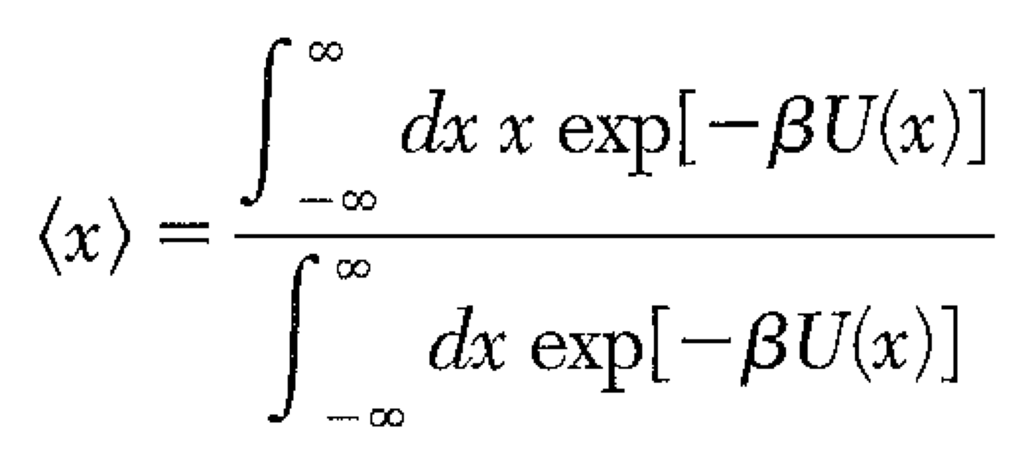
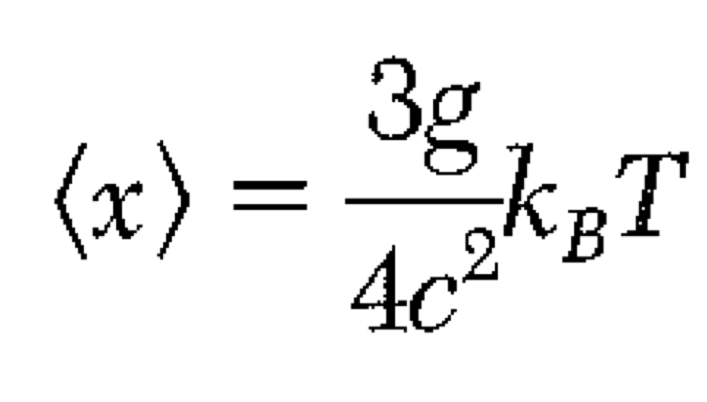
Classical model of thermal expansion Potential near min: gx³ is small
Using Taylor expansion for exp(-gx³). Note that odd terms give zero! (That’s why harmonic potential gives no expansion.)

Slide 24
Lattice Thermal Conductivity – Phonon Gas
We consider how much energy is transferred by a phonon moving from a hot region to a colder region.
The rate of energy transfer depends on how fast the phonon moves, v_{x}.
In addition, the amount of heat transferred depends on the mean free path (longer path will give a bigger temperature drop). If we fix the collision time τ, then the amount of heat transferred will include another factor of v_{x}.

Slide 25
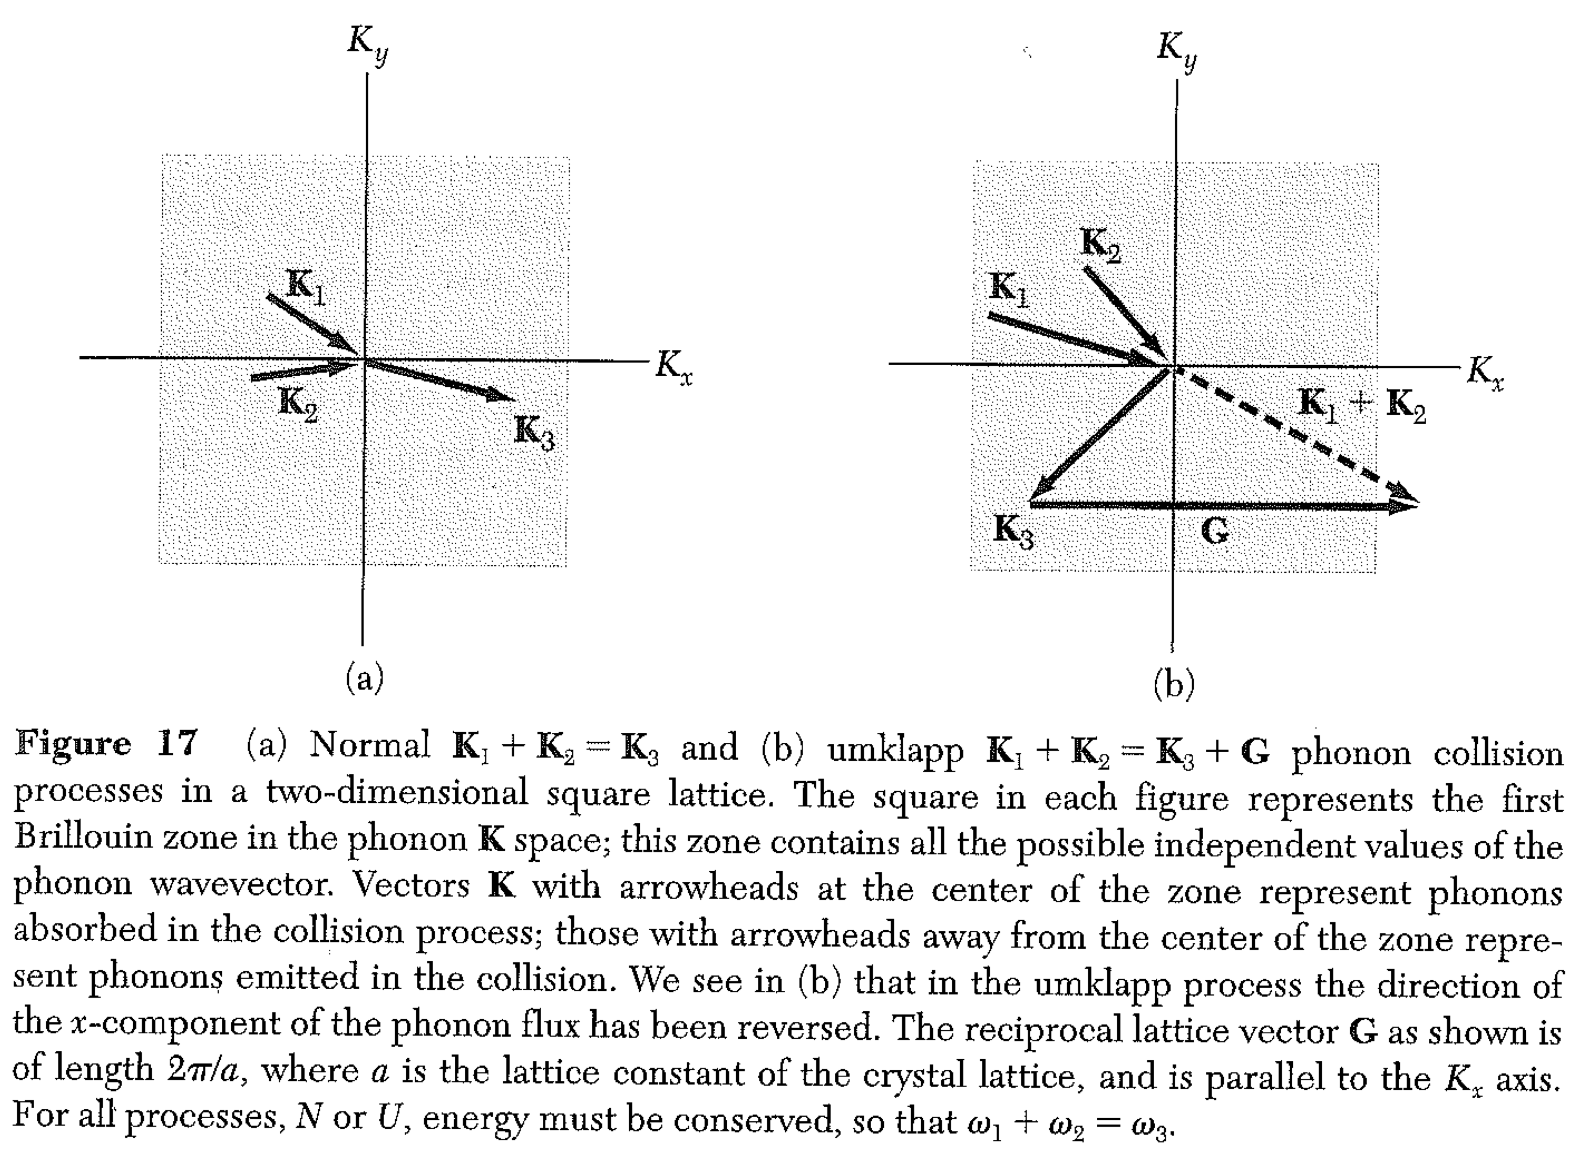
Umklapp - “flip over” processes – 1929 Peierls (student of Pauli)

Slide 26
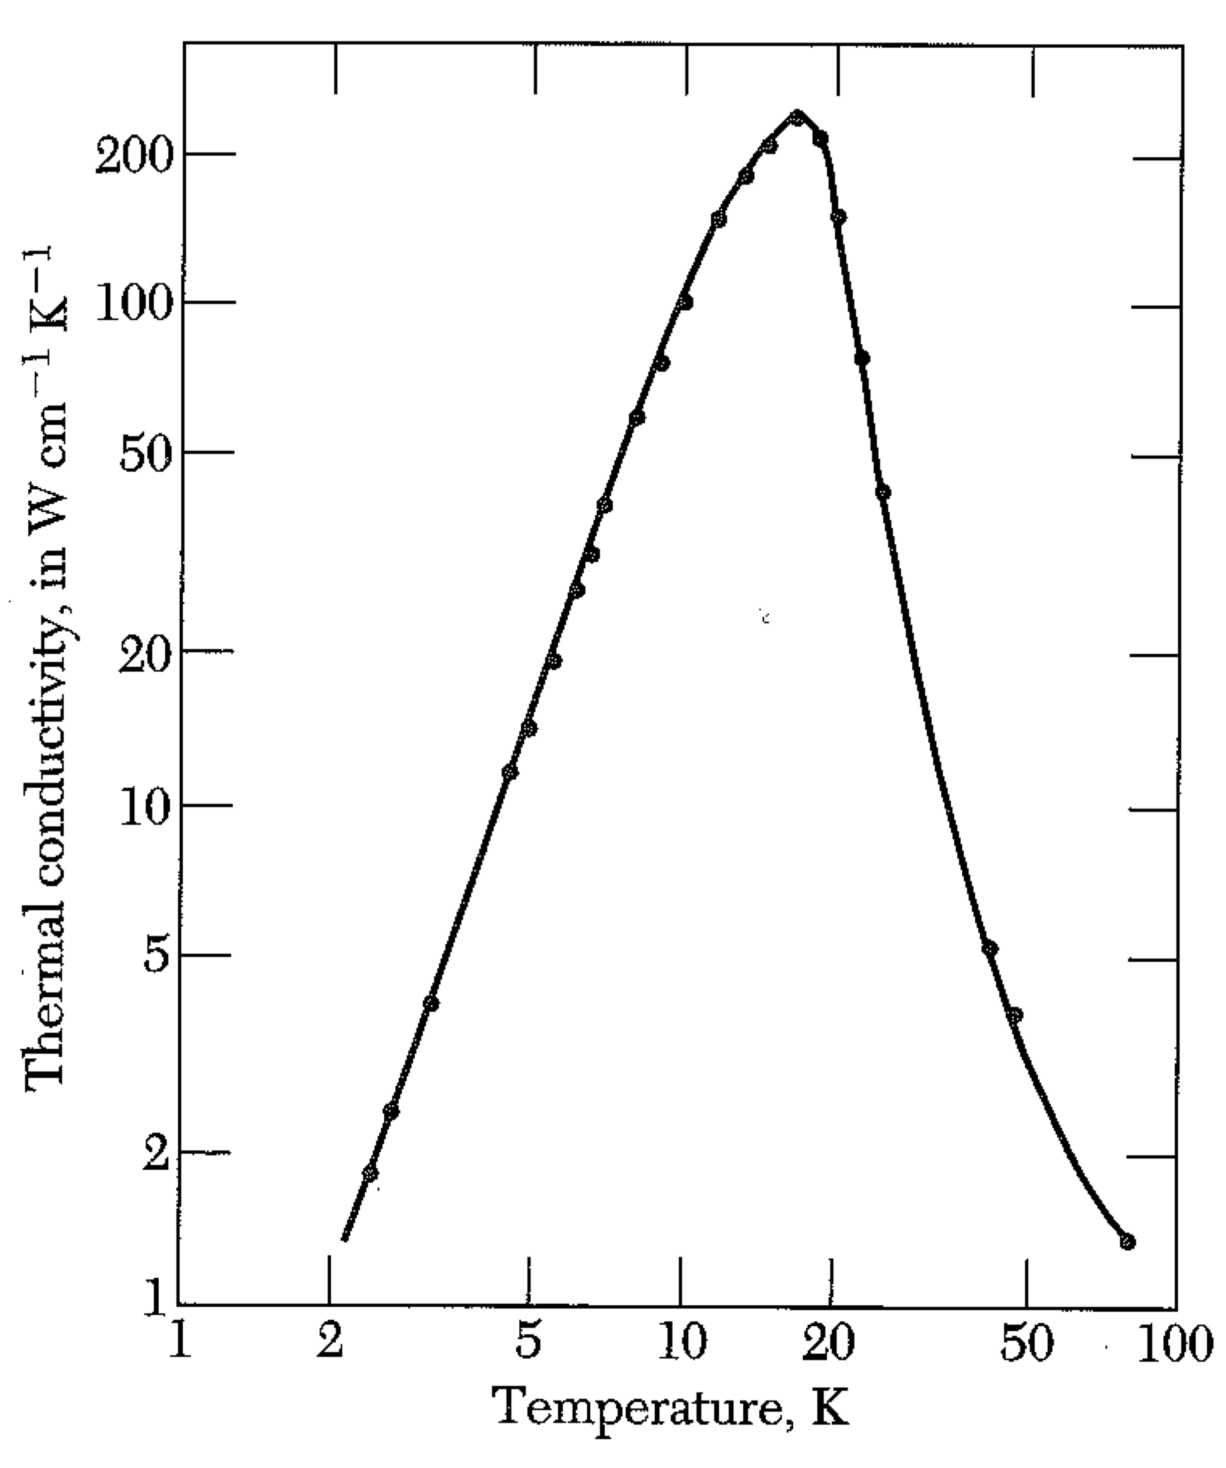
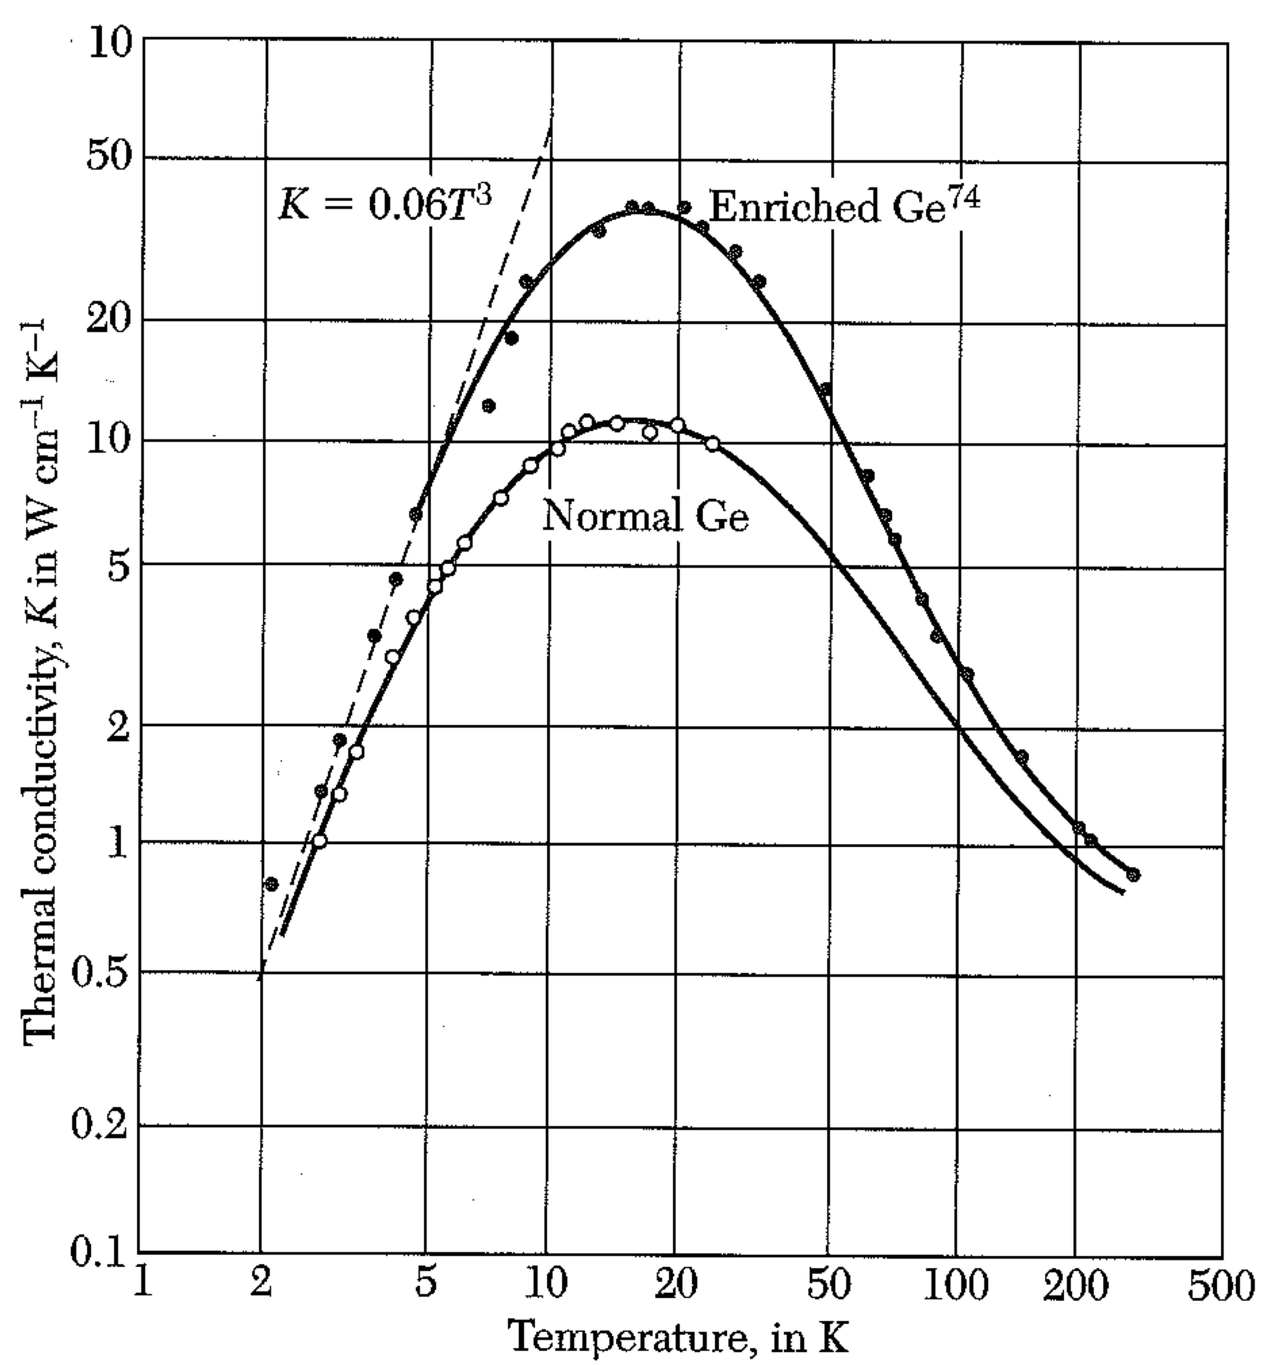
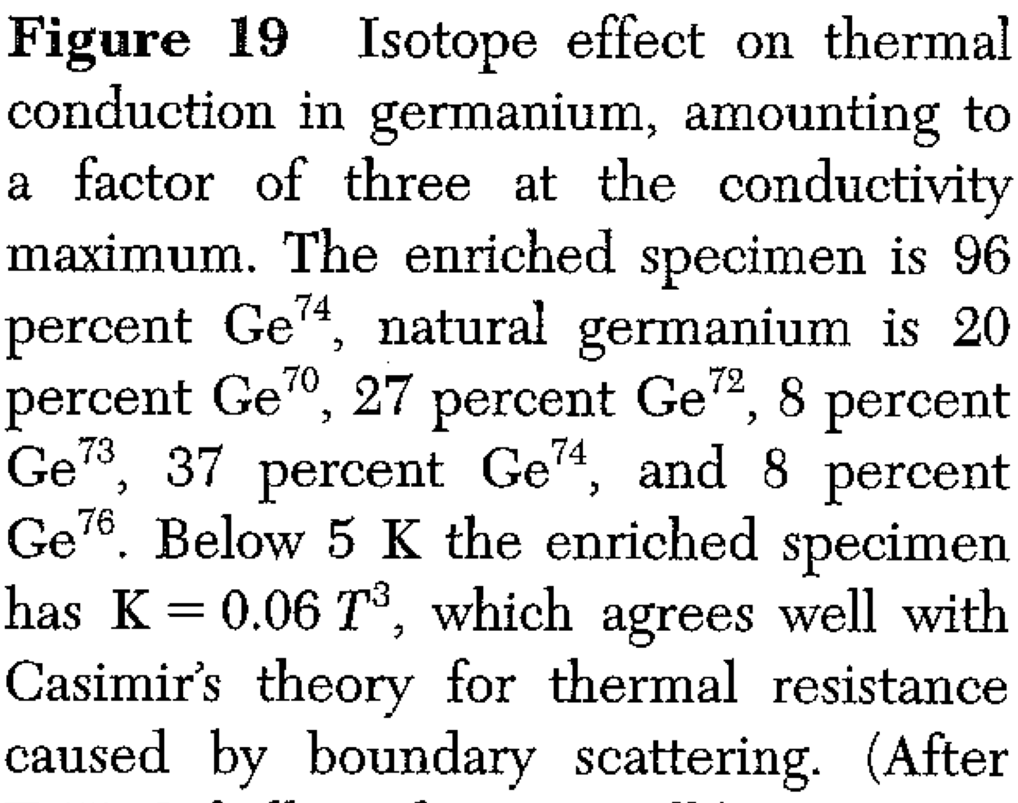
Low T size effect Impurity effect

Slide 27
Practical thing to know: Sapphire (Al₂O₃) has higher thermal conductivity than copper 200 W/cm-K at 30K …though in principle metals are better thermal conductors than dielectrics, because the conduction electrons can also conduct heat. Gallium 845 W/cm-K at 1.8K.

