Slide 1
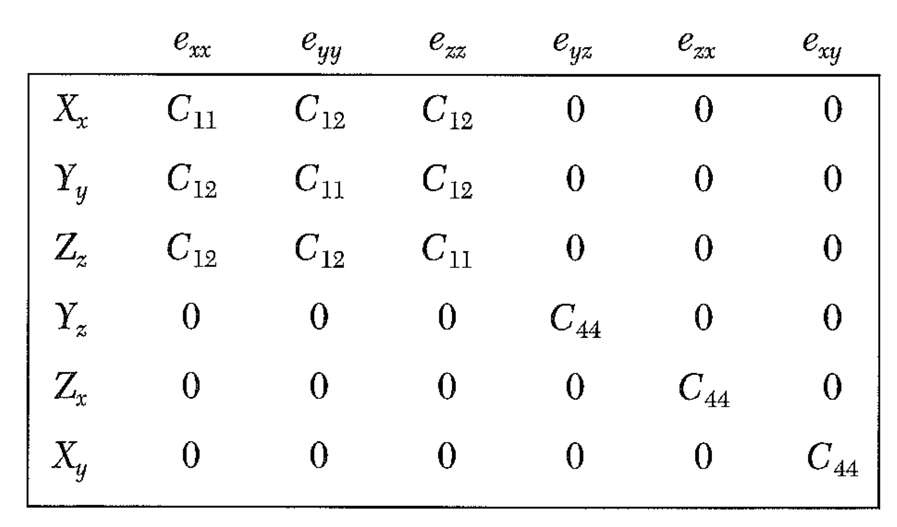
Solid State Physics Lecture 7 Waves in a cubic crystal HW for next Tuesday: Chapter 3 10,13; Chapter 4 1,3,5

Slide 2
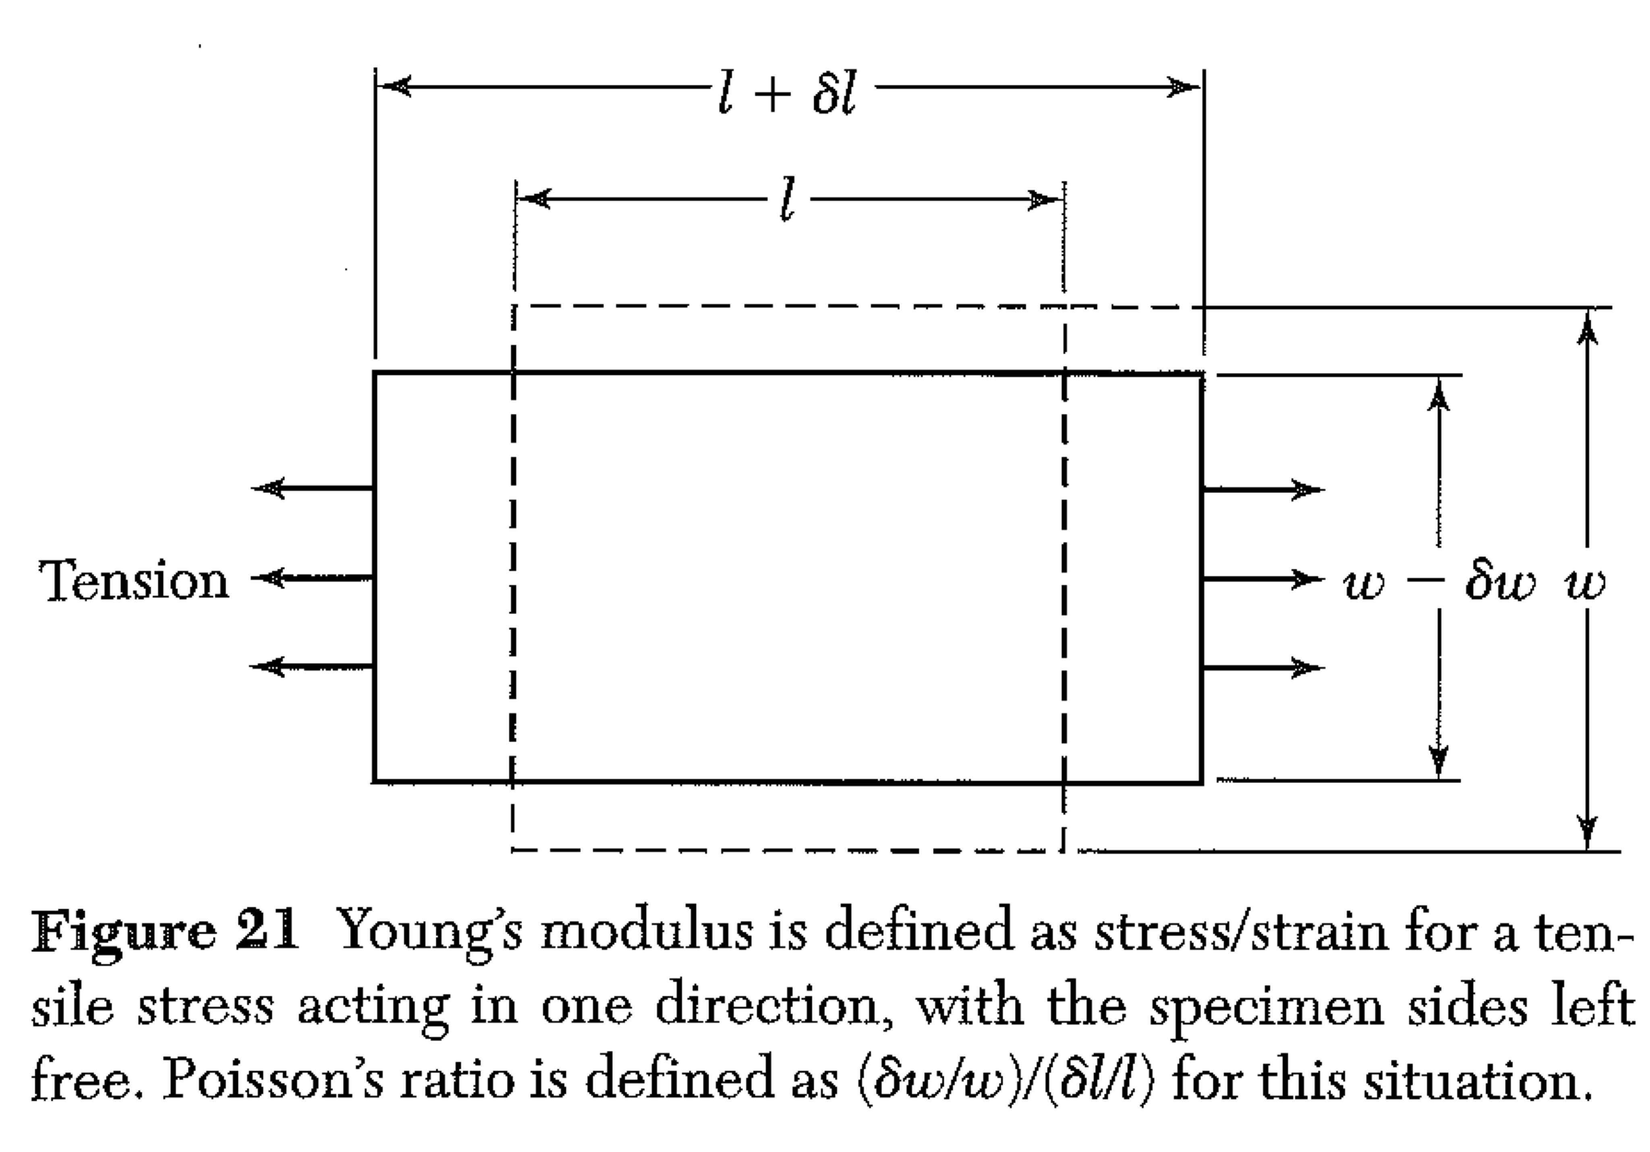
Stress – Cubic Crystal
Find Young’s modulus (Y = X_{x}/e_{xx}) and Poission’s ratio: ( δw/w)/(δl/l)
Y_{y} and the others are all 0, but e_{yy} is not!
It will help to be able to invert the matrix C (to get the matrix S.)
C₄₄ = 1/S₄₄ C₁₁-C₁₂=(S₁₁-S₁₂)⁻¹ C₁₁+2C₁₂ = (S₁₁ + 2S₁₂)⁻¹
How does δw/w relate to e_{yy}? Can you find e_{yy} in terms of C’s?

Slide 3
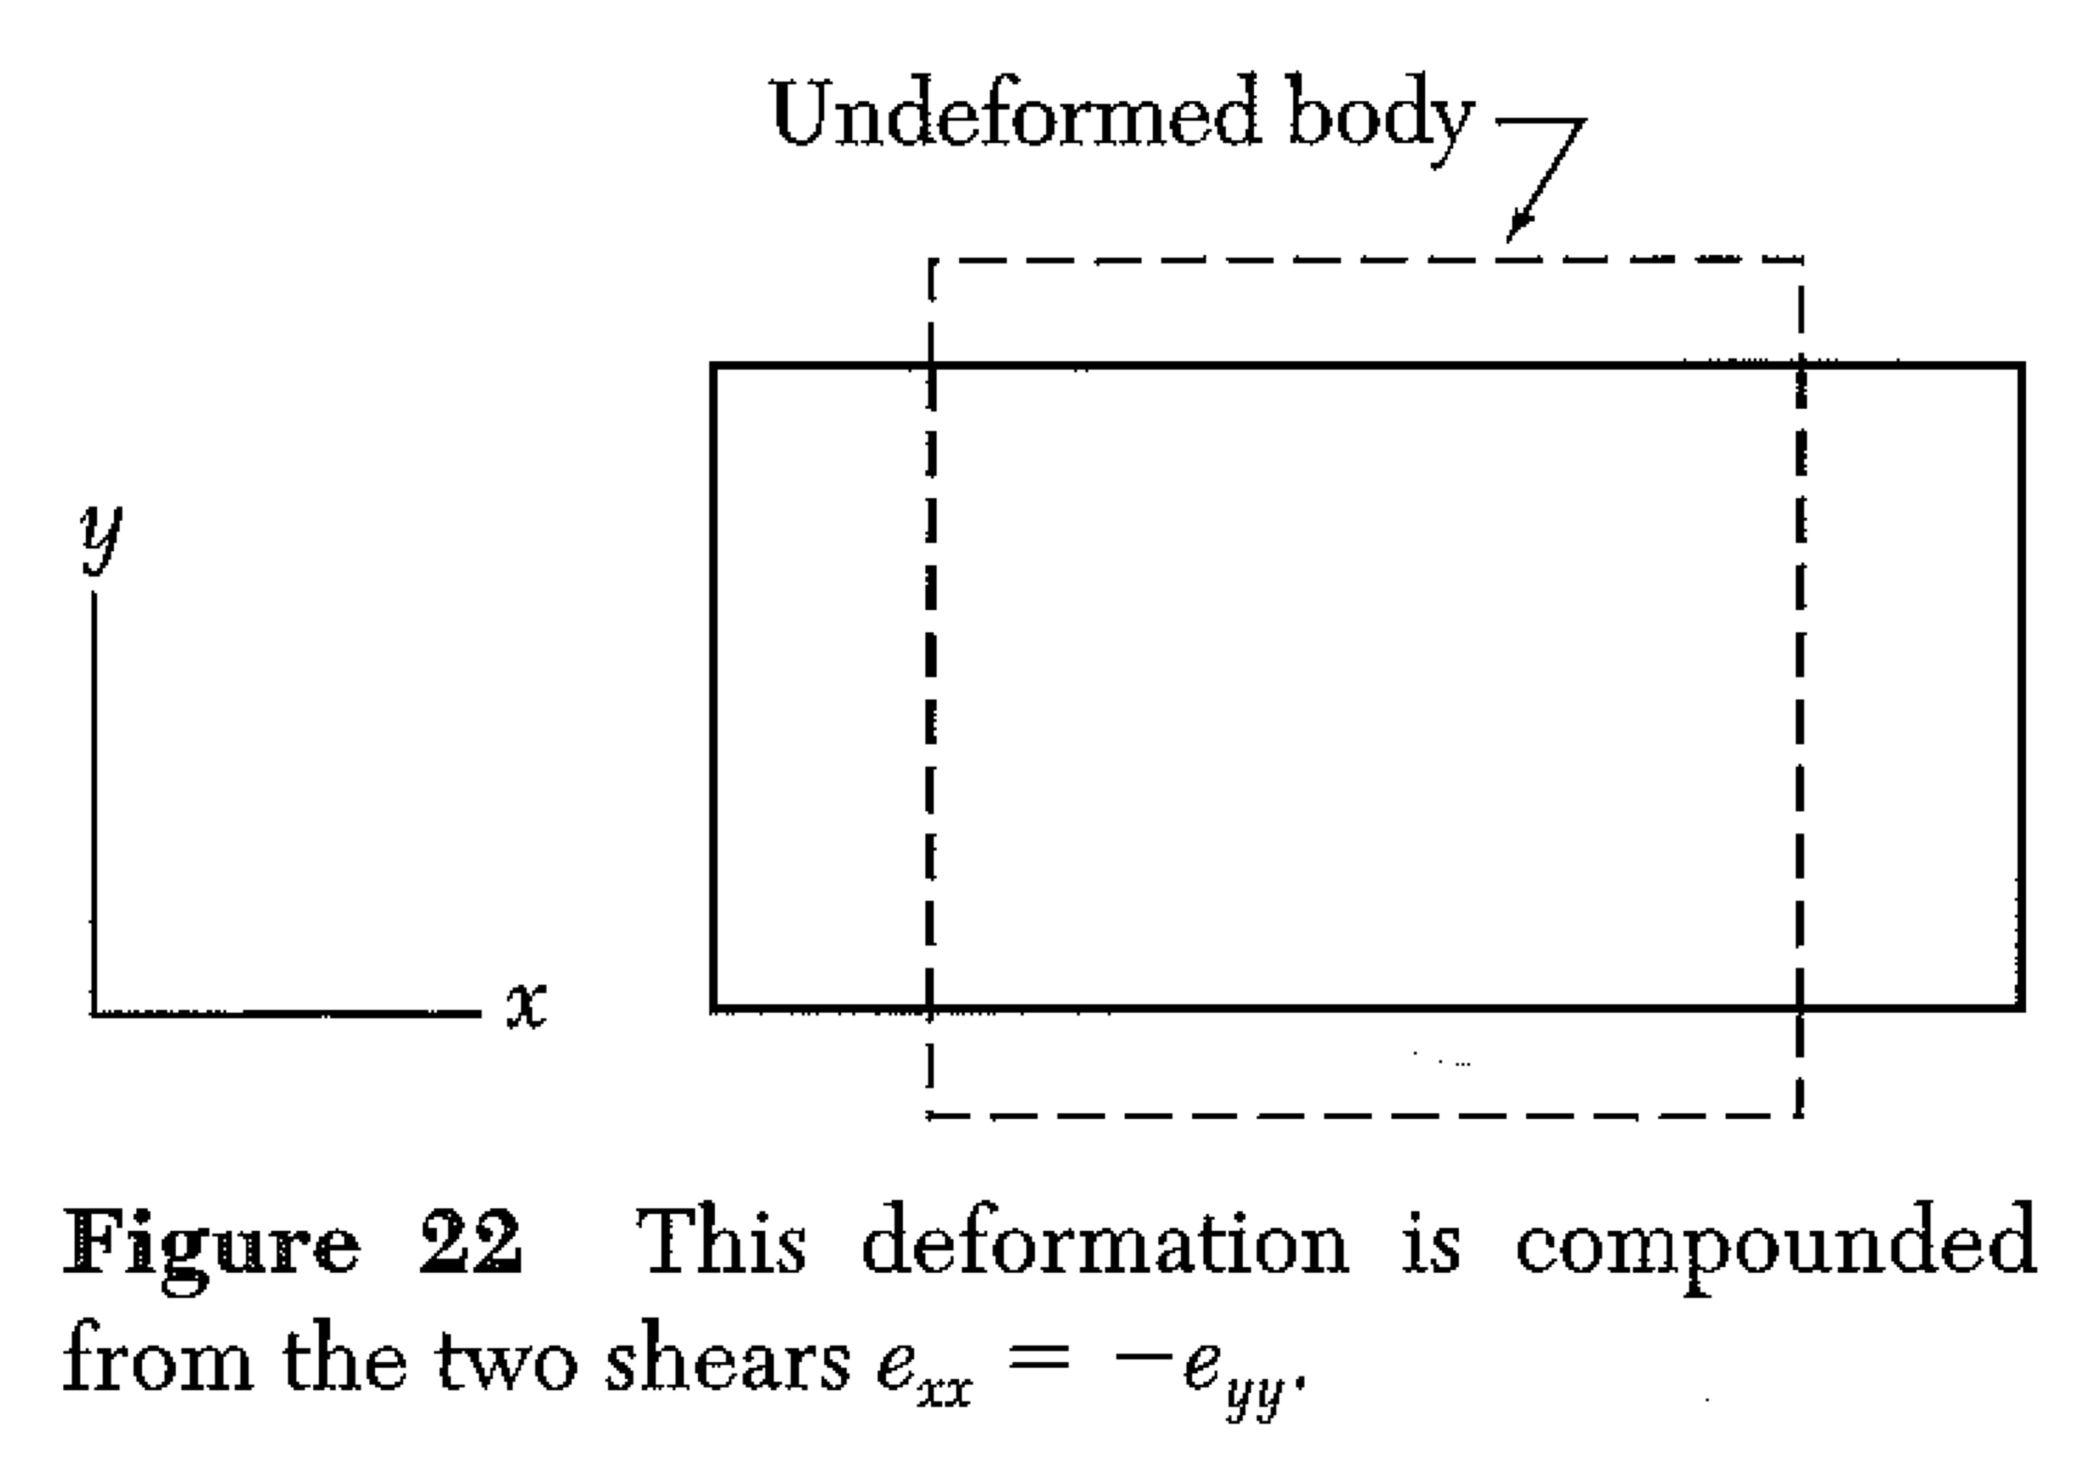
Stress – Cubic Crystal
Grab some chalk! We speak of shear as an action that does not change volume, but distorts a square into a diamond shape.
Note that this is the same kind of deformation as moving the top surface of a cube to the right (and down slightly, to conserve volume) while holding the bottom fixed.

Slide 4
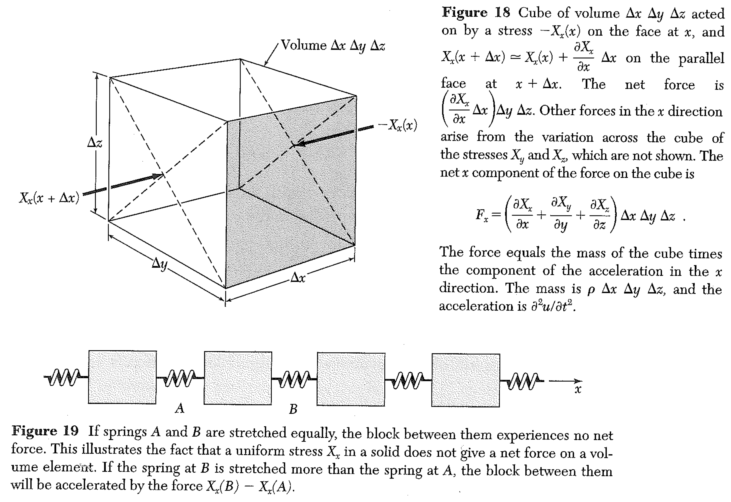

Slide 5
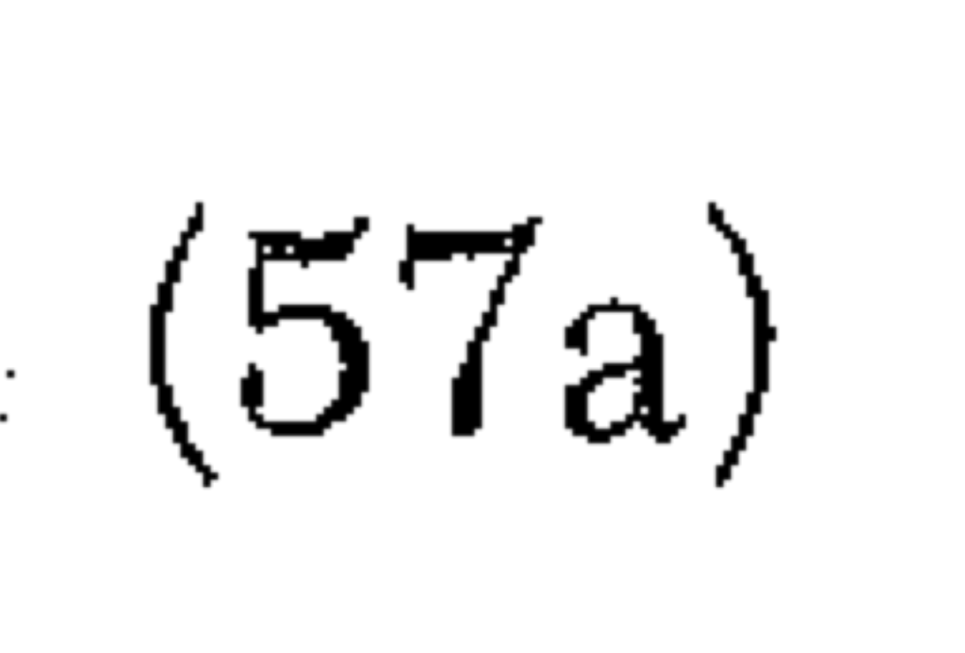
v=0, w=0
Wave speed

Slide 6
v=0, w=0
Wave speed
A transverse (shear) wave is obtained with v replacing u in the y analog of 57a, (57b) or replacing x with y in solution to 57a. (In this case, displacement is still in x, but wave motion is along y.) Only the C₄₄ term contributes.
Wave speed, shear wave

Slide 7
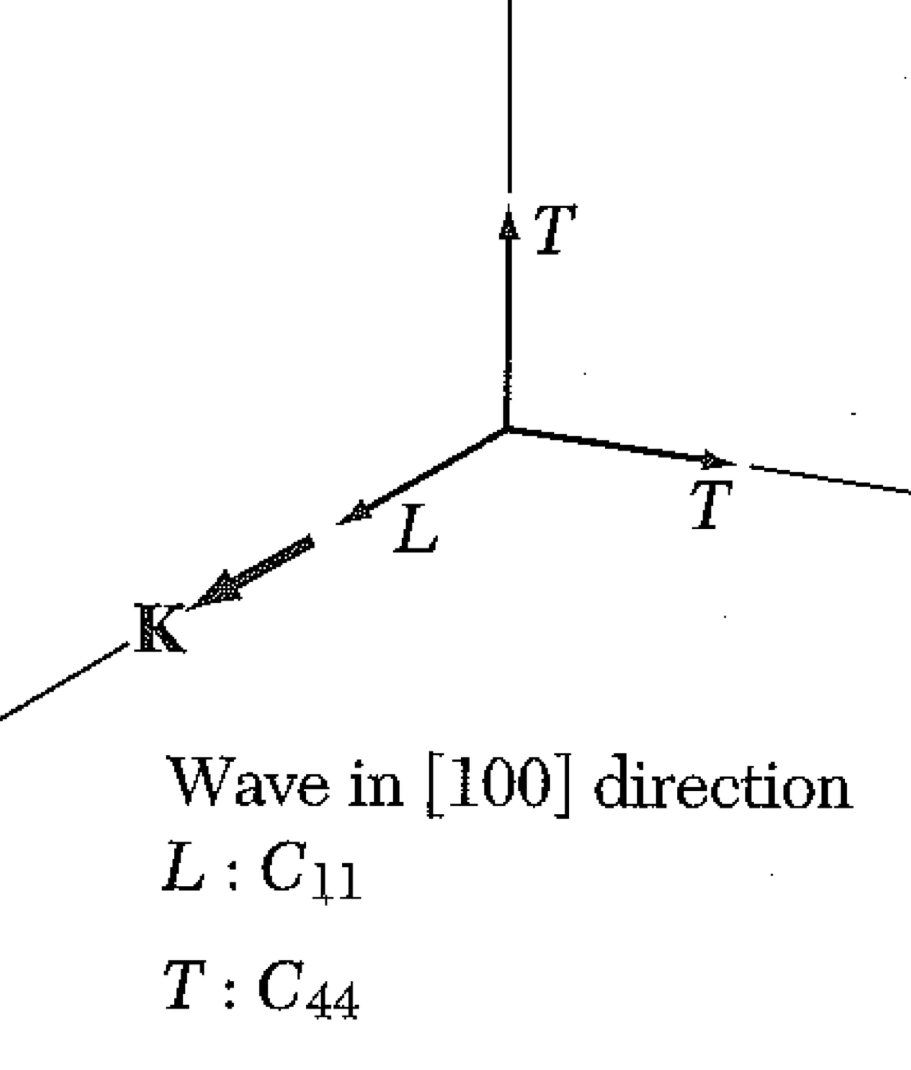
Wave speed, longitudinal wave
“Effective elastic constant” = C₁₁
Wave speed, shear (transverse) wave

Slide 8
[011] direction (or [110])
Shear wave traveling any direction in the YZ plane.
The elastic constant for a shear wave in the yz plane, with displacement along x, is C₄₄
For a shear wave in the xy plane, with displacement along z – same.

Slide 9
[011] direction (or [110])
Most complicated case we will discuss:
Propagation in a plane, with motion in the same plane.
Following Kittel, we study xy plane.

Slide 10
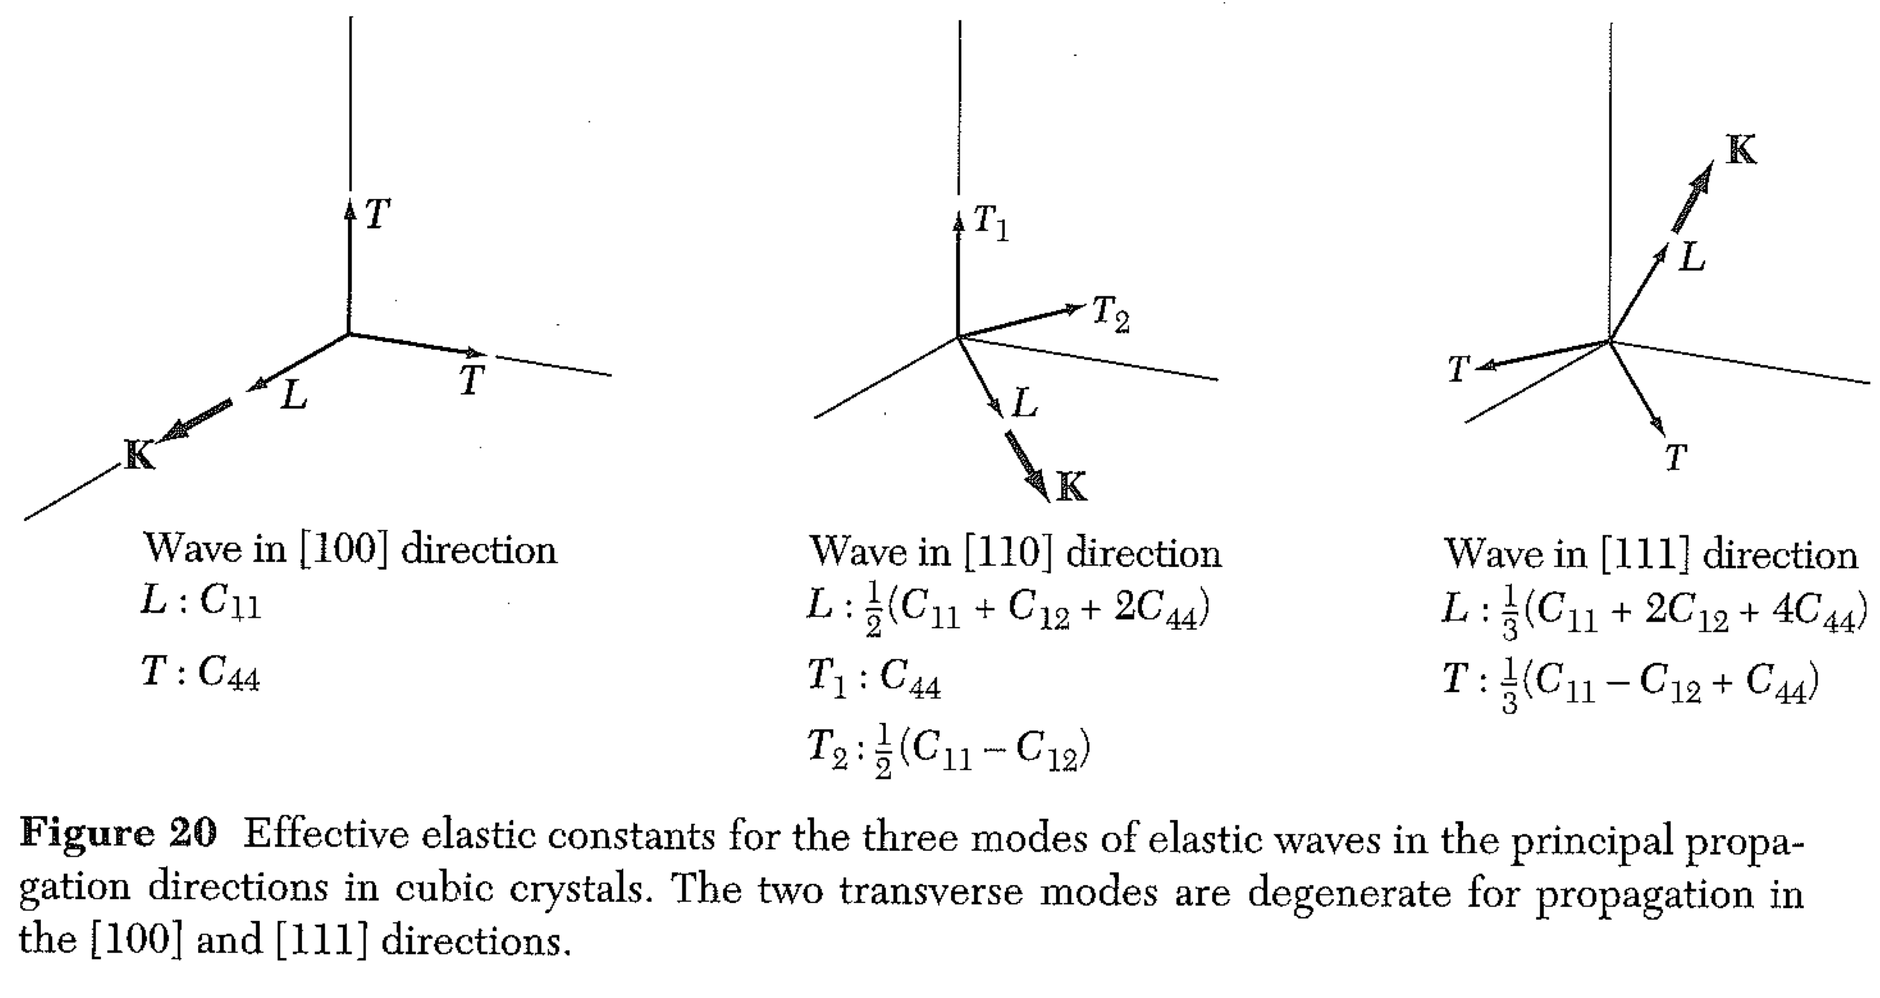

Slide 11
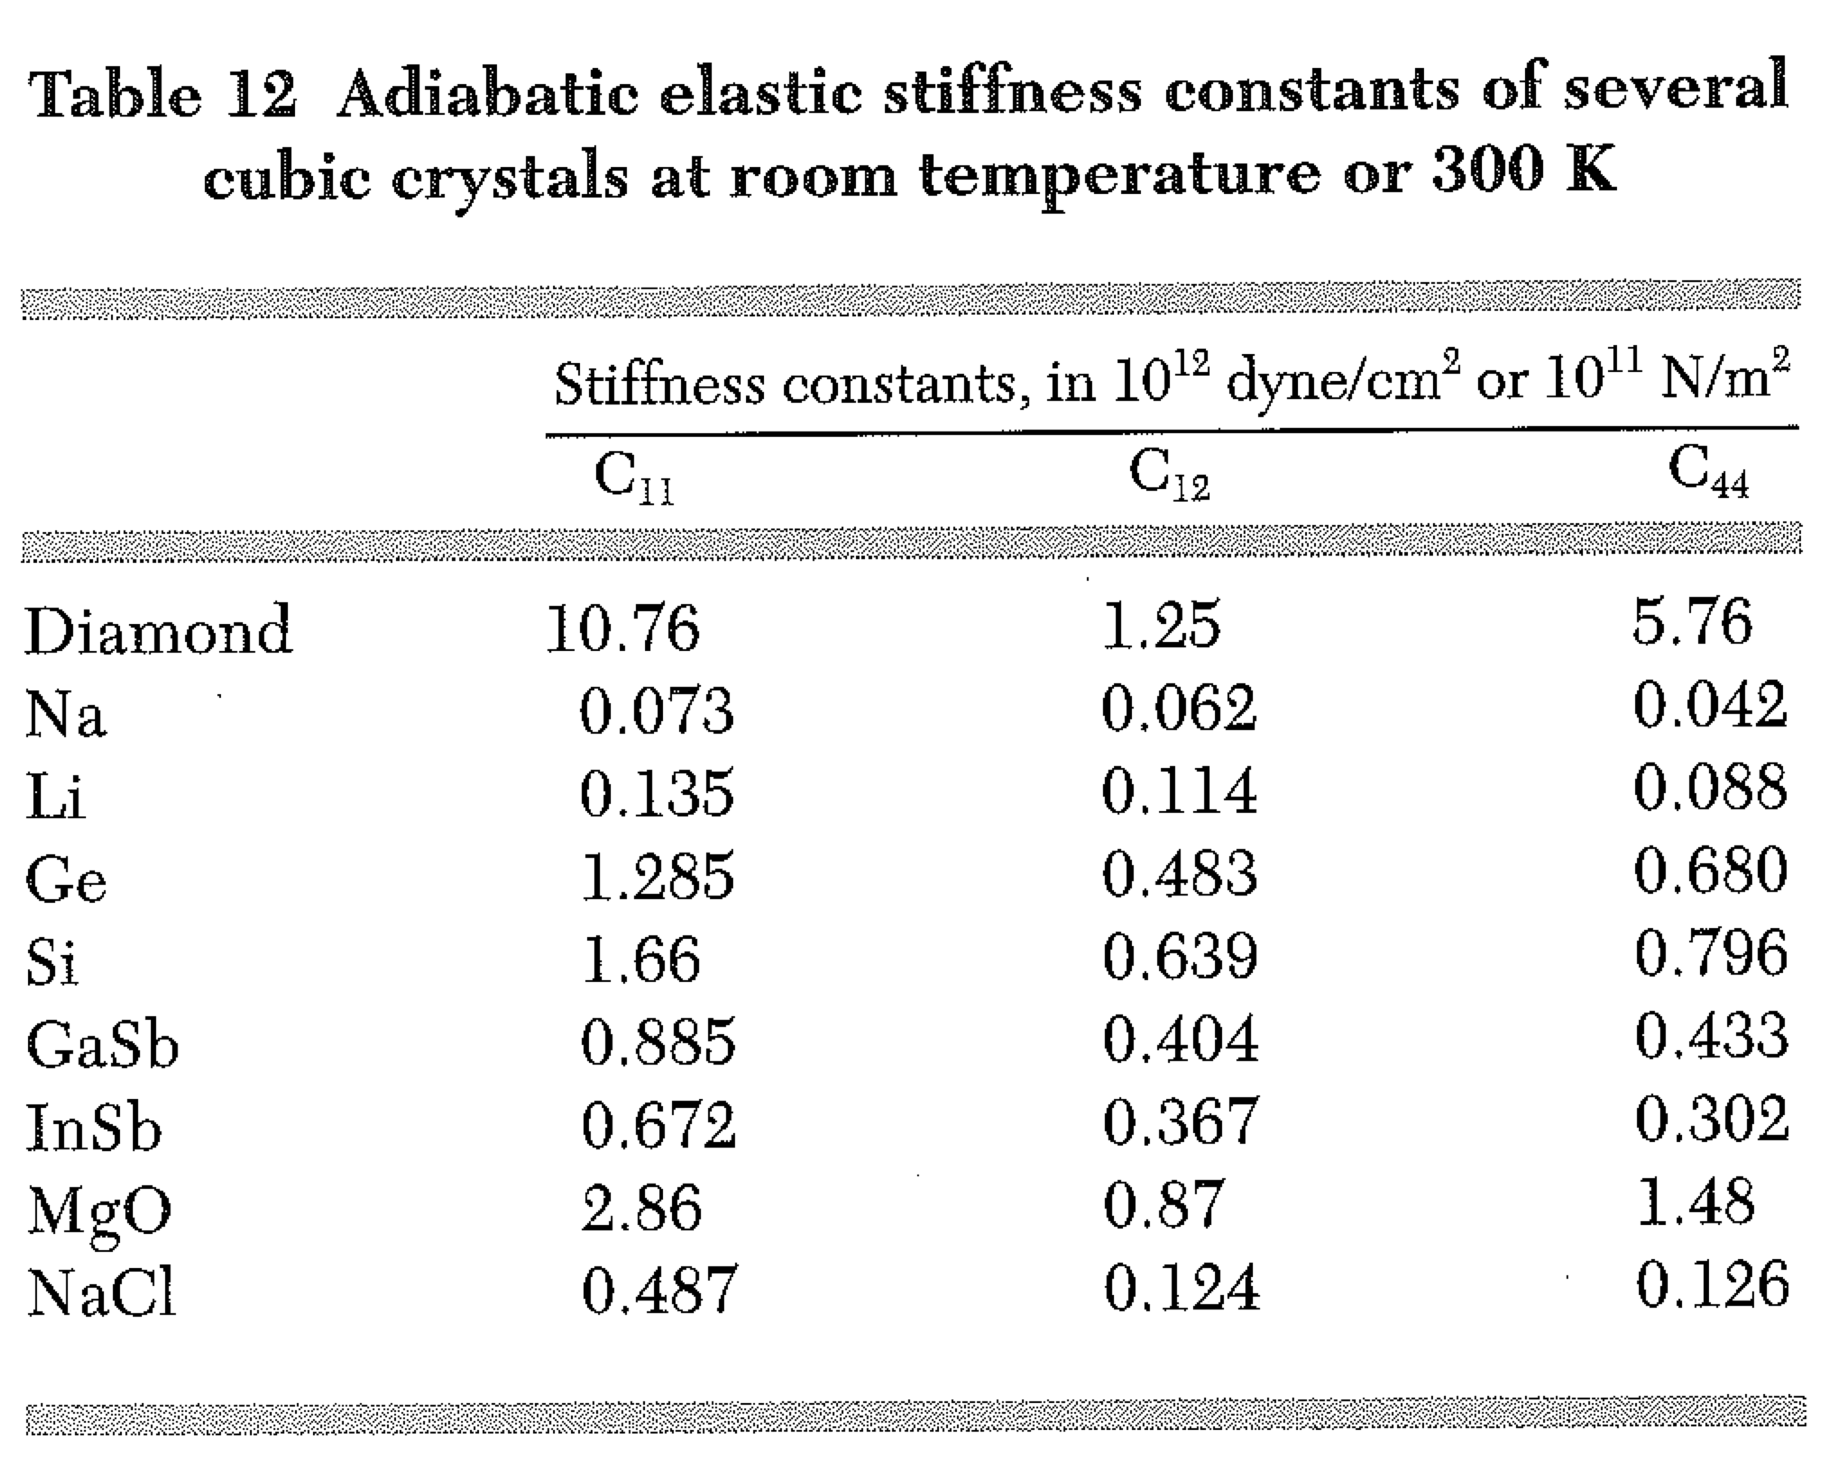
Conclusions: diamonds are hard and salt is soft.

Slide 12
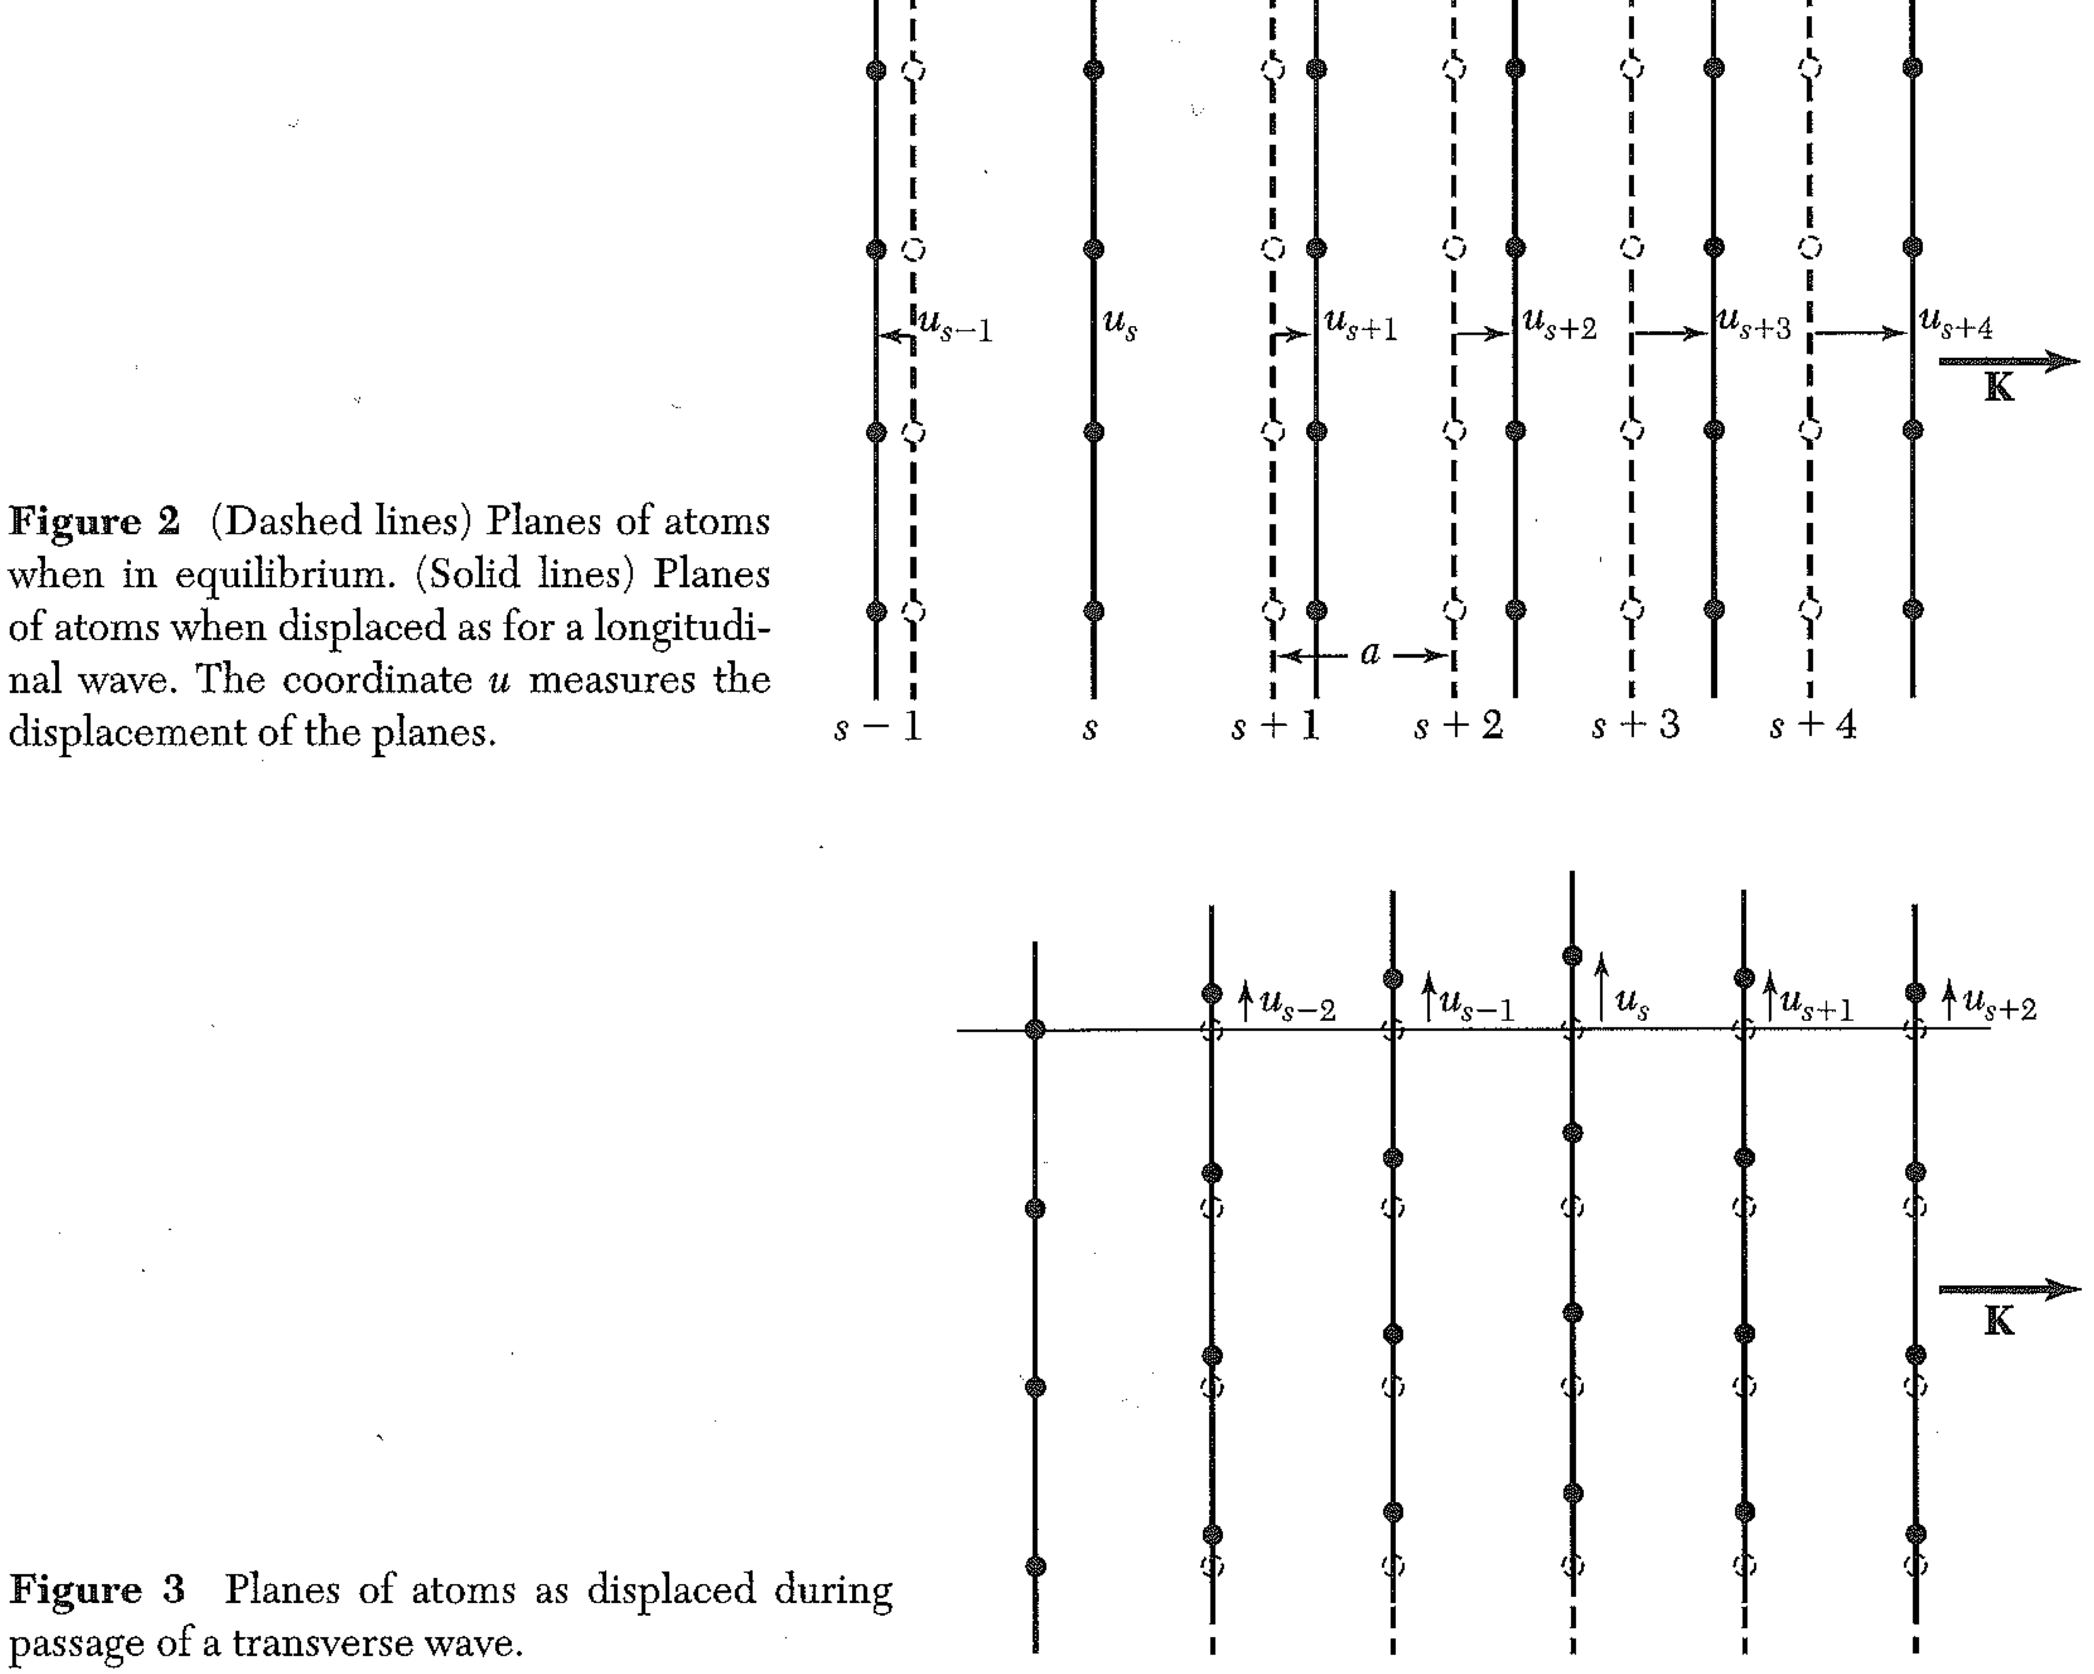
Atomic Description of Wave Motion in Crystals

Slide 13
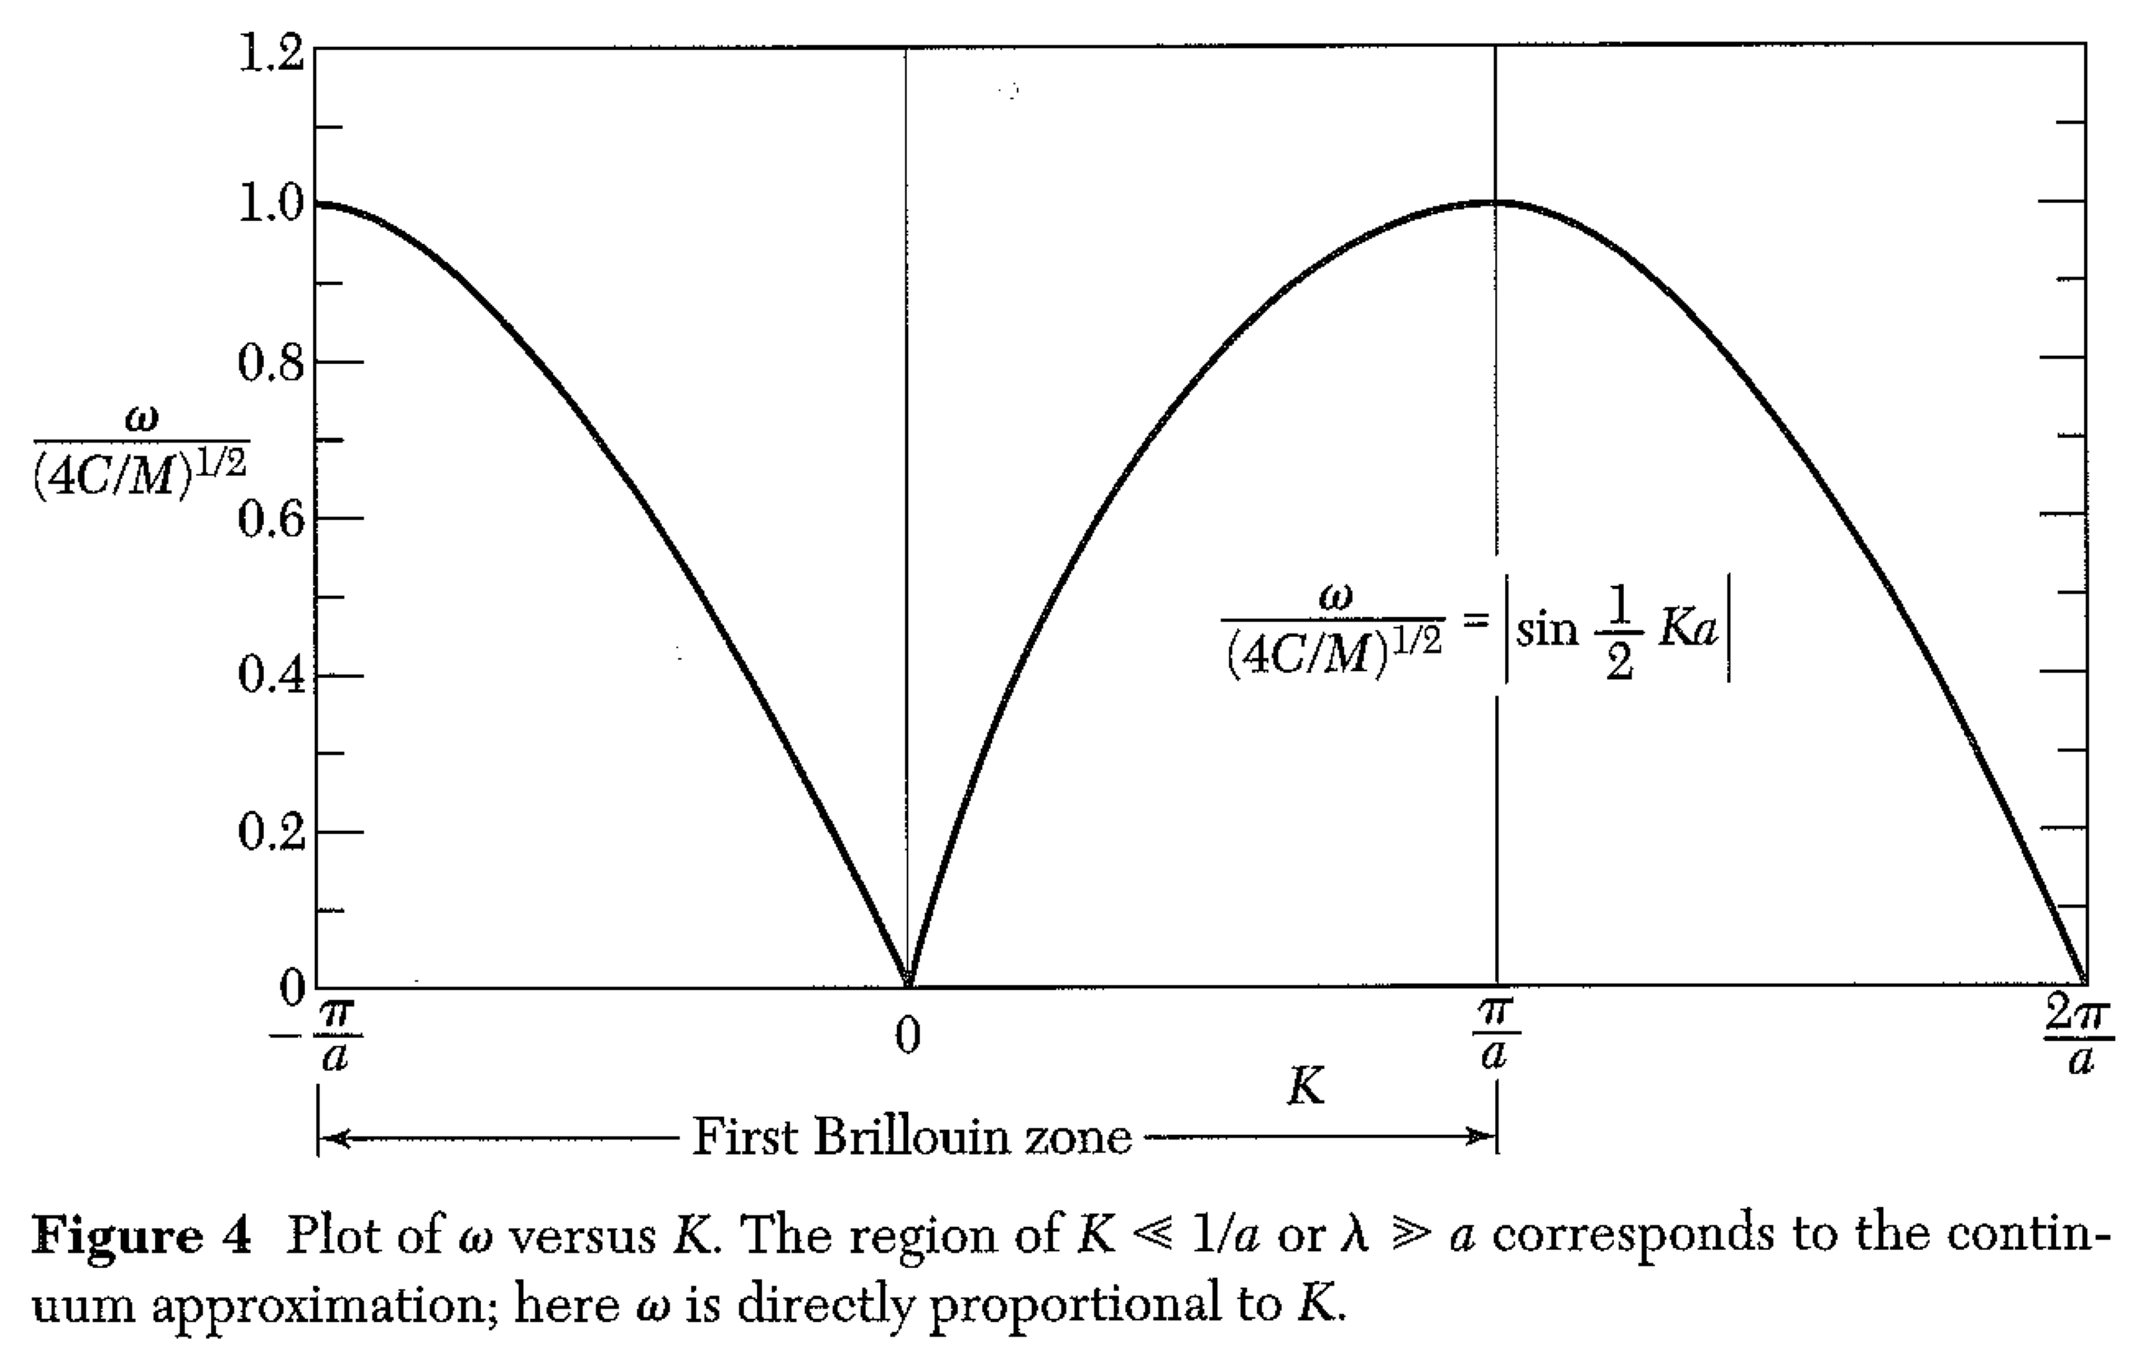
Atomic Description of Wave Motion in Crystals
The continuum approximation does not work for short wavelengths.

Slide 14
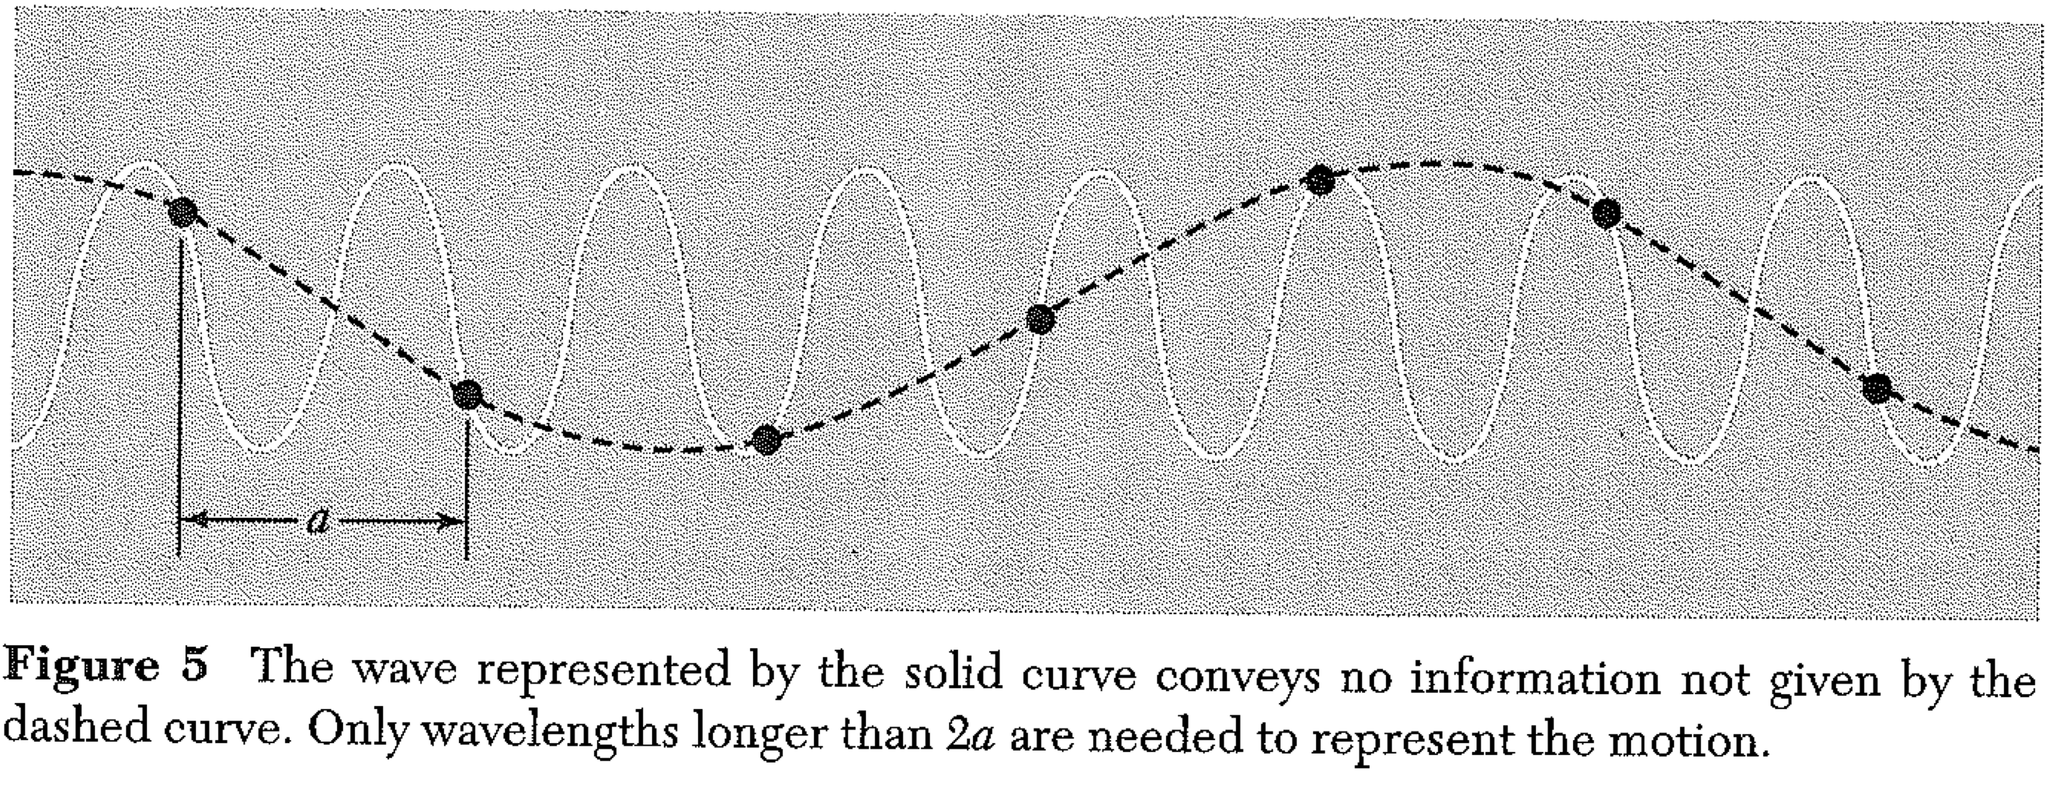
Atomic Description of Wave Motion in Crystals

Slide 15
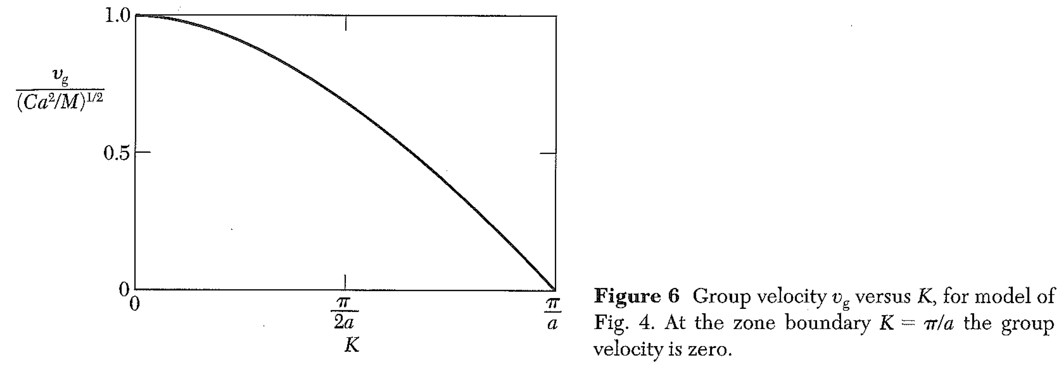

Slide 16
Lecture 8 Continuum mechanics - revisited
To better understand the continuum description of waves, let’s try to solve this problem:
Take a crystal for which C₁₂ ≠ C₁₃, but otherwise has all the same matrix elements as for a cubic crystal. How do you modify the equations for u and v?

Slide 17
Continuum mechanics - revisited
Take a crystal for which C₁₂ ≠ C₁₃, but otherwise has all the same matrix elements as for a cubic crystal. How do you modify the equations for u and v?
Let’s take C₄₄=C₁₁/5=C₁₂=C₁₃/3 = C
Consider a wave traveling in the [110] direction (45° to xy in the xy plane),
With a displacement also in the xy plane.
Substitute into your equations for u, v
Find the eigenvalues for ω, and the eigenvectors.
Are these waves purely longitudinal or transverse?

Slide 18
Continuum mechanics - revisited
Take a crystal for which C₁₂ ≠ C₁₃, but otherwise has all the same matrix elements as for a cubic crystal. How do you modify the equations for u and v?
You should have found that the normal modes are NOT transverse or longitudinal.
(In fact, they are not even perpendicular to each other!)
Suppose we launch a pure transverse wave in the [110] direction. What happens?

Slide 19
Last Time: Discrete atoms Difference equation (instead of differential equation) Assume a sinusoidal solution
M = mass of plane of atoms.
a = separation of planes
C = force of one plane on adjacent plane when separation changed a unit amount

Slide 20
M = mass of plane of atoms.
a = separation of planes
C = force of one plane on adjacent plane when separation changed a unit amount
How do these parameters relate to C₁₁ or C₄₄?
C₁₁ is force per unit area (stress)
The mass of a plane of atoms is
So

Slide 21
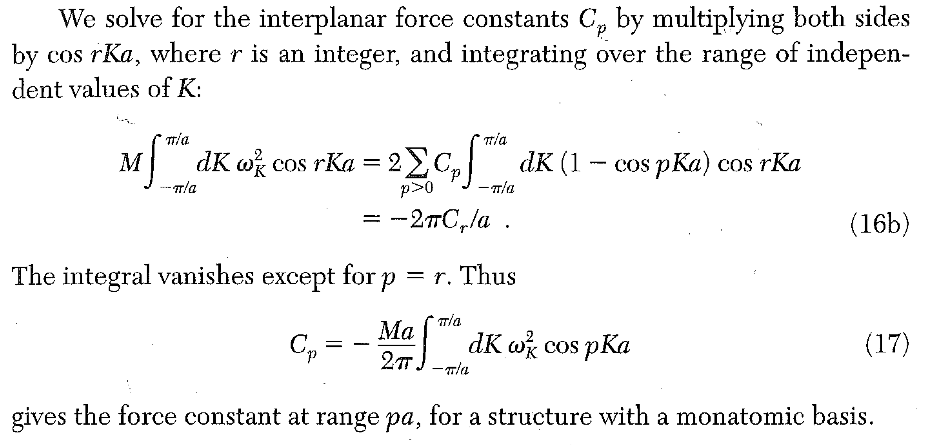
We can easily extend this model to include non-nearest plane interactions.

Slide 22
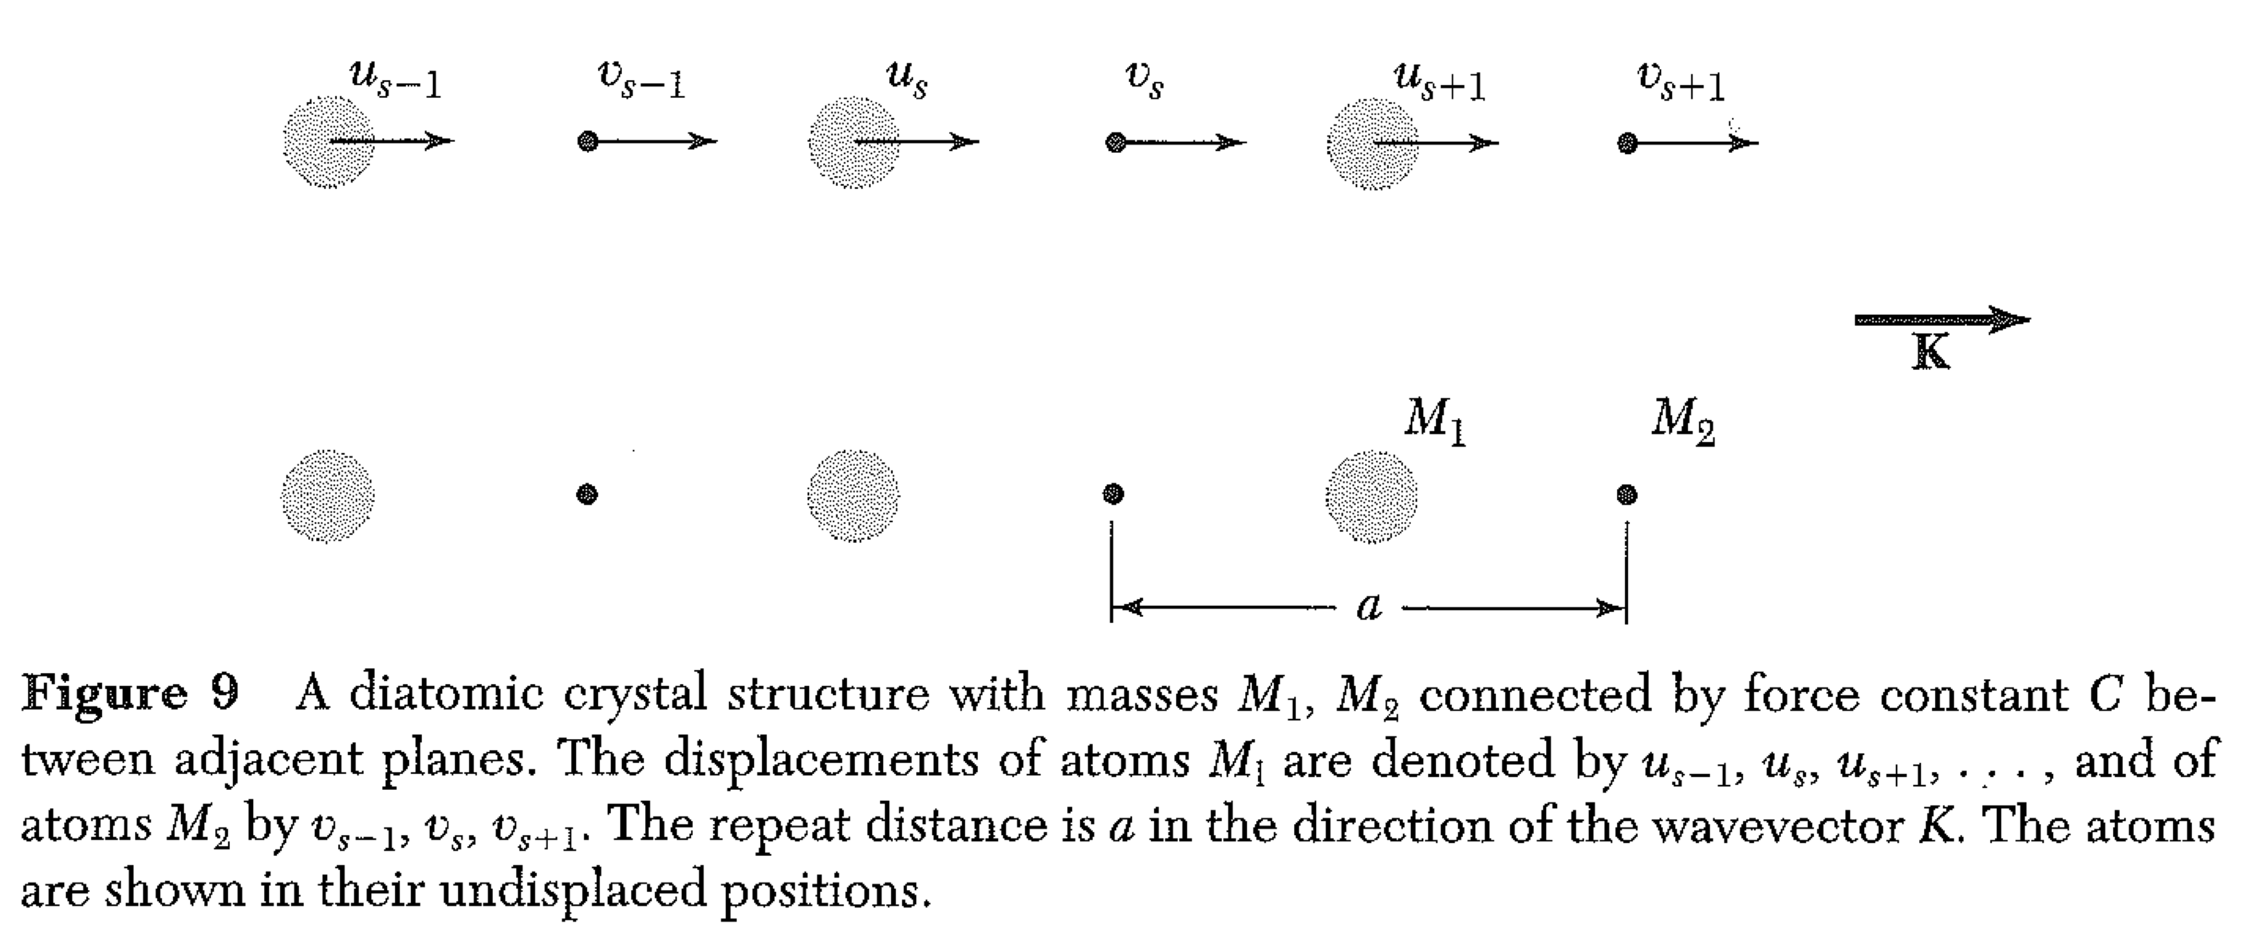
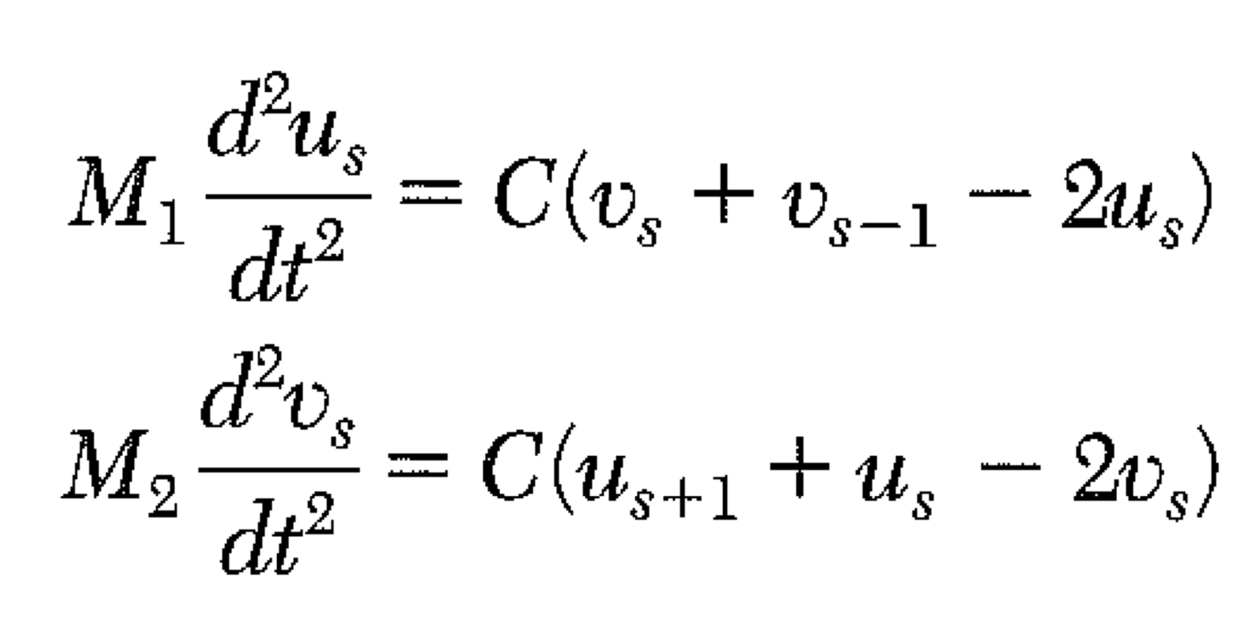
Two atoms per primitive basis

Slide 23
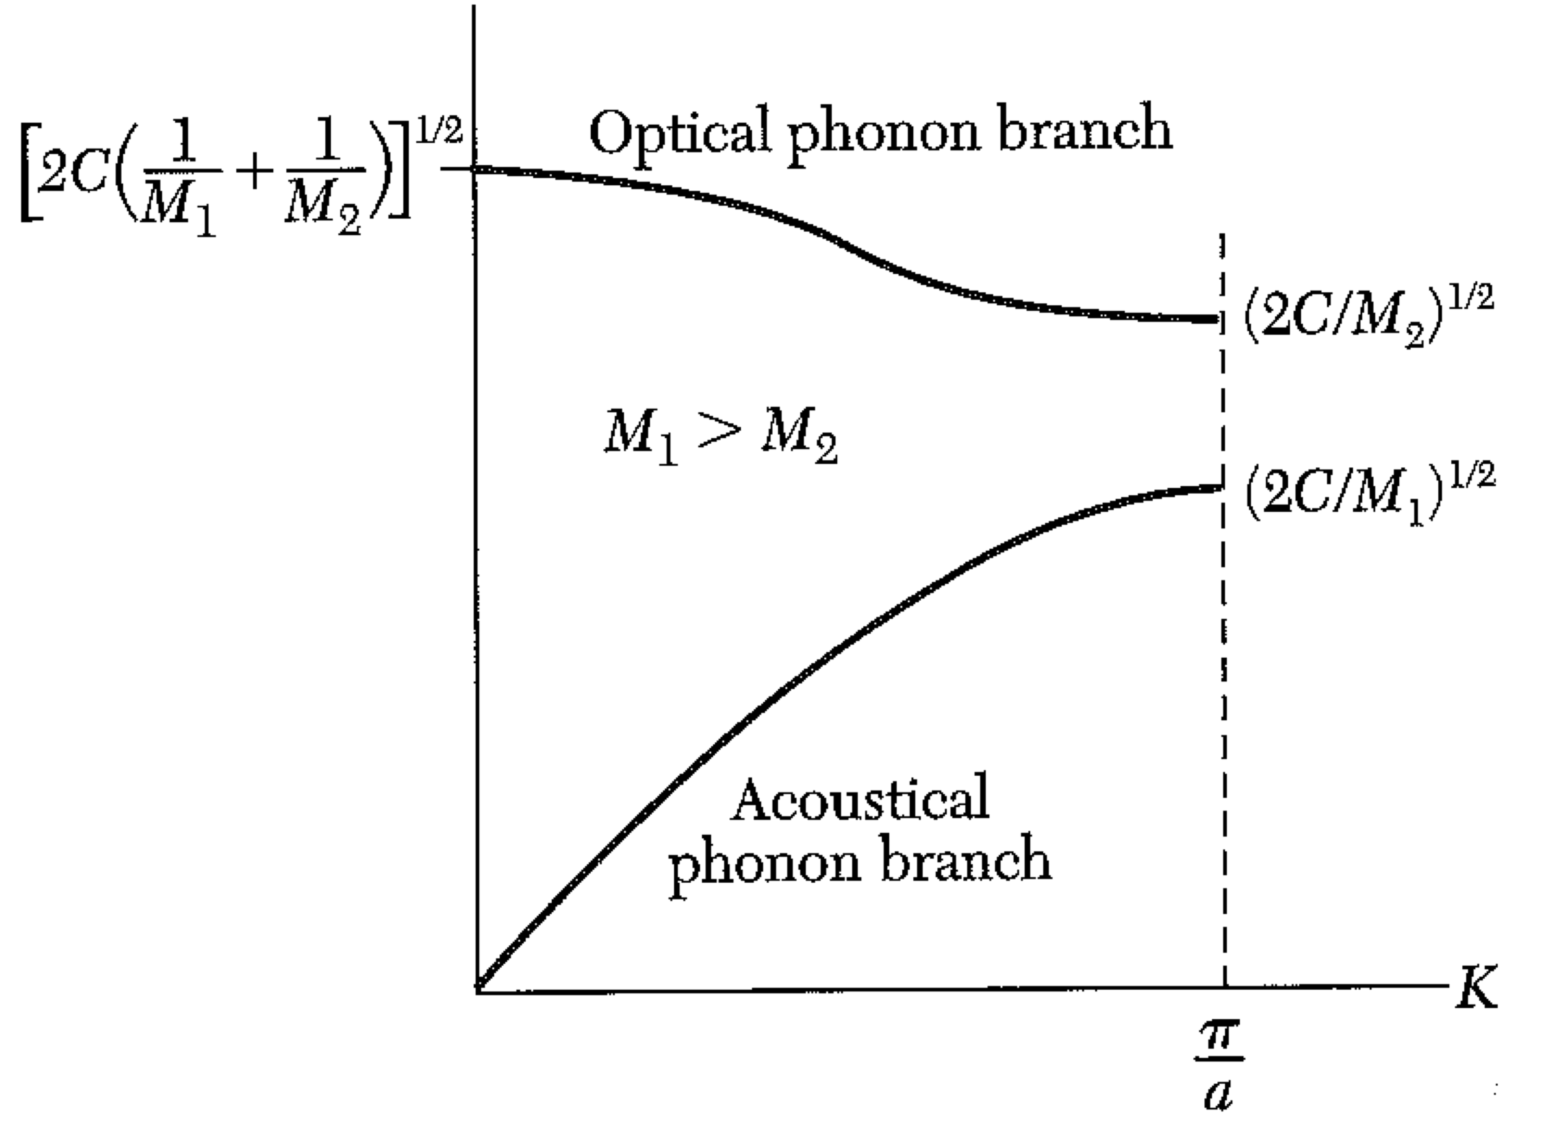
Interesting points:
there is a frequency gap… certain frequencies of phonons are not allowed
Even at K=0, the frequency of the “optical branch” is not zero.

Slide 24
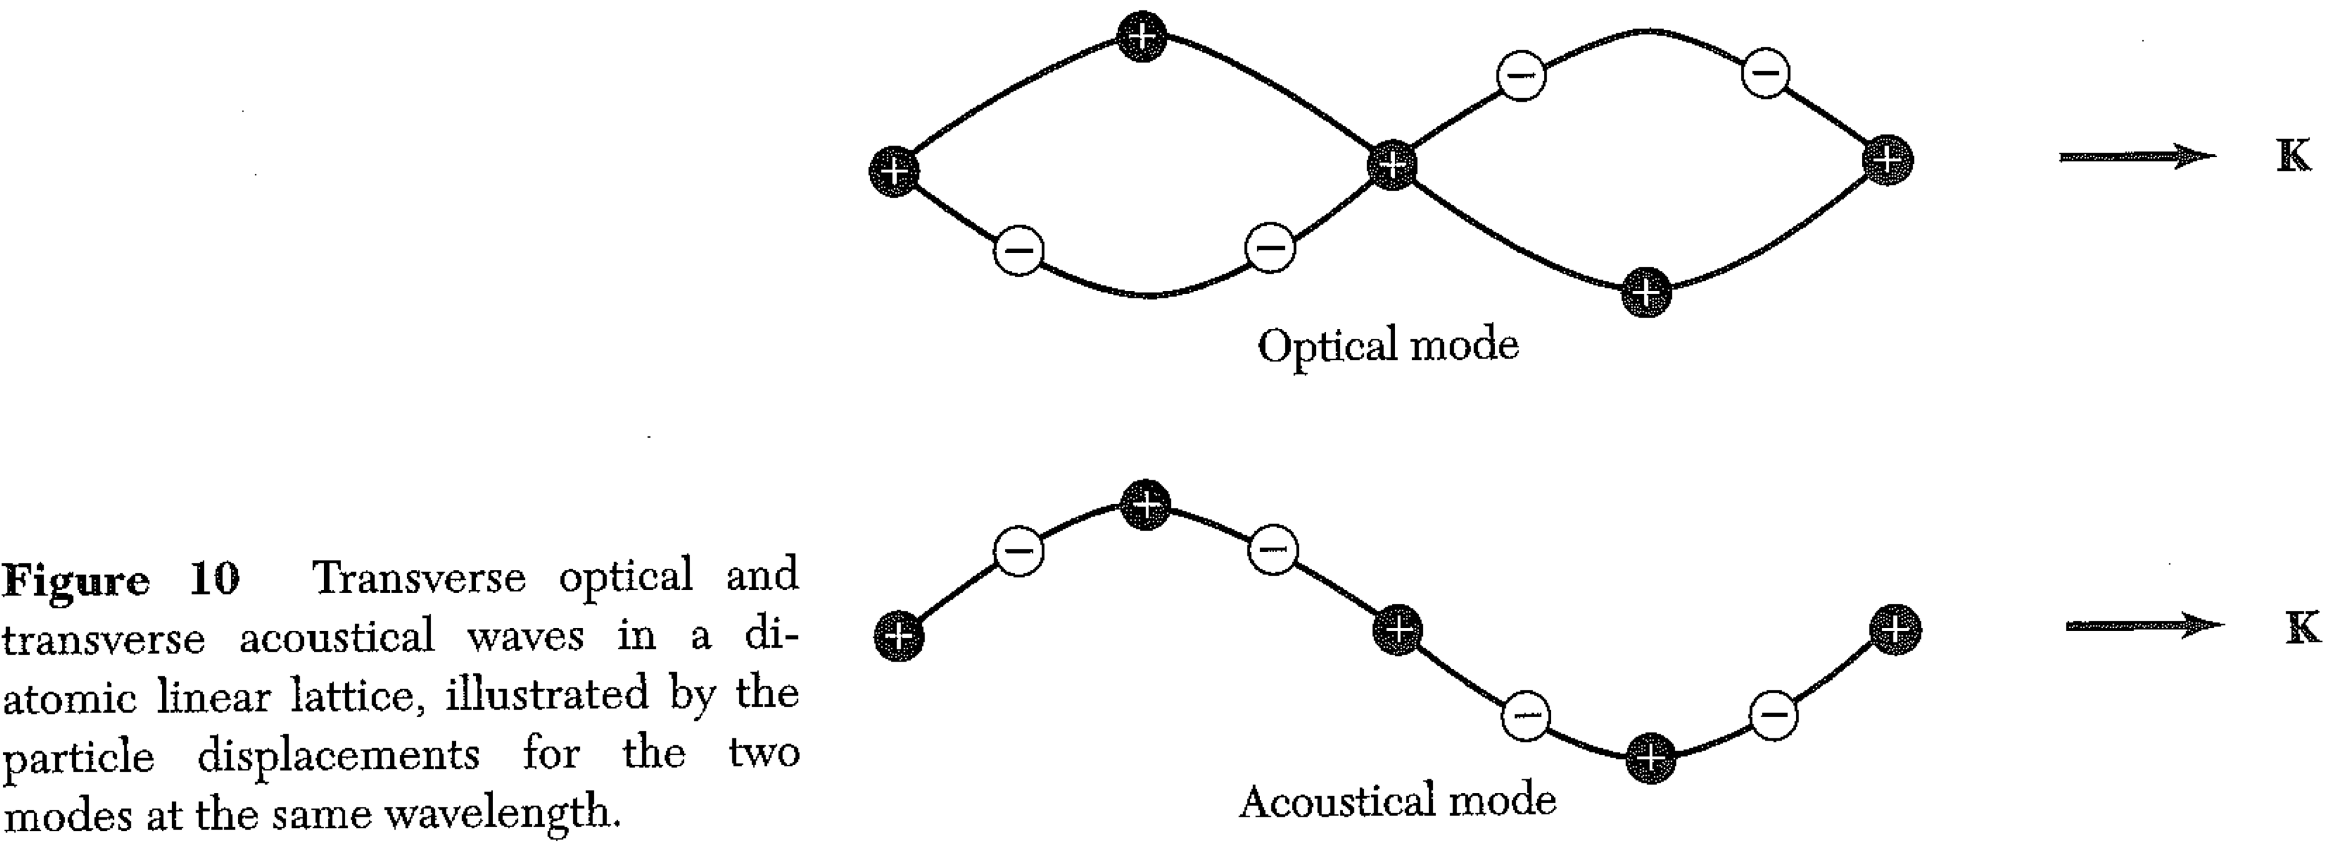
Two atoms per primitive basis
For long wavelengths (K ~ 0), the optical mode has no center of mass displacement.
Alternate atoms move in opposite direction, keeping center of mass fixed.
If alternate atoms have (even partially) different charges, you can excite the optical phonon with an electromagnetic wave of the right frequency.

Slide 25
A phonon is the quantum of vibration… in other words, it is the minimum energy that must be absorbed to cause a vibration.
We can estimate the displacement associated with a single phonon by calculating the energy in an elastic wave.
Of course, the energy will depend on how big a volume the wave fills.
(There is no such thing as a smallest atomic displacement. But it is true that energy given to vibrations must be in multiples of )

Slide 26
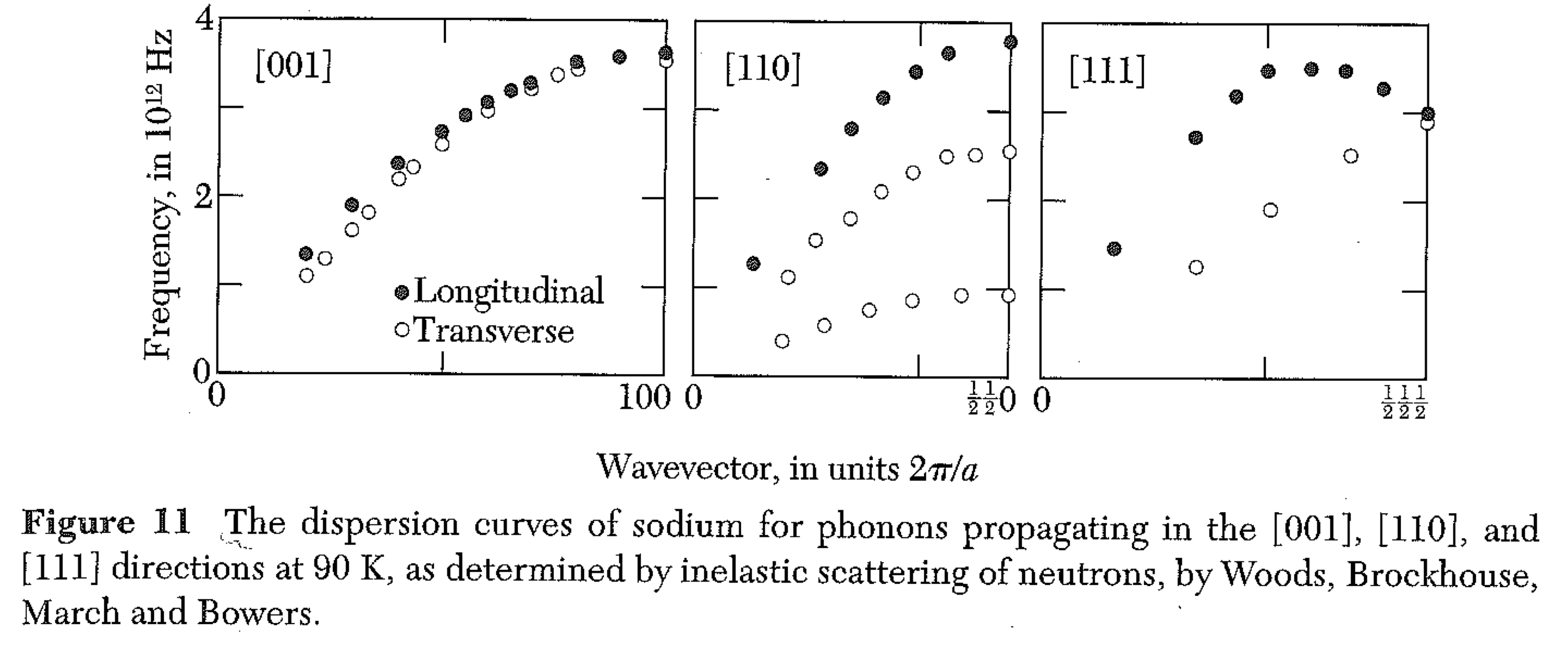
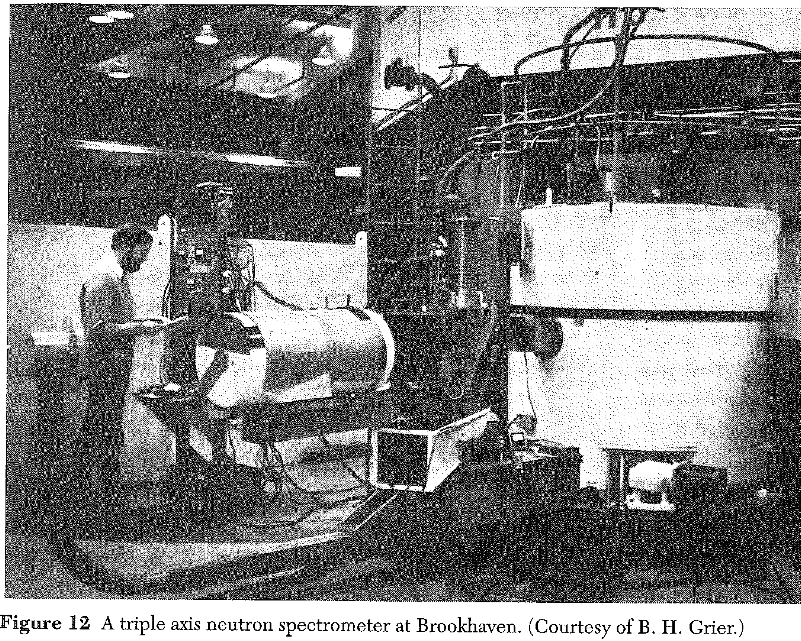
We can measure phonon dispersion (in other words, ω vs K) for phonons by INELASTIC SCATTERING (for example, of neutrons.)
We need to measure how much energy the neutron loses, and how it’s wavevector changes.
K is the phonon wavevector, k, k’ are neutron wavevectors.
We chose G to make sure that K is in the 1st Brillouin Zone.

