Slide 1
Solid State Physics Lectures 5&6
Chapter 3
Crystal Binding
Continuum Mechanics - Waves

Slide 2
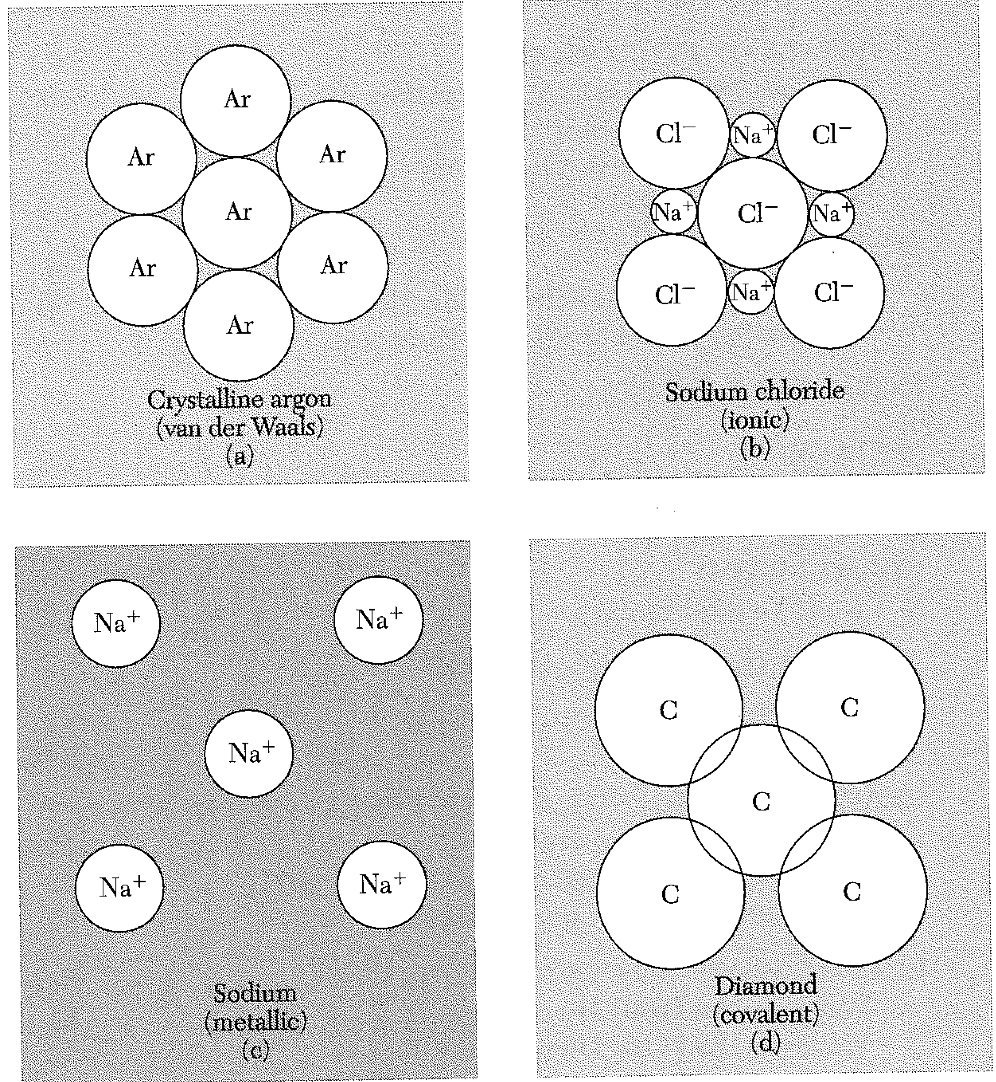
Ways of binding

Slide 3
A semi-classical approach to van der Waals attraction Basic ideas: 1. We can treat the atom as a spring. The electron can oscillate with respect to the nucleus. (Note: we are NOT saying the electron IS oscillating. The electronic orbitals of an isolated atom are stationary.)

Slide 4
A semi-classical approach to van der Waals attraction Basic ideas: 2. IF one electron were to oscillate, it would have an effect on the energy of the other. In other words, the total energy of the combined system depends on the “positions” of both electrons.

Slide 5
Basic ideas: 3. The quantum part: oscillators have a ground state, minimum energy that is proportional to their frequency and Planck’s constant. The coupling between the (here, identical) oscillators changes the normal modes of vibration. We show that one normal mode (the symmetric mode, where both electrons move together) has a smaller “spring constant”, and the other normal mode (the antisymmetric mode) has a bigger “spring constant”. The shifts are equal and opposite.

Slide 6
Again, these springs are not actually springing! We consider them to be in their quantum mechanical ground states (normal modes). They still have a tiny bit of energy, however… their “zero point energy”. But with coupling, the ground states change. The normal modes are the sym. and antisym. modes. The frequencies of these modes are proportional to the square root of the spring constants. Square root function is concave down, so the new zero point energy is lower than for the two isolated atoms.

Slide 7
The van der Waals interaction is purely quantum mechanical. (An analogy: a particle in a box at zero K still exerts pressure on the walls… if the walls are allowed to recede, the zero point energy goes down.)

Slide 8
Pauli repulsion You might expect that, as electron “clouds” overlap, the charge repulsion would become significant. This is wrong. (You are bringing the nuclei closer also, so that more than makes up for the electrostatic repulsion. The lowest classical energy state of the nuclei and electrons is all at a point!)

Slide 9
Pauli repulsion Electrons cannot occupy the same quantum state. This sounds like a “black and white” proposition…either two things are in the same quantum state or they aren’t in the same quantum state, right? Not quite. Think of quantum states as “normal modes”. There are an infinite number of normal modes for the electron around each nucleus. Any electron wave can be expressed as a sum of normal modes. (The normal modes are a “complete set” of functions.)

Slide 10
Pauli repulsion Any electron wave can be expressed as a sum of normal modes. (The normal modes are a “complete set” of functions.) If we tried to write down the electron cloud for the atom on the left (at the bottom) in terms of the normal modes for the nucleus on the right, we would find that we need to include some of the ground state wave. [Note that we don’t need to include any of the ground state wave to describe the left top electron wave. It doesn’t overlap.] But Pauli says this is not allowed. So we can’t put both electrons in their respective (pure) ground states if the nuclei are this close. We need to “partially promote” one electron to unoccupied higher energy states.

Slide 11
Pauli repulsion This is confusing. Ground state electrons don’t overlap in space for reasons that have (almost) nothing to do with charge repulsion, but rather have to do with the mathematical expression of the electronic state. (Recall that, in an atom, electron waves DO overlap in space, but they do NOT overlap mathematically… the eigenstates are “orthogonal”.)

Slide 12
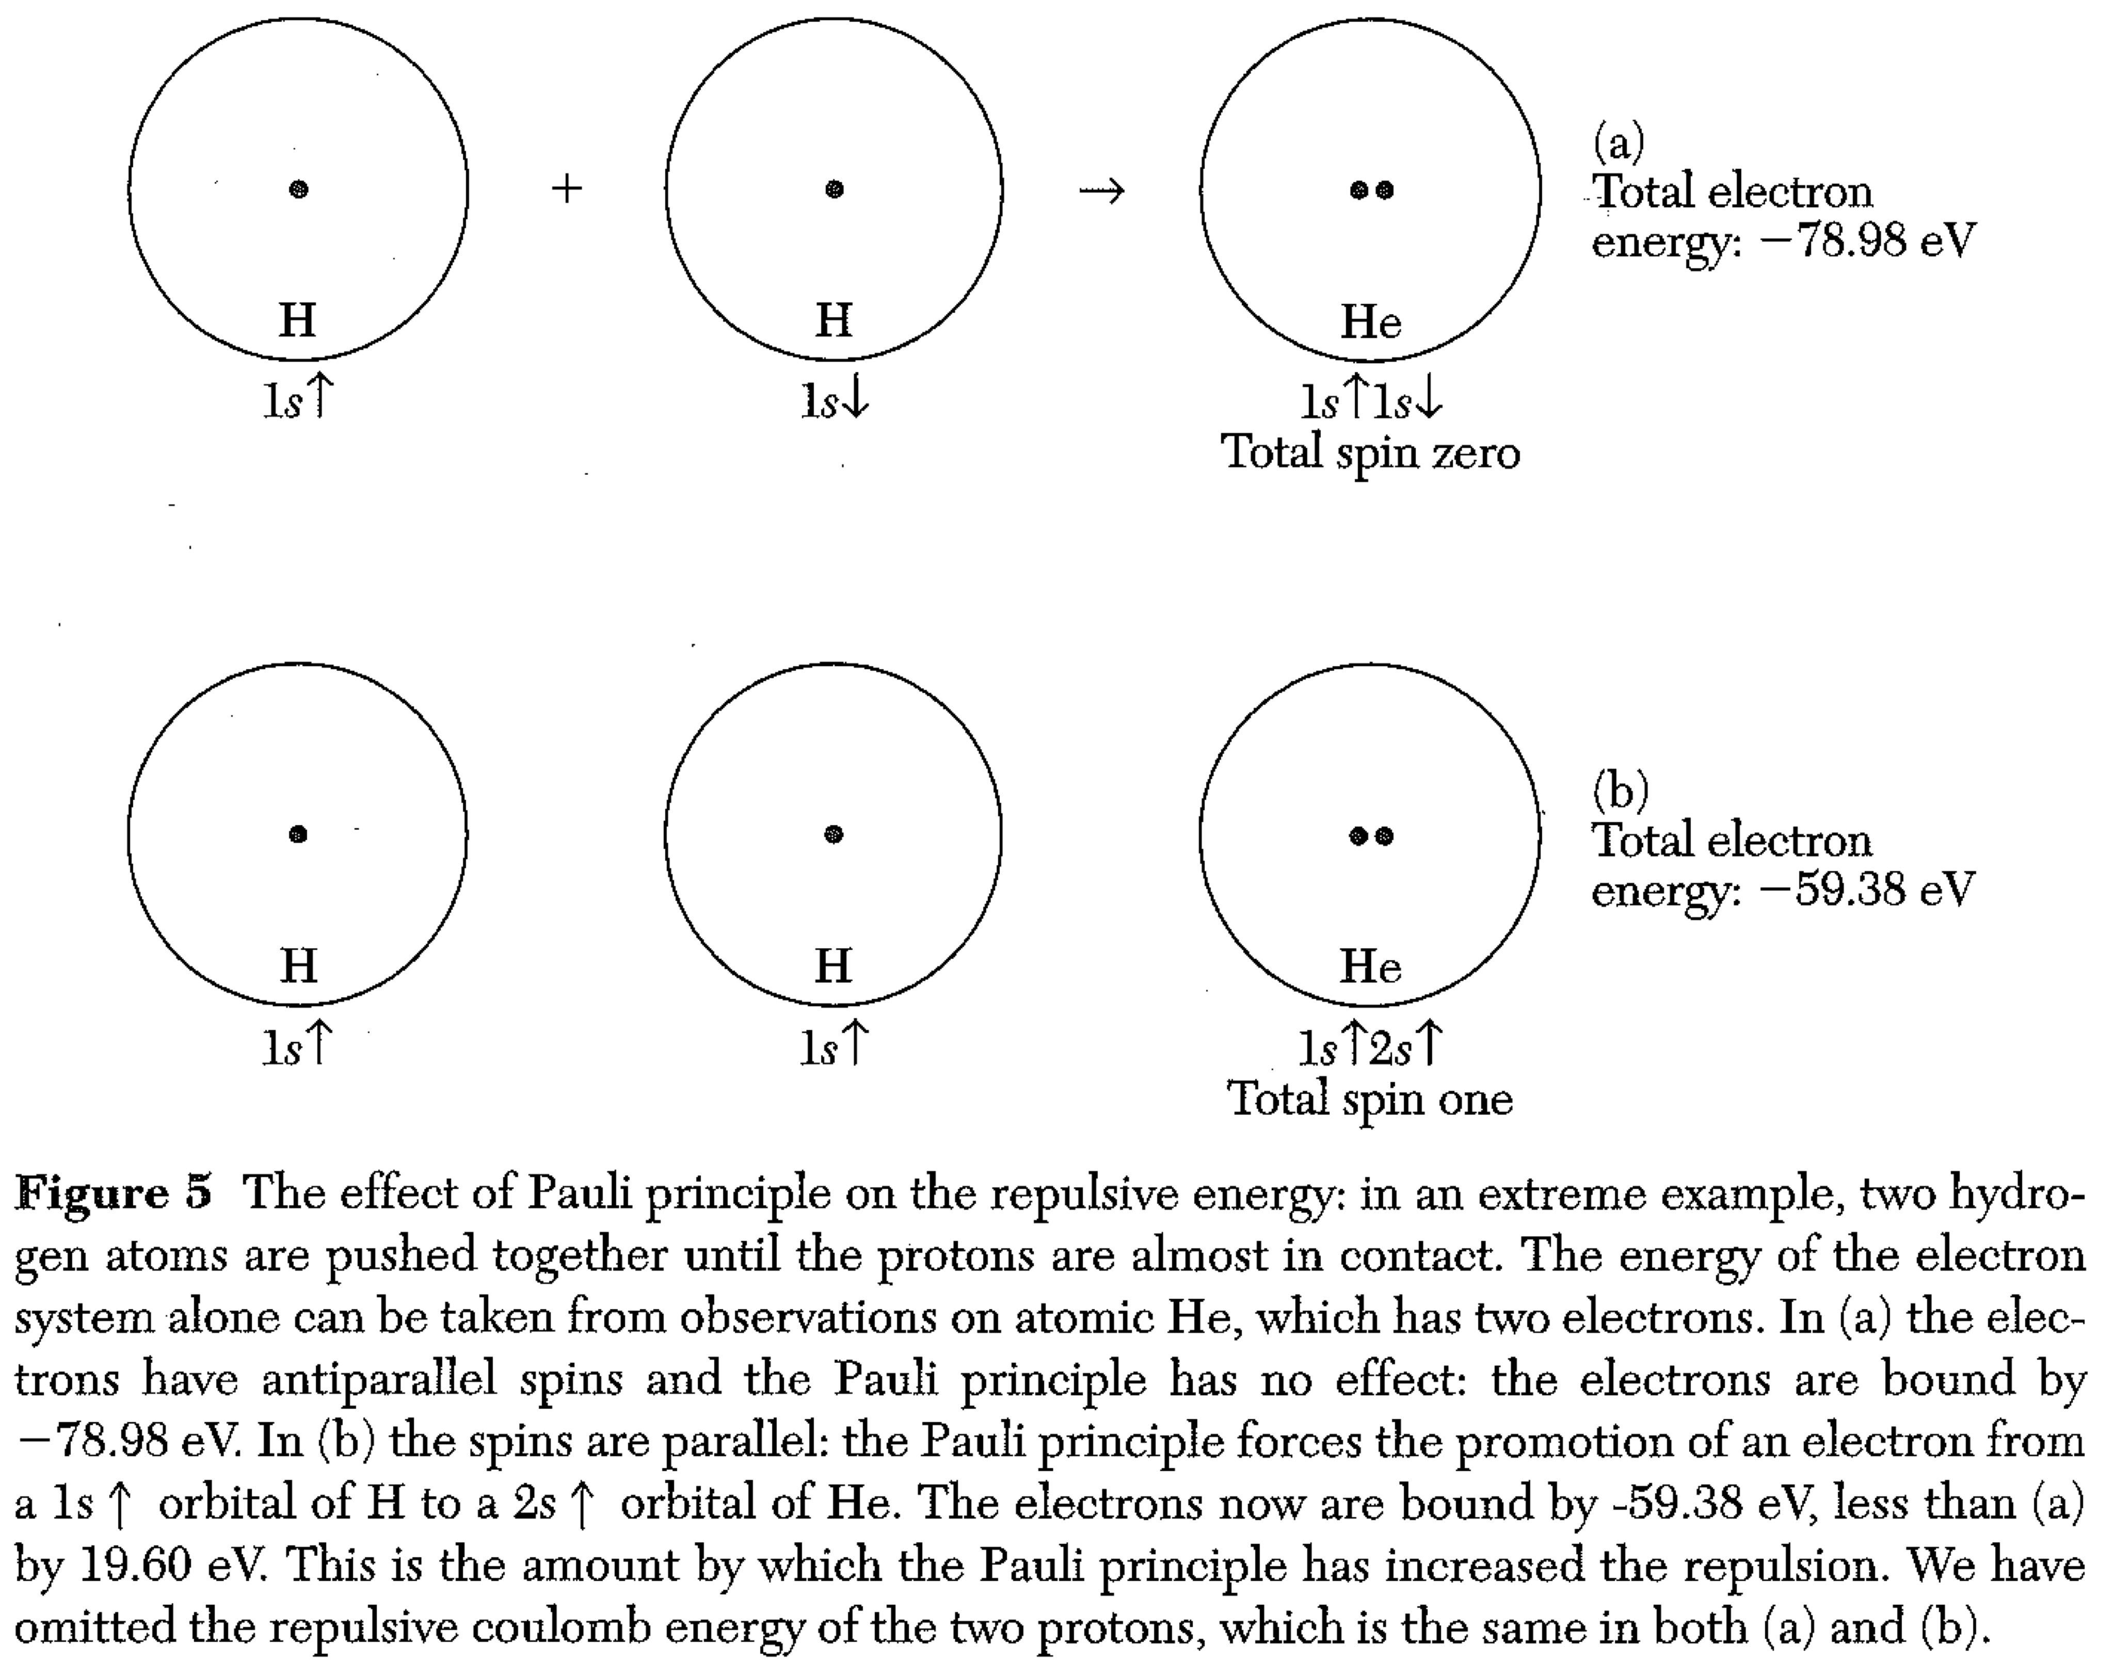

Slide 13
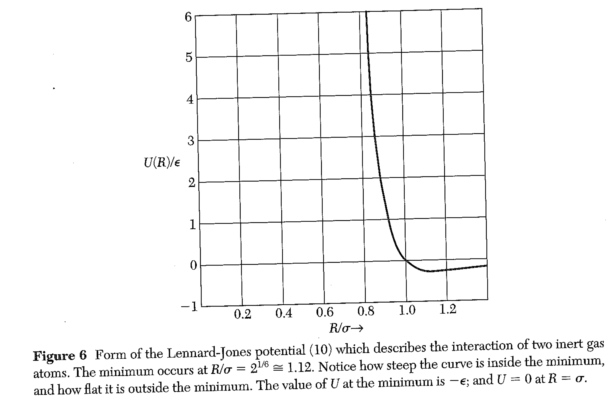

Slide 14
Zero point quantum effects: nuclear motion. The lighter the nucleus, the
larger its velocity uncertainty on confinement, and the higher the ZPE.
Put R₀ and the sums into U_{tot}

Slide 15
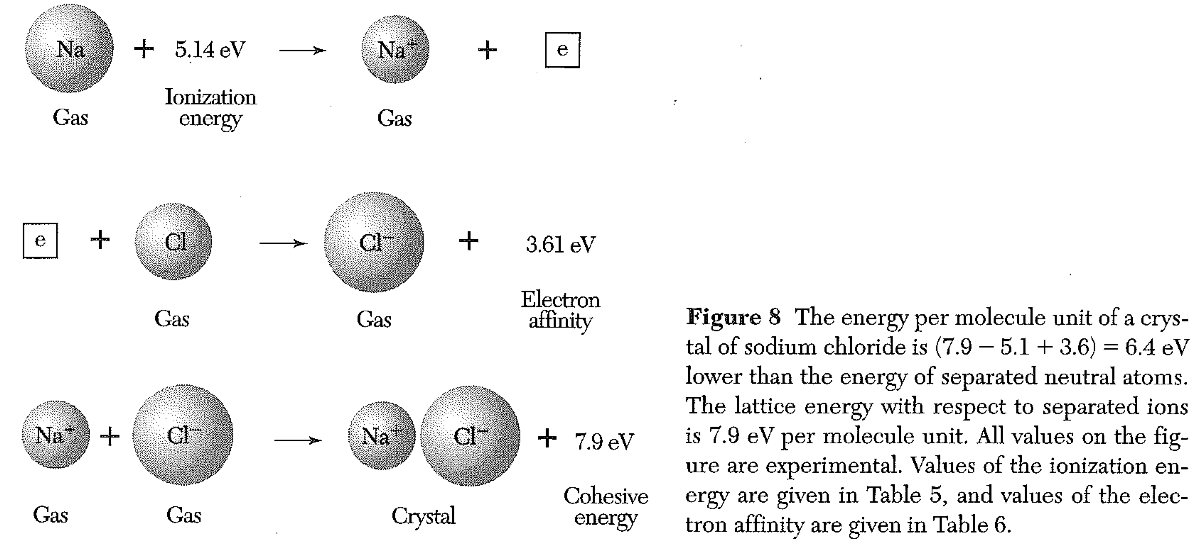
Ionic Crystals
The lowering of energy by binding the opposite ions together is electrostatic.

Slide 16
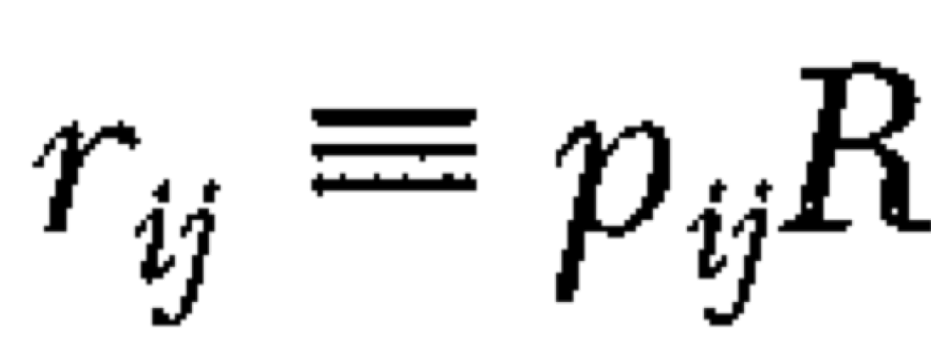
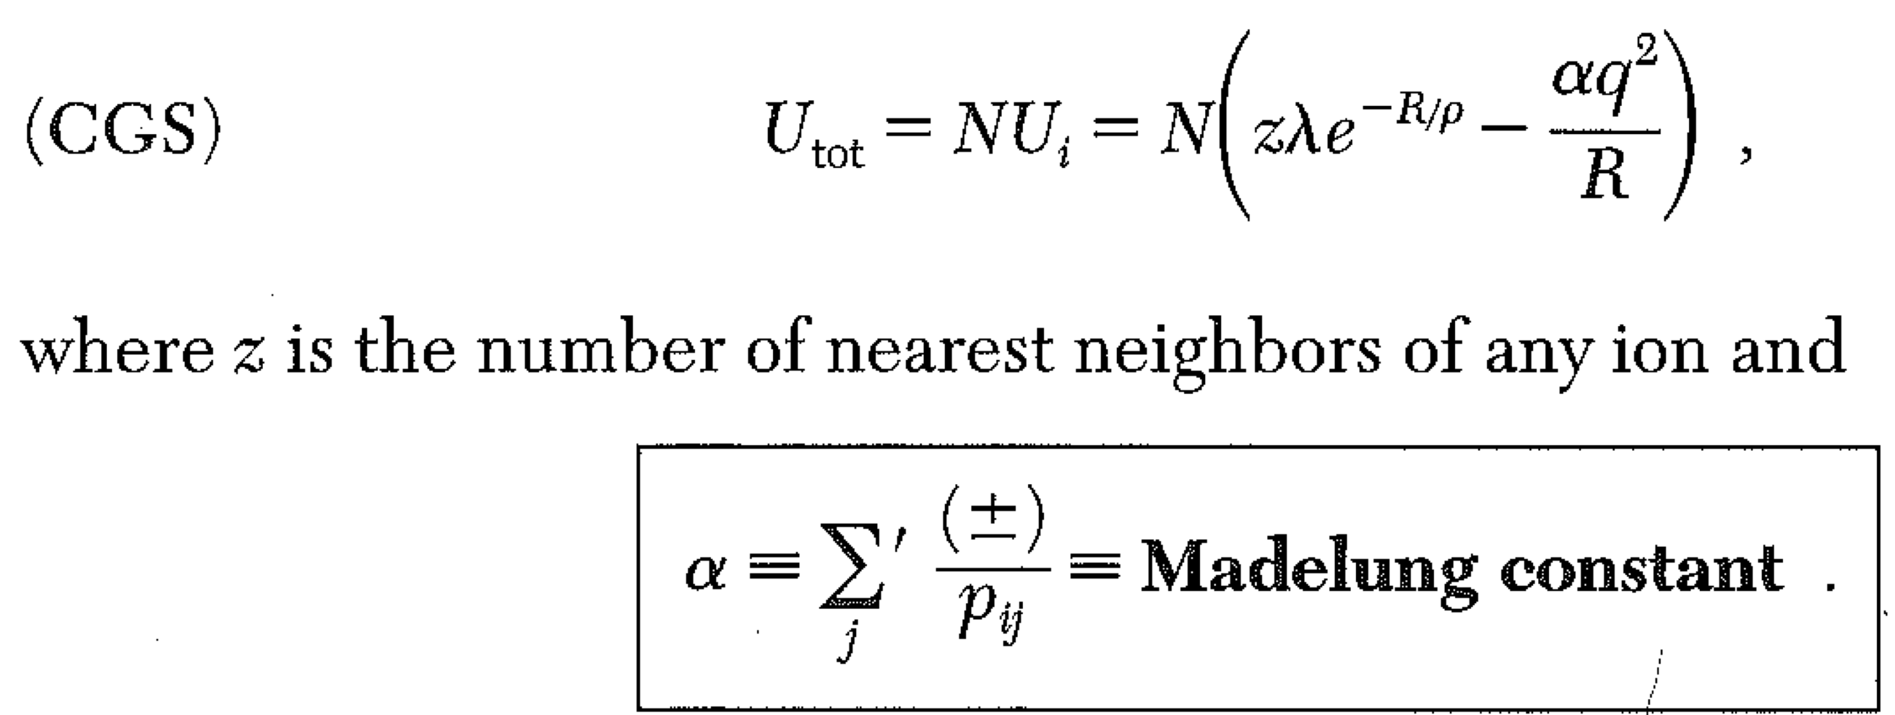
Energy considerations in ionic crystals
N pairs of ions
(Exponential repulsive force for computational convenience)
Prime -> don’t include j=i

Slide 17
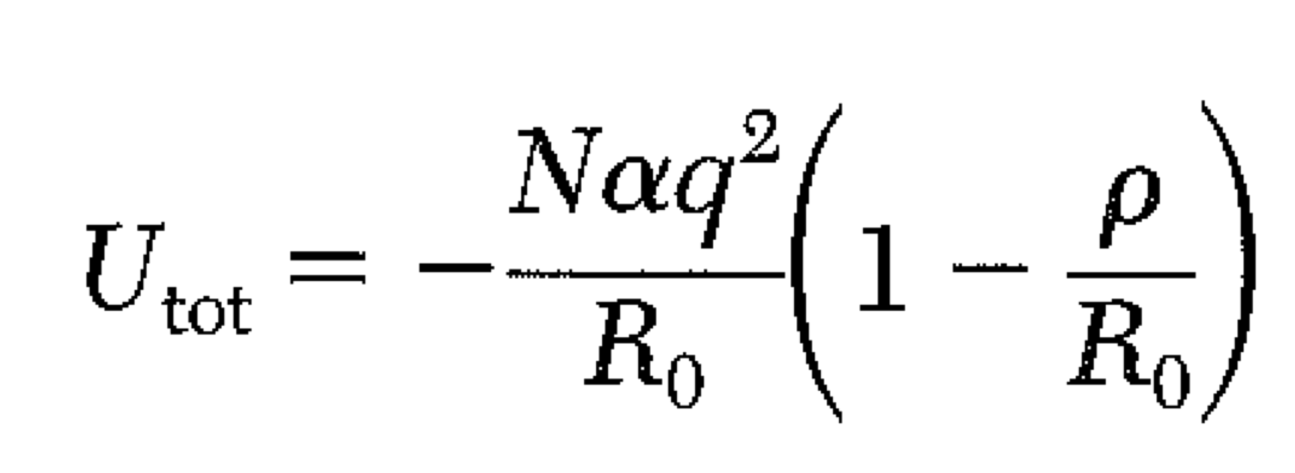
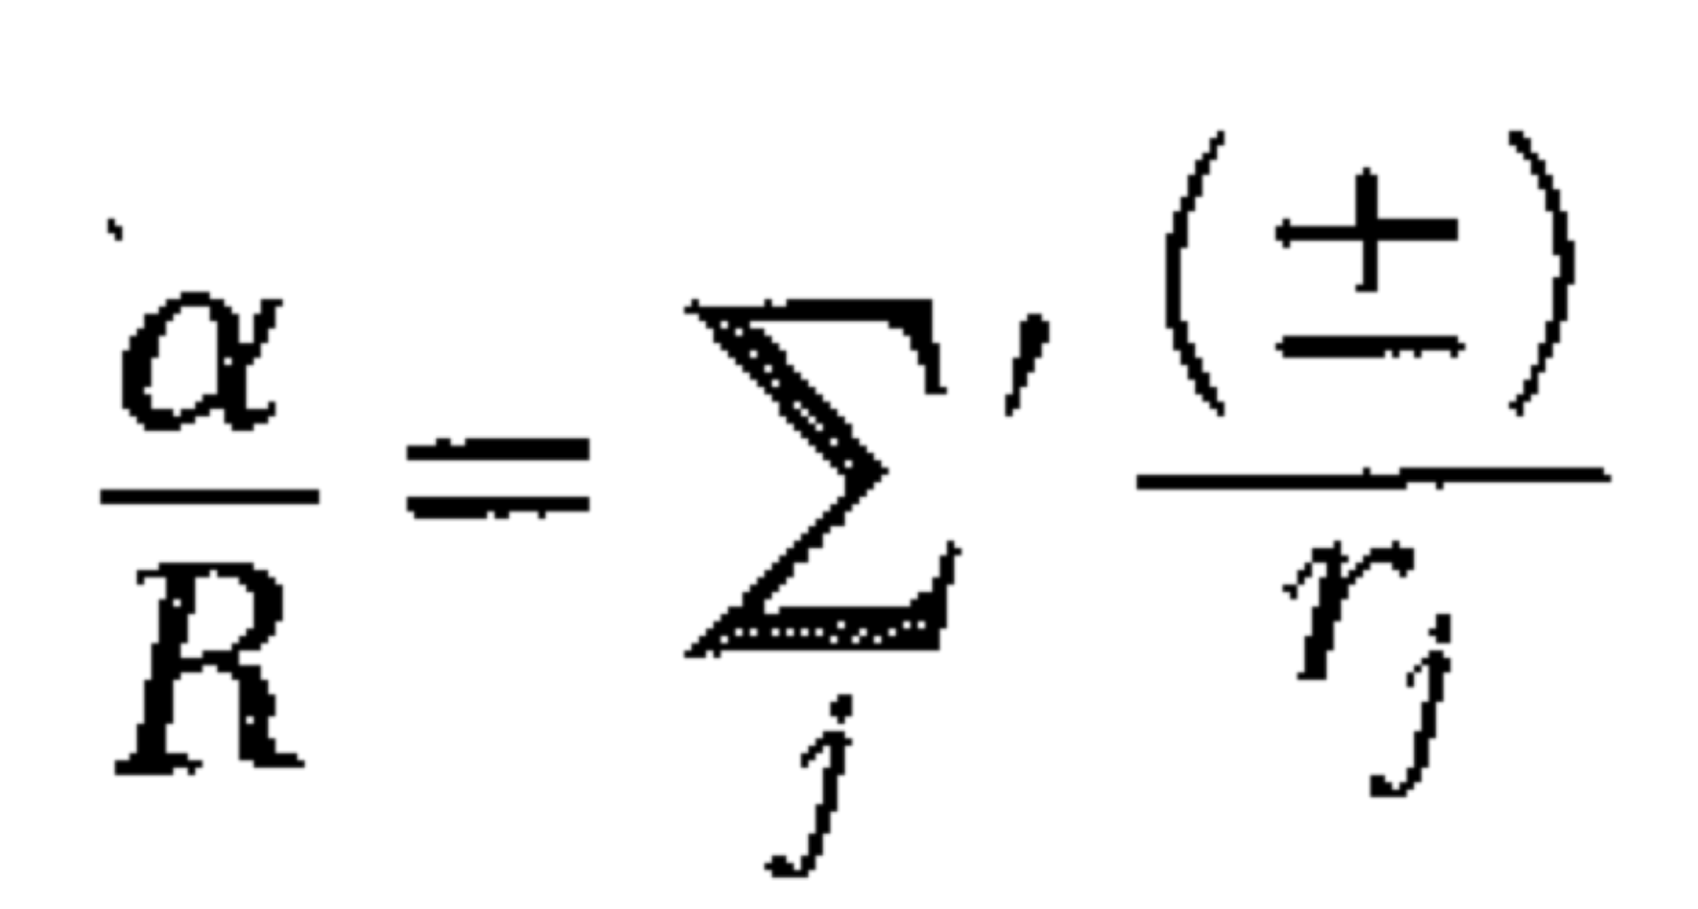
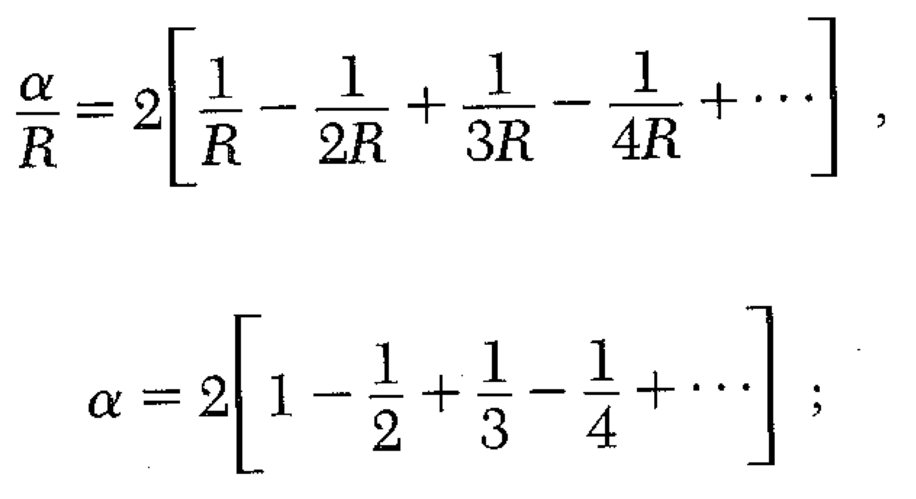
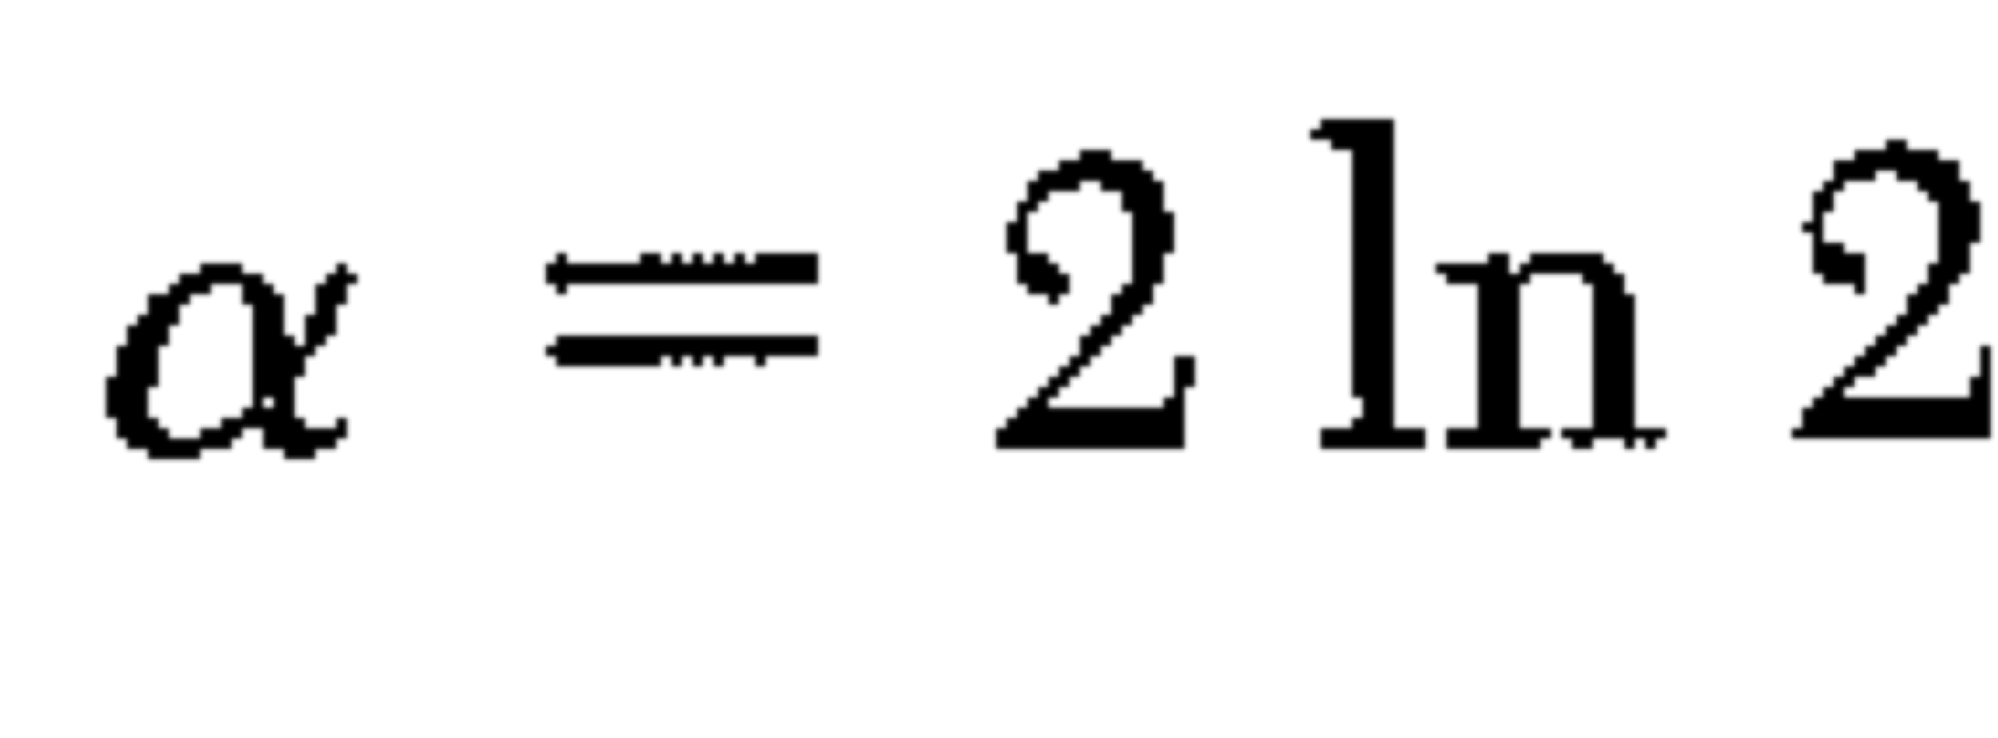
Setting the derivative w.r.t. R = 0 to minimize the energy gives:
1D example
3D is much harder!

Slide 18
The bigger α is, the more the electrostatic effects reduce the energy and stabilize the crystal.
If every pair of ions had separation R₀/ α (and they only interact with each other) the energy would be equal to the crystal energy.
Fcc
Simple cubic
diamond
Bigger alpha -> more negative (lower) energy = tighter electrostatic binding

Slide 19
Covalent bonds
Quantum mechanical
Highly directional -> gives rise to lower density structures, like diamond, e.g.
Metals
In some elements, outer electrons can delocalize.
This lowers their kinetic energy (they are no longer confined.)
Sodium, for example, “wants” to lose an electron. (Sort of… there is an ionization energy cost, but the reduction in electron energy when it can delocalize is greater.)
Pure sodium is a (very reactive) metal.

Slide 20
Grab some chalk – form groups of 2-3.
Imagine a crystal that exploits the Coulomb attraction of Na⁺Na⁻ to make an fcc crystal.
Is such a crystal stable?
Important information:
Electron affinity of Na = .55 eV (Na⁻ is stable.)
Ionization potential of Na = 5.14 eV
Cohesive energy (sign?)
(In cgs units! U in ergs=10⁻⁷ J.
Electron charge= 4.8 x 10⁻¹⁰ esu)
Use 1.9 Å for atomic radius.,
R₀ will be twice this.

Slide 21
Stress and Strain
Strain ~ deformation, Stress ~ Force (per unit area)
If we make a (any) small deformation of the axes x,y,z, we can write the new axes in terms of the old ones using a linear relation.

Slide 23
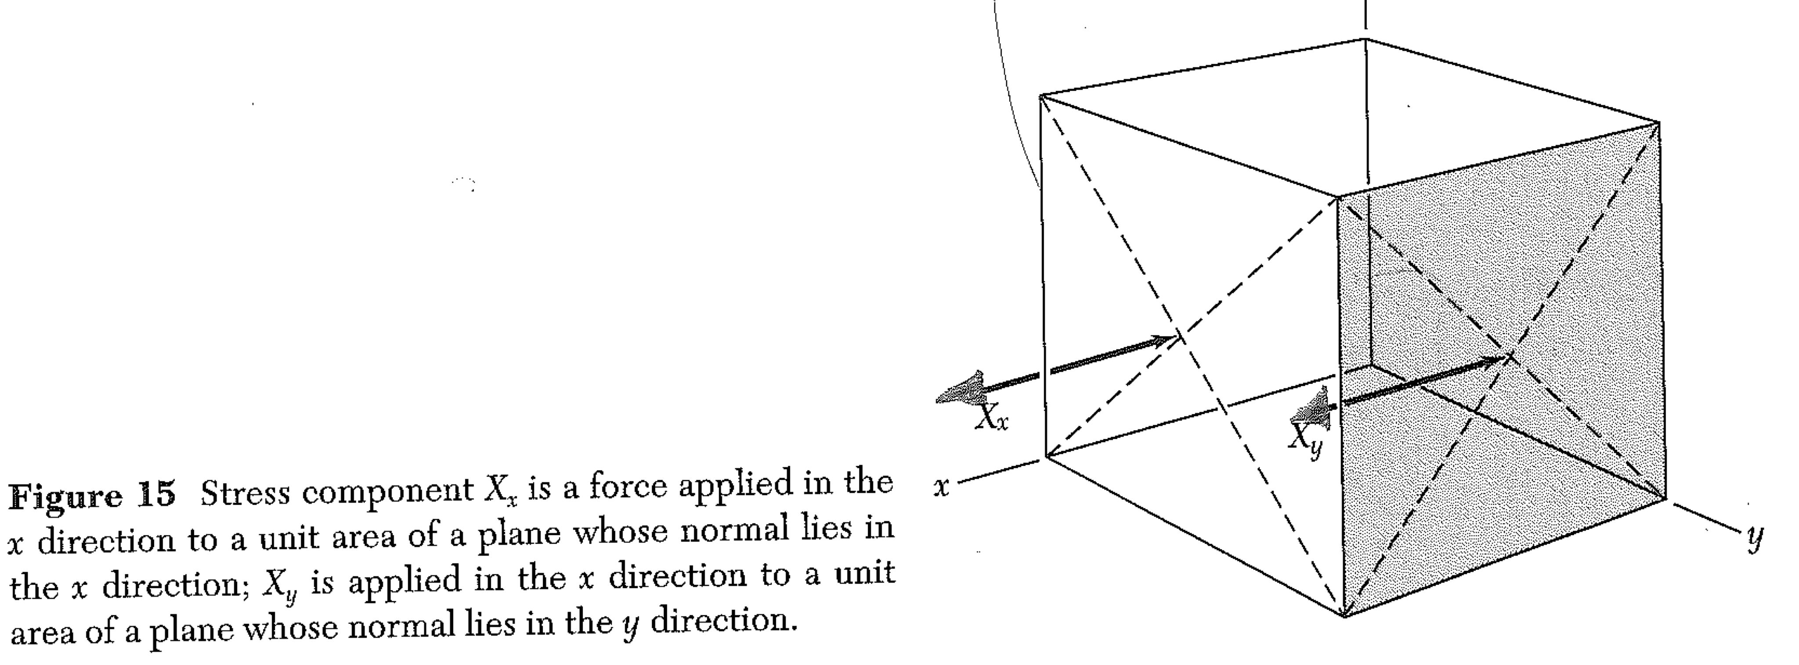
Stress

Slide 24
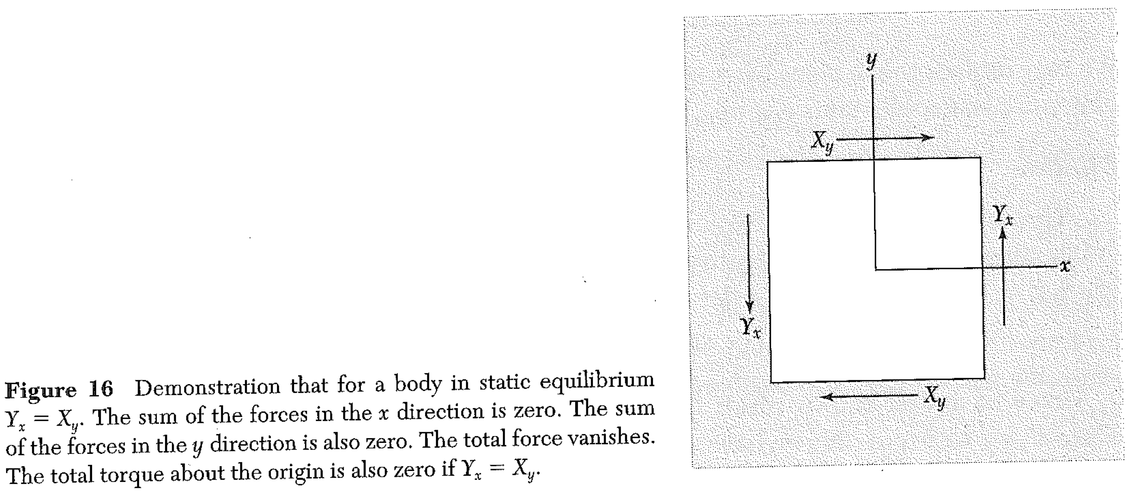
Stress

Slide 25
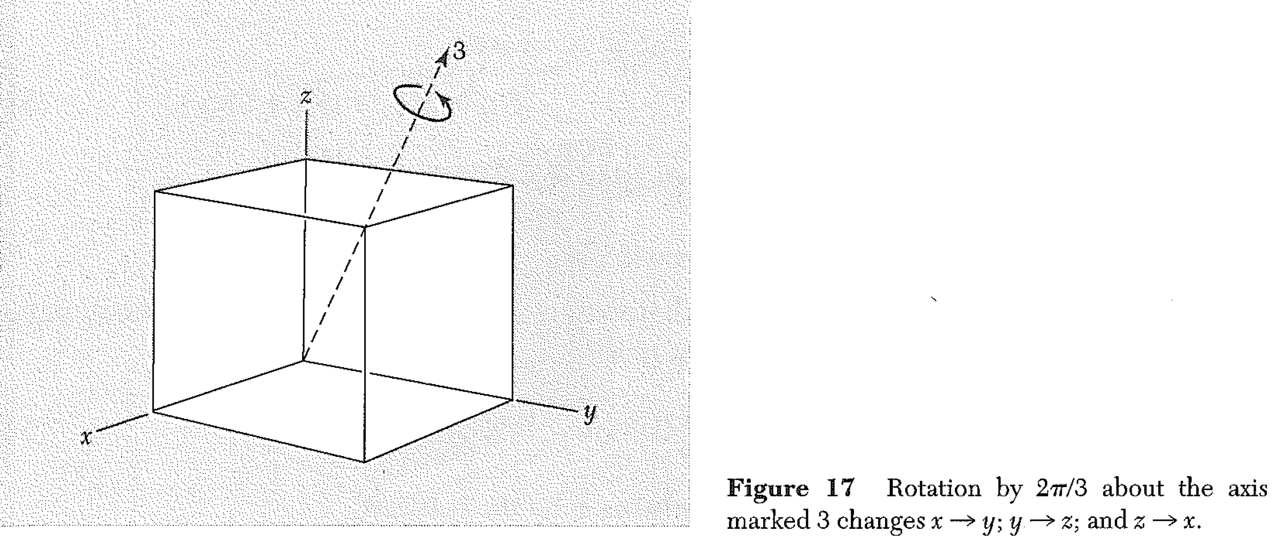
Stress – Cubic Crystal

Slide 26
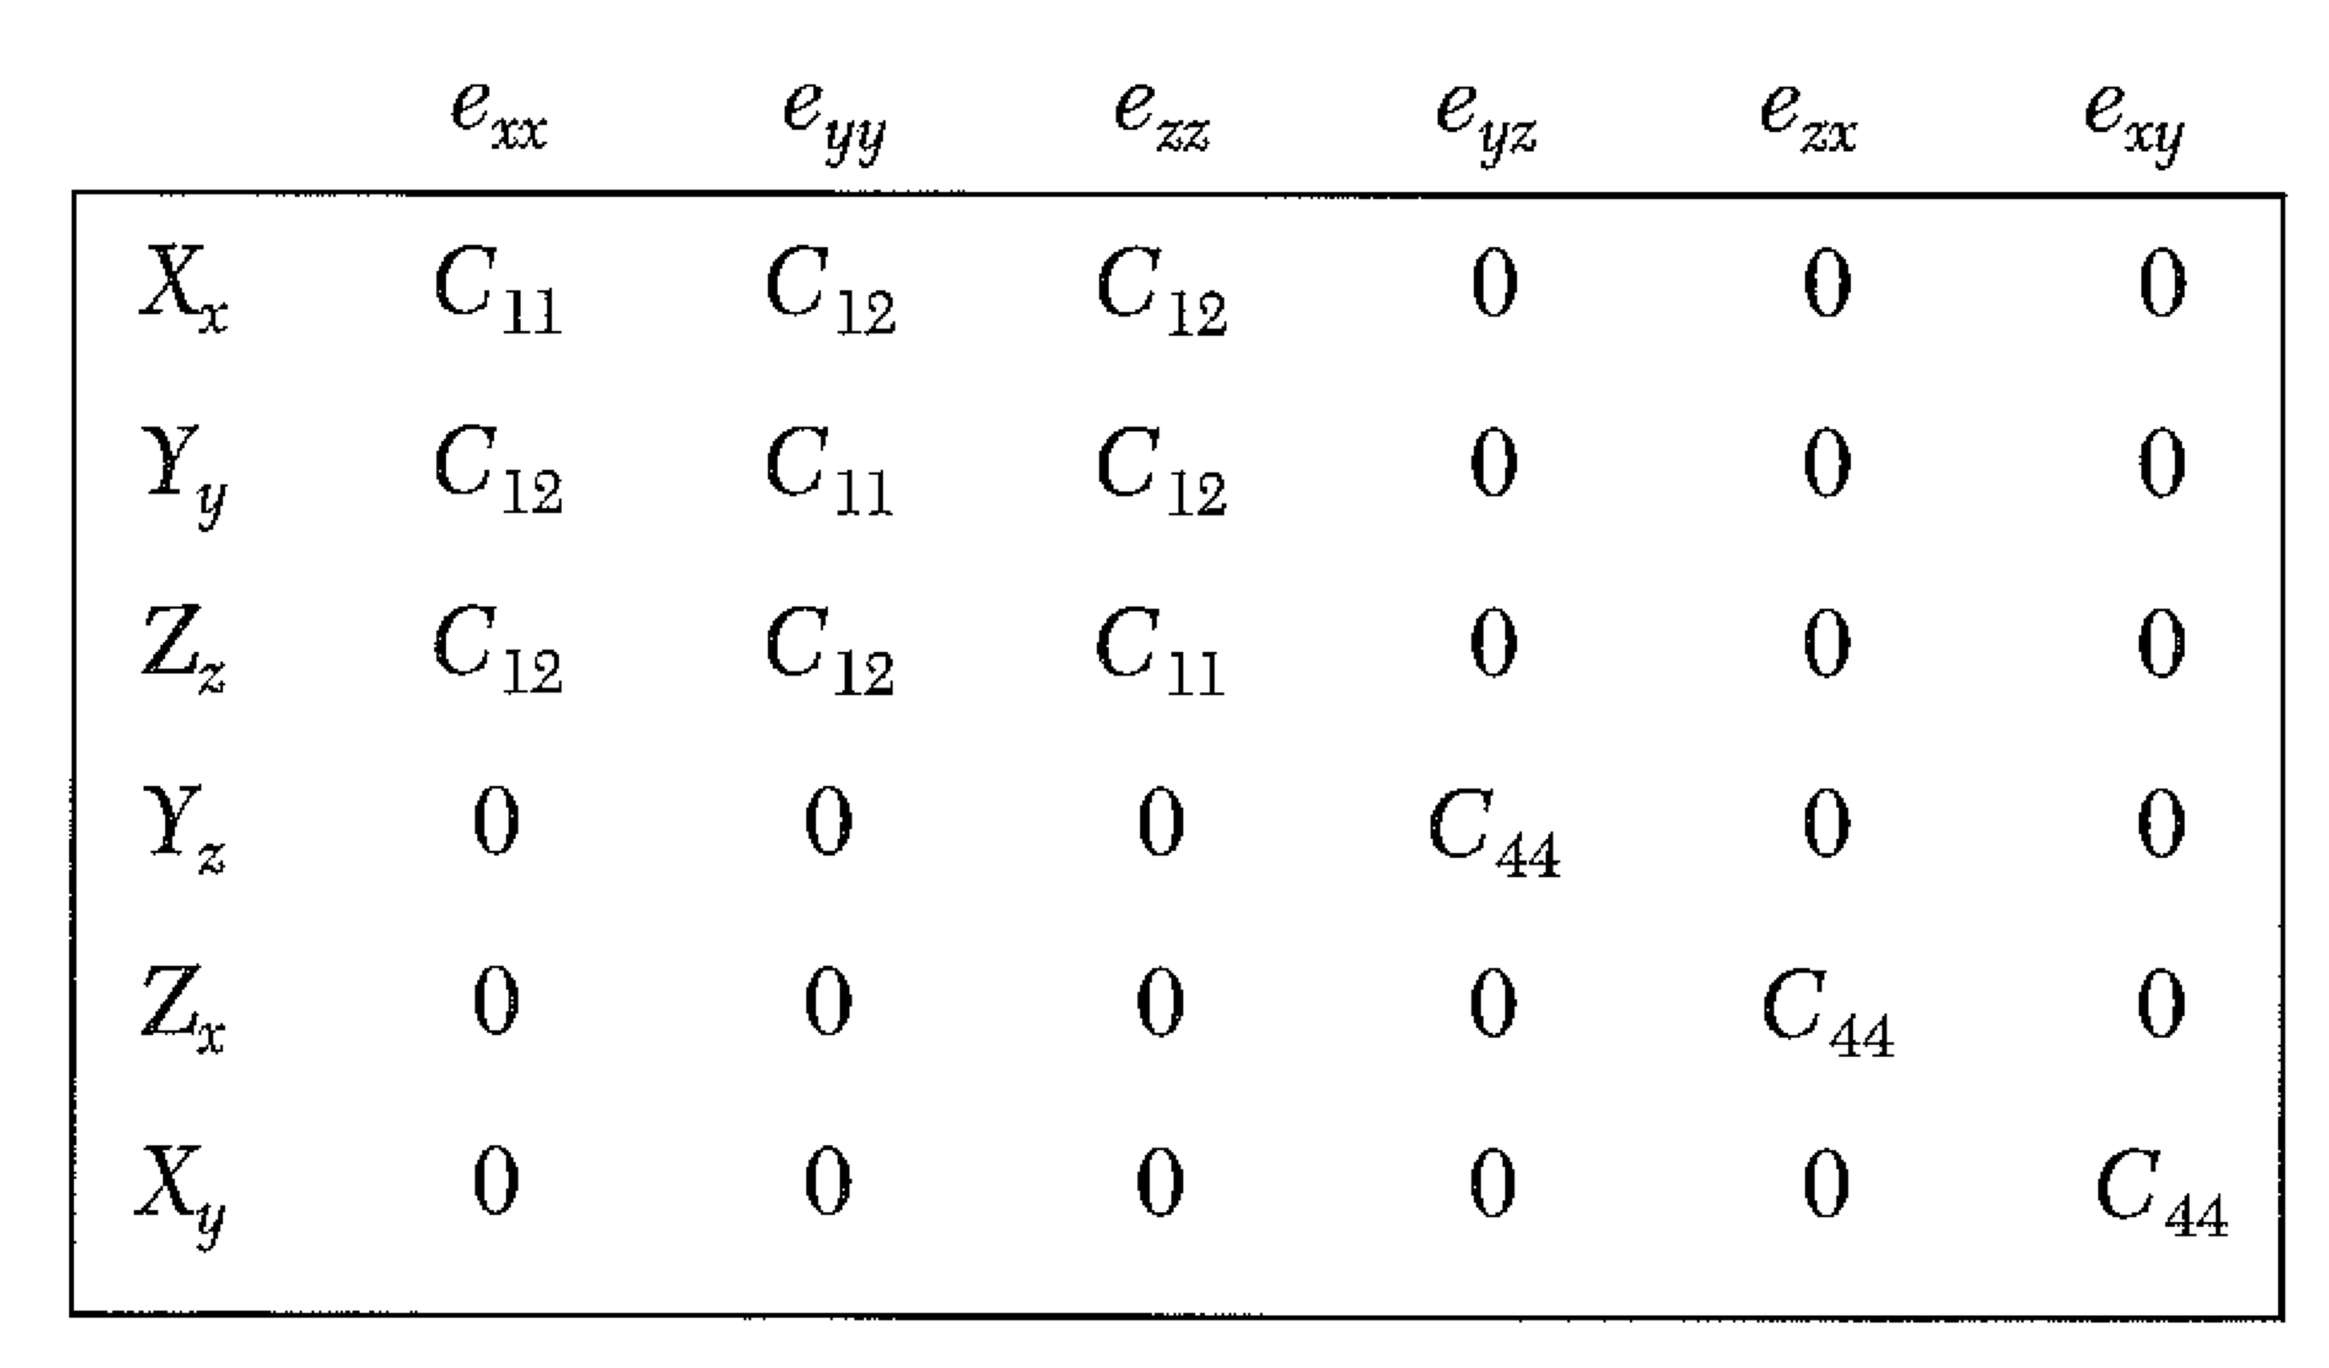
Stress – Cubic Crystal

Slide 27
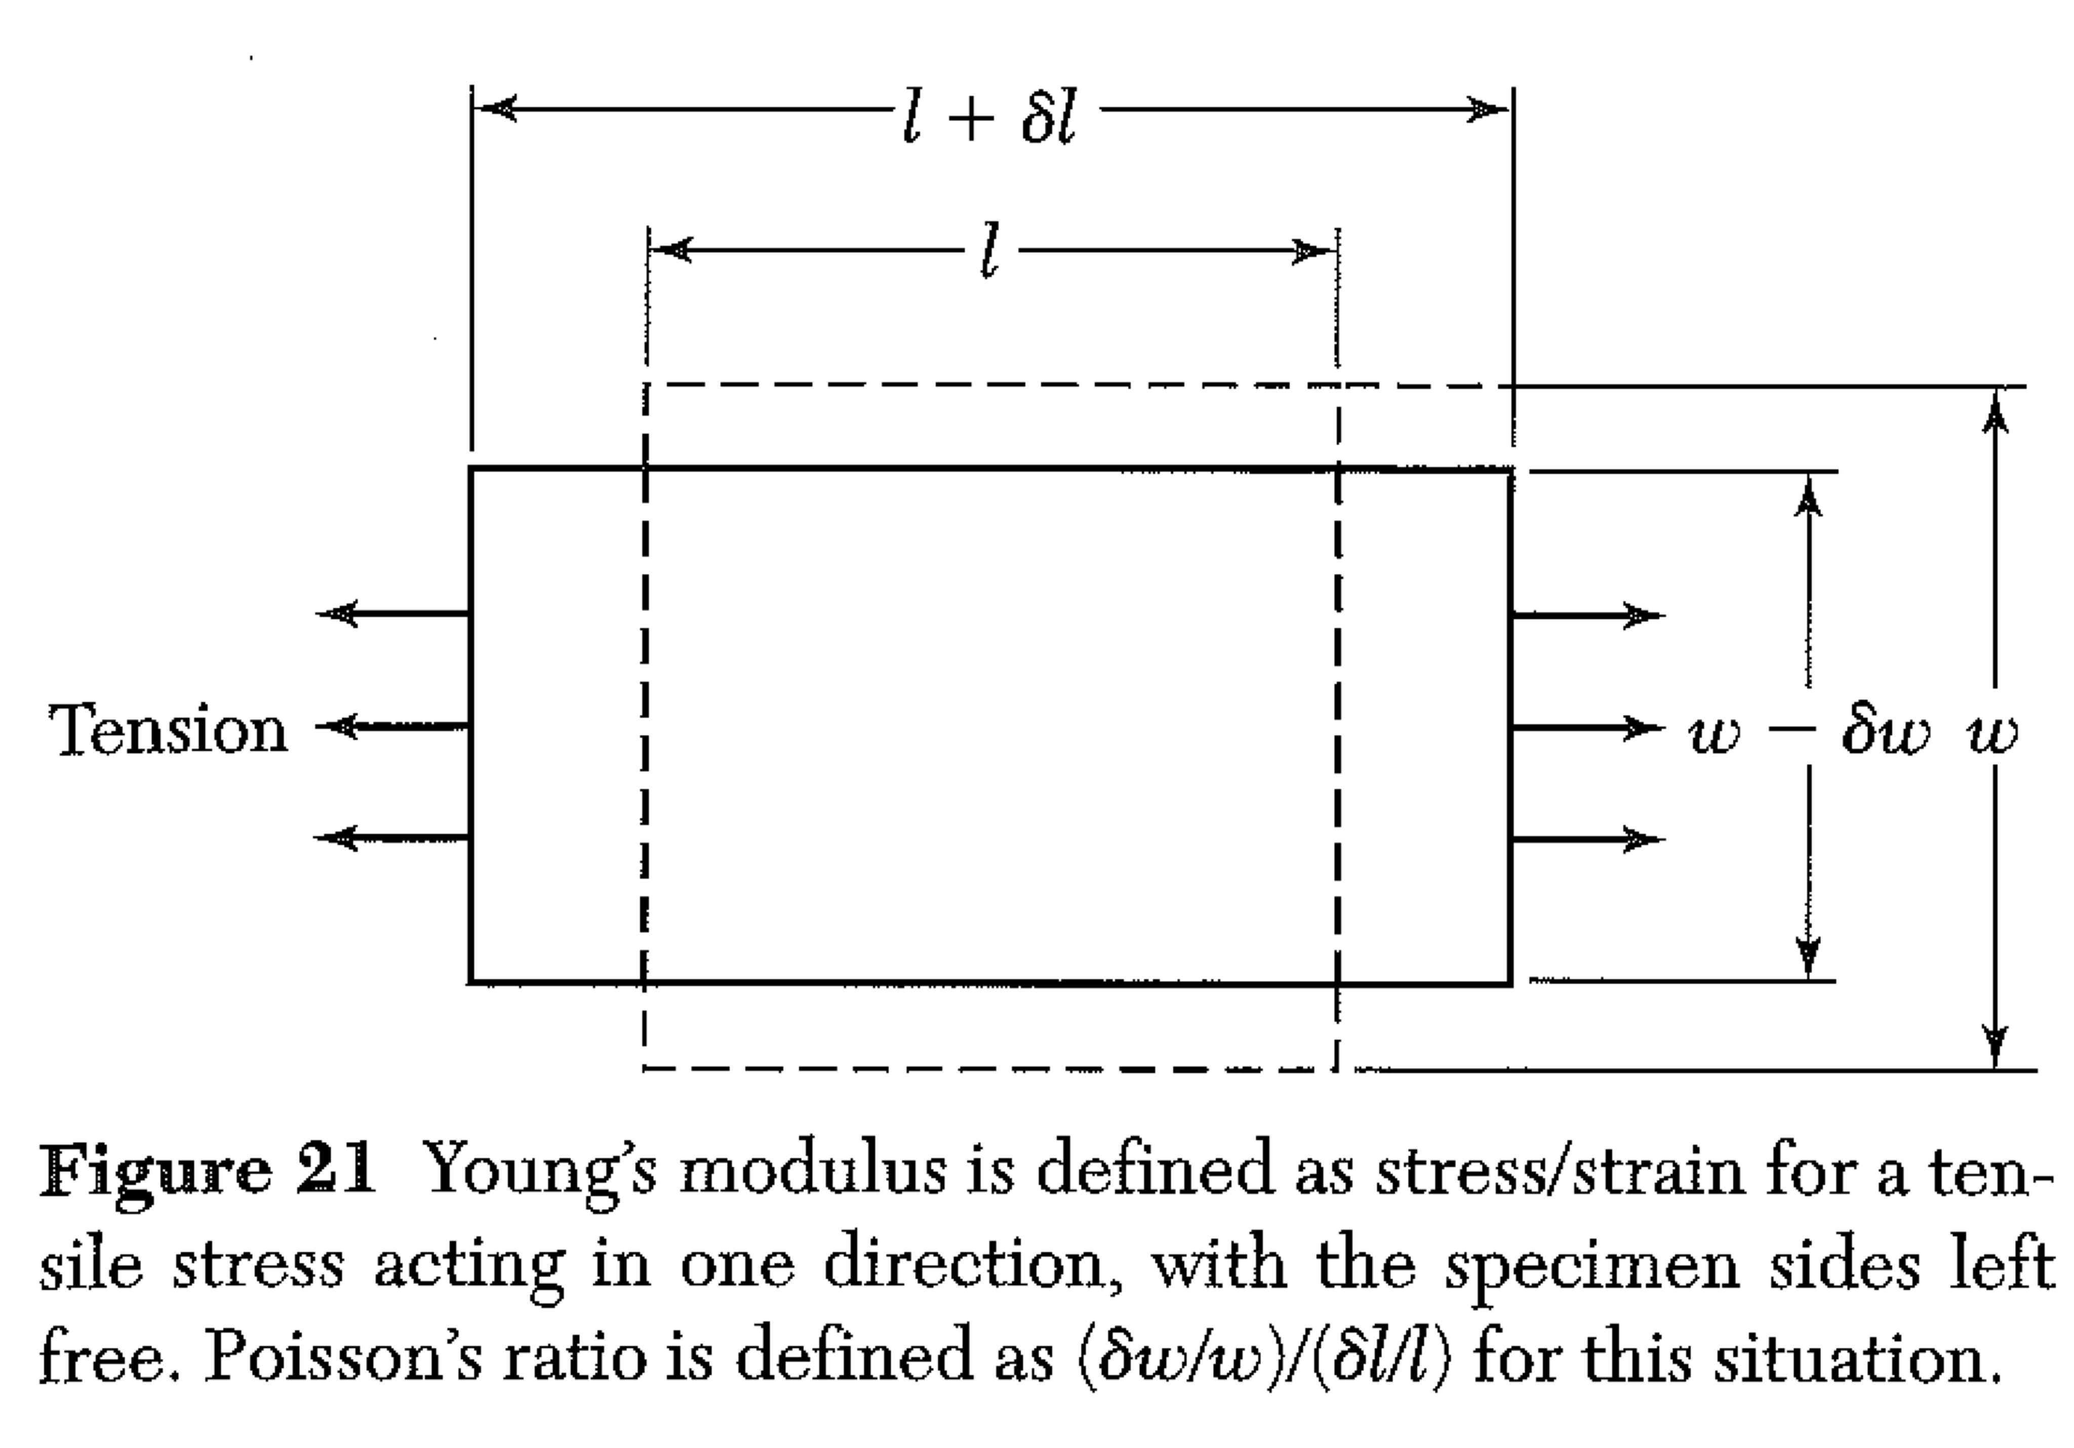
Stress – Cubic Crystal
Grab some chalk! We want Young’s modulus Y = X_{x} / e_{xx} in terms of C’s.
Y_{y} and the others are all 0, but e_{yy} is not!
It will help to be able to invert the matrix C (to get the matrix S.)
C₄₄ = 1/S₄₄ C₁₁-C₁₂=(S₁₁-S₁₂)⁻¹ C₁₁+2C₁₂ = (S₁₁ + 2S₁₂)⁻¹
Some guidance: write e_{xx} = S₁₁X_{x} (why is this okay, but X_{x}=C₁₁e_{xx} is not?)

Slide 28
Stress – Cubic Crystal
Grab some chalk! Find Poission’s ratio: ( δw/w)/(δl/l)
Y_{y} and the others are all 0, but e_{yy} is not!
It will help to be able to invert the matrix C (to get the matrix S.)
C₄₄ = 1/S₄₄ C₁₁-C₁₂=(S₁₁-S₁₂)⁻¹ C₁₁+2C₁₂ = (S₁₁ + 2S₁₂)⁻¹
How does δw/w relate to e_{yy}? Can you find e_{yy} in terms of C’s?

Slide 29
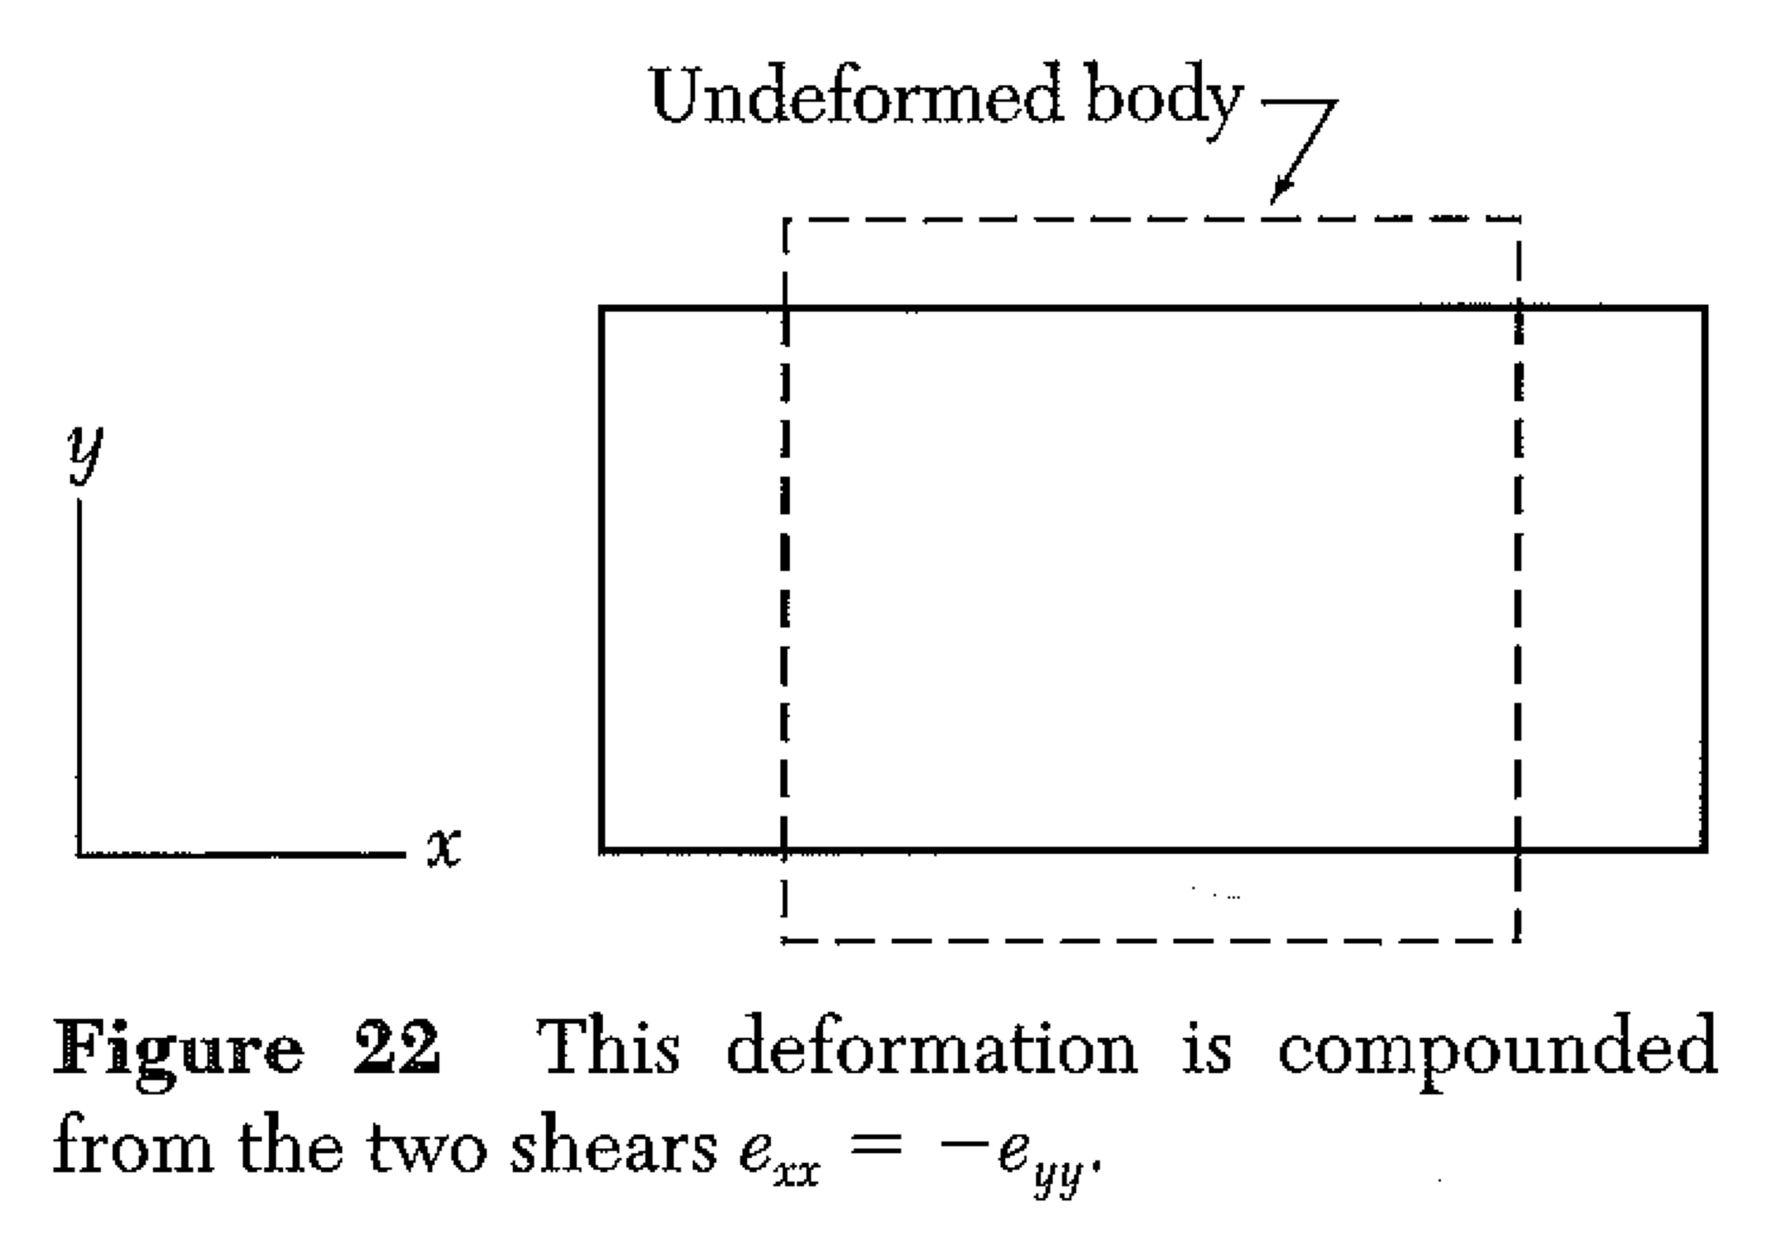
Stress – Cubic Crystal
Grab some chalk! We speak of shear as an action that does not change volume, but distorts a square into a diamond shape.
Note that this is the same kind of deformation as moving the top surface of a cube to the right (and down slightly, to conserve volume) while holding the bottom fixed.

