Slide 1
Energy Gaps Insulators & Superconductors
When does an energy or band gap lead to insulating behavior?
Band gap insulators, Peierls’ insulators
When does it reduce or eliminate scattering and lead to superconducting behavior?
Cooper pairs, Quantum Hall Effect
On Tuesdays, a band gap leads to insulating behavior…
But on Thursdays, it leads to superconductivity!

Slide 2
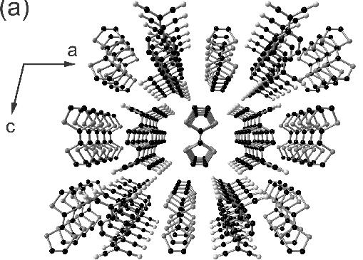
Our confusion puts us in good company!

Slide 3
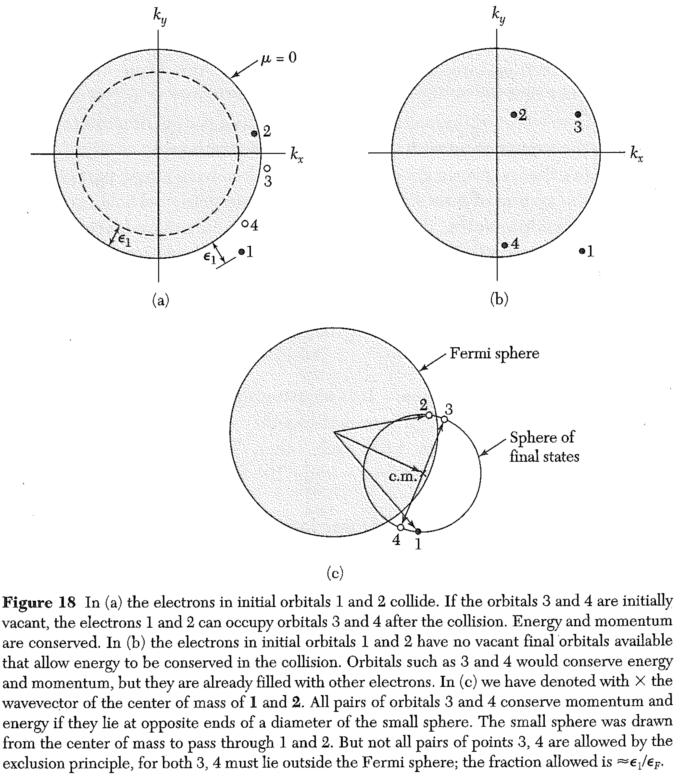
Conductivity requires either
• energetically accessible states that electrons (or pairs of electrons)
can move to that alter the overall k
Or
• a shifting of all occupied states in k-space to provide a net k (giving a current).
Anomalously low resistance (zero or near zero) will result if the electrons do not scatter off other electrons or phonons.
Electron-electron scattering is low anyway, because only electrons near the top of the Fermi sea can scatter.
It would vanish if states 3&4 were not allowed, at right.
(You may rightly conclude that electrons in insulators don’t scatter! Are they moving?)

Slide 4
Let’s consider “normal” conductivity. If we apply an electric field to the right, the electrons try to shift to the left in k-space.
There are lots of k-states just to the left of the Fermi sphere, so they can do that.
Normal conductivity has resistance, because the electrons can be scattered by phonons or other electrons.

Slide 5
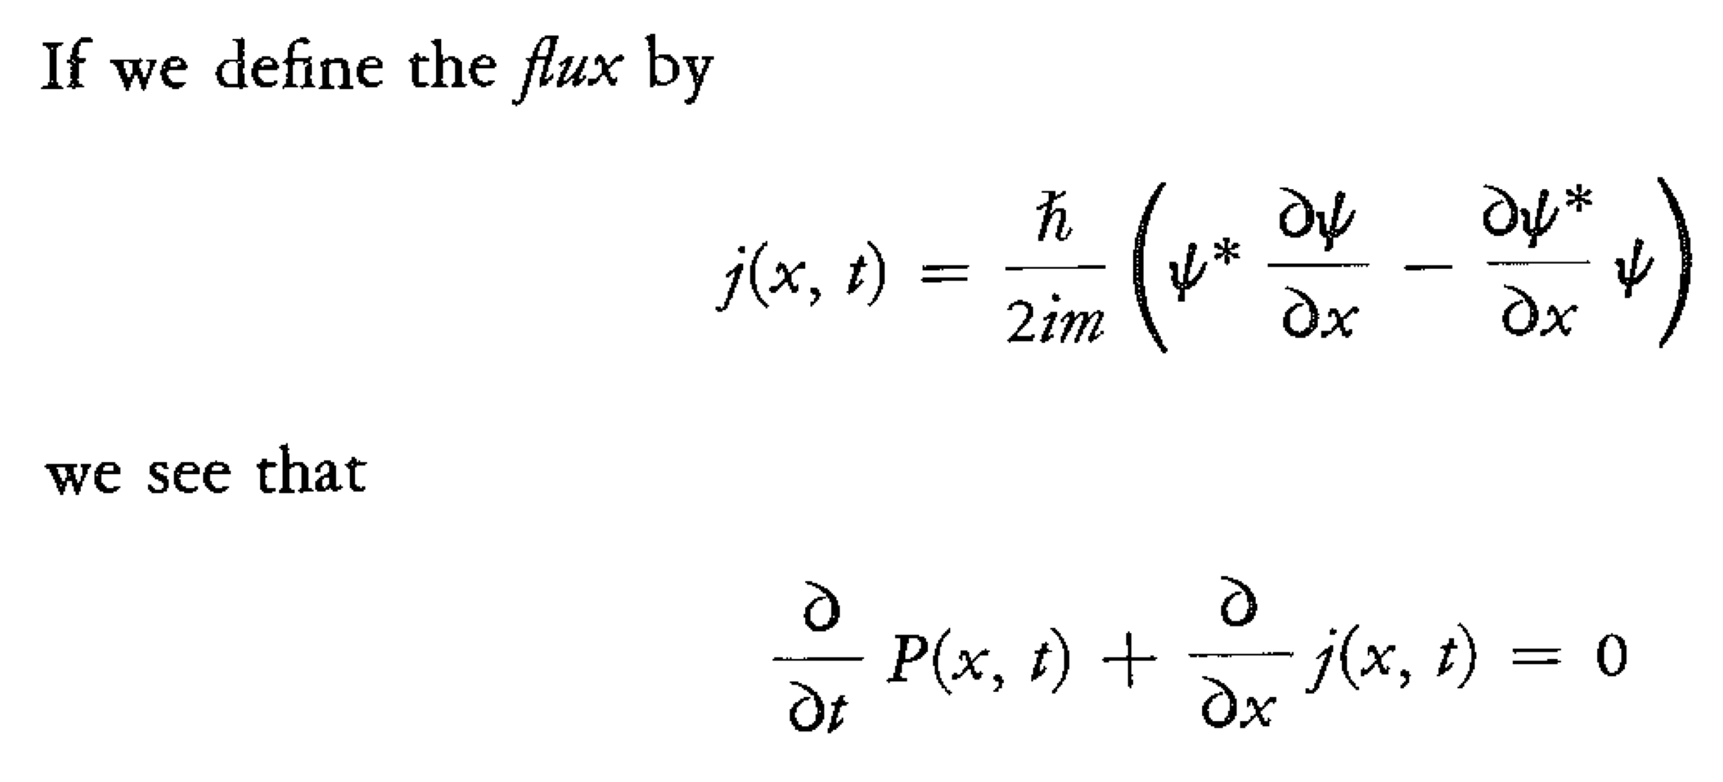
Superconductivity
Electrons k⬆ and -k⬇ form a bound Cooper pair.
In our toy model, we envisioned a jointly-occupied single superposition state
If the + cores deform slightly and move closer to the electron density, the energy is lowered.
Of course, we can also form states like this:
This phase term just causes this pair to drift with a speed ω/η.
These pairs of particles carry current.

Slide 6
Superconductivity
Electrons k⬆ and -k⬇ form a bound Cooper pair. The Cooper pair may move, which we can represent mathematically by a phase term.
The energy gap in superconductors is not at a specific value of k (or η).
It is simply the energy needed to break a Cooper pair.
Cooper pairs can certainly carry momentum and charge, without breaking.
The existence of the energy gap just means that it is very hard to scatter random phonons (or even unpaired electrons) off a Cooper pair. Scattering would need to break the pair.
So: the energy gap in superconductors is NOT a “band gap”

Slide 7
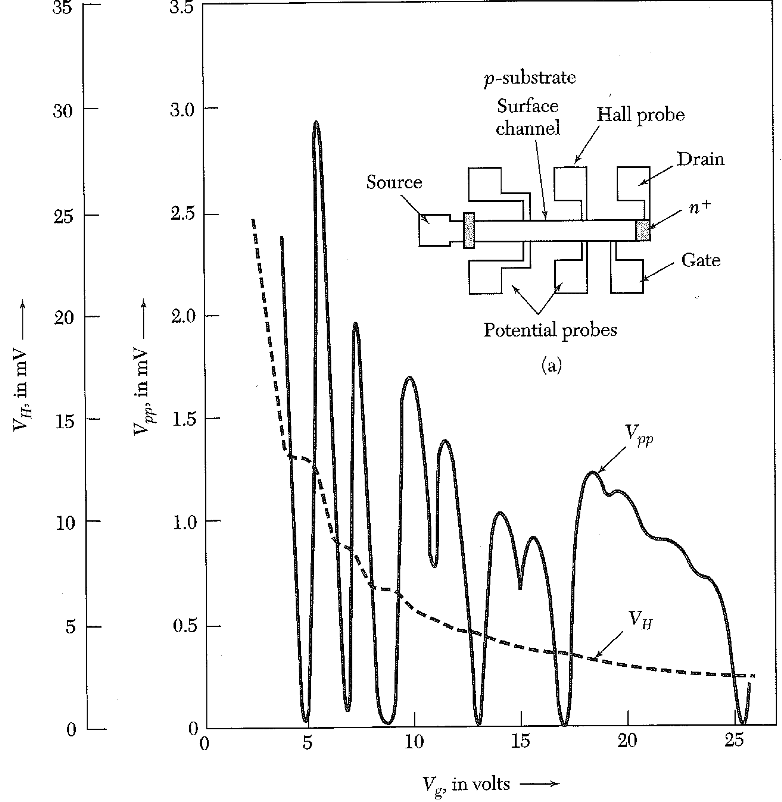
Integer Quantum Hall Effect, Revisited
We saw that, at low T and high B, the effective resistance of a 2D conductor gets darn close to zero, at certain special values of the electron concentration.

Slide 8
Integer Quantum Hall Effect, Revisited
We know that, in a B field, the electron orbital eigenstates are quantized to enclose a flux quantum. These states lie on circles in k-space. They have a large degeneracy… and in a large field, the energy gap is very large.
Areas of orbits in k-space are related to area in real space
The number of states on each circle is given by the number of dots… but the location of the dots is (essentially) meaningless.

Slide 9
Integer Quantum Hall Effect, Revisited
Classically, in a frame of reference moving at speed E_{y}/B_{z} (SI units), an electron will feel a force
The last term exactly cancels the electric force… in this frame, there is a magnetic field, but no effect from the electric field.
Thus, in this frame, the electron orbits are the Landau levels... but back in the lab frame, they will have a drift velocity.
We have a situation that is nearly analogous to superconductivity.
Our quantum states allow for current, but the energy gap strongly suppresses scattering.

Slide 10
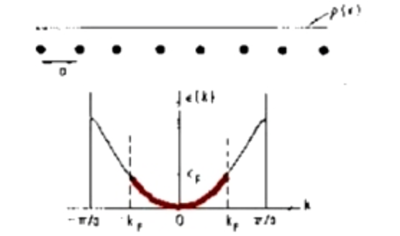
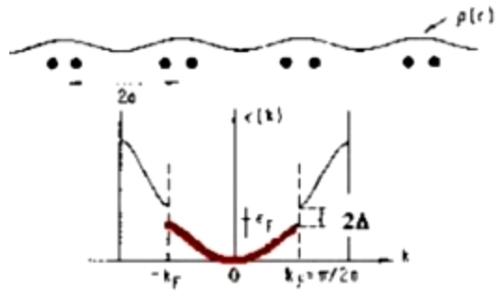
Peierls’ Insulators
Rudolph Peierls showed that a 1D crystal is unstable to a lattice deformation at 2k_{f}.
The argument is frighteningly similar to the Cooper pair formation. It is easiest to see when k_{f} = G/4, or when the 1st BZ is half filled. Take a cosine as the electron wave. It repeats every 4 lattice sites… but the electron density concentrates on every 2nd lattice site.
(Do you see where the factor of 2 comes in Peierls’ argument?)
If the atomic cores shift, we establish a “superlattice” of twice the original period.
This superlattice has two electrons per unit cell, and thus a filled 1st Brillouin zone.
It will have a band gap, and be an insulator (or semiconductor.)

Slide 11
Peierls’ Insulators
Key differences between Peierls’ insulators and Cooper pairs.
• Dimensionality – Peierls’ is 1D, though 3D conductivity is affected.
• With Peierls, the phonon k is restricted to 2k_{f} (expt observations all have k=G/2).
• The Cooper pair is a boson. There are no bosons in the Peierls instability.
• Measureable, stable lattice distortion occurs with Peierls.
The consequence is that what is an “energy gap” in superconductors becomes a “band gap” (at a specific k) in Peierls insulators.

Slide 12
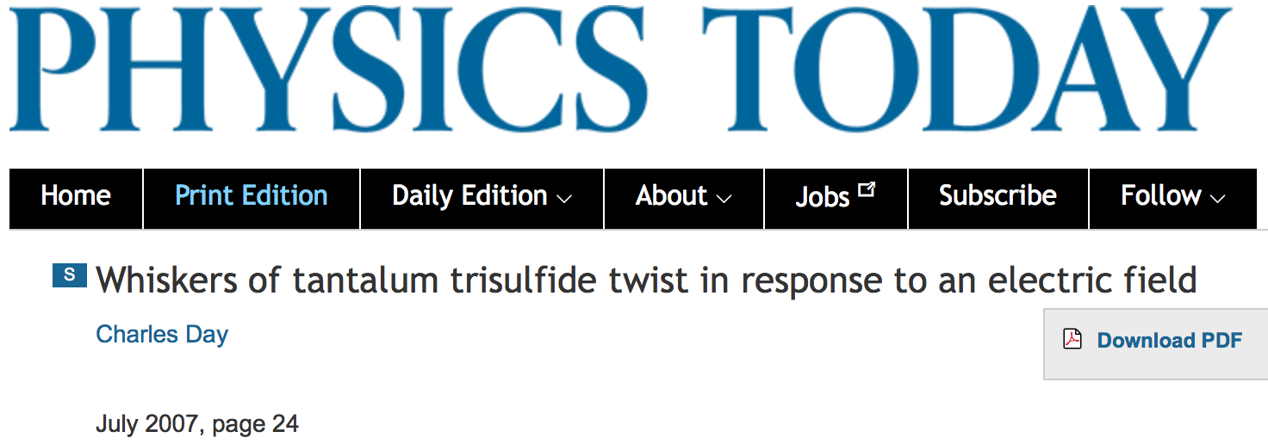

Slide 13
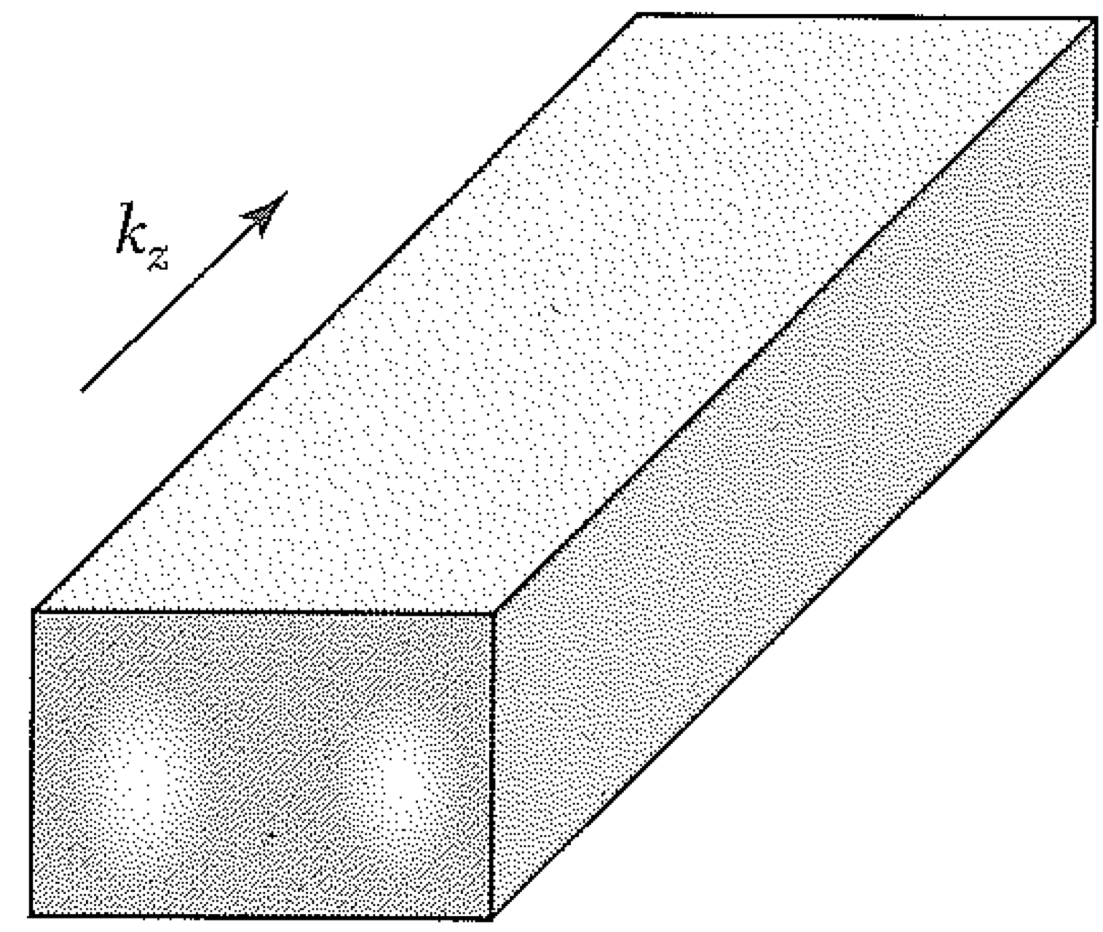
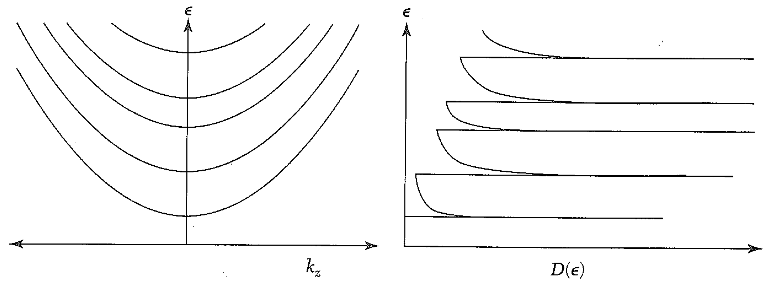
Conductance Quantization in 1D
We will apply some key ideas discussed over the past couple months to show something remarkable.
A nanoscale wire:
Energies and eigenstates:
The dispersion curves and density of states:
Van Hove singularity

Slide 14
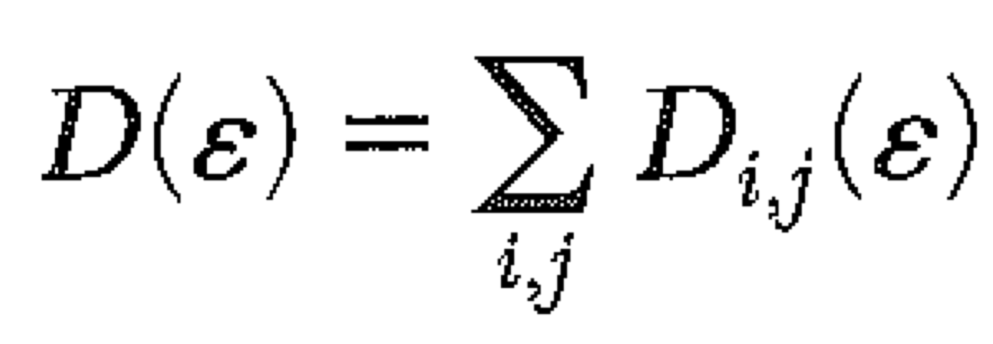
The dispersion curves and density of states:
(2 spin states, 2 signs of k, ν = classical electron speed.)
Now we consider a 1D wire with a voltage drop.
The difference in electron energy gives a different Fermi level (or chemical potential).

Slide 15
Now we consider a 1D wire with a voltage drop.
The difference in electron energy gives a different Fermi level (or chemical potential).
N = “excess states”
Only half are rightward moving
Δn is the density of charges carrying the current, x cross section area. In 1d, charges/L.
There is a quantum resistance that is independent of any scattering!
Each additional band adds quantal current / conductance.
(We can occupy more bands by adding more electrons.)

Slide 16
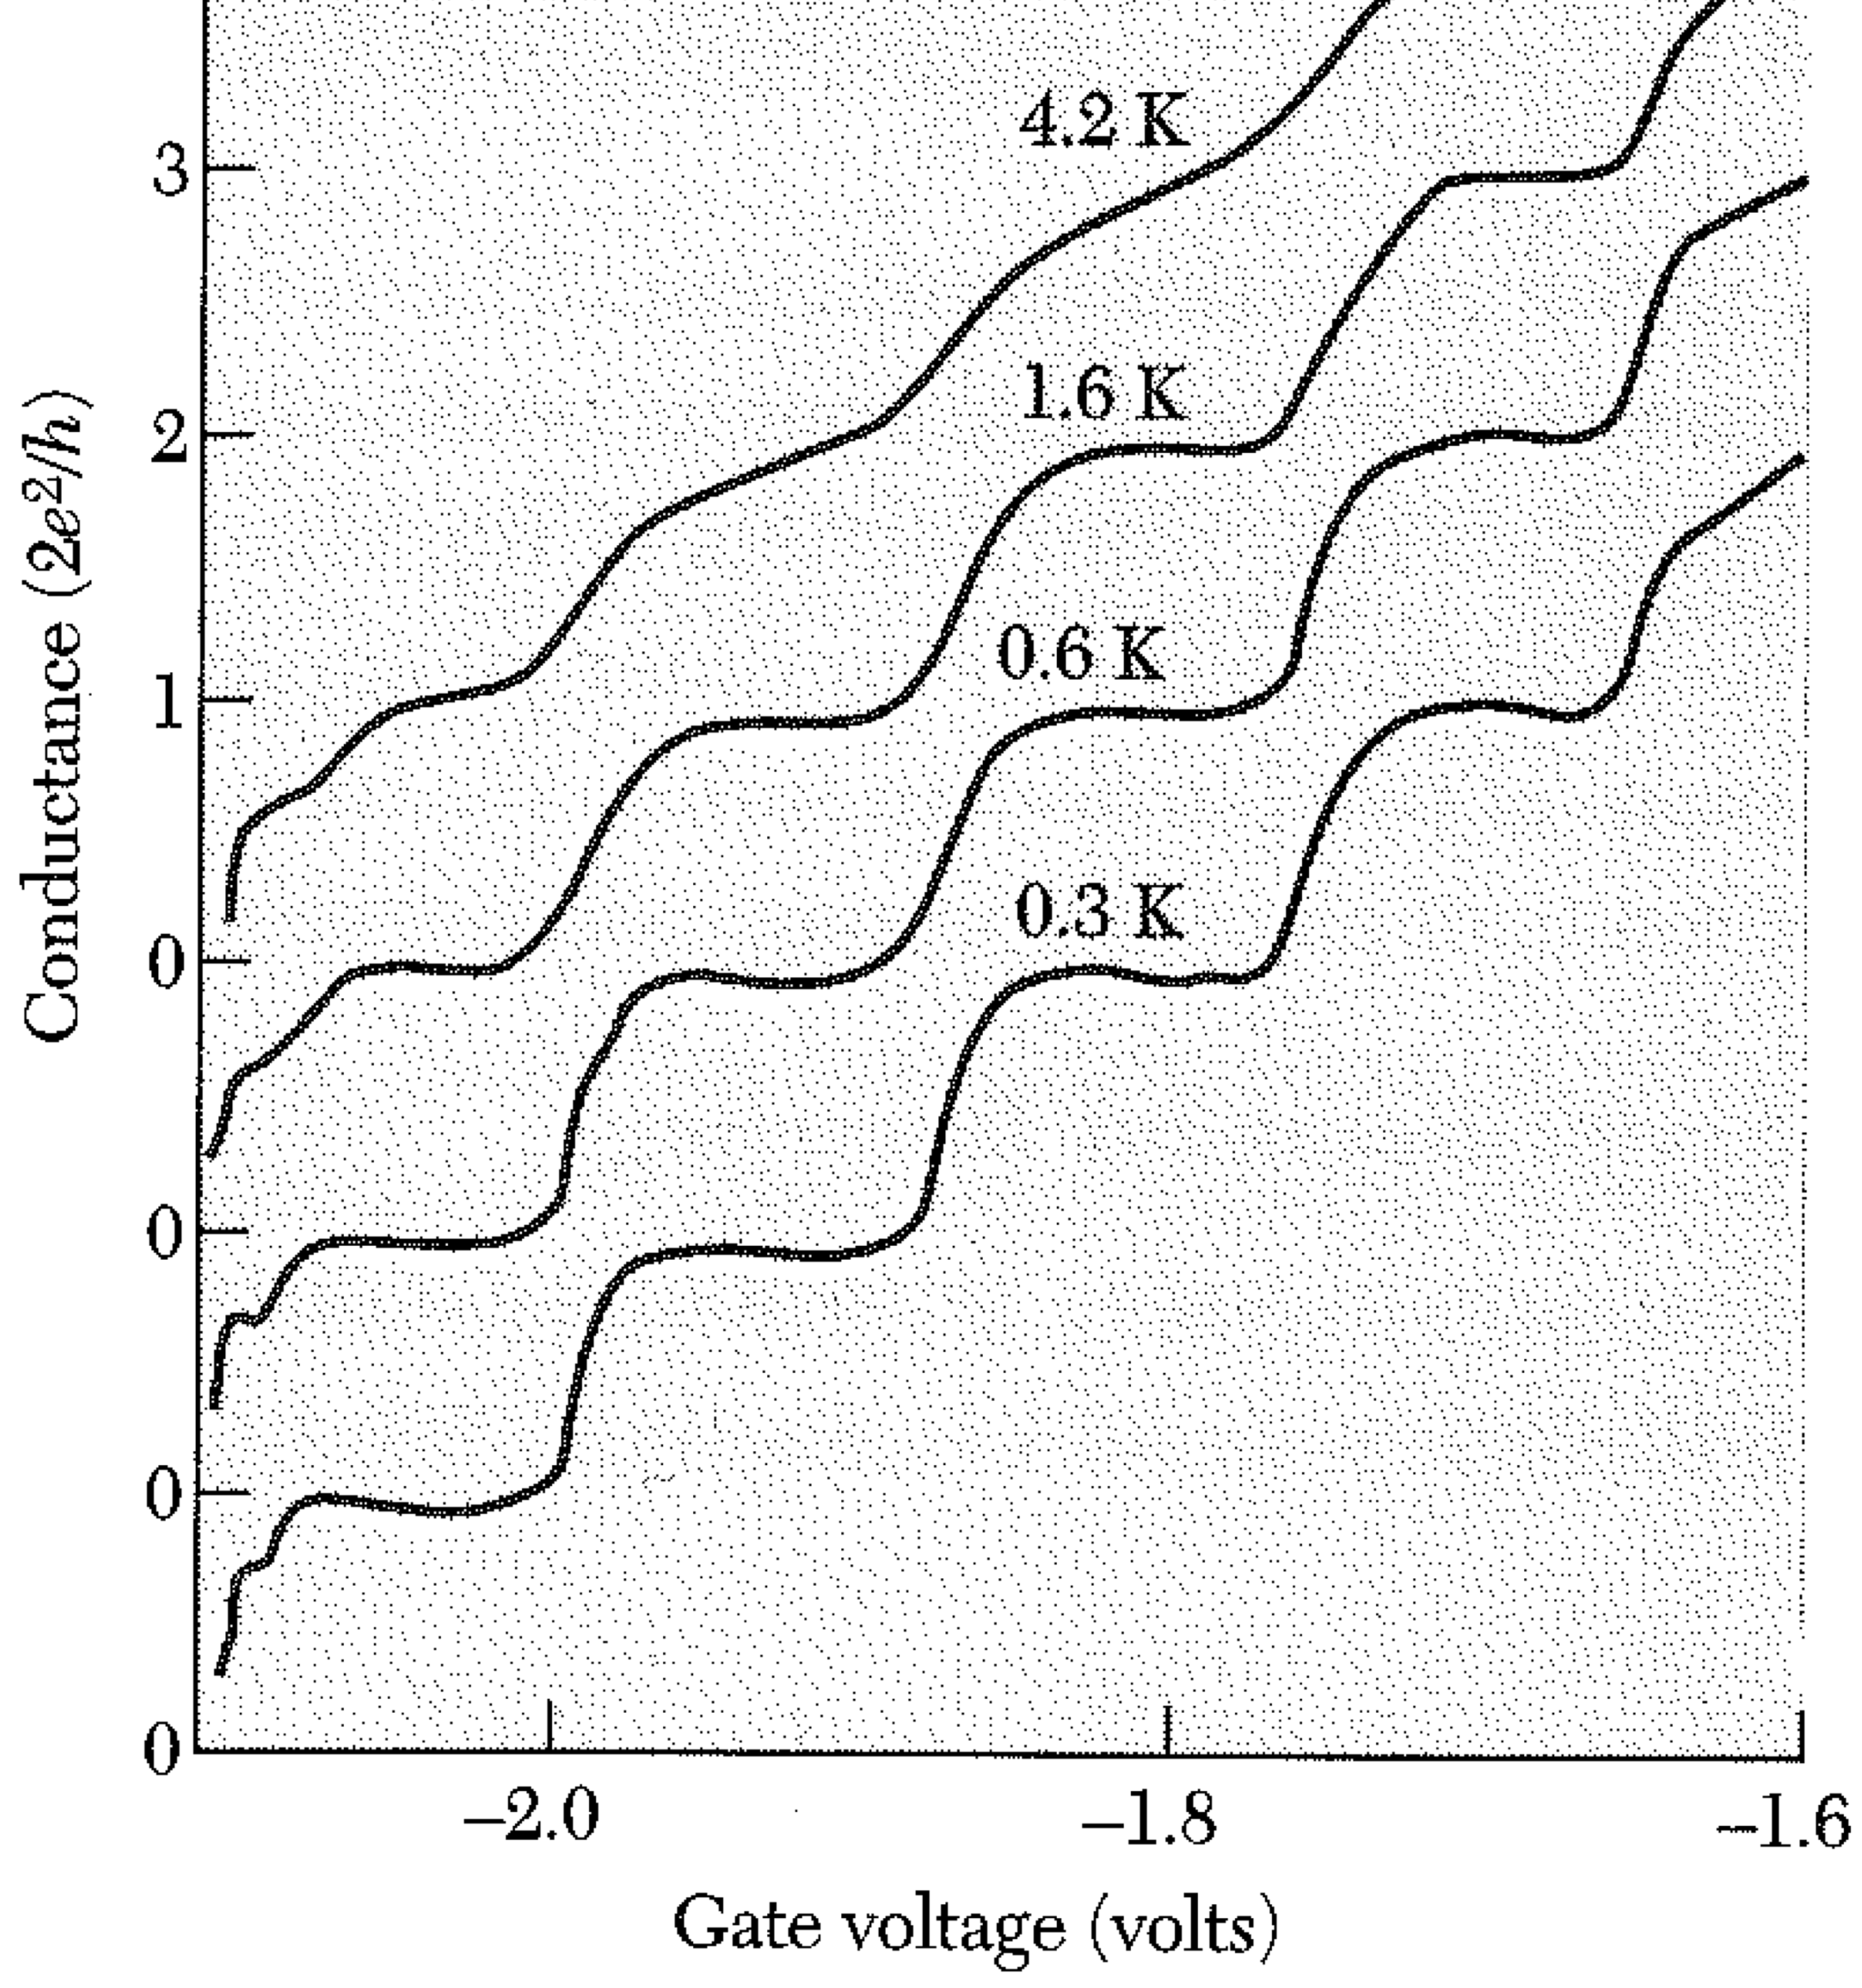
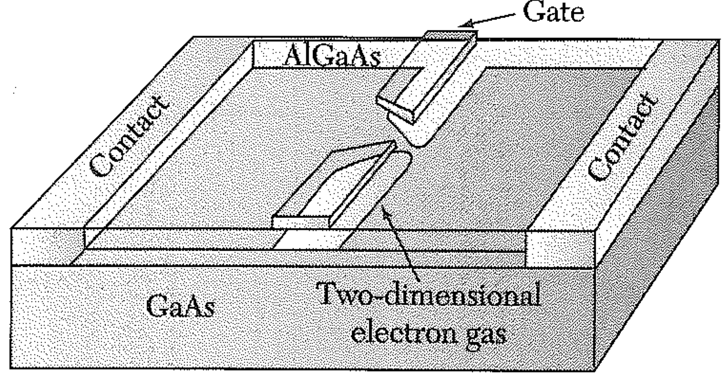
Proof of the pudding:

