Slide 1
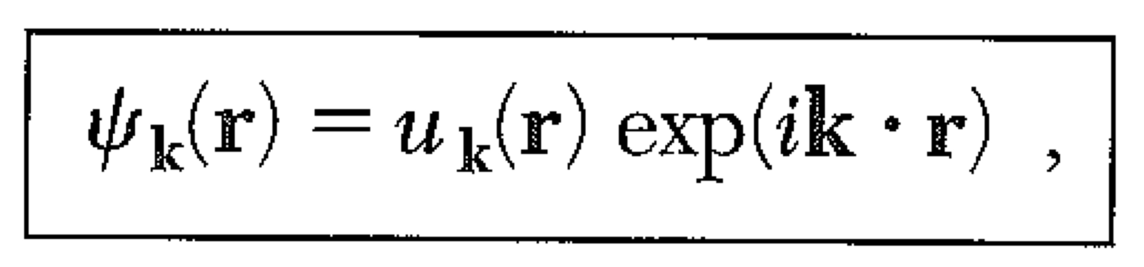
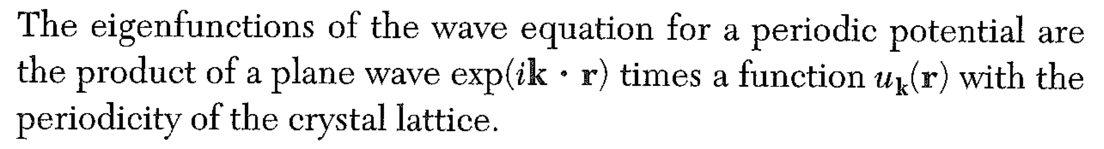
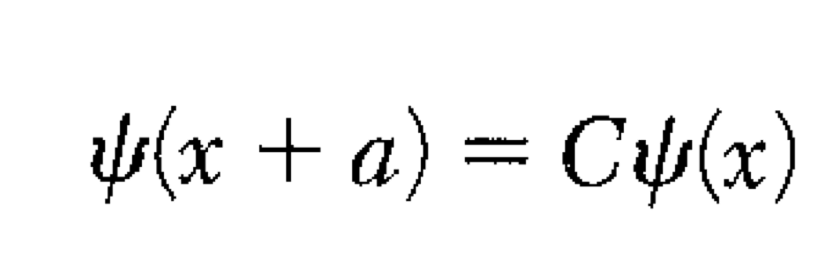
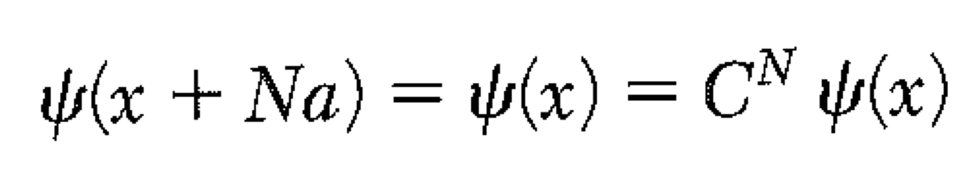
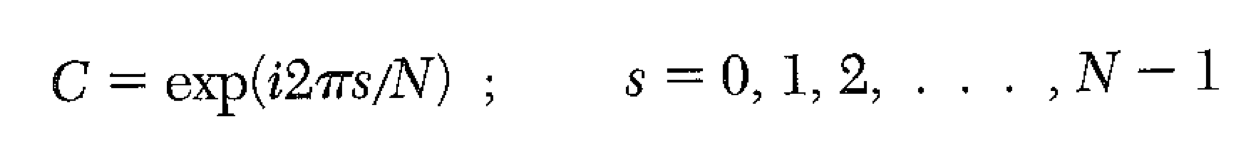
Solid State Physics Lecture 15
HW 8 Due March 29 Kittel Chapter 7: 3,4,6
The free electron standing wave and the traveling wave are not eigenstates.
To find the exact eigenstates, we will use the Bloch Theorem.
Apply periodic boundary conditions, and seek solutions.
In other words, C is an operator that translates the wave by one unit cell.
With PBC, if we apply C N times, we get back the original wave.

Slide 2
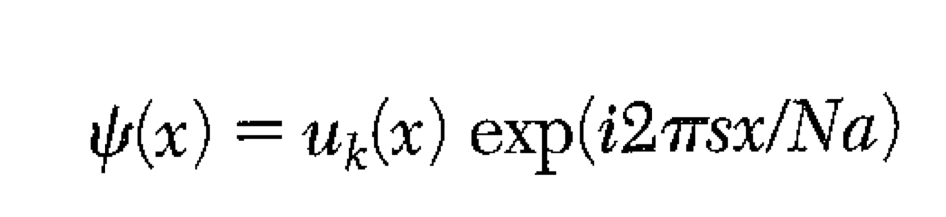
In other words, C is an operator that translates the wave by one unit cell.
With PBC, if we apply C N times, we get back the original wave.
IF:
Then
Will have the form required so that there is a meaningful translation operator.
In the limit of large N, the plane wave can have any wavelength.
This is a symmetry argument… nothing much QM.

Slide 3
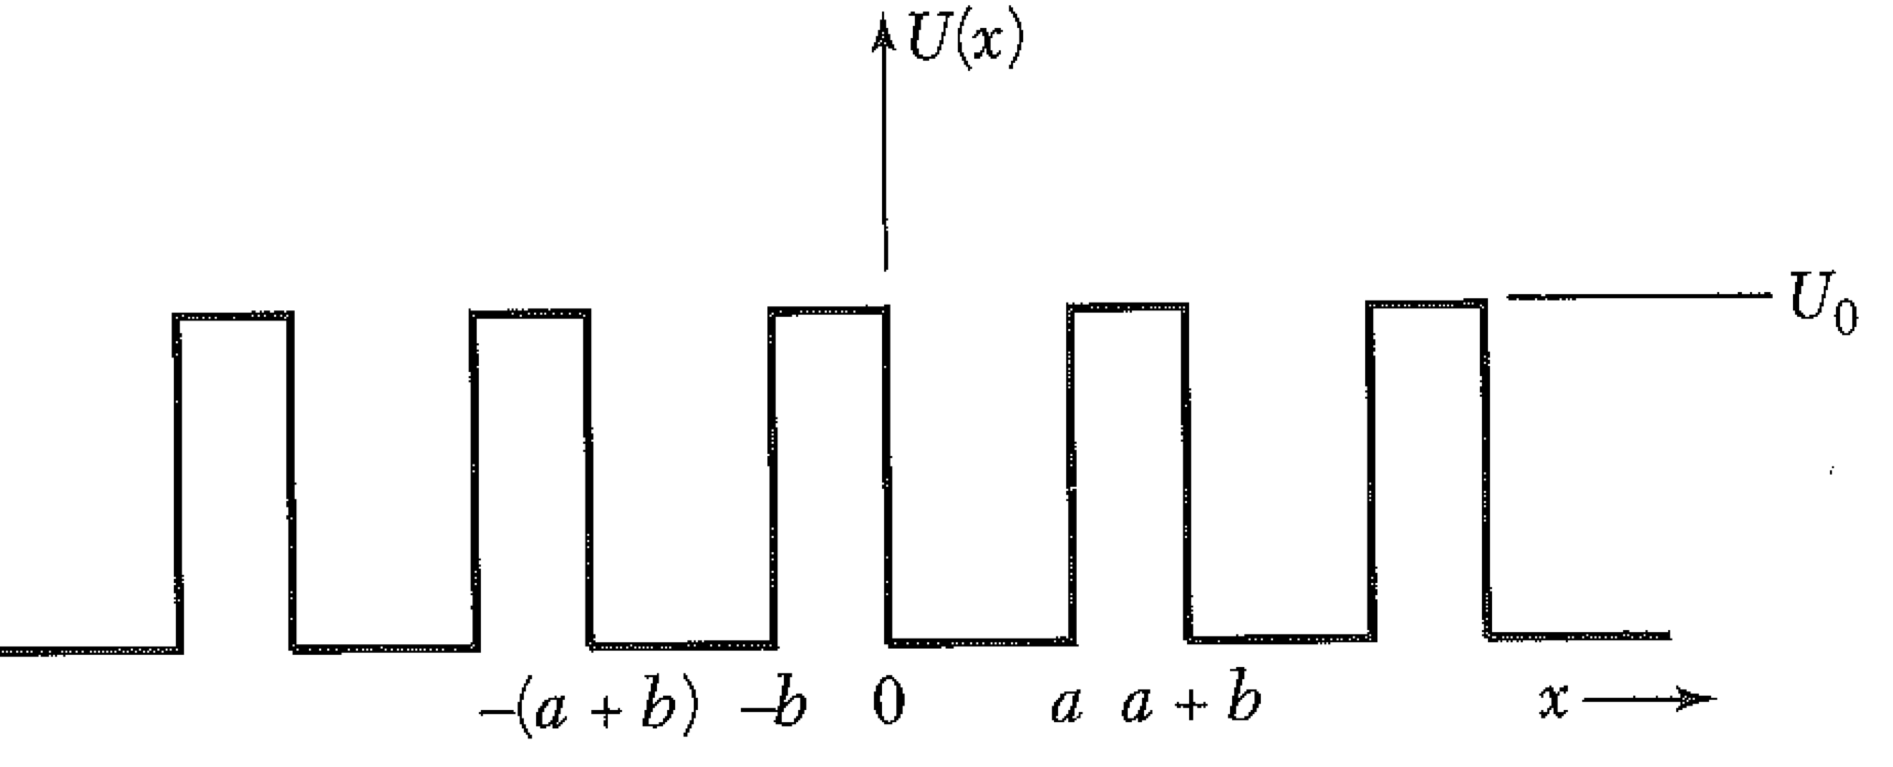
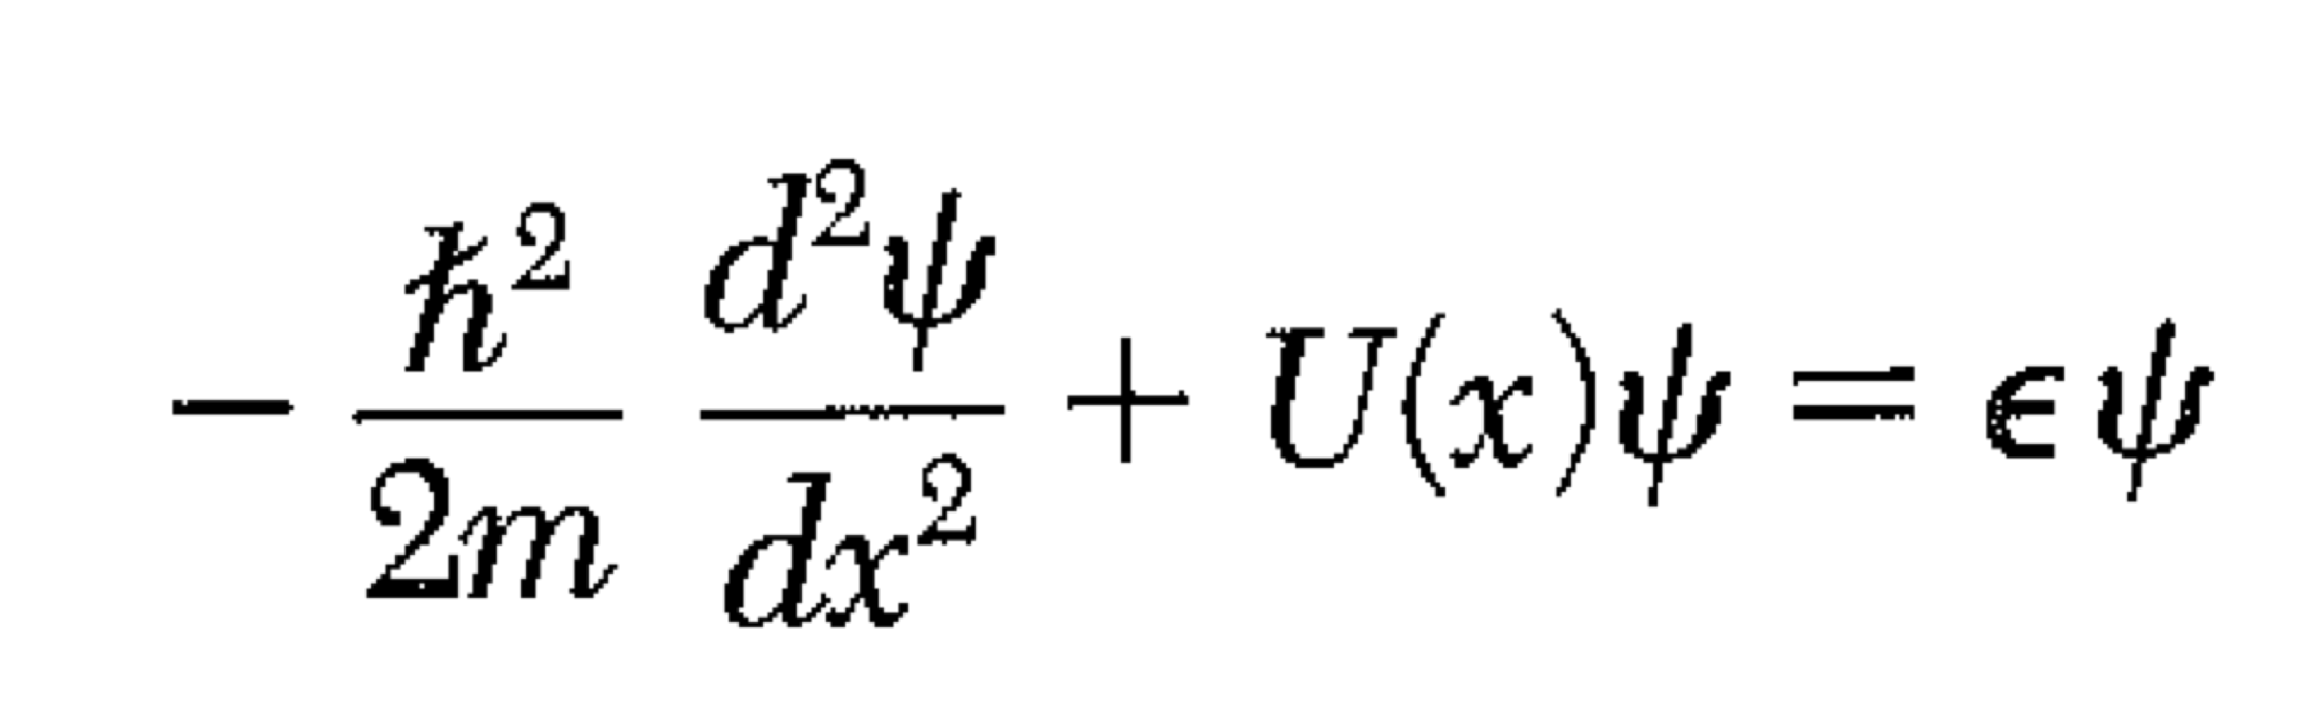
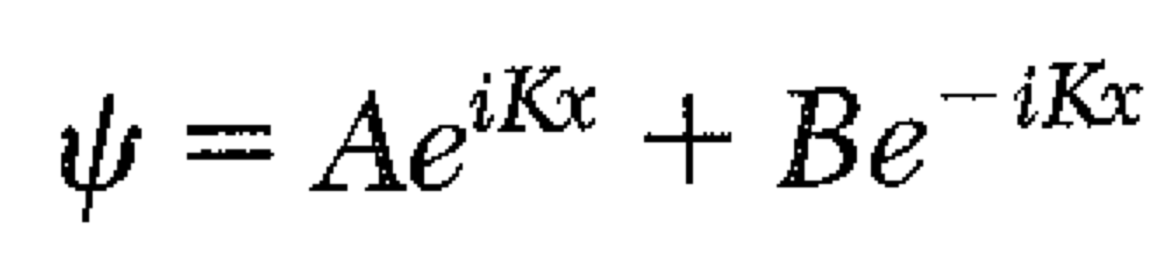
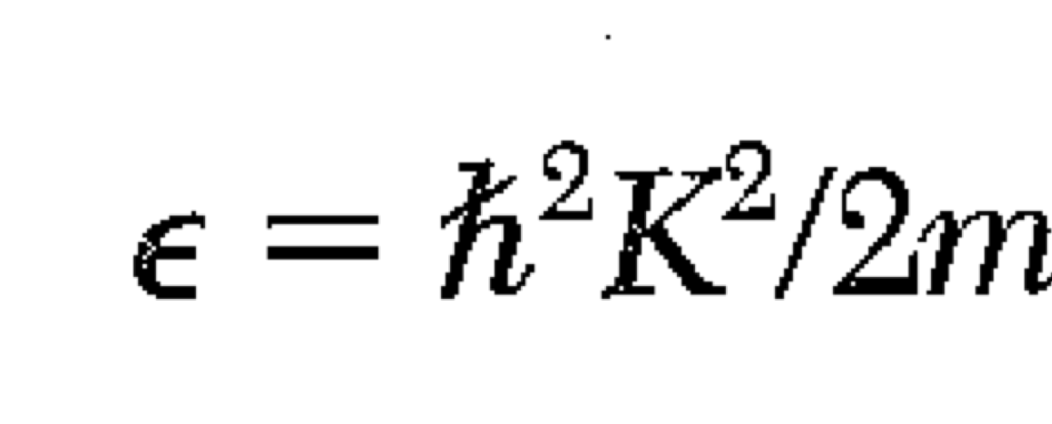
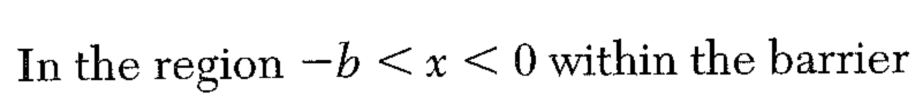
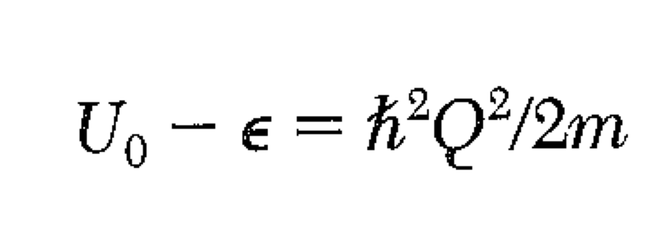
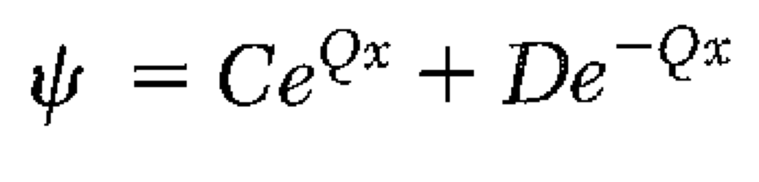
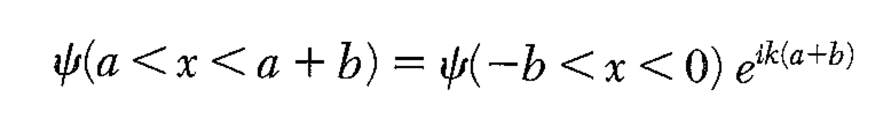
Kronig – Penney Model
Note: K ≠ k. The Bloch k relates to the change in phase of the wave from cell to cell.
Bloch
A,B,C,D chosen to make ψ and ψ’ continuous

Slide 4
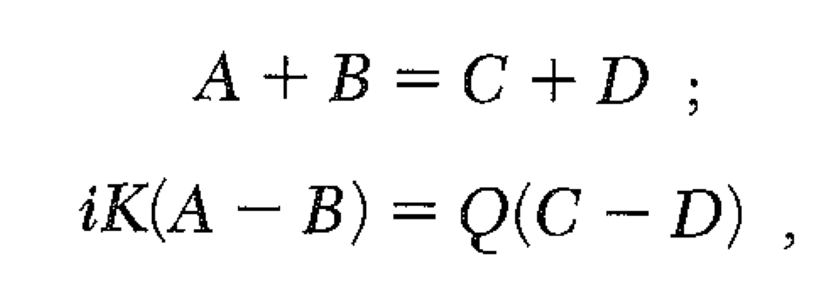
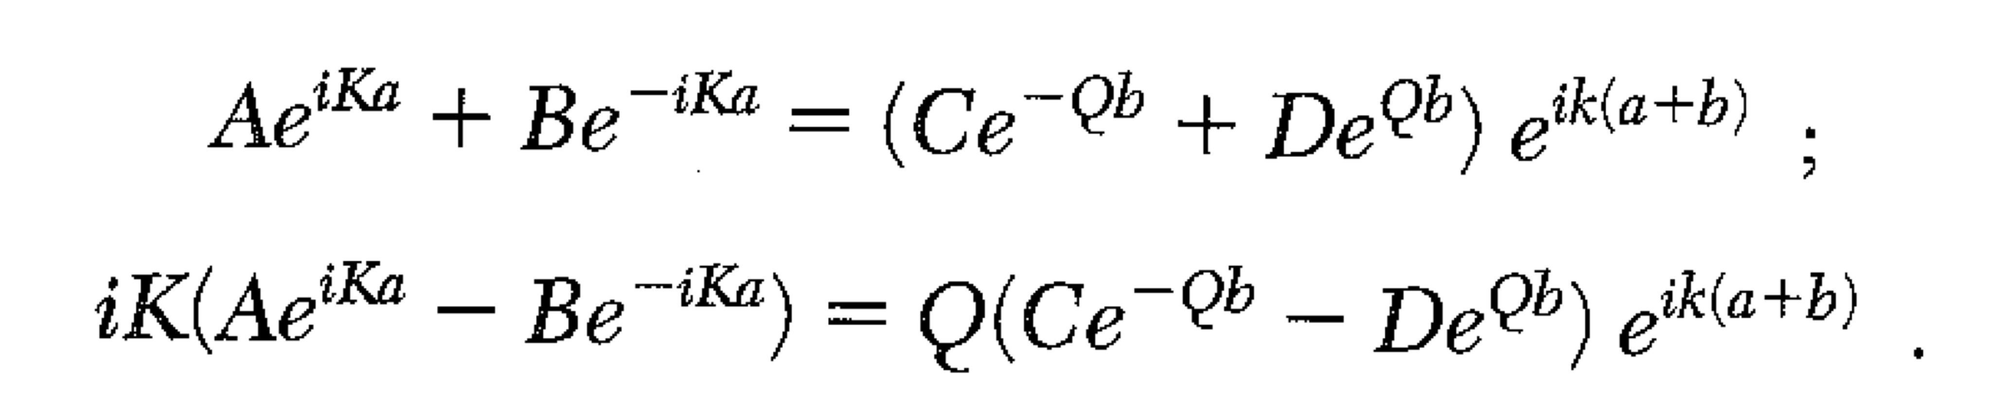
Kronig – Penney Model
A,B,C,D chosen to make ψ and ψ’ continuous
At x = 0
At x=a
(Used solution for –b<x<0, translated by a+b)
Now, the exact amplitude of the wave is indeterminate, so this system of equations must be underdetermined, i.e. they must NOT be linearly independent, i.e. the 4x4 determinant must be zero.

Slide 5
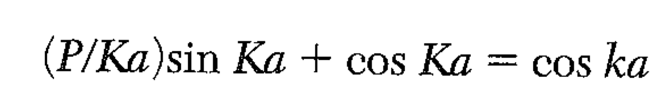
Kronig – Penney Model
What a mess! Simpler if we let U₀ -> infinity, b -> 0. (Delta function potentials)
If we keep U₀*b finite, then Q²b is finite, we can write Q²ab/2 = P (def of P).
Q²>> K (of course! It’s infinity). Also Qb ~ 1/Q << 1.
sinh x = x for small x, cosh x = 1 for small x

Slide 6
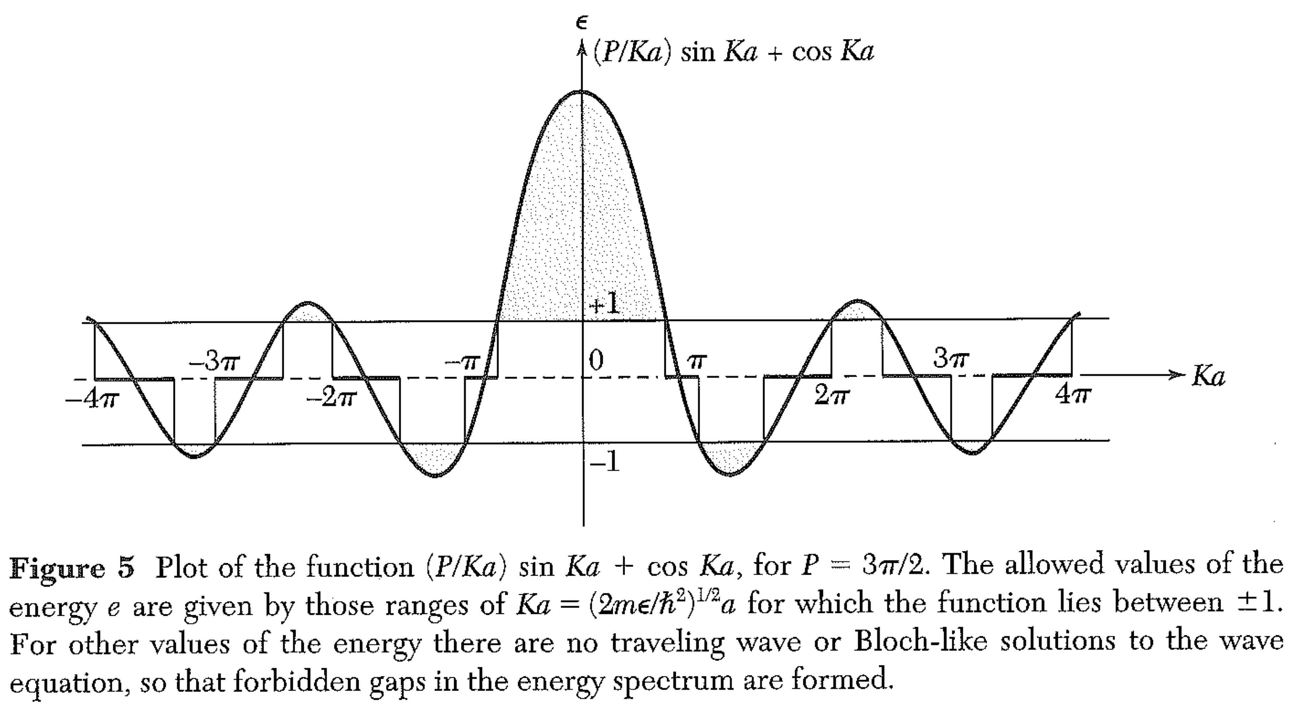
Kronig – Penney Model – Delta function potentials
Plot of the left hand side of the KP equation.
There are no solutions if the LHS is not between ± 1.
These are the band gaps.

Slide 7
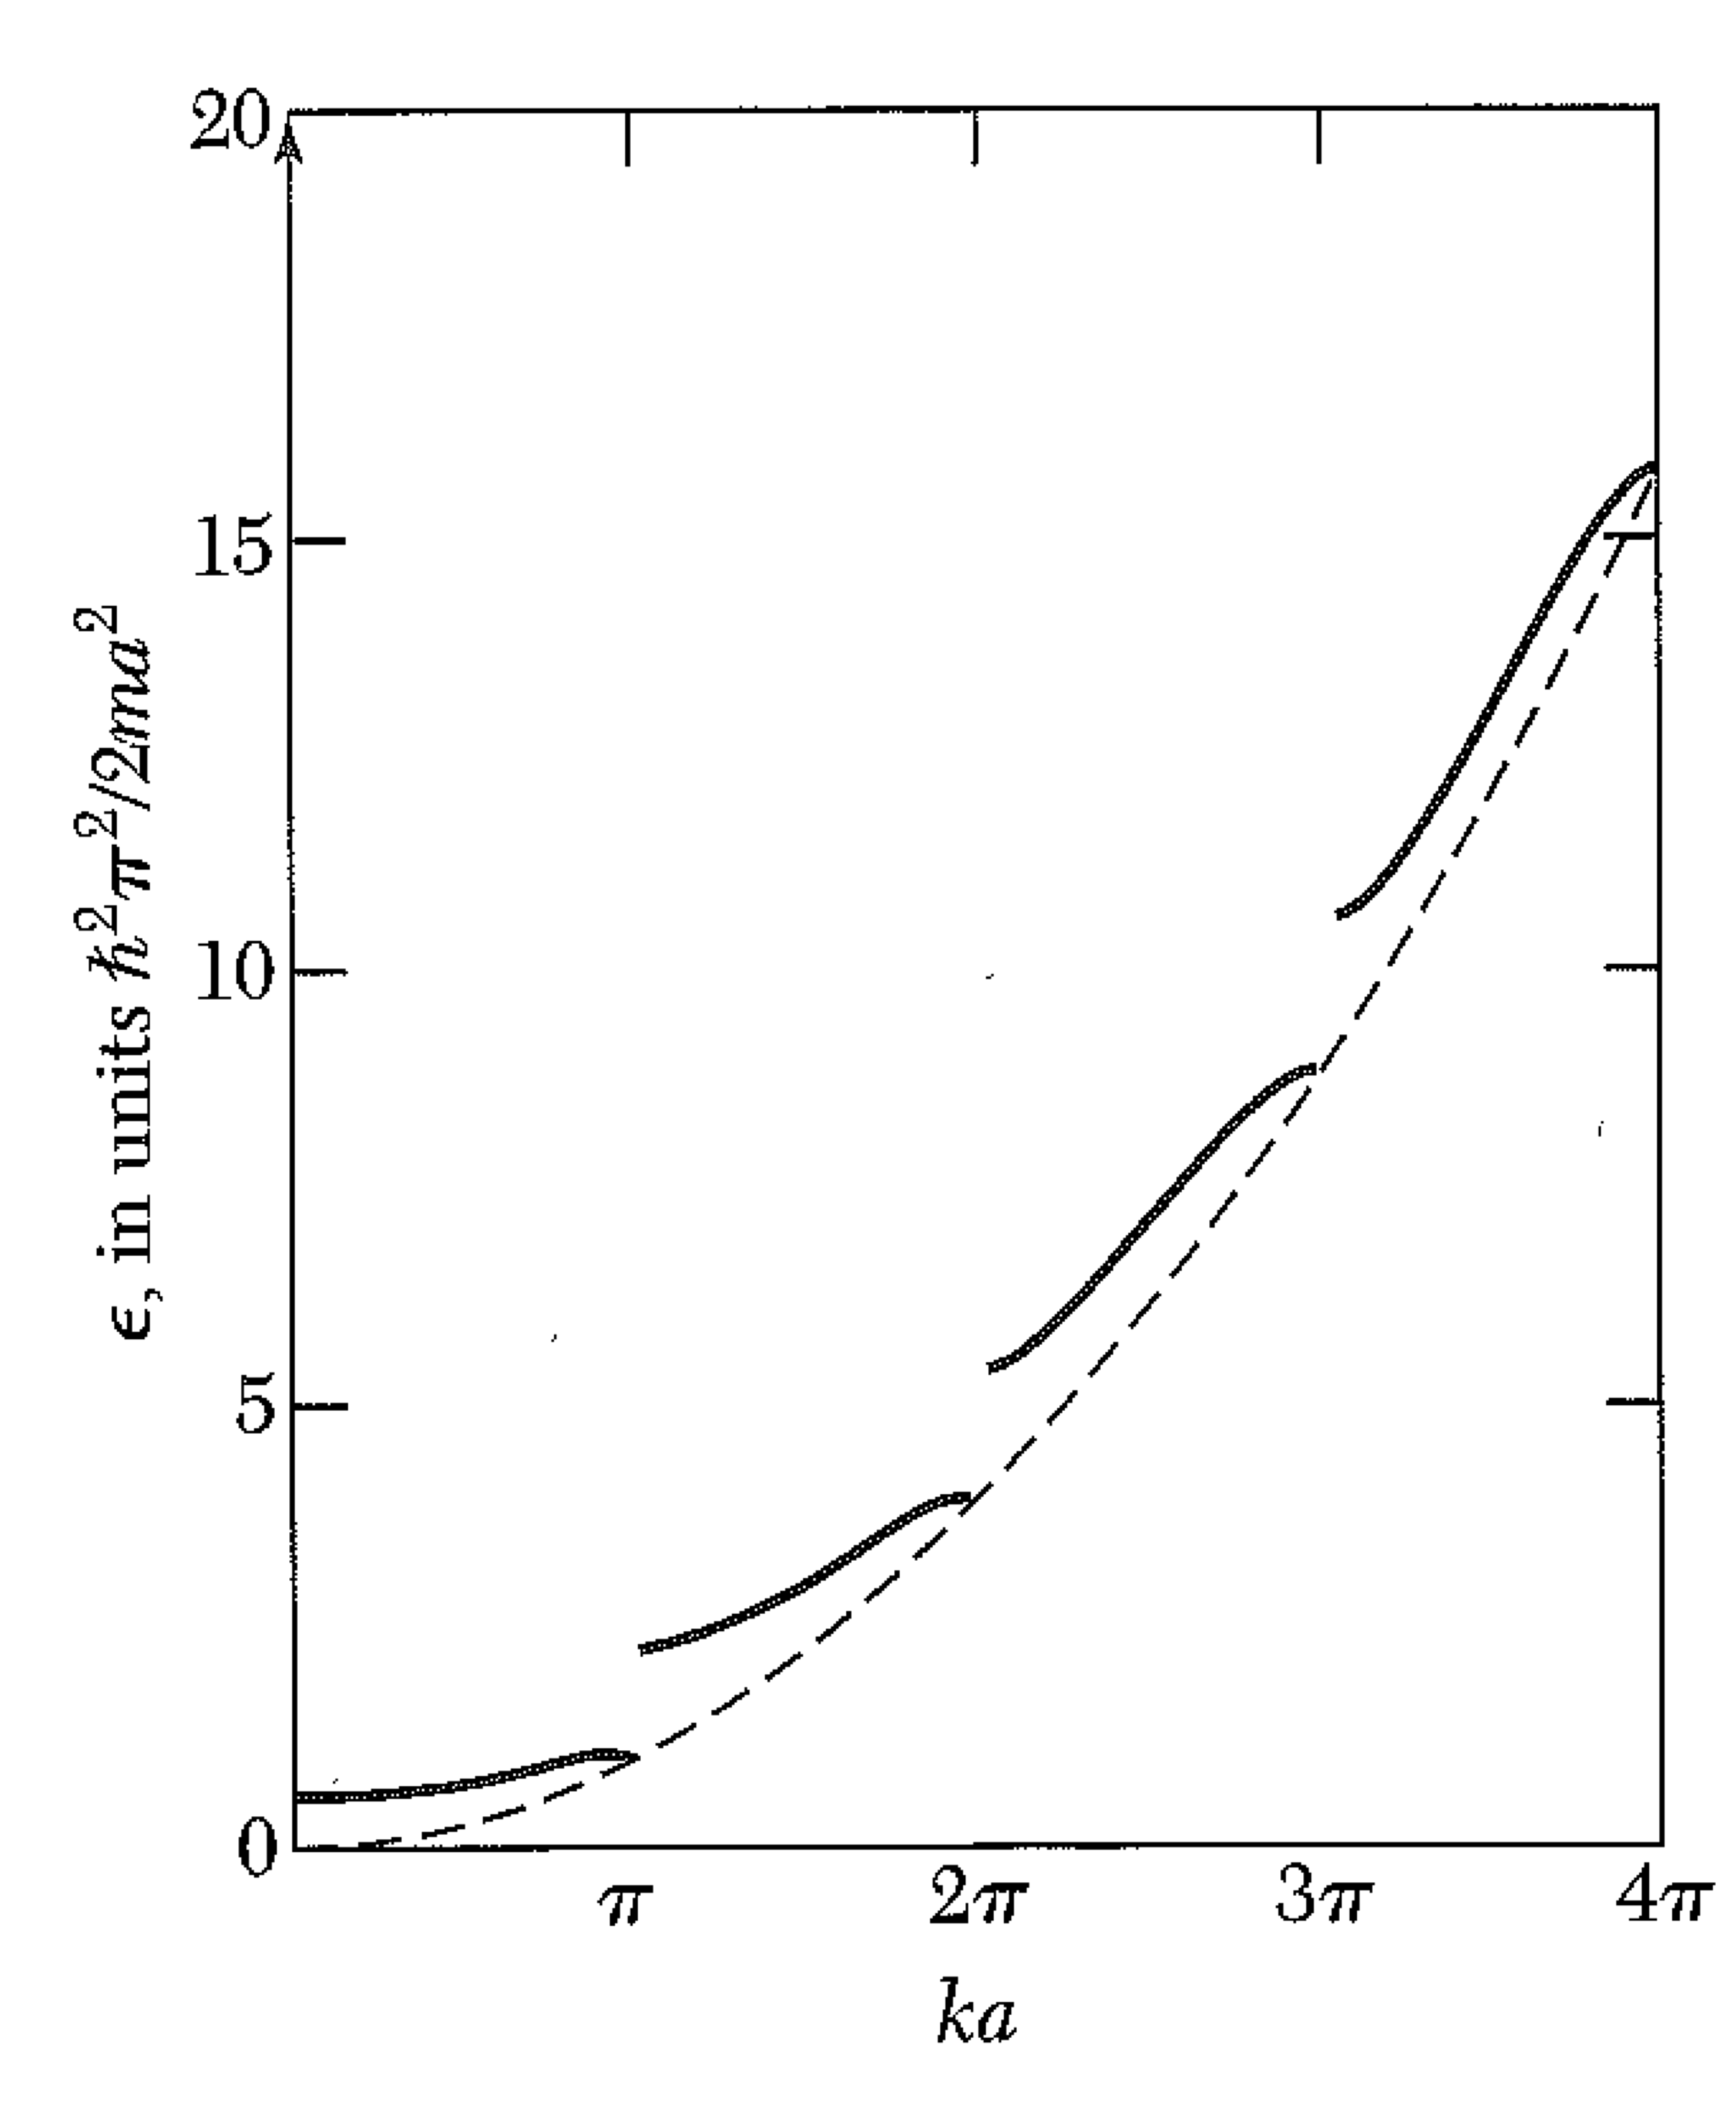
Kronig – Penney Model– Delta function potentials
Again: k is not the “real momentum” of the electron… it is the crystal momentum.
Kronig Kalculator

Slide 8
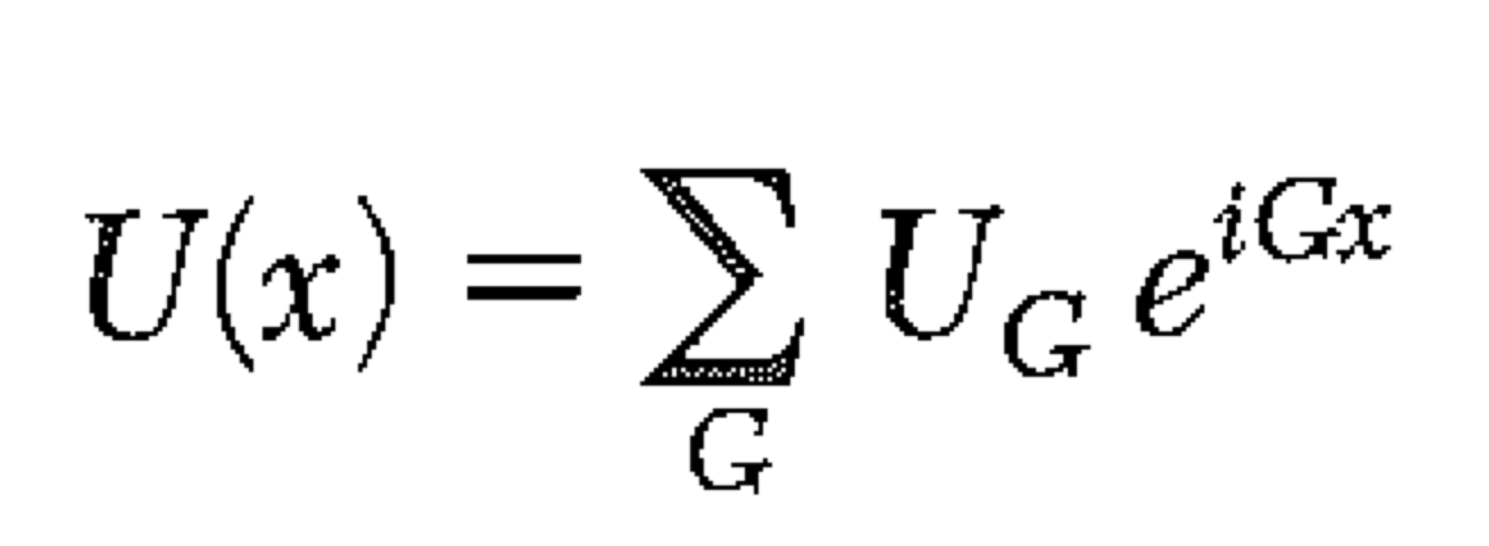
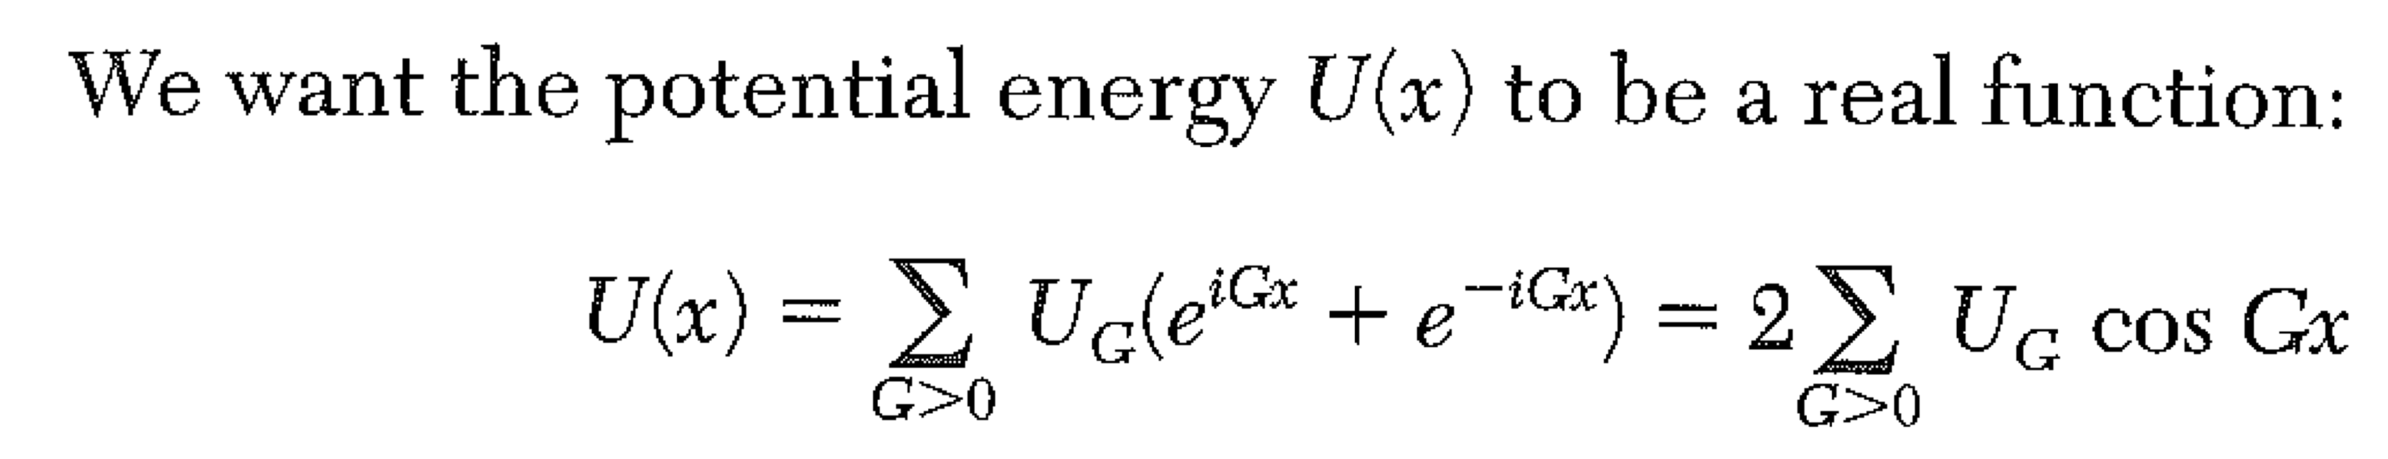
The Central Equation
The Central Equation is a restatement of the Schroedinger Equation in reciprocal space.
You would think that there’s no advantage in writing the SE in reciprocal, or momentum space. After all, momentum can take on any value, just like position. So we might expect to replace one differential equation (for position) with a similar one (for momentum.)
In fact, because the potential energy is periodic, we will find a great advantage in working in reciprocal space. The potential energy can be written as a Fourier series in the reciprocal lattice vectors. In 1D:
For a Coulomb potential, U_{G} falls like 1/G²… we won’t need to use all G’s to get a good approximation.

Slide 9
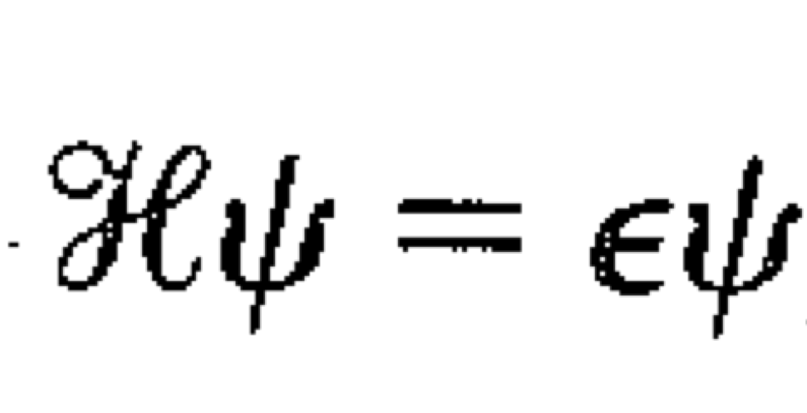
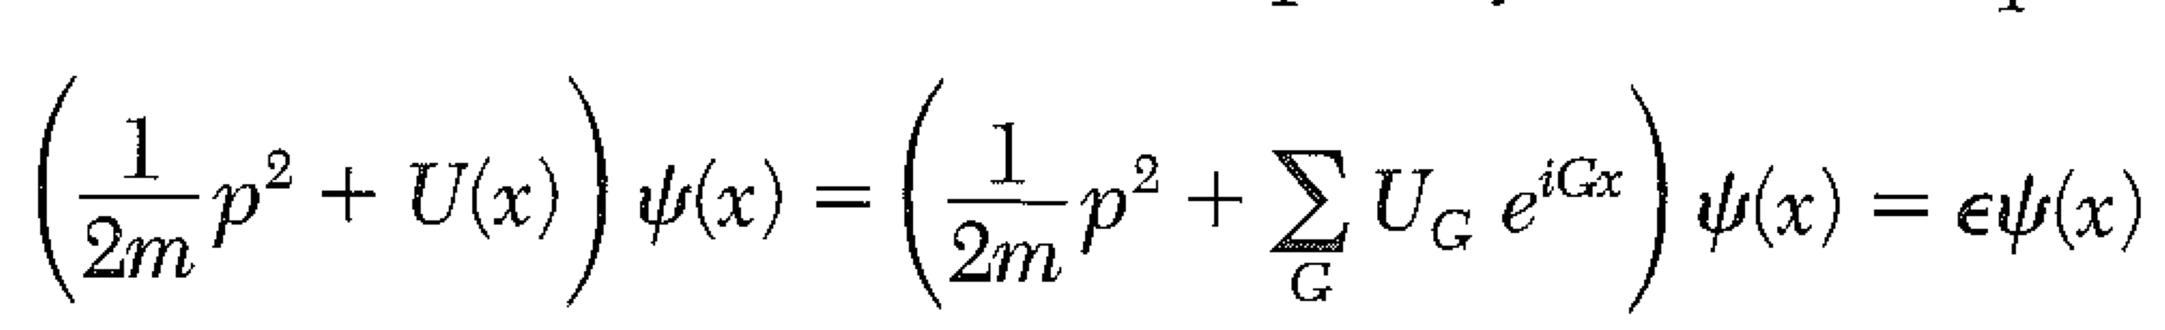
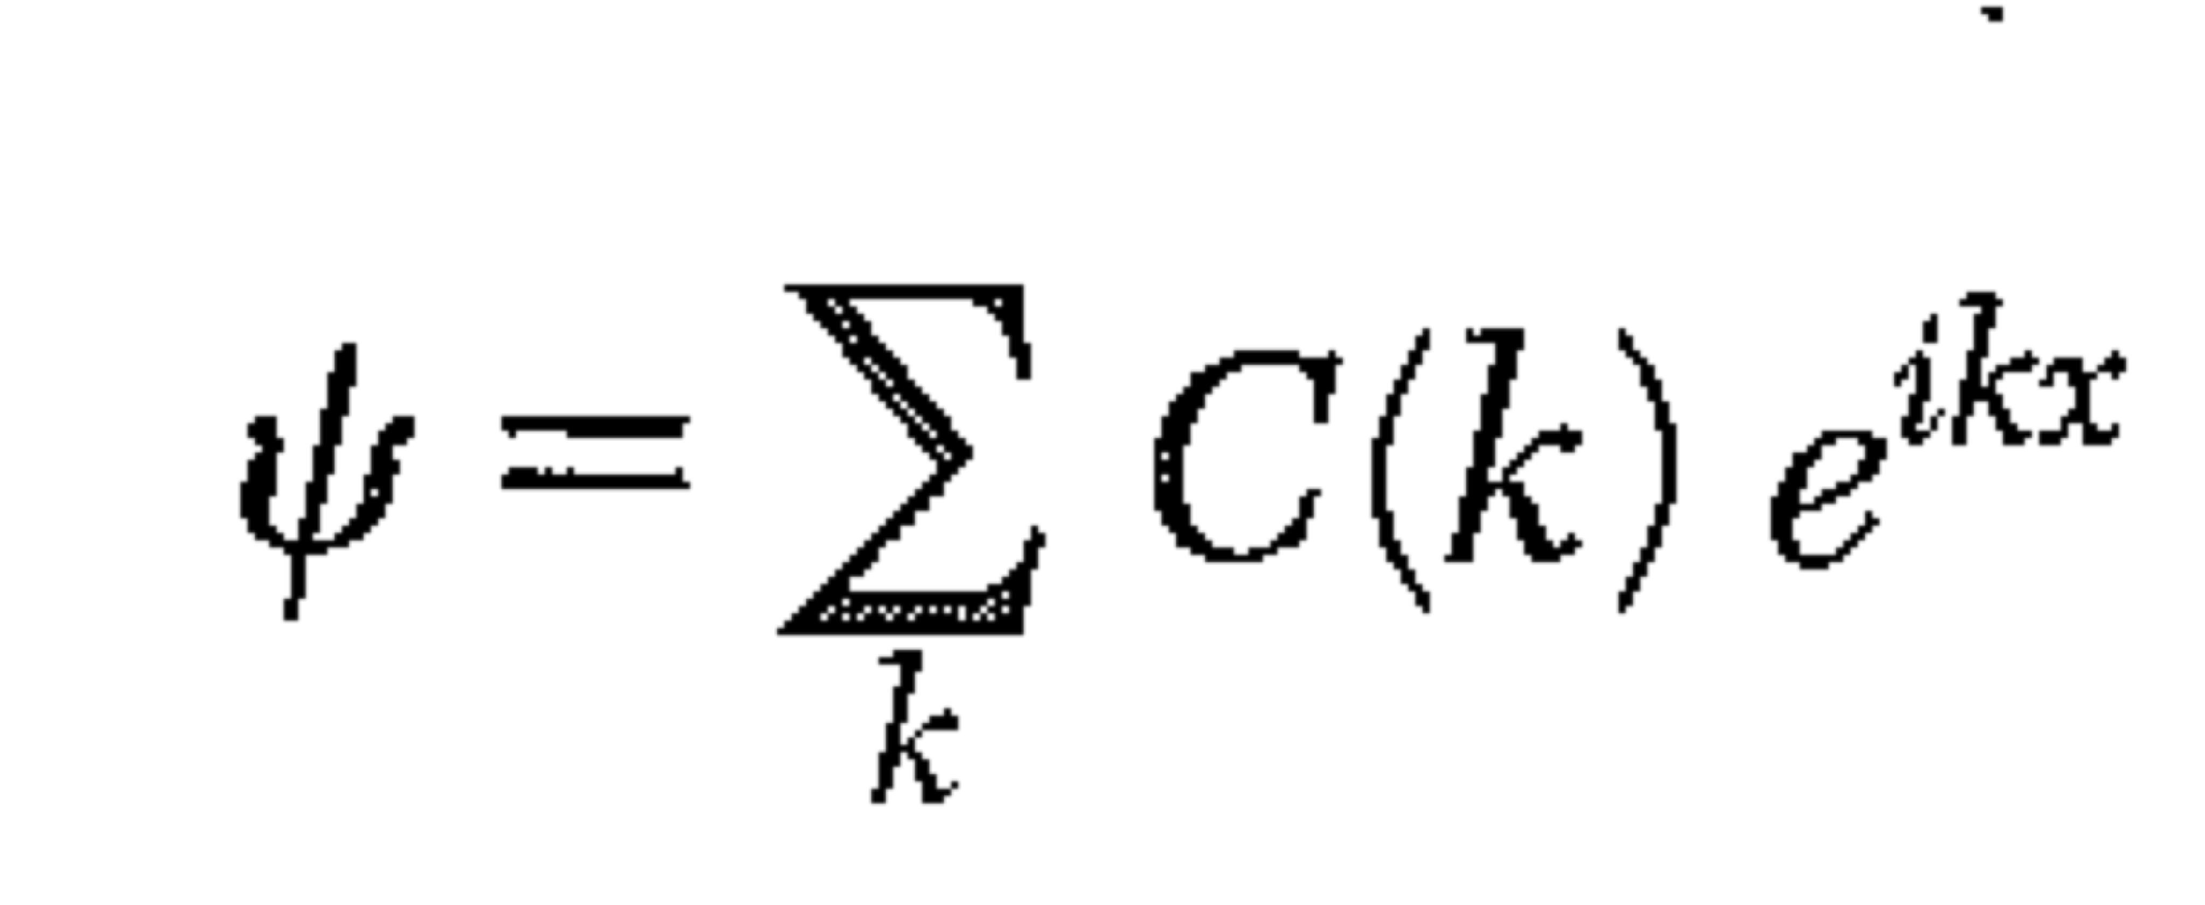
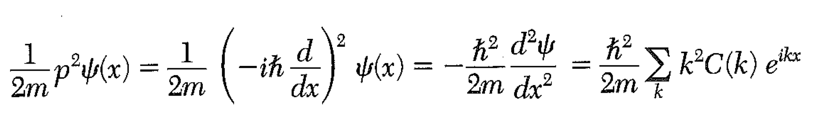
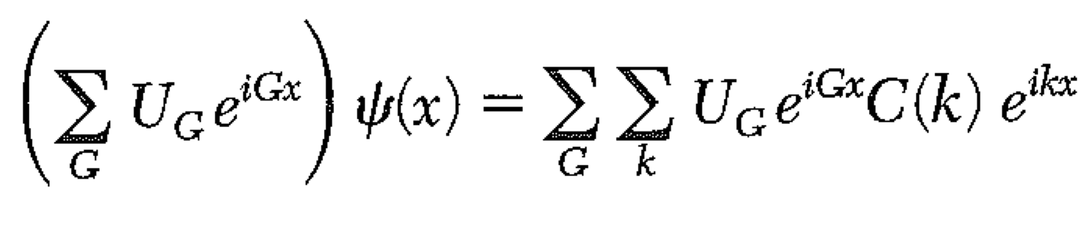
Note: this sum is NOT just over reciprocal lattice vectors! It’s over all k’s… it’s only a sum because we use PBCs.
Substituting in SE gives kinetic and potential terms:

Slide 10
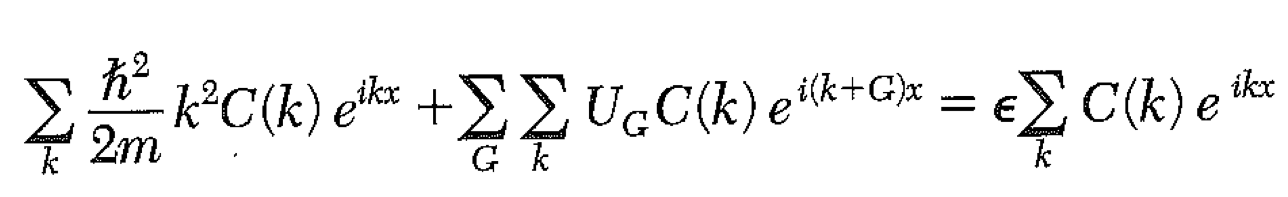
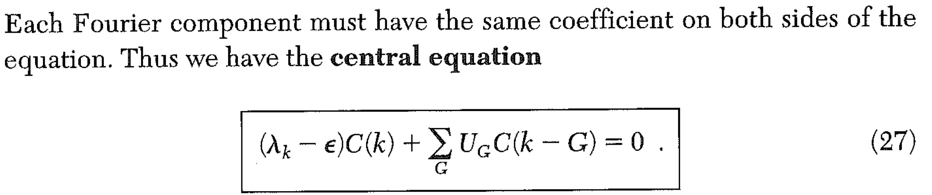
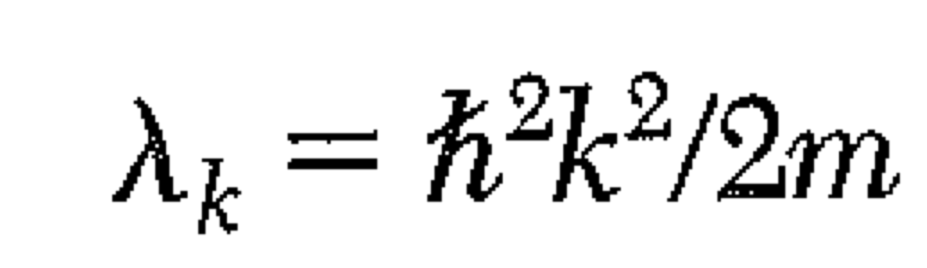
Note: the way to see this is to make the middle term a sum over k’. (It’s a dummy variable anyway.) Then the middle term has the same exponent (ikx) if k’+G = k i.e. when k’ = k-G.
Note also: the equation for coefficient C(k) does NOT involve ALL other k’s… it only involves k’s that are shifted by a reciprocal lattice vector!

Slide 11
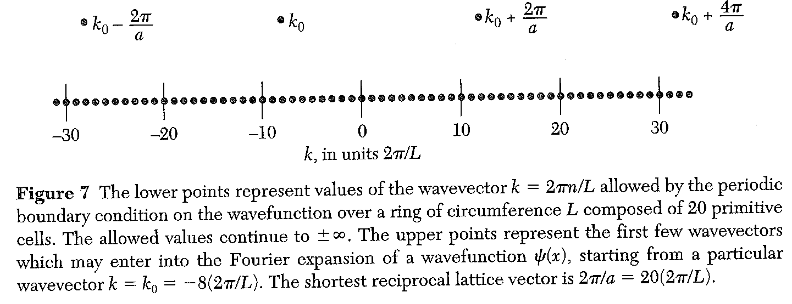
The equation for coefficient C(k) does NOT involve ALL other k’s… it only involves k’s that are shifted by a reciprocal lattice vector!

Slide 12
If we choose a value of k, the central equation is a set of simultaneous algebraic equations for C(k-G).
• We might as well choose k in the 1st BZ.
The set of equations is infinite. However, we can often get a good solution by studying a small, finite subset.
Let’s write down the equations explicitly for the potential
Note that

Slide 13
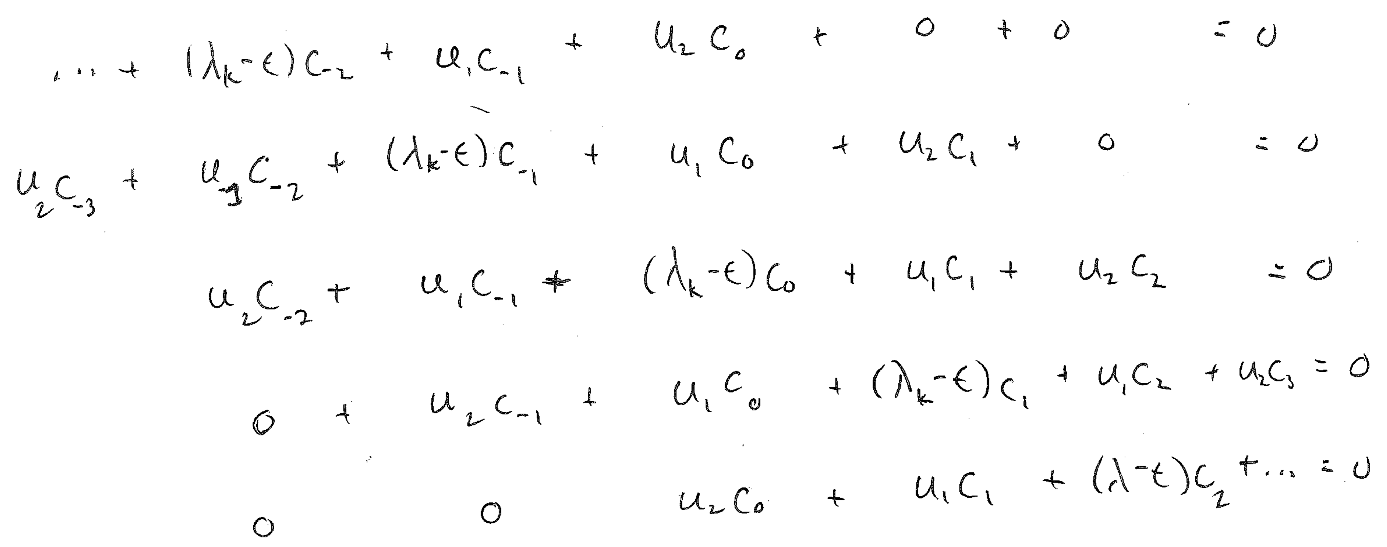
To simplify notation, I’ll call C(k) = C₀, C(k-(2πx/a)) = C₋₁, etc.
If I truncate this to five terms, I have five equations in the unknown C’s.
Since the absolute size of the C’s is unimportant, these five equations must be linearly dependent… the determinant must vanish.

Slide 14
To simplify notation, I’ll call C(k) = C₀, C(k-(2πx/a)) = C₋₁, etc.
If I truncate this to five terms, I have five equations in the unknown C’s.
Since the absolute size of the C’s is unimportant, these five equations must be linearly dependent… the determinant must vanish.
The equation for the determinant is fifth order, so there are five values of ε that solve… 5 eigenvalues for the energy.
These 5 energies are in five different bands.
All 5 electron states use the same combination of k’s (i.e. k+G, with all Gs), but they use different amounts of each.

Slide 15
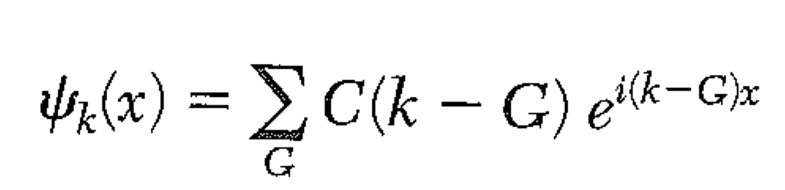
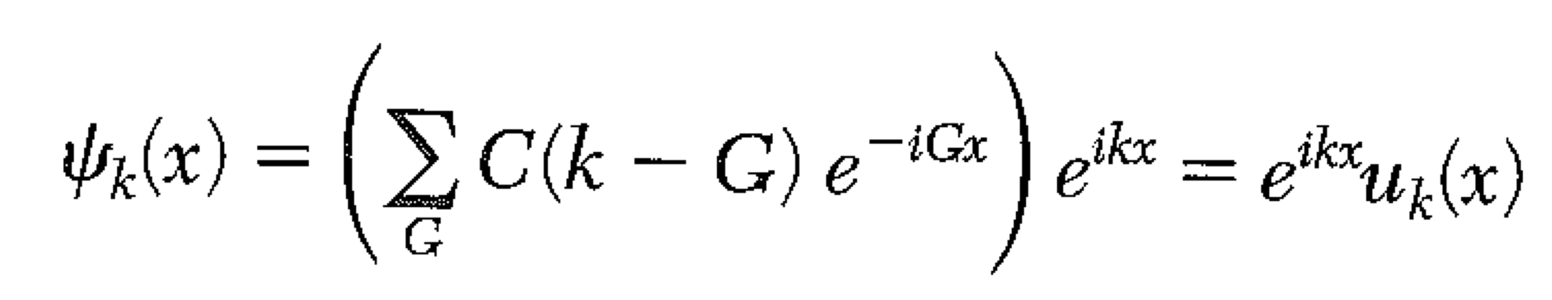
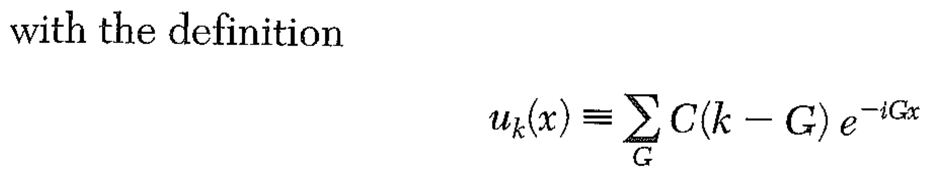
You can see that there is an infinite set of bands.
Higher energy bands will use larger G’s. That’s why, if we pick k in the first zone, we can get a good answer with only a few terms in the central equation for the lower energy bands.
Bloch Theorem Revisited. From the CE, the wavefunction is:
u_{k}(x) is invariant under translation of a integral number of crystal cells:
The wavefunction is periodic in the crystal lattice spacing, with a phase shift from cell to cell.

Slide 16
The wavevector k is not electron momentum.
(Obviously, electrons in different bands have the same k!)
Conservation laws, i.e. selection rules for quantum transitions, use k.
is the crystal momentum of an electron.
Some practice with thinking about Fourier series representation of the potential, U…
And a homework question.
Let’s analyze diamond in the conventional cubic cell.
The potential arises from each of the two atoms in the conventional cell.
If the side of the conventional cell is length a, show that U_{G} vanishes for

Slide 17
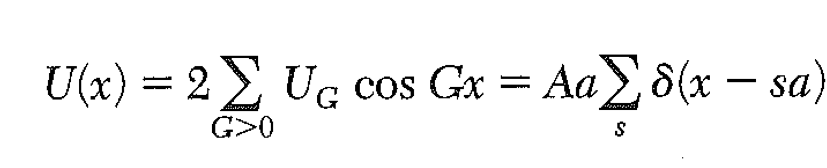
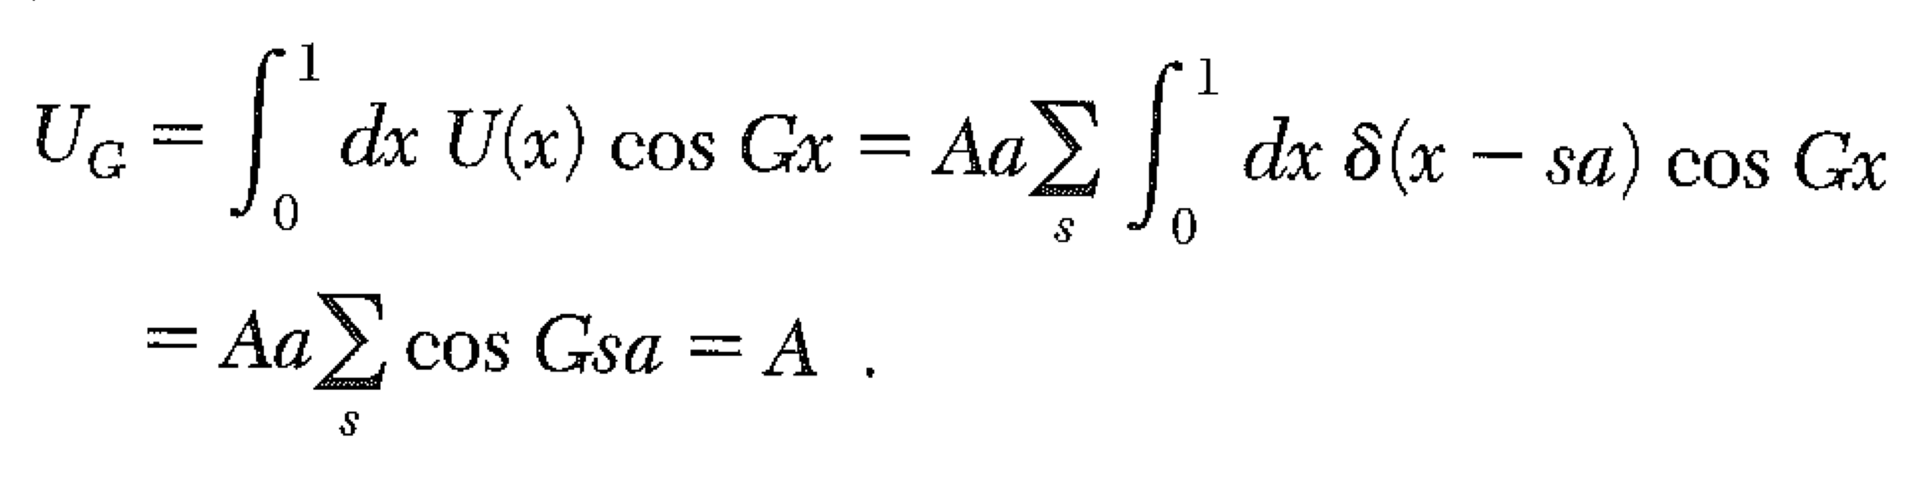
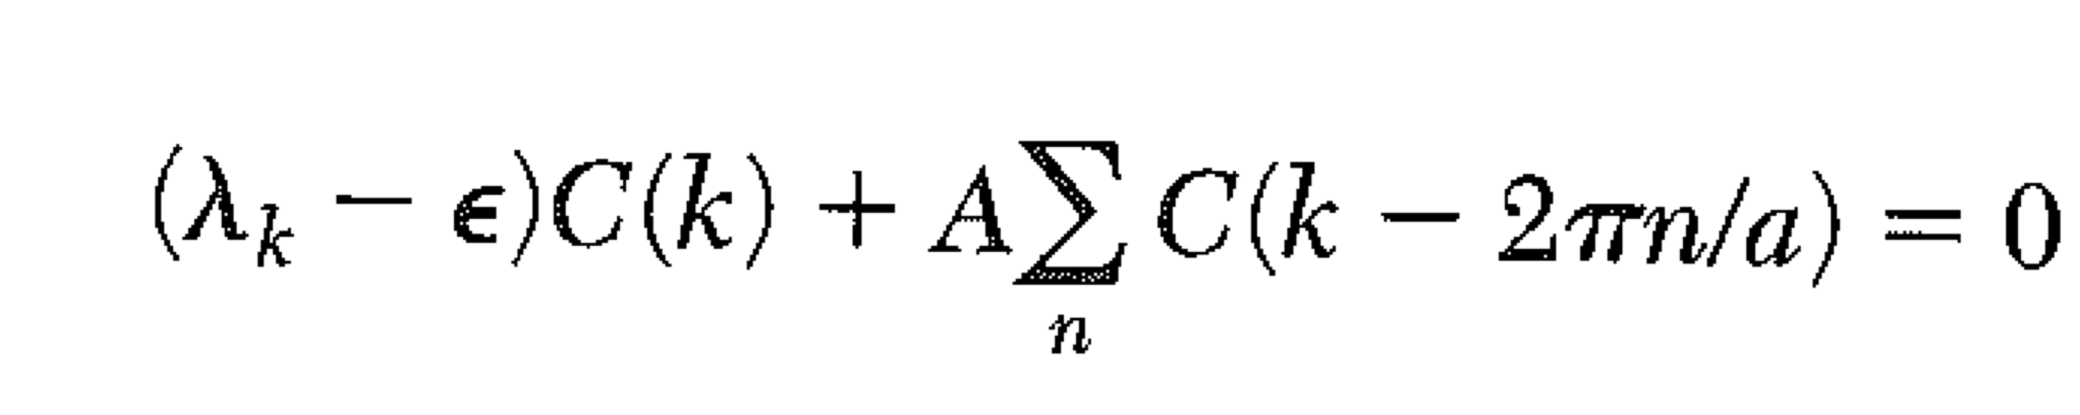
Lecture 16
Kronig-Penney Model in the Central Equation
Unlike the “Nearly Free Electron” model, both the Central Equation and the Kronig-Penney Model are exact.
The Central Equation can be used to express the KP model, i.e. 1D delta-function potentials.
A delta function potential
makes all U_{G} the same.

Slide 18
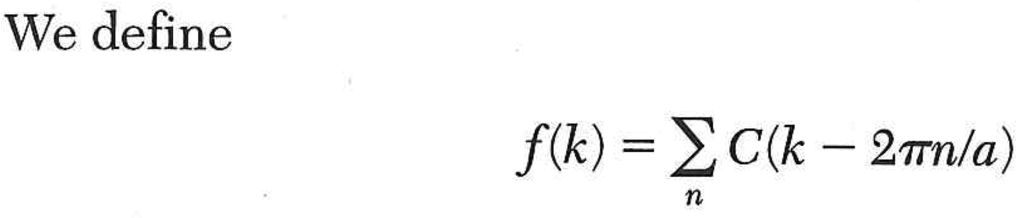
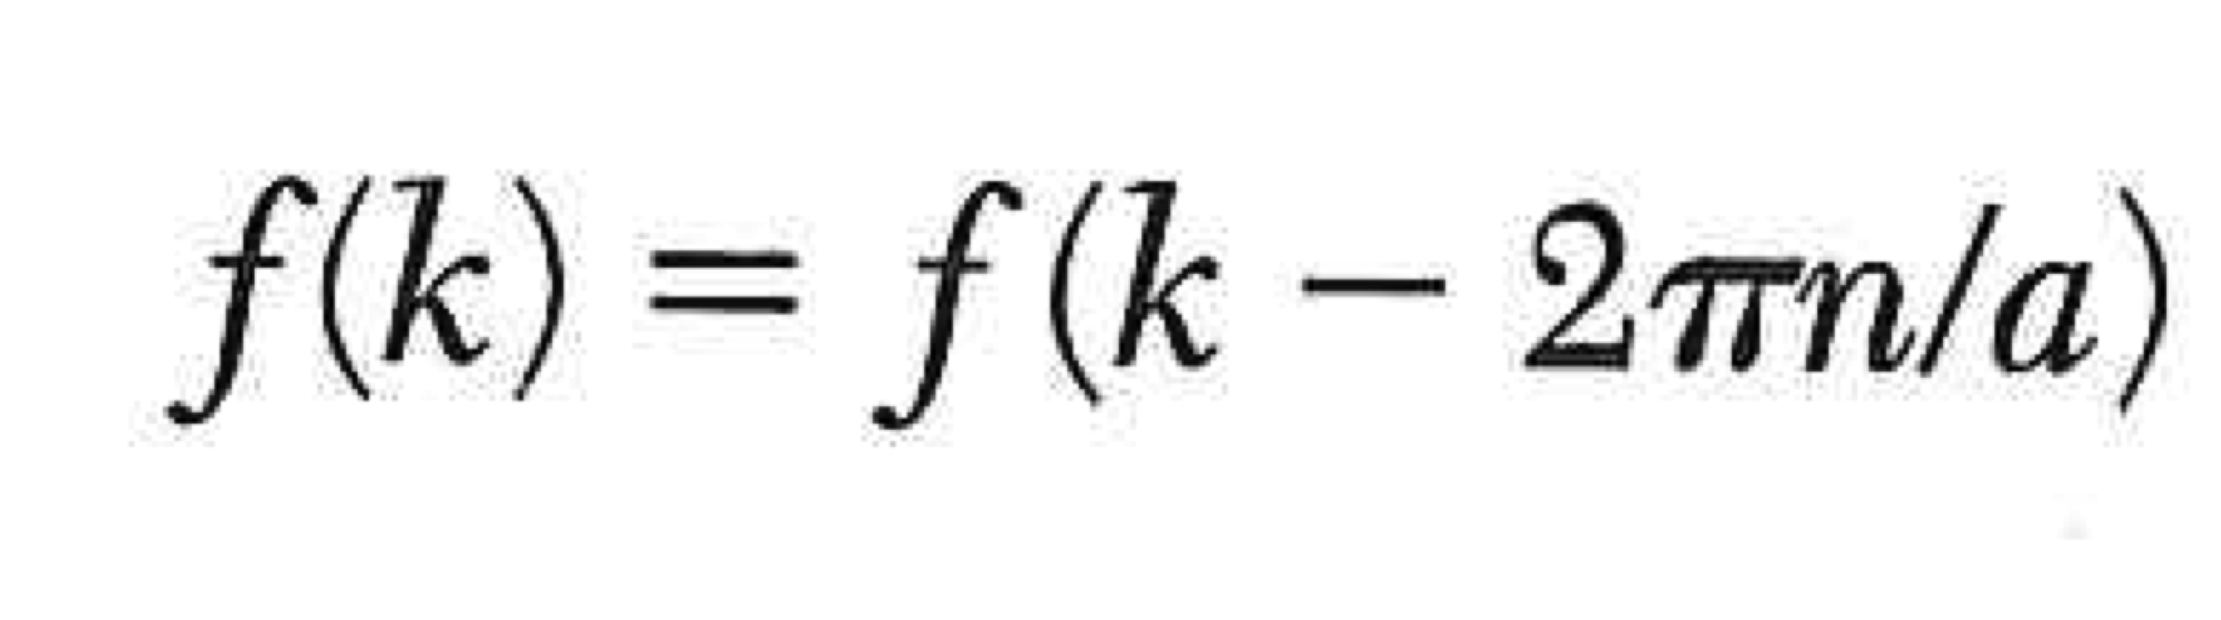
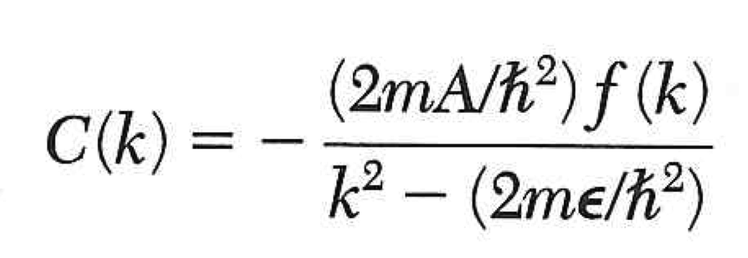
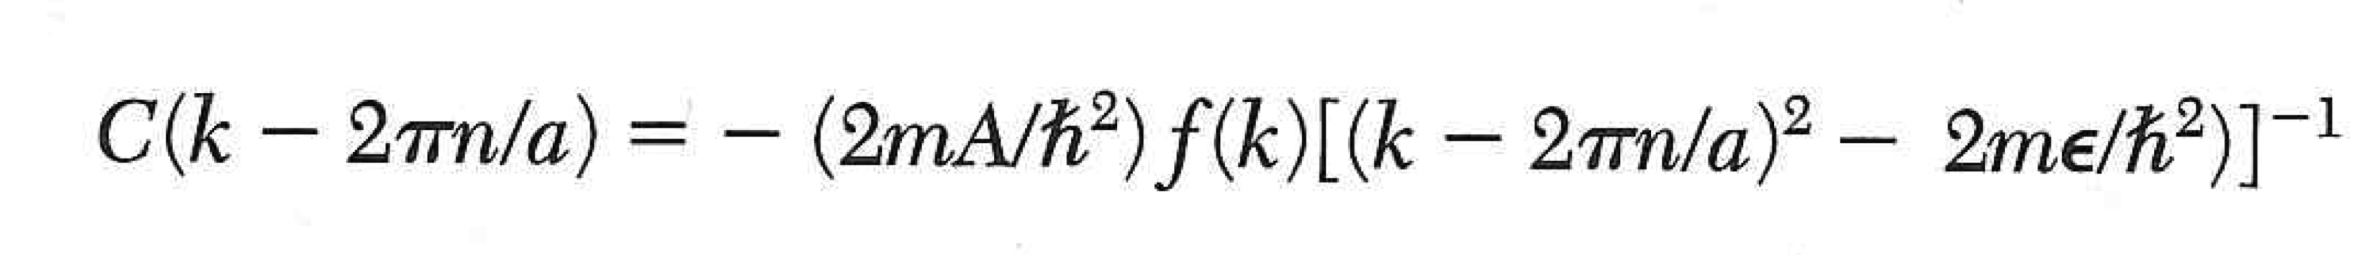
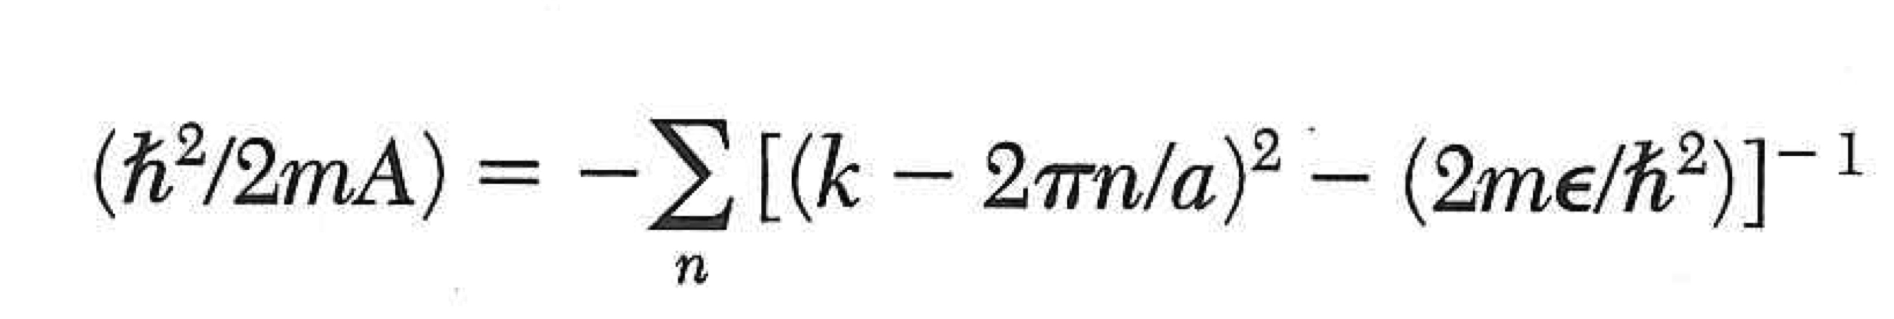
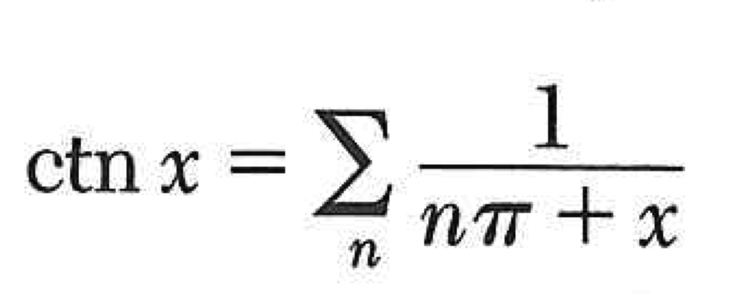
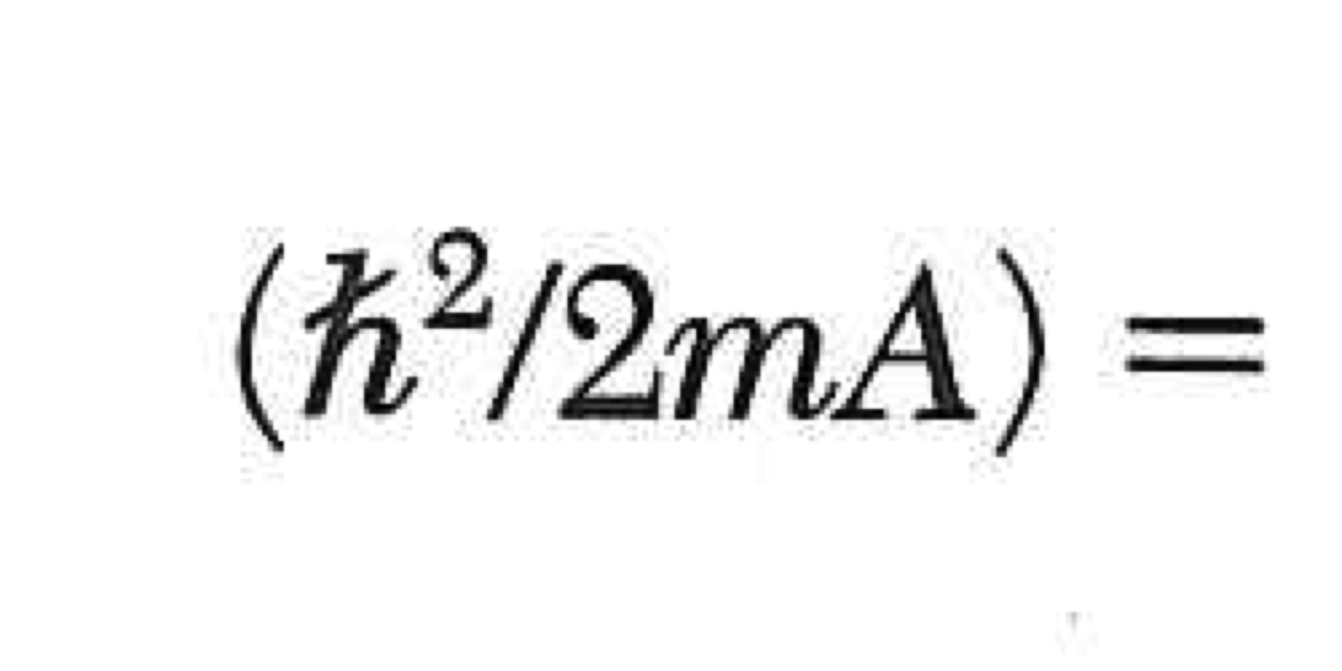
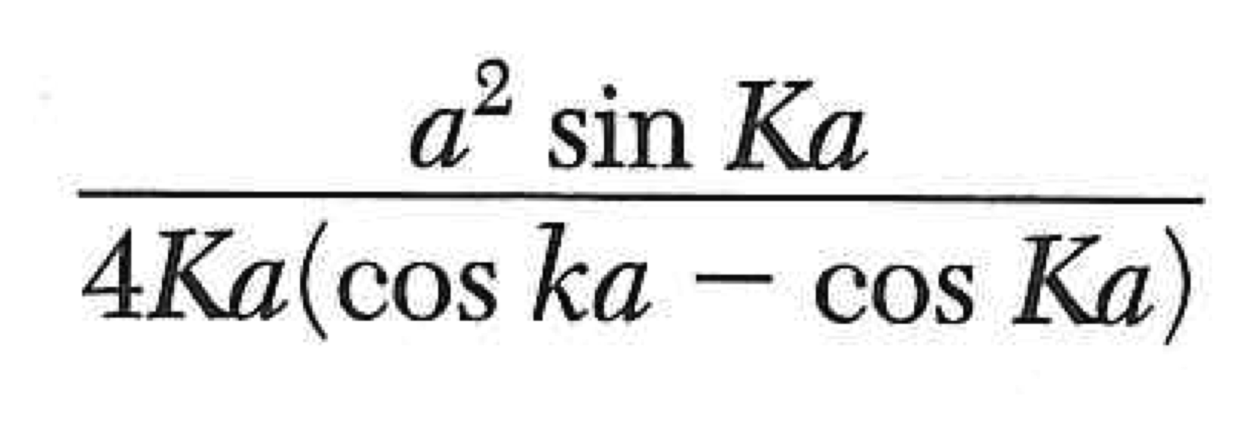
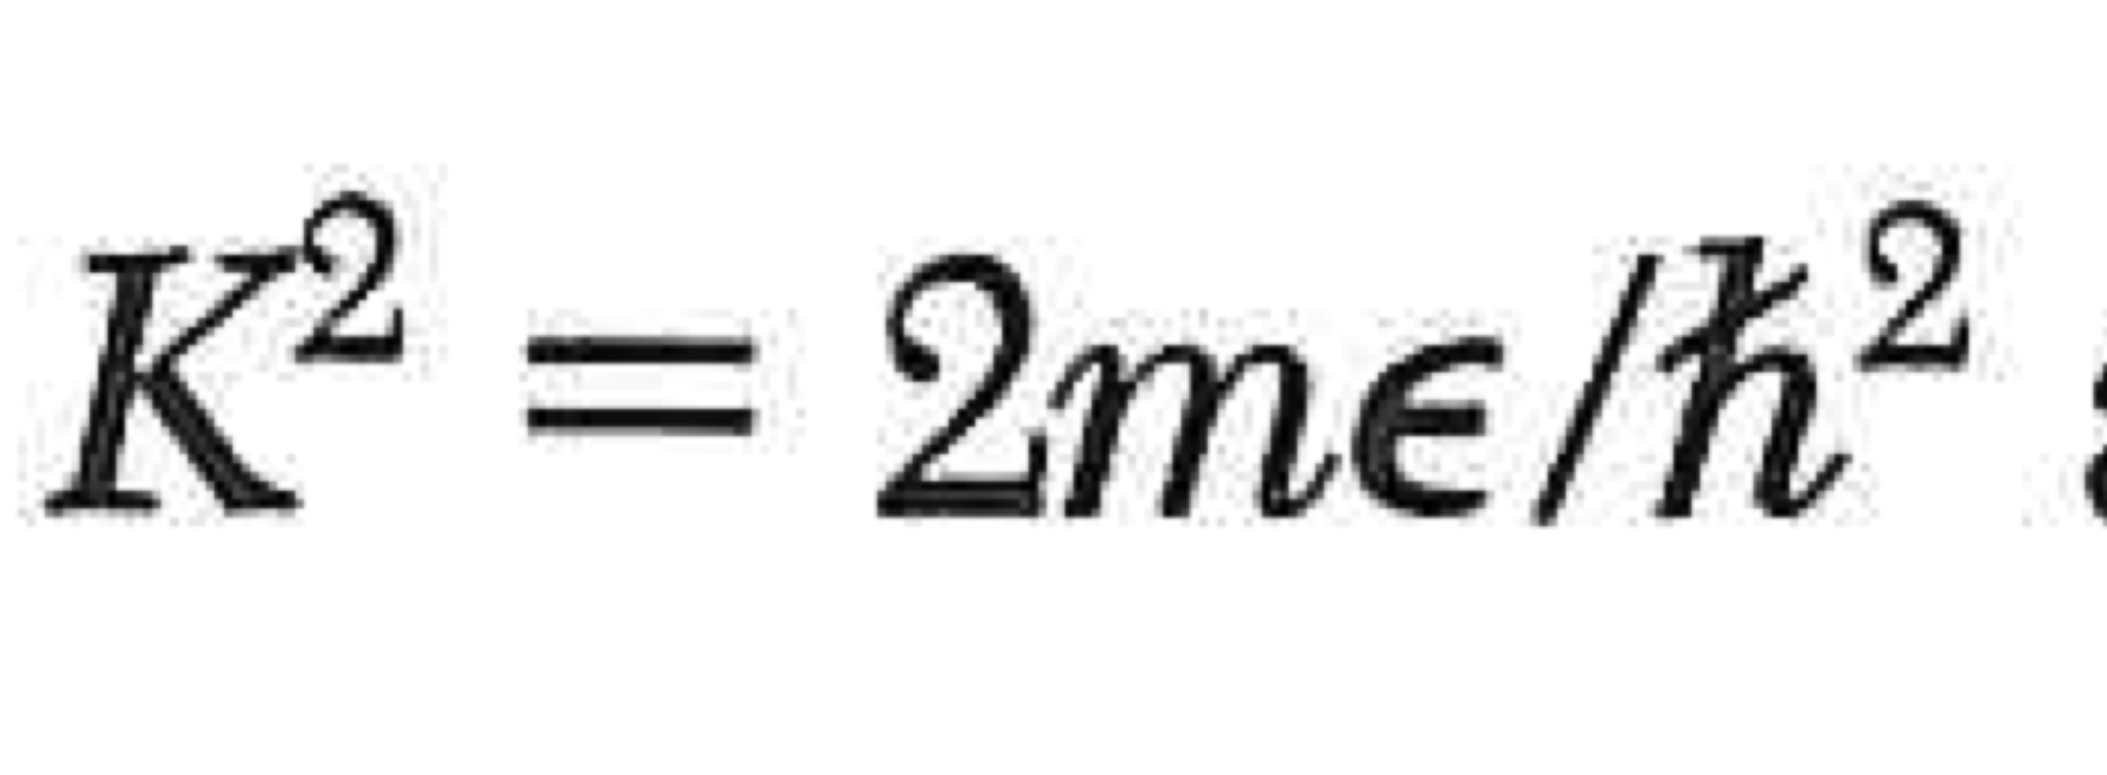
We’re not looking for C(k), we really want a relation between k and ε
Note:
Then:
Sum both sides over all n, then cancel f(k)
Some difficult math, plus the relation
Gives:
Identical to Kronig-Penney result

Slide 19
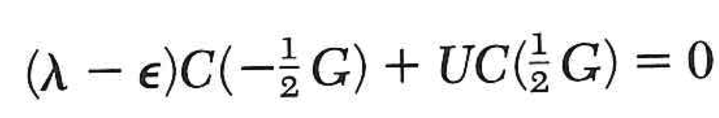
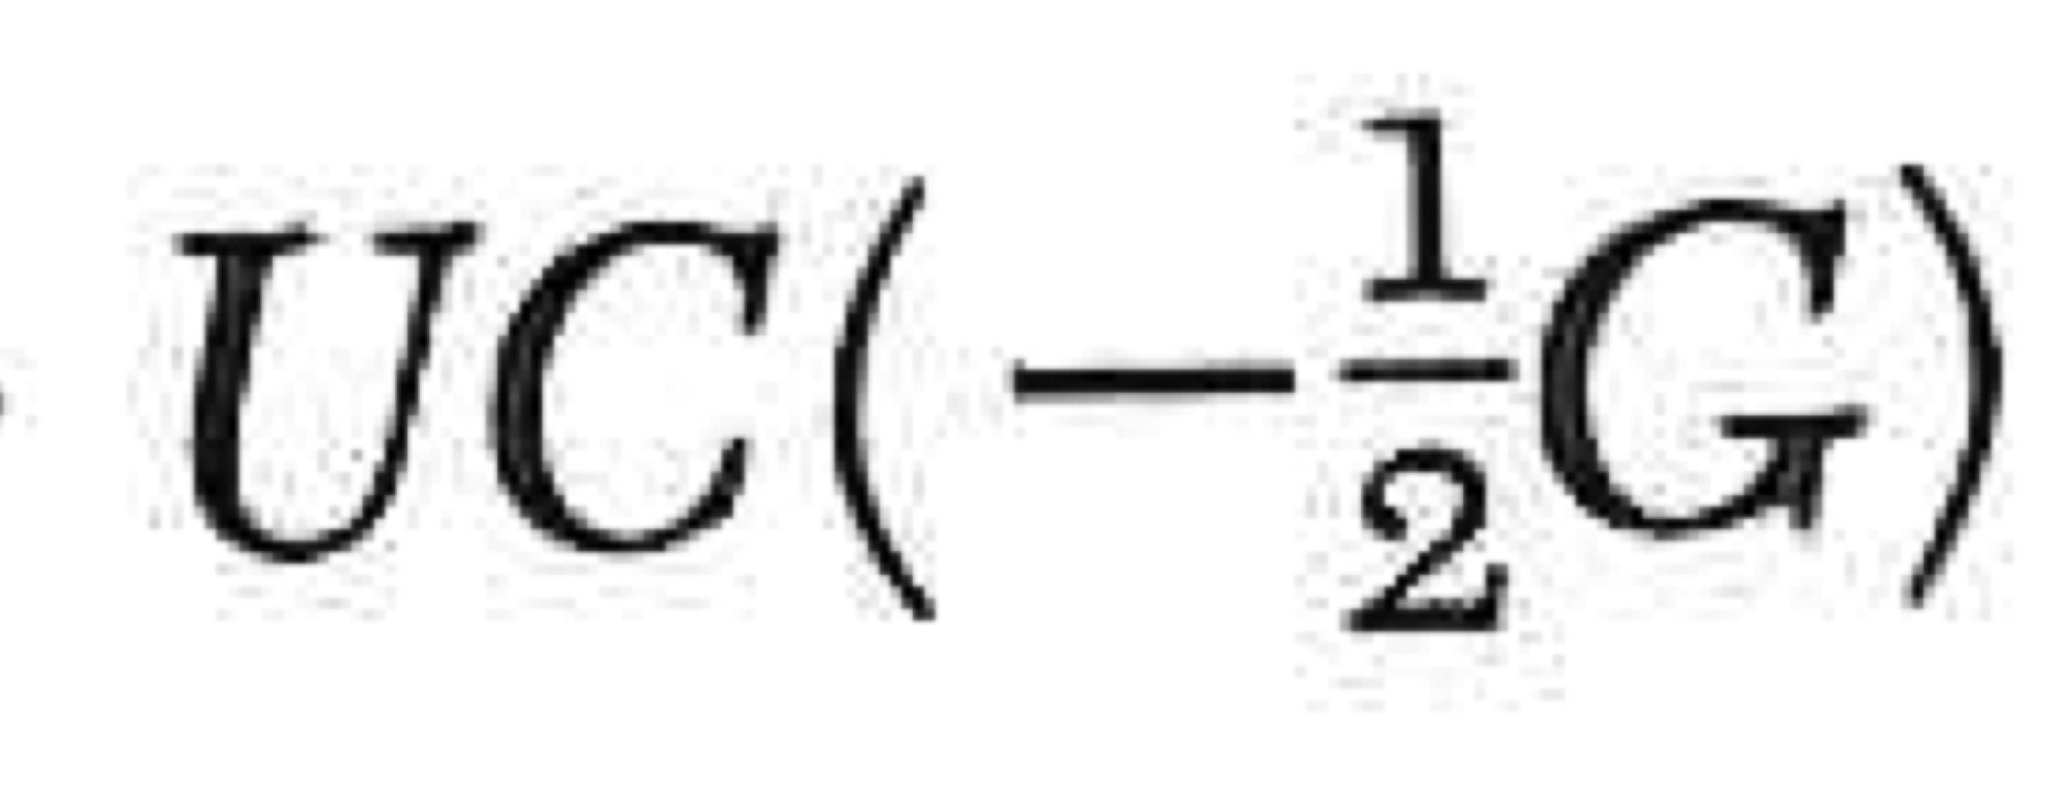
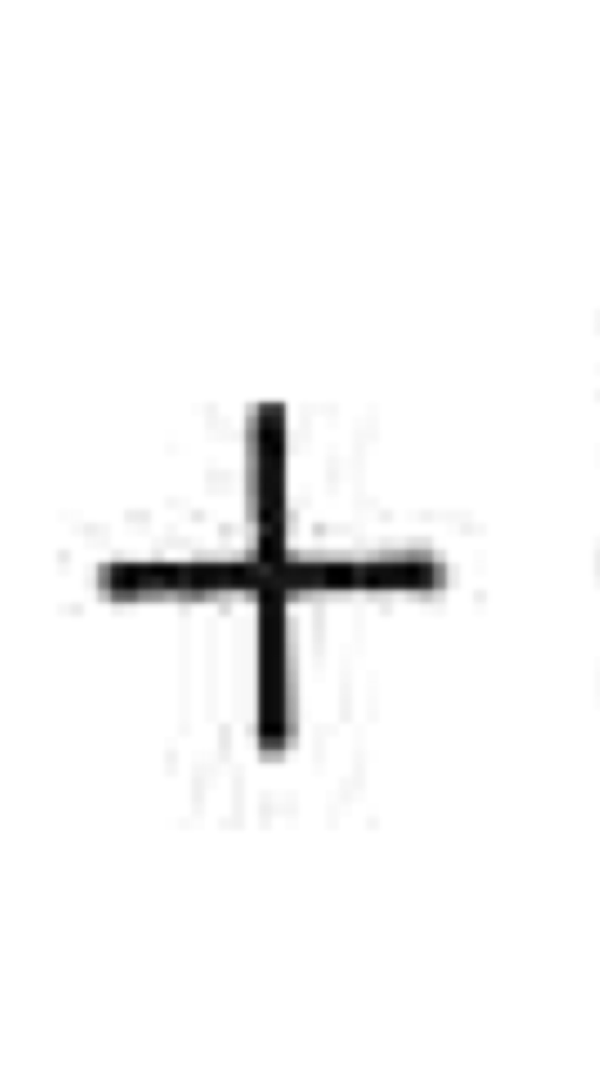
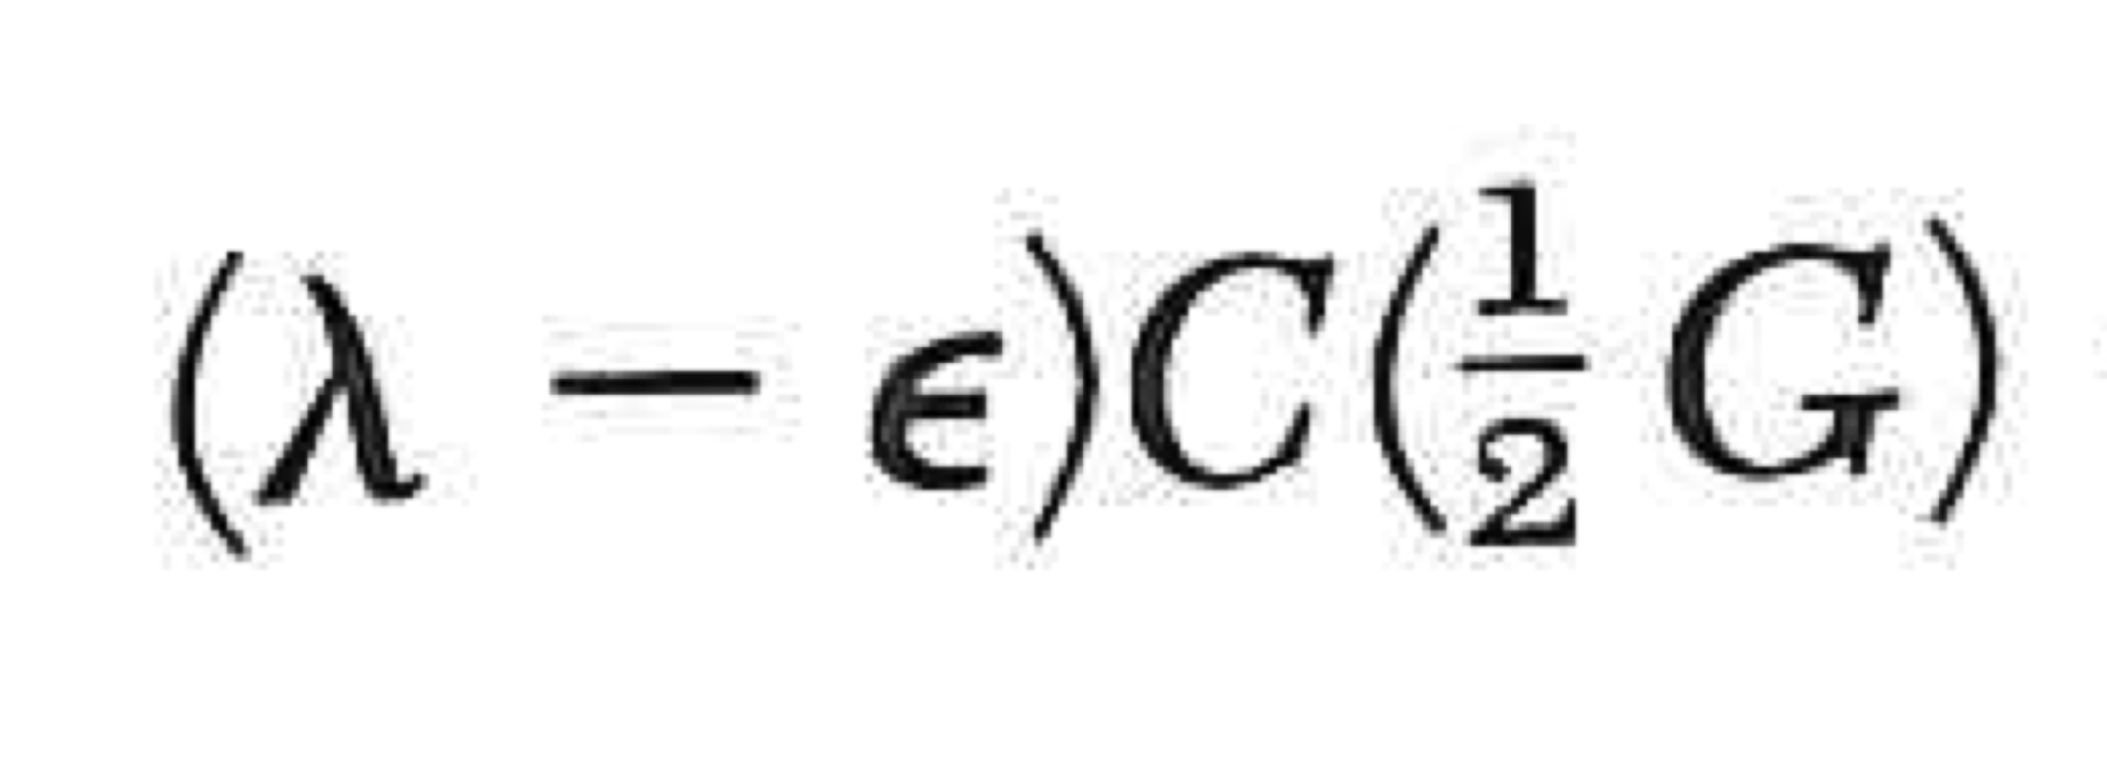



Solution of CE at a BZ boundary
We will seek a solution where all C’s are zero, except C(+½G) and C(-½G).
We will also make the approximation that we can neglect the “lines” in the central equation that “describe” C’s other than these two.
And, as with the NFE model, we consider only the cosine component of the atomic potential. U(x) = 2Ucos (2pi*x/a)=2Ucos(Gx). The problem becomes:
This is the same as the NFE model.

Slide 20


Solution of CE at a BZ boundary
If we put the eigenvalues back into the central equation, we get the (relation between) the C’s
These are the same as the NFE solutions we assumed… sine and cosine.

Slide 21











Solution of CE NEAR a BZ boundary
We will write out the two lines of the central equation for an arbitrary k (presumed near to +½G).
Define
Define:

Slide 22

Solution of CE NEAR a BZ boundary
Define
Define:
The bands are flat at the BZ boundary!

Slide 23

Each primitive cell contributes one value of k (for each band.)
There are 2N orbitals in each band.

Slide 24
Practice for exam.
x, y

