Slide 1
Lecture 13 & 14
HW Chapter 6: 6, 10 Chapter 7: 1,2

Slide 2
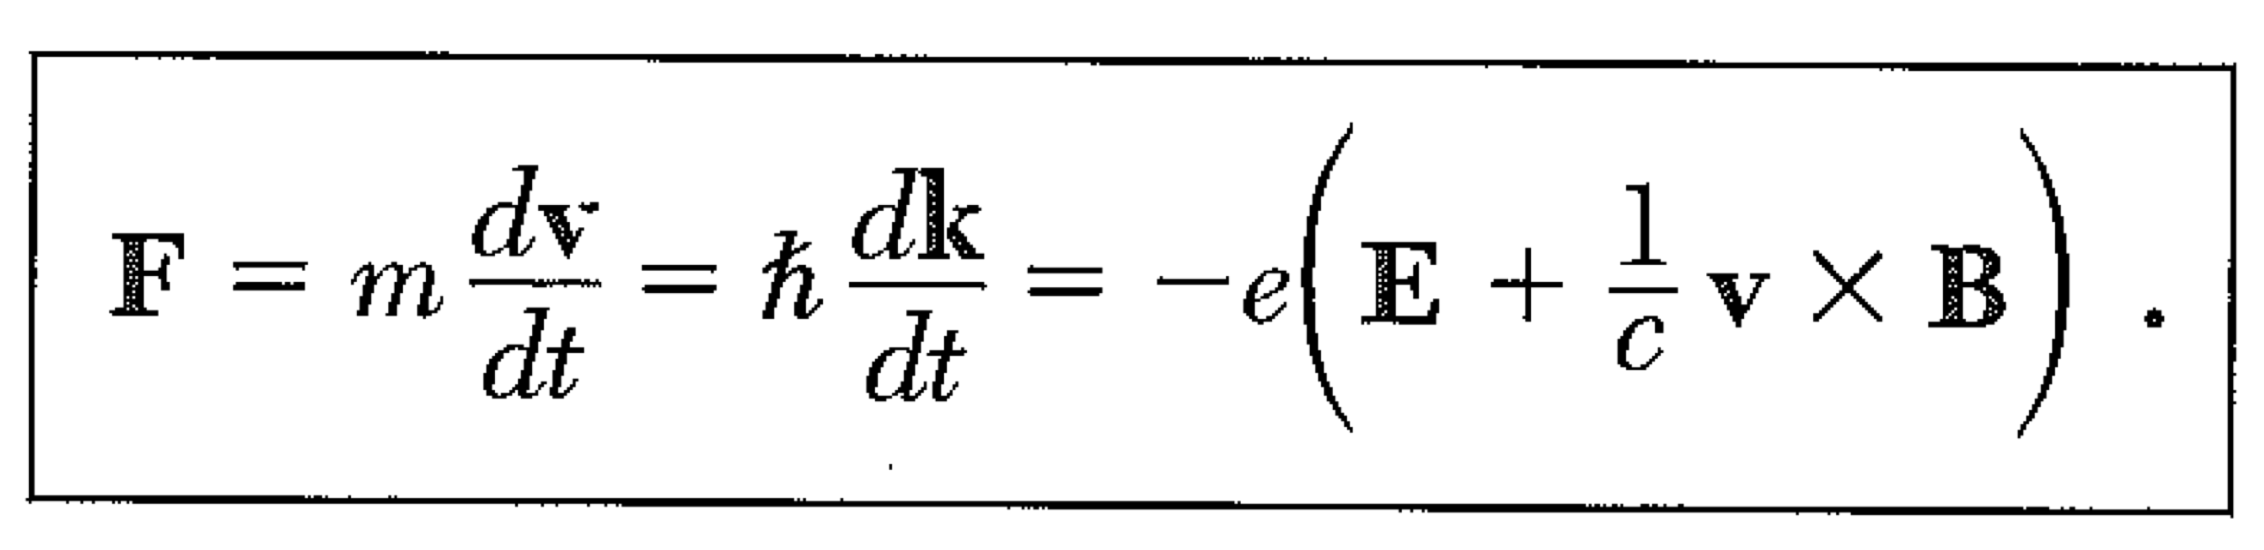
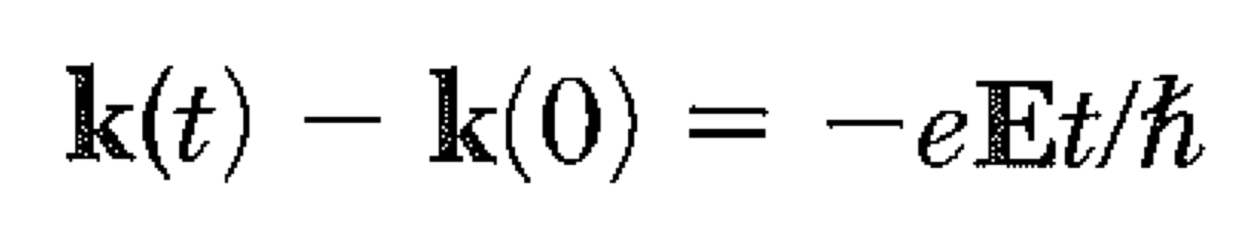
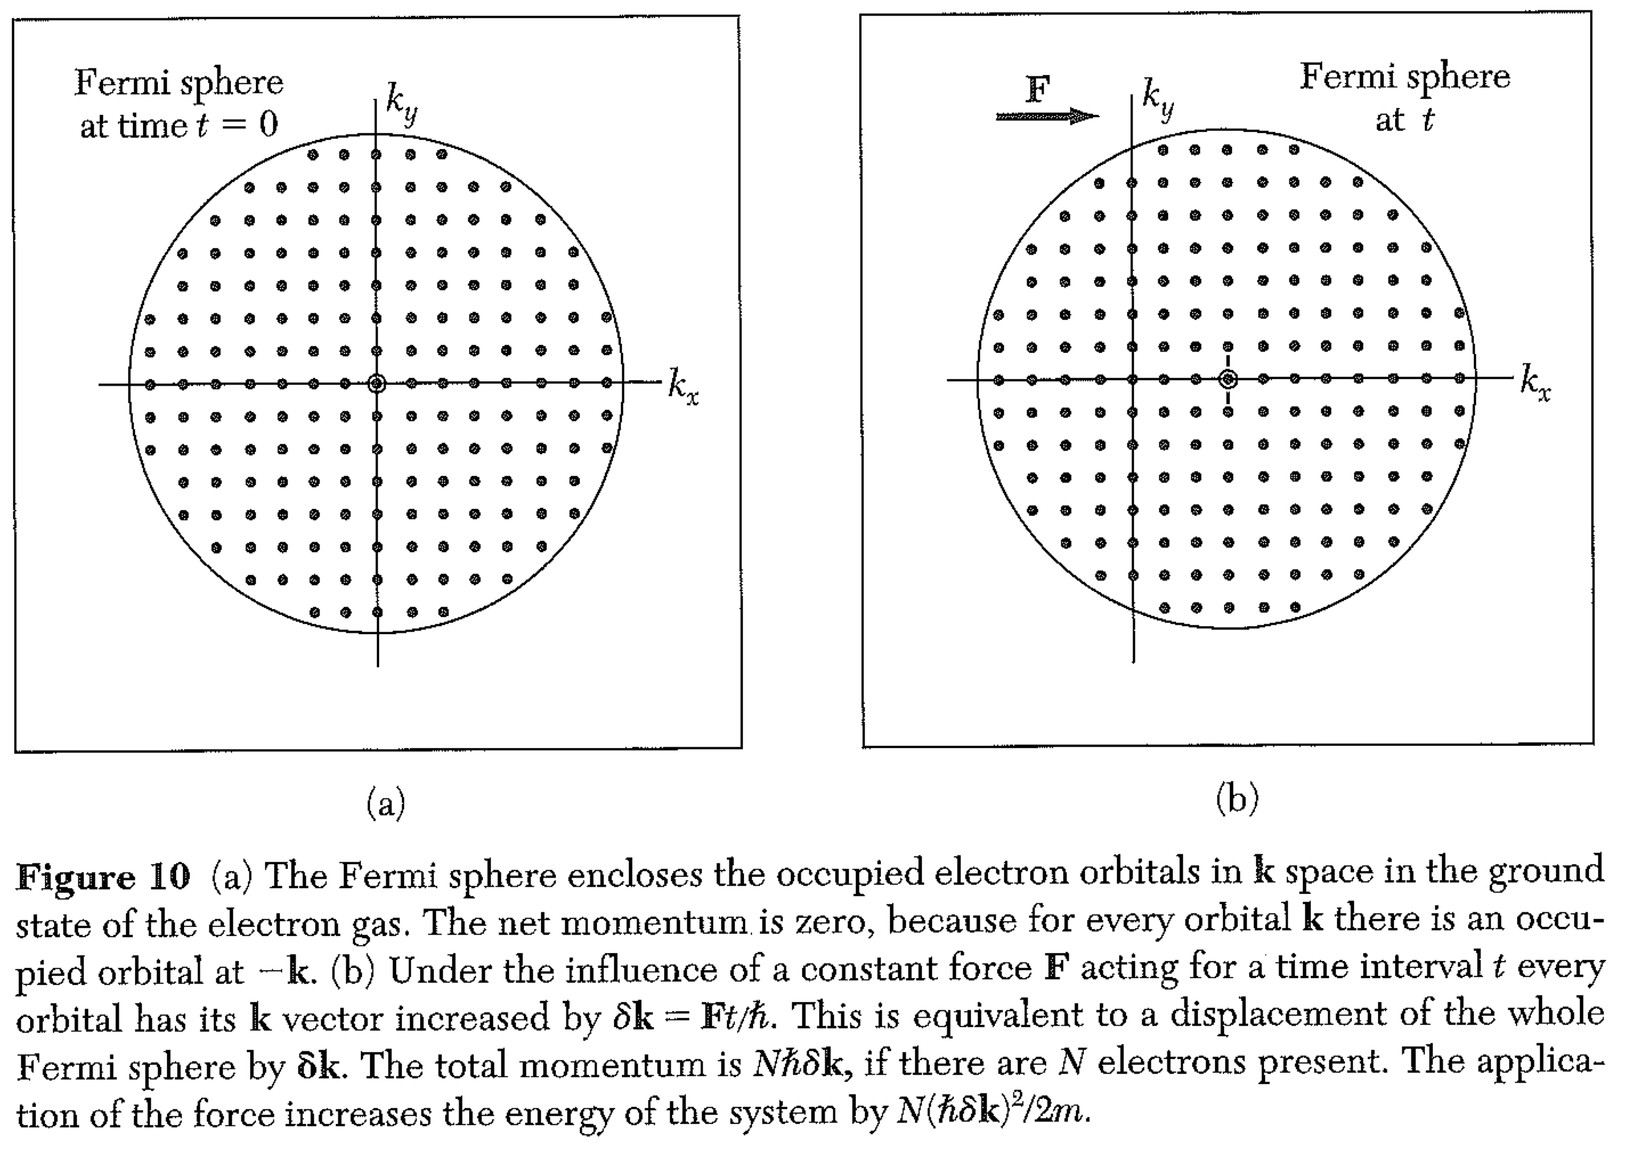
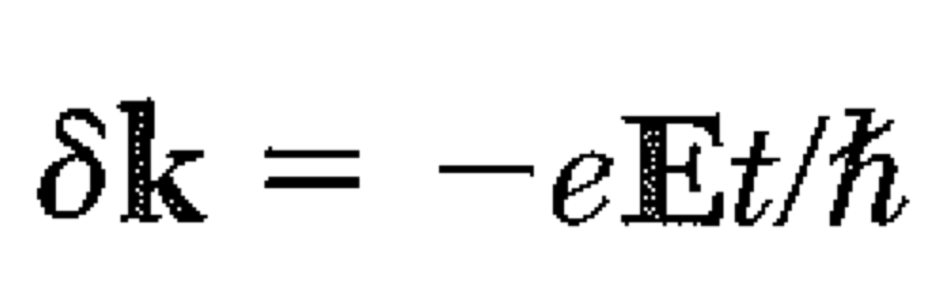
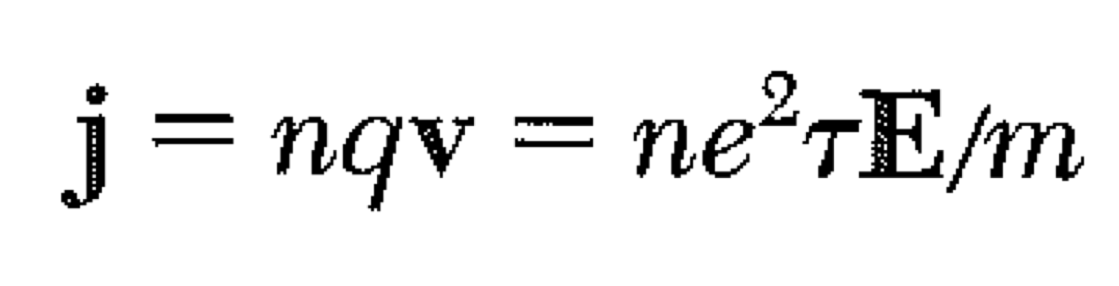
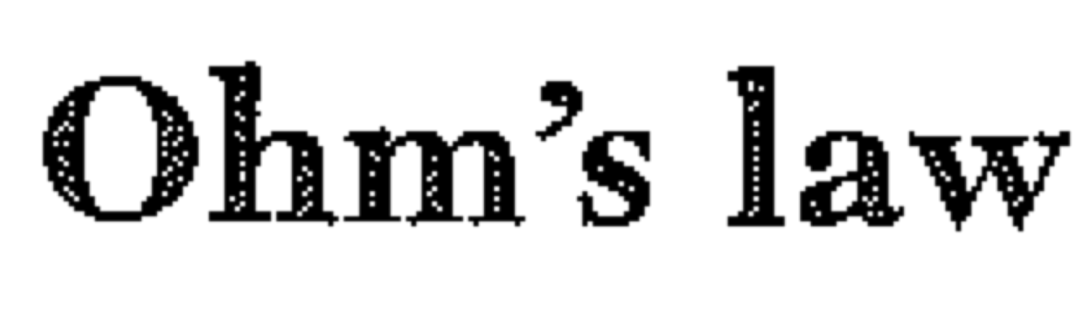
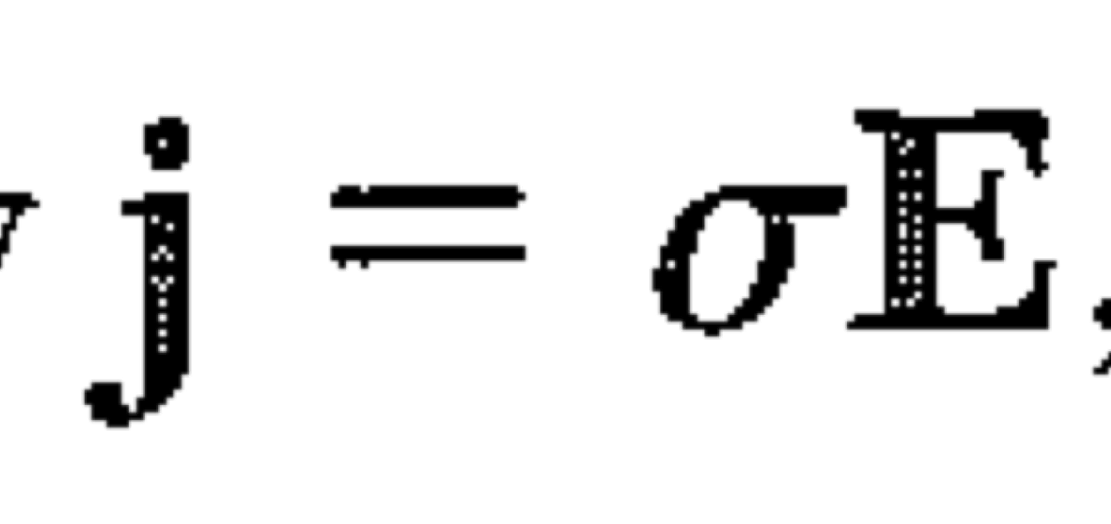
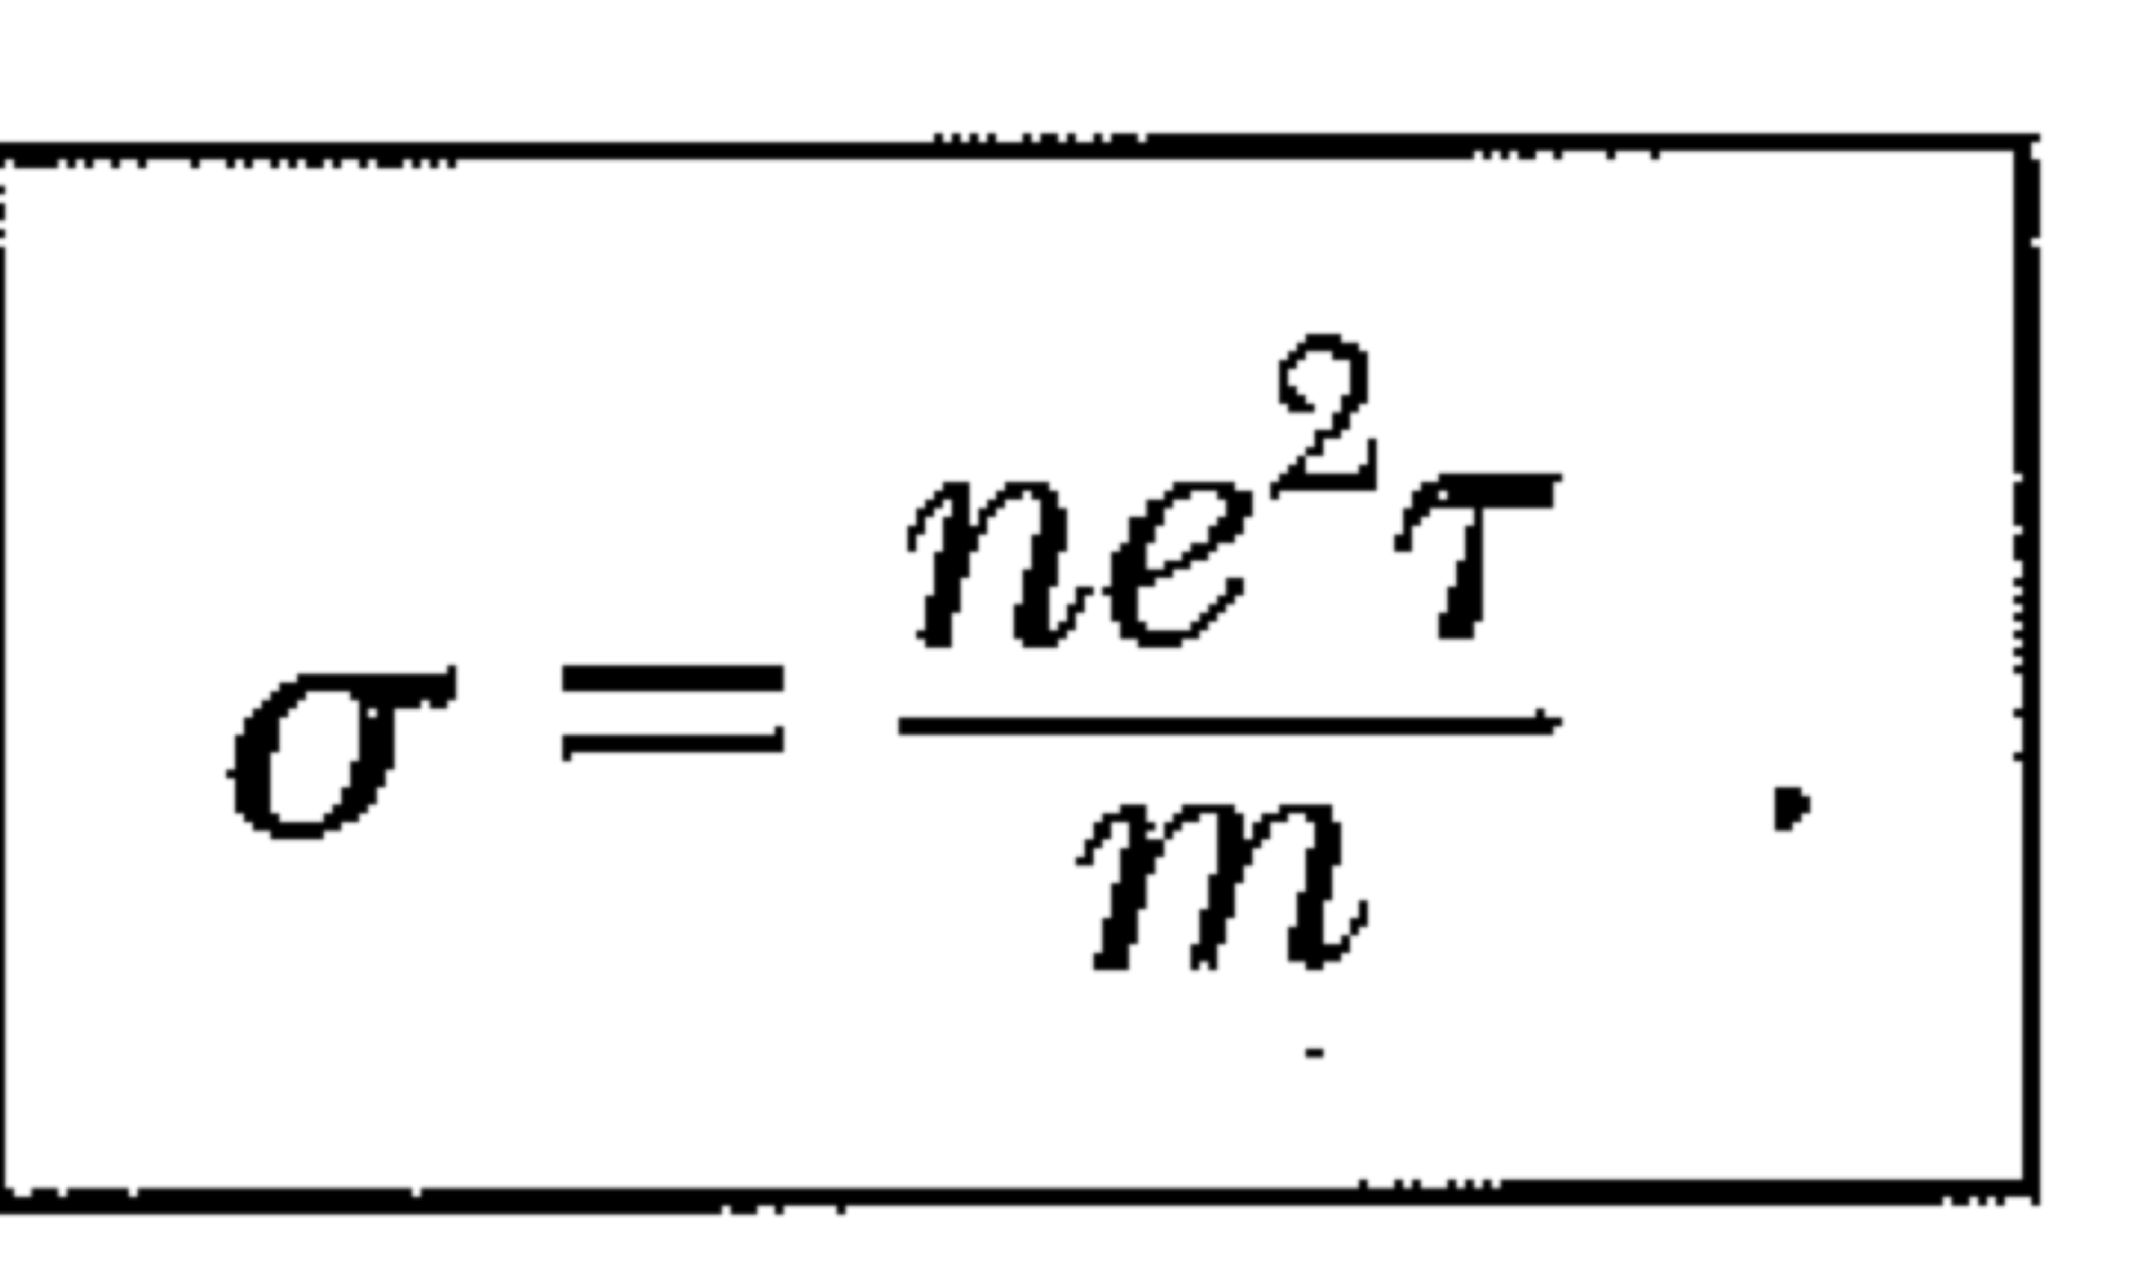
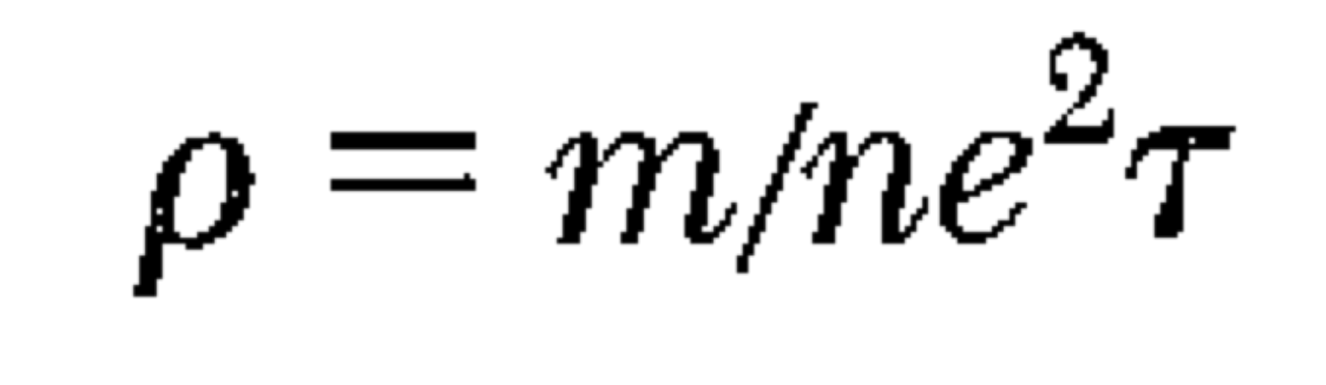
Electrical Conductivity
resistivity

Slide 3
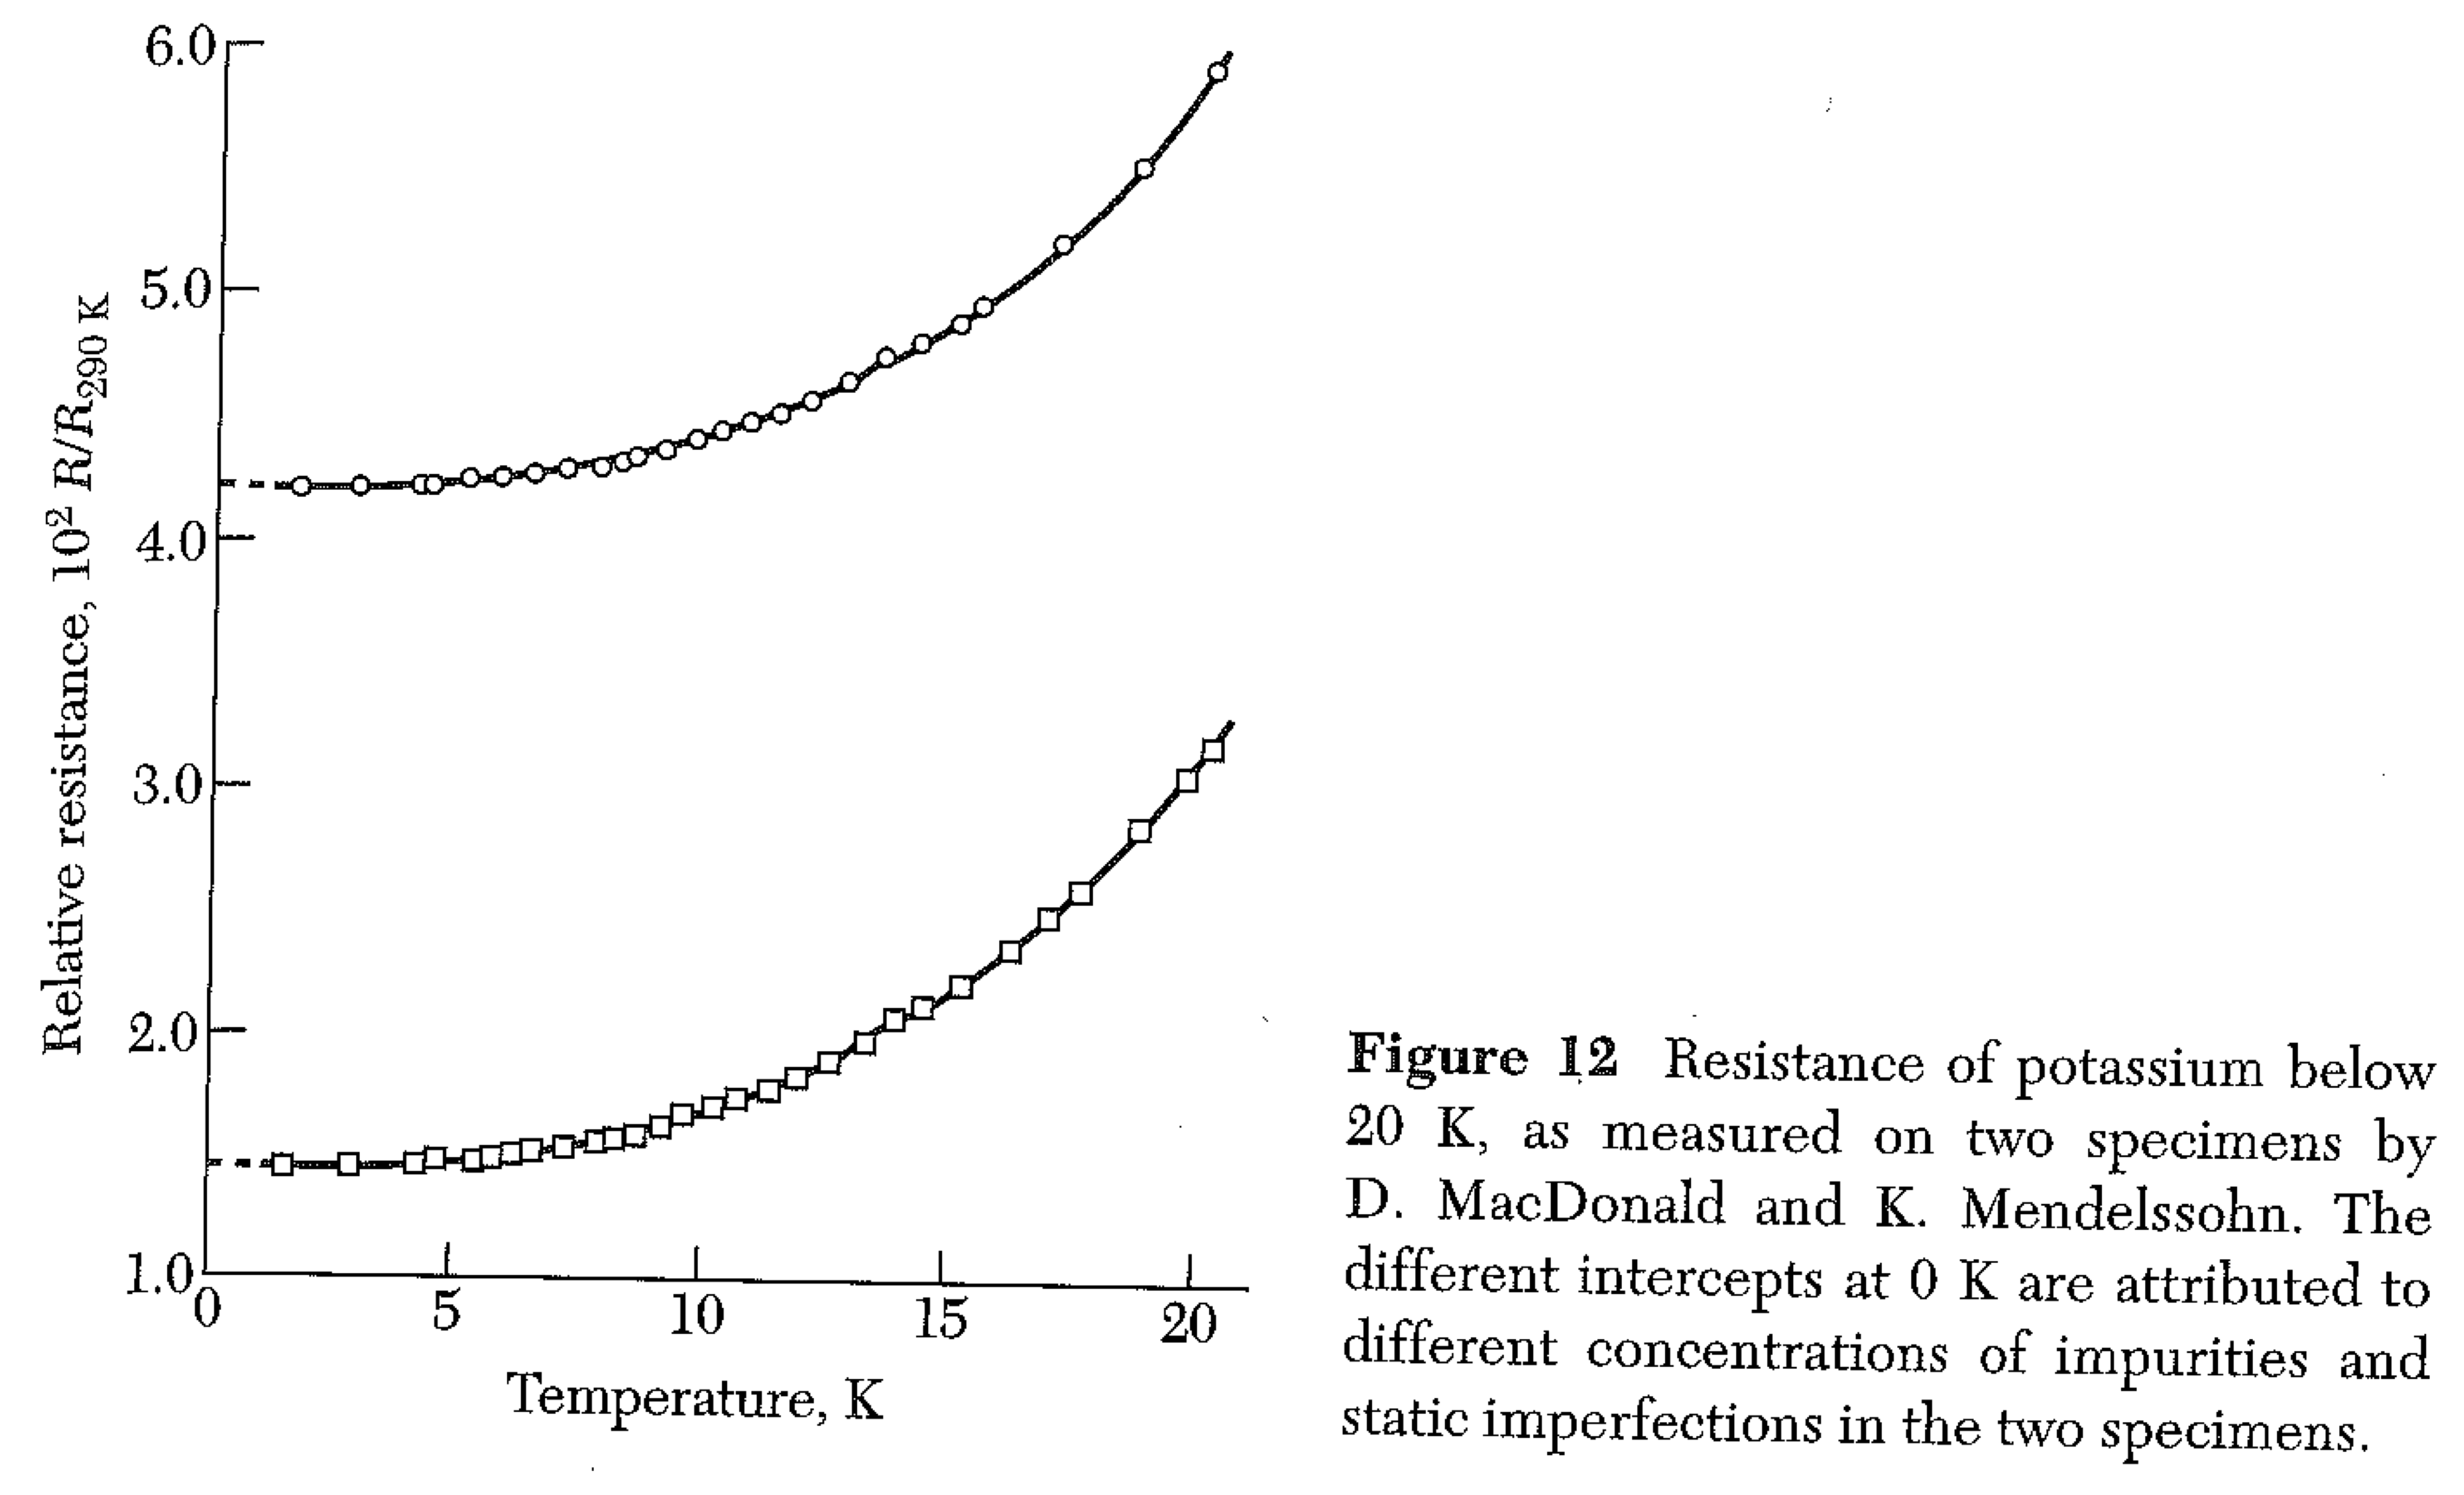
At low T, fewer phonons. Lower resistivity.
Limit at T = 0K is from impurities / static imperfections only.
Note: “superconductivity” means something different from a really pure, really cold sample.

Slide 4
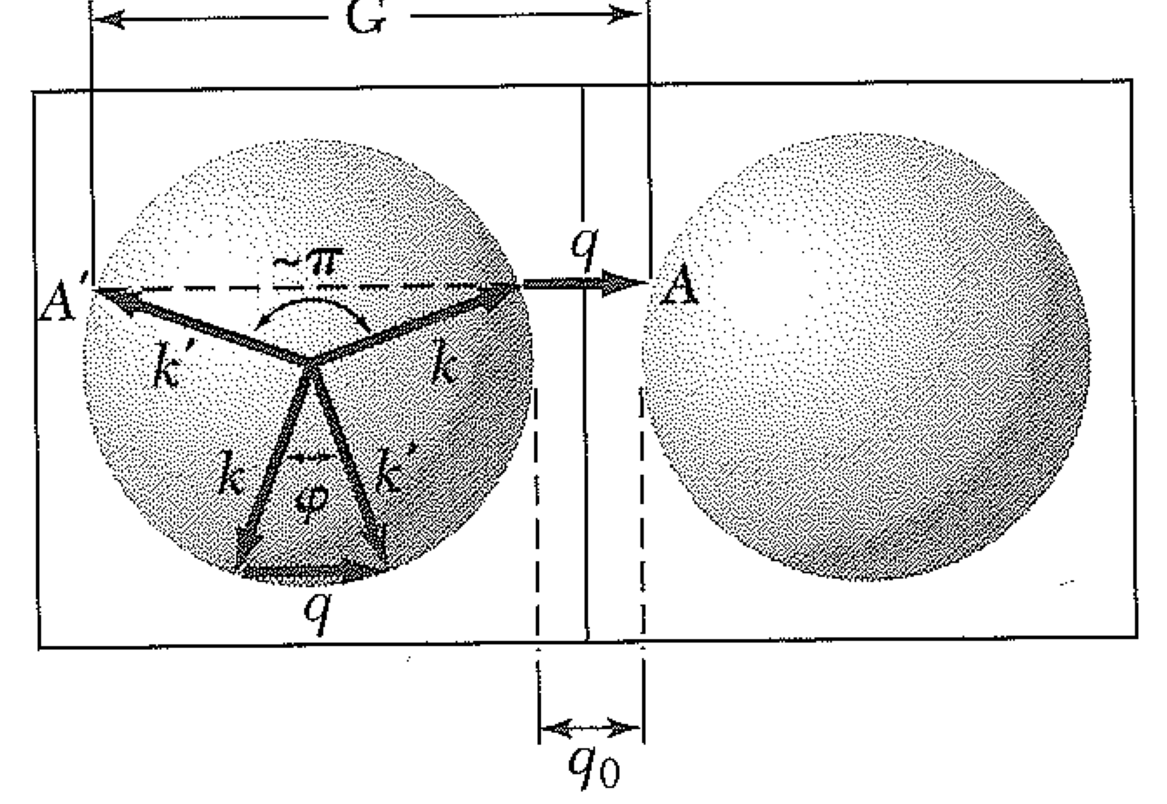
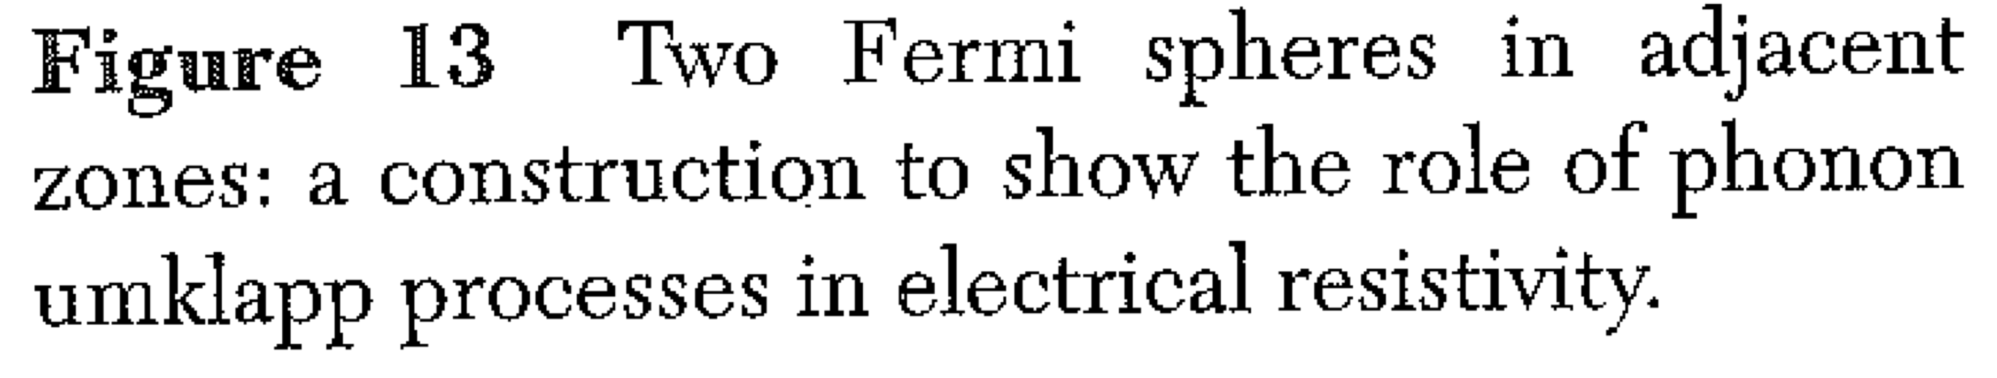
Not all electron-phonon collisions are equally effective in “redirecting” the electron.
(In our model, τ is the time for an electron to completely randomize its direction… to get to an “average” velocity of zero.)
Collisions with low energy (long wavelength) phonons don’t change the electron wavevector much.
k’ = k + q q=phonon momentum (phonon destroyed / “absorbed”)
Near BZ boundary, we can have
k’ = k + q + G, giving a big change in electron k.

Slide 5
Because umklapp processes are most effective at scattering electrons through a big momentum change, the resistivity does NOT vary like T⁴…

Slide 6
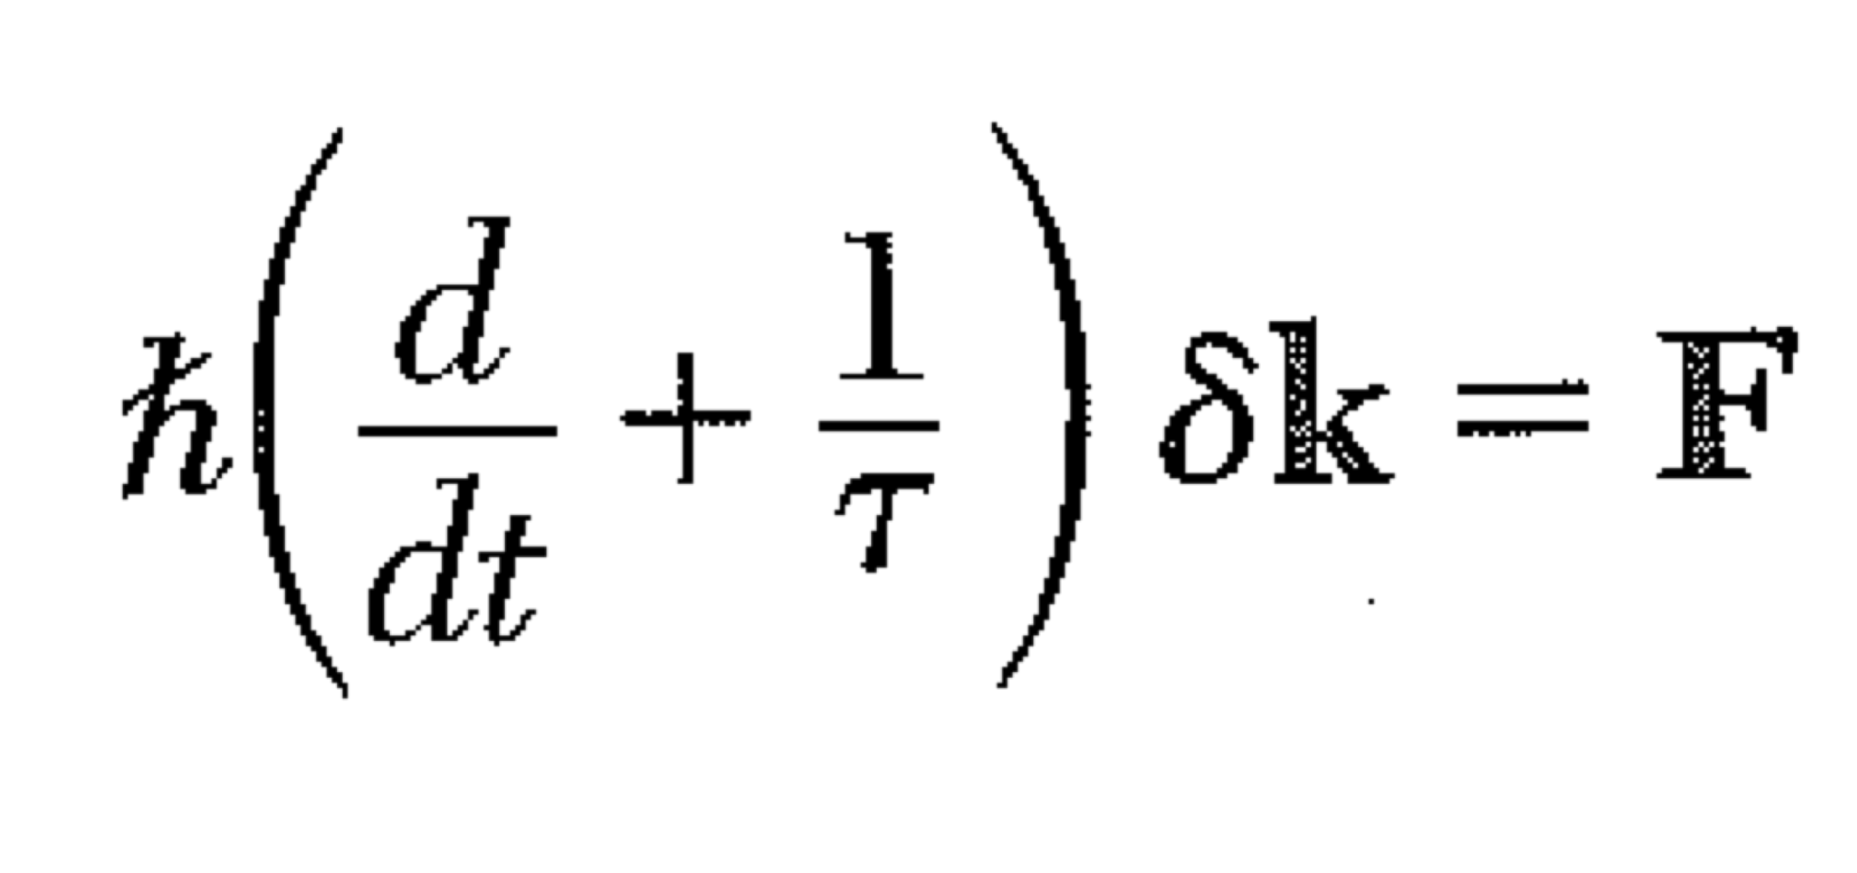
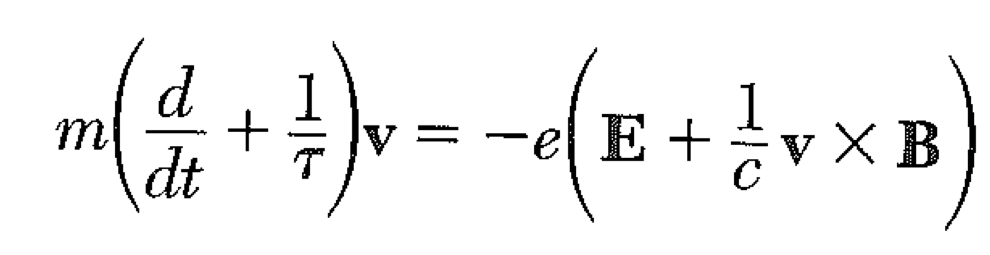
The idea that collisions limit the “time domain” of the Lorentz force law can be mathematically incorporated by writing
Here, a steady force gives momentum that approaches a constant with exponential time constant τ

Slide 7
This “phenomenological” law gives a frequency-dependent conductivity. This is what is observed in real metals.
To find the freq depd conductivity, let
Conductivity is complex.

Slide 8
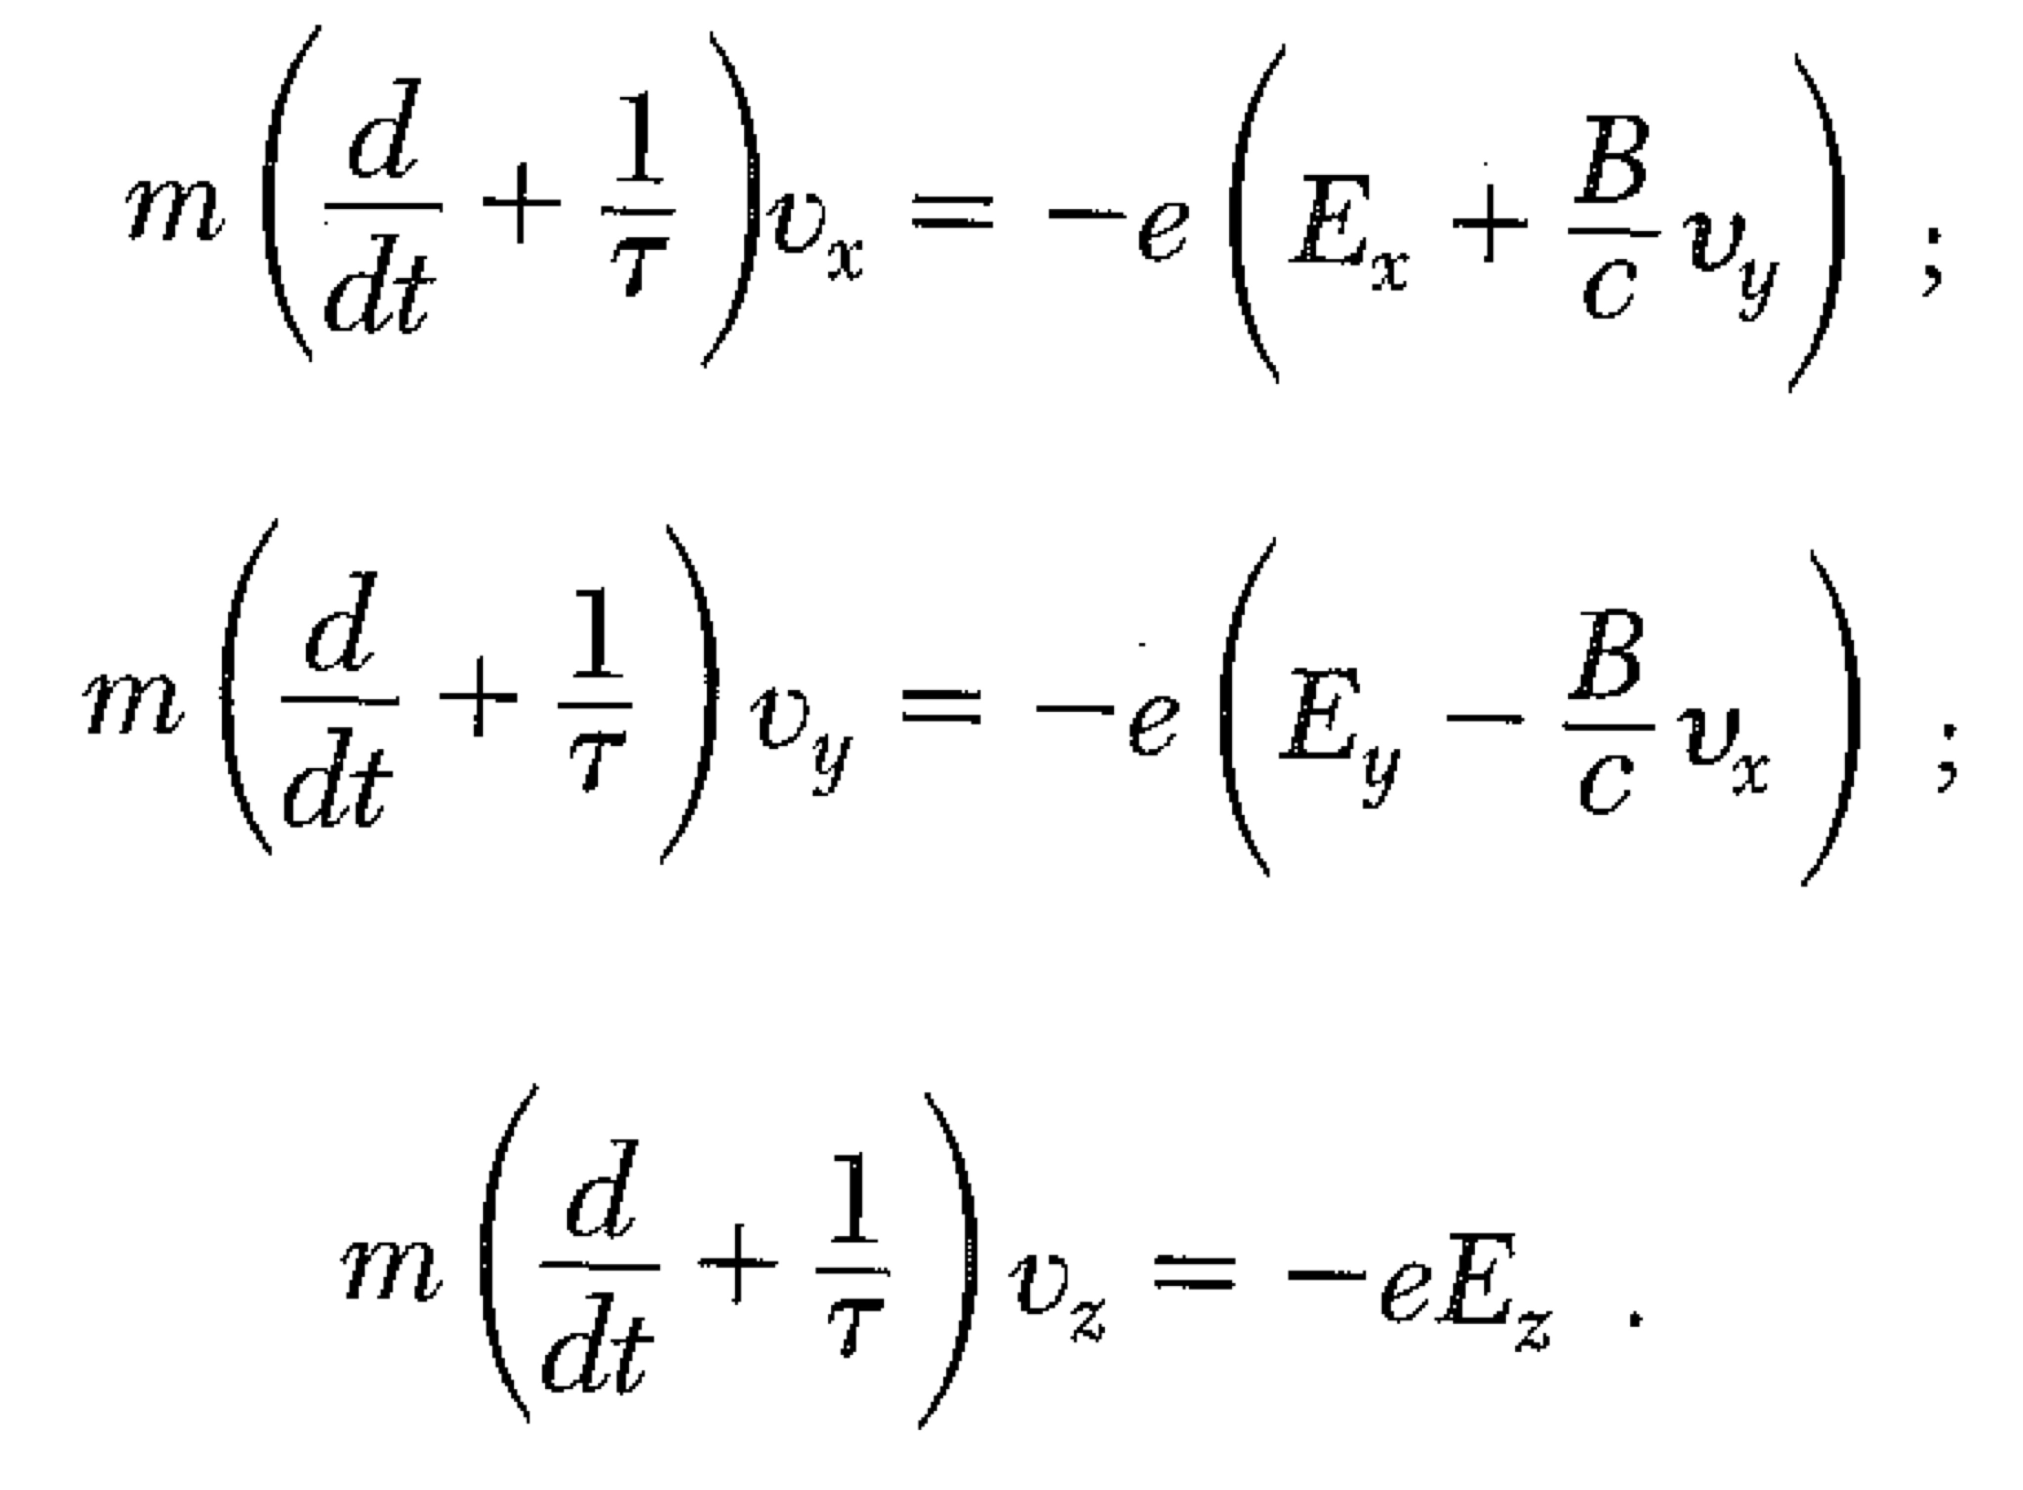
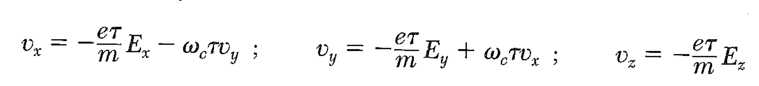
Cyclotron Frequency. B field along z-axis.

Slide 9
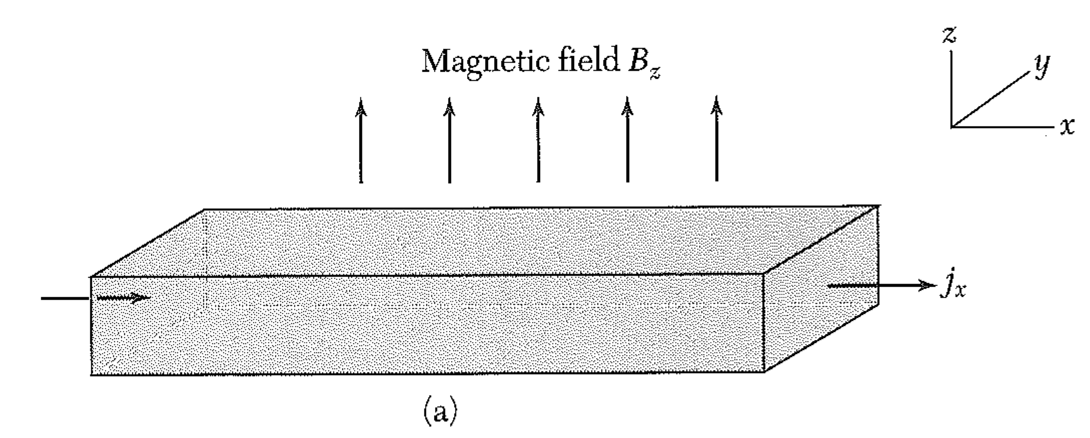
Hall effect.
If we apply a field only along x, what happens?
You will find that v_{x} is (solve for v_{y} and substitute in v_{x} eqn)
So v_{y} is not zero.
If we have slab of conductor:
Current cannot flow along y, so v_{y}
must be zero.

Slide 10
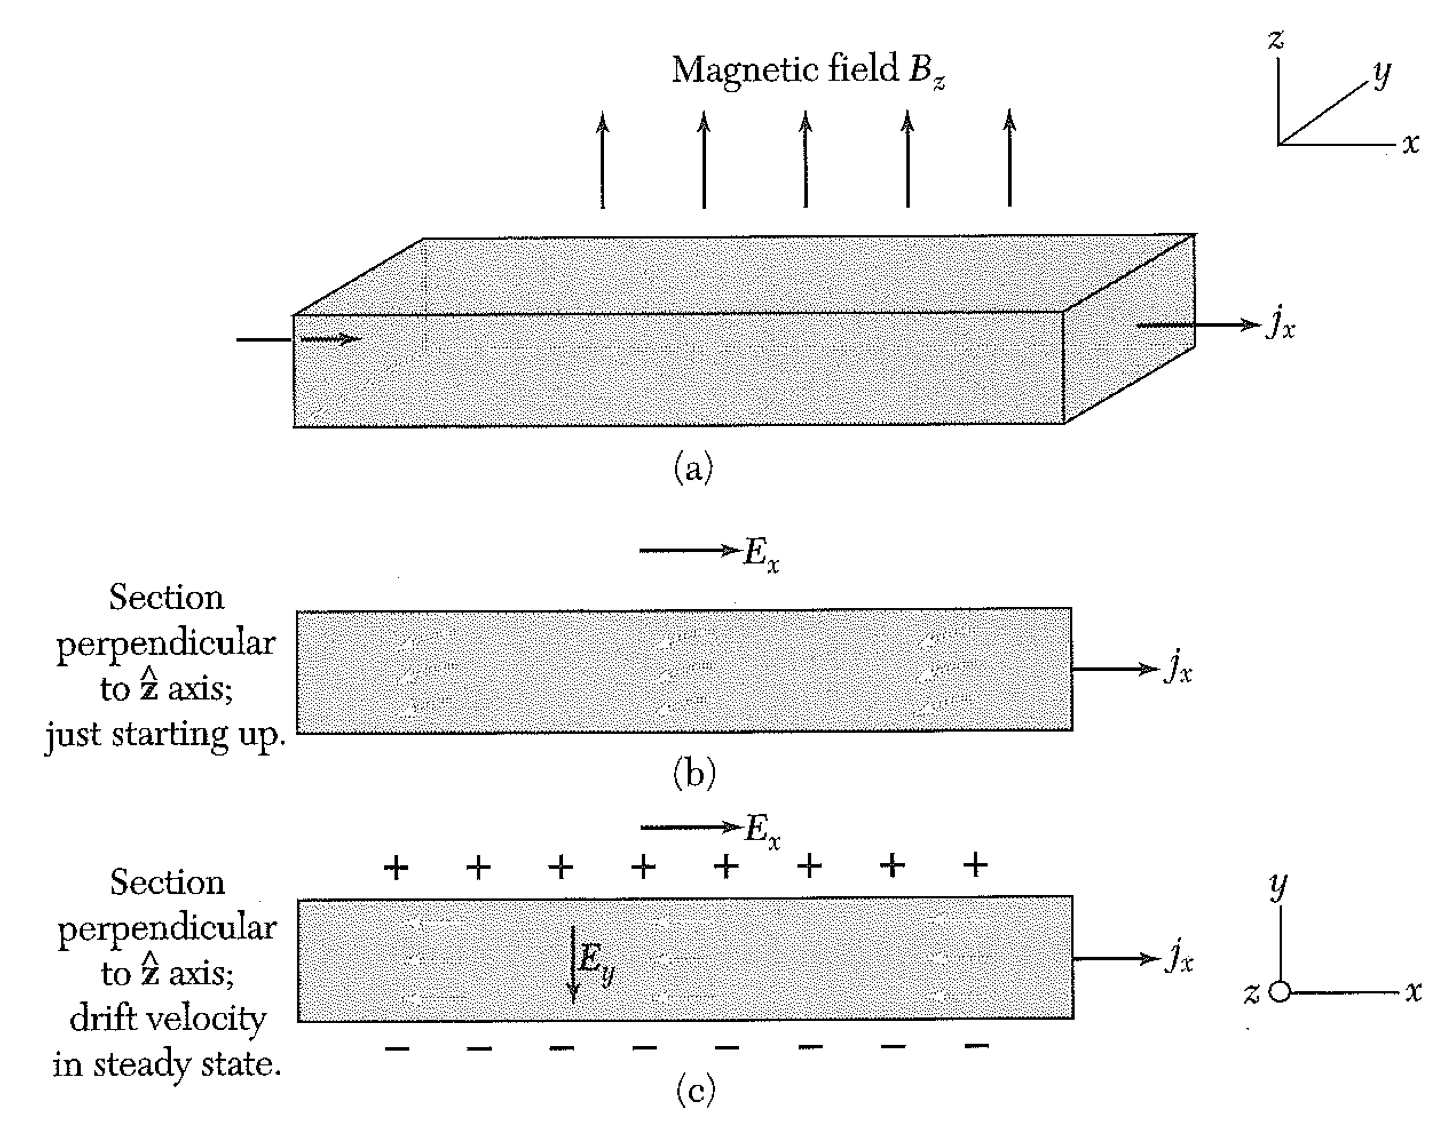
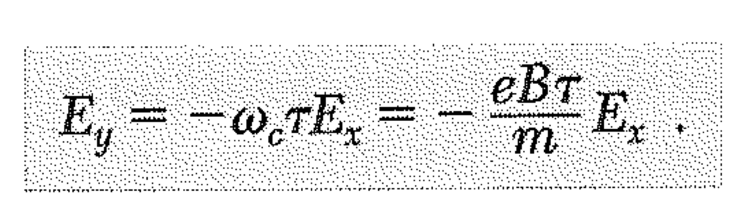
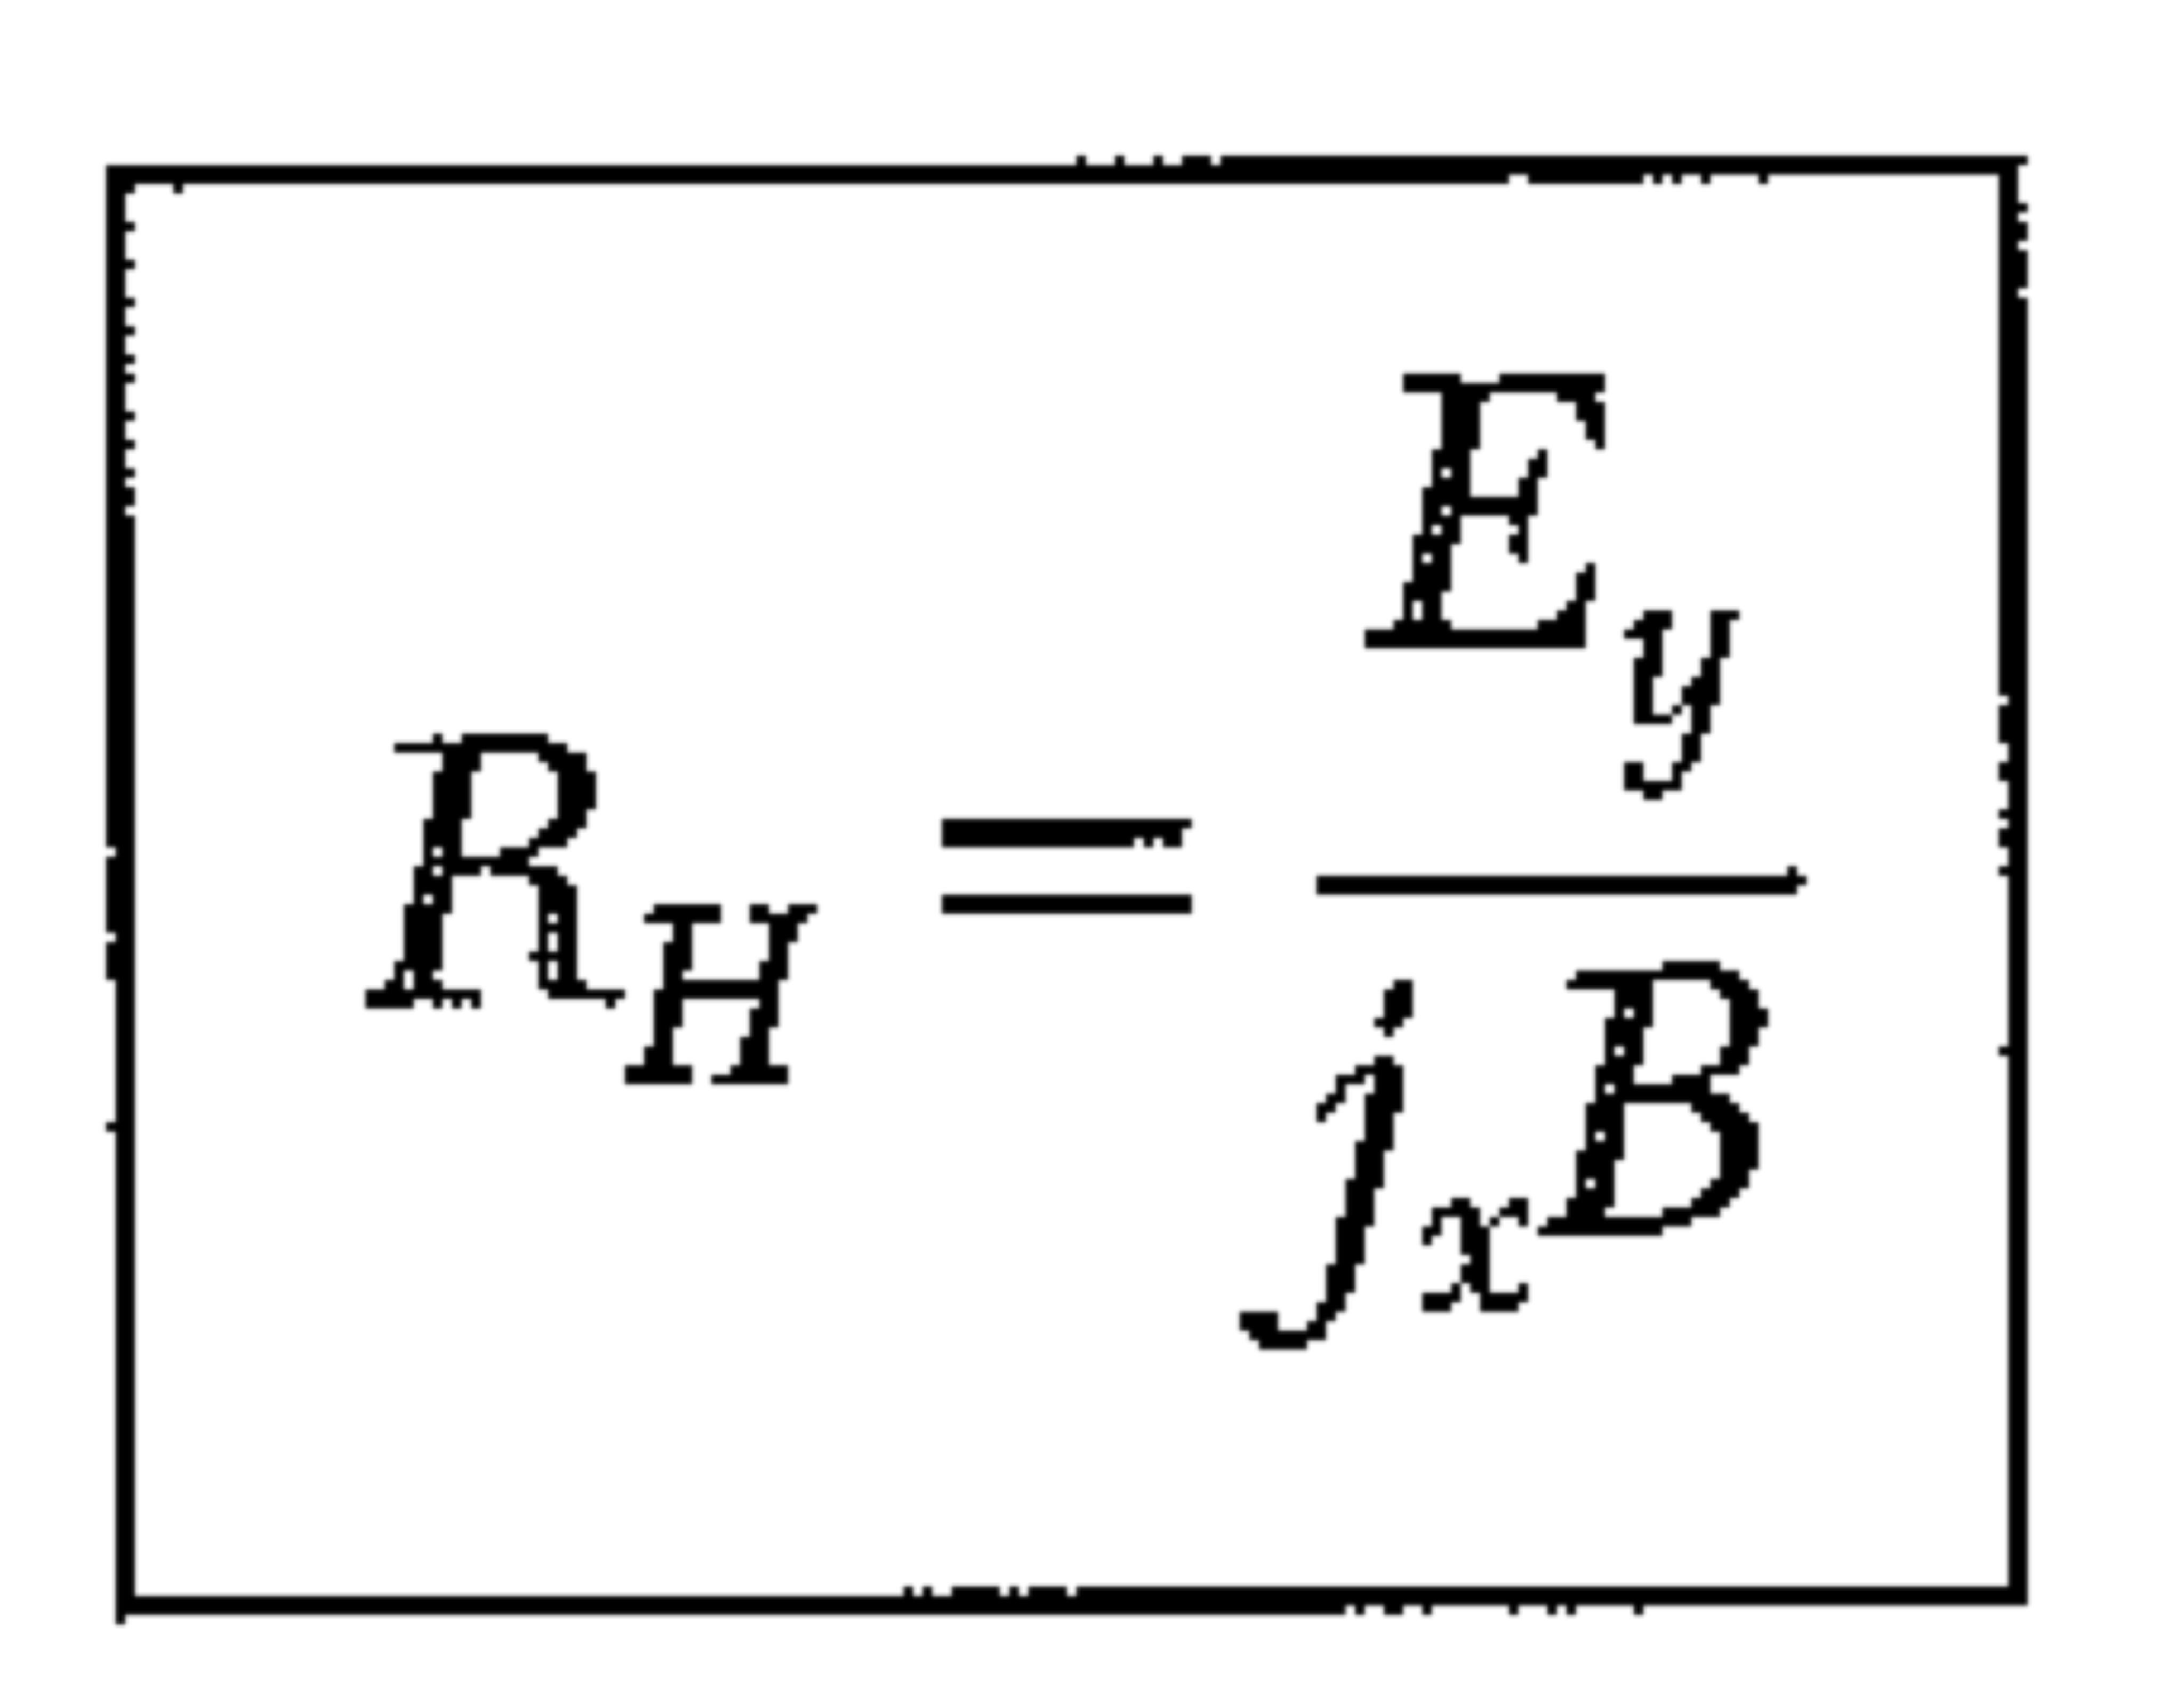
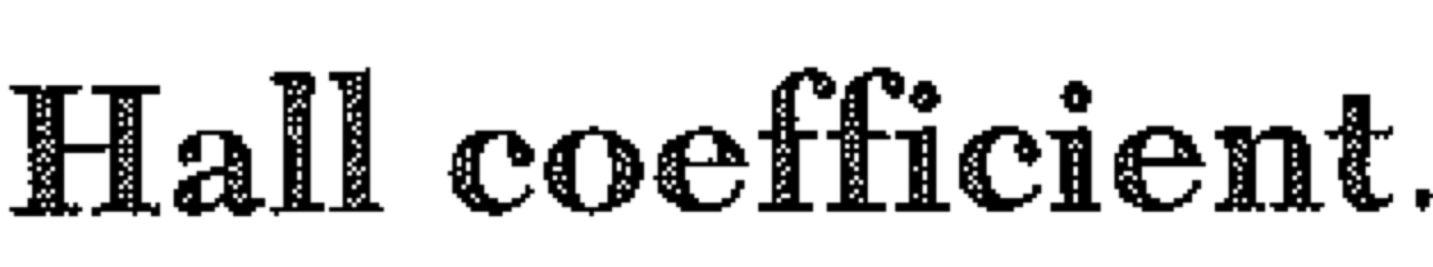
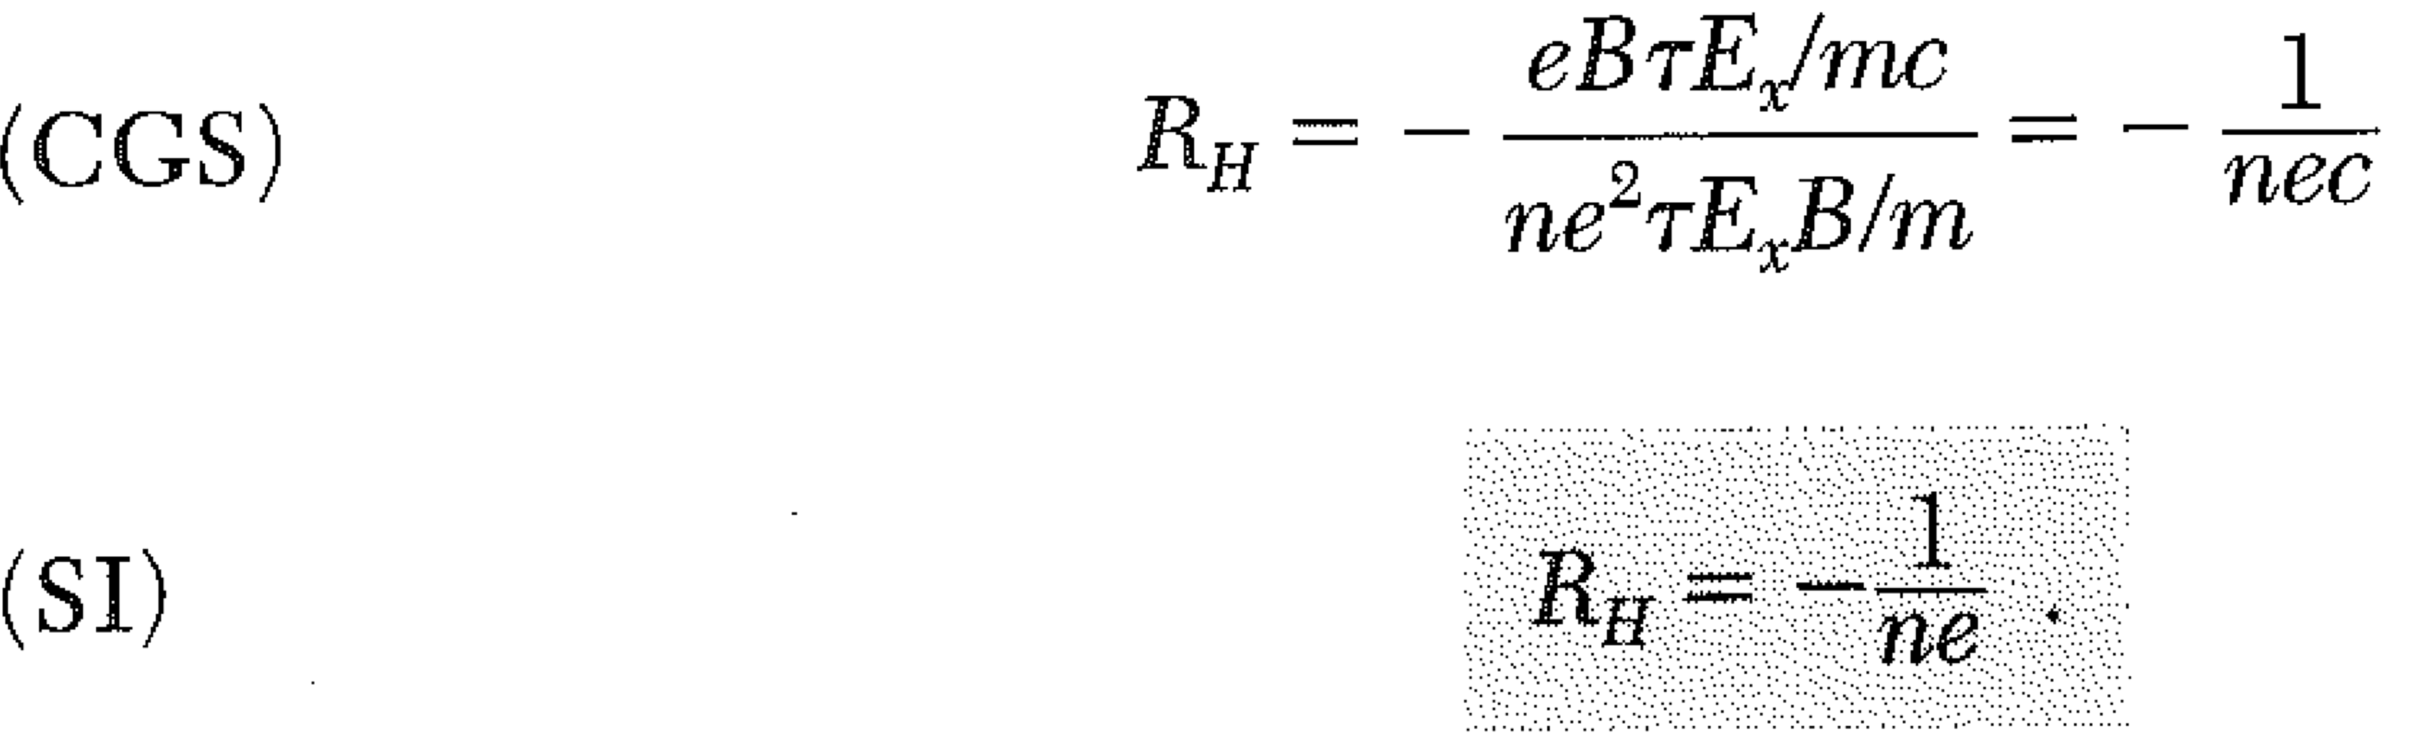
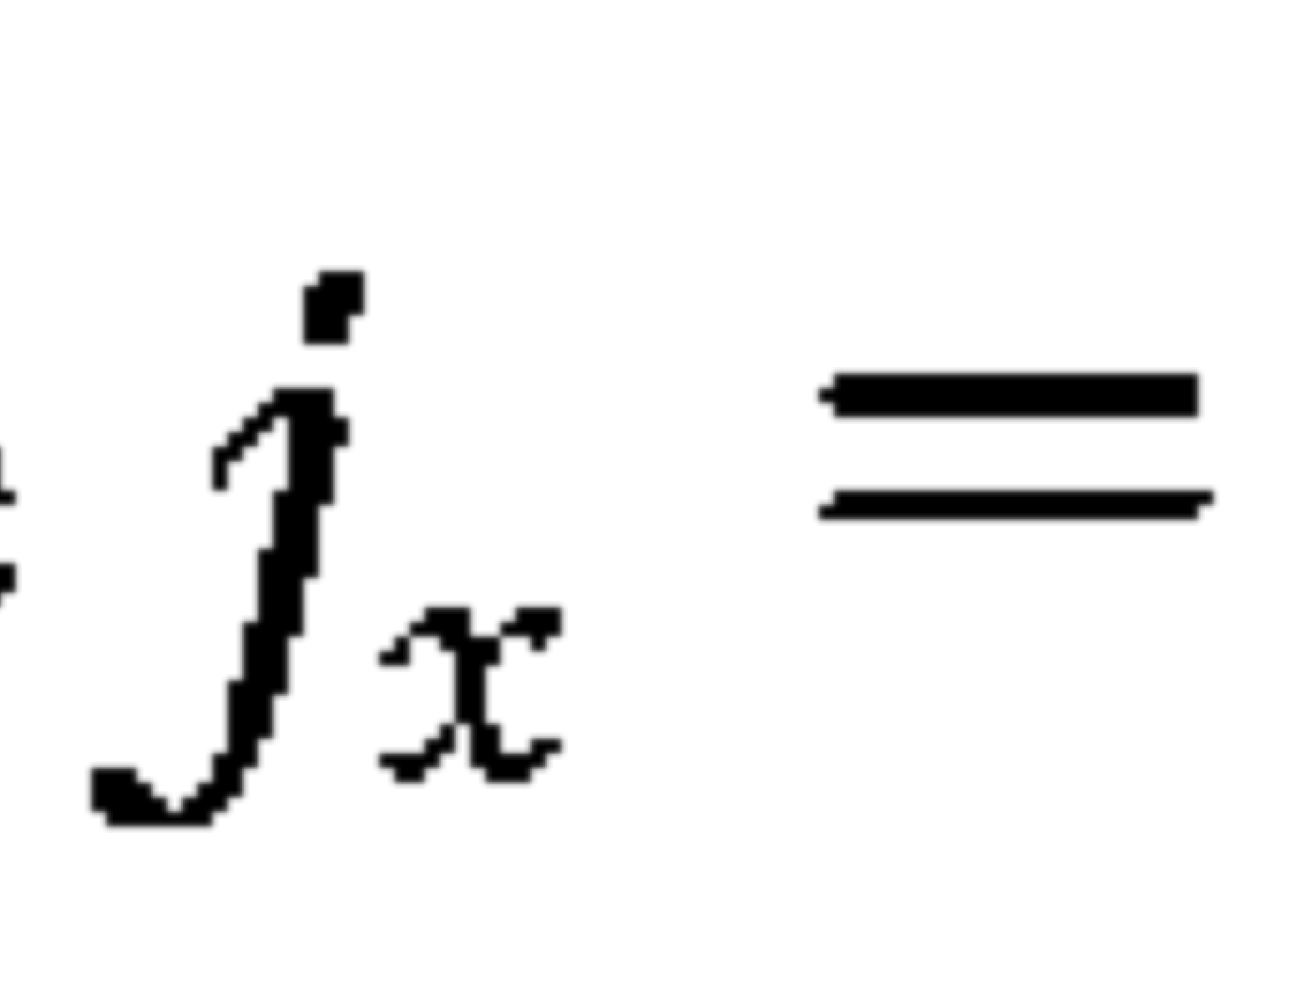
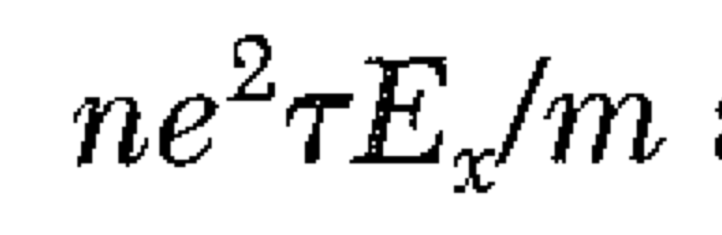
Hall tells carrier concentration and sign!

Slide 11
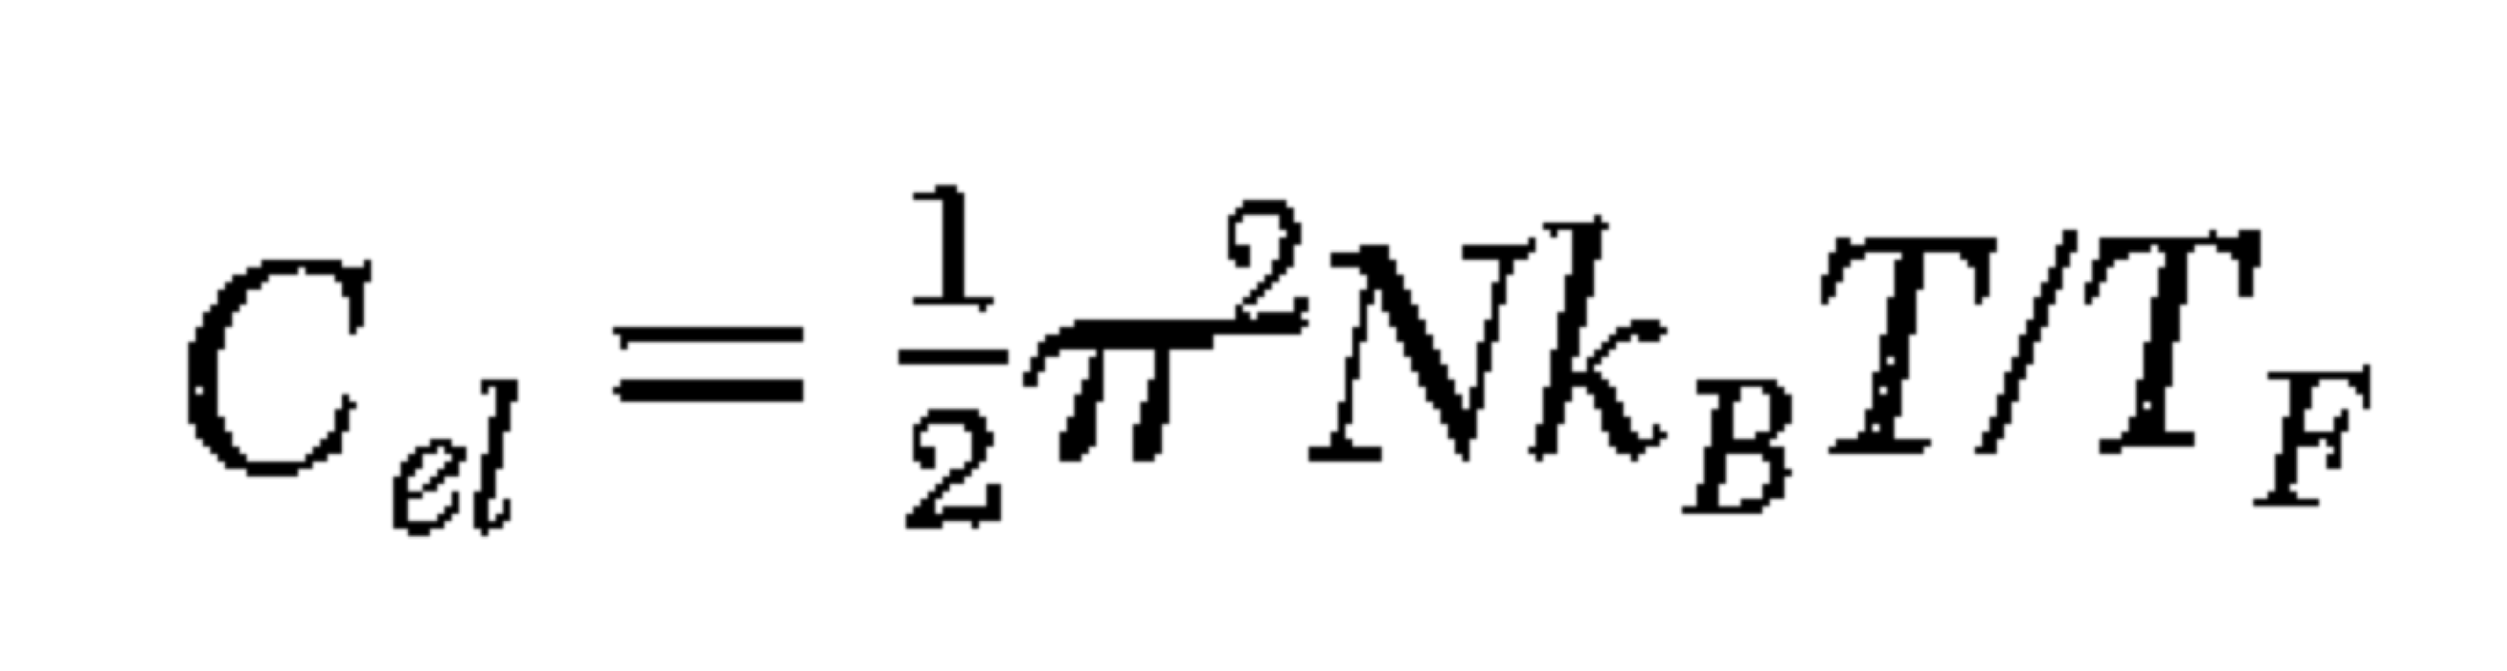
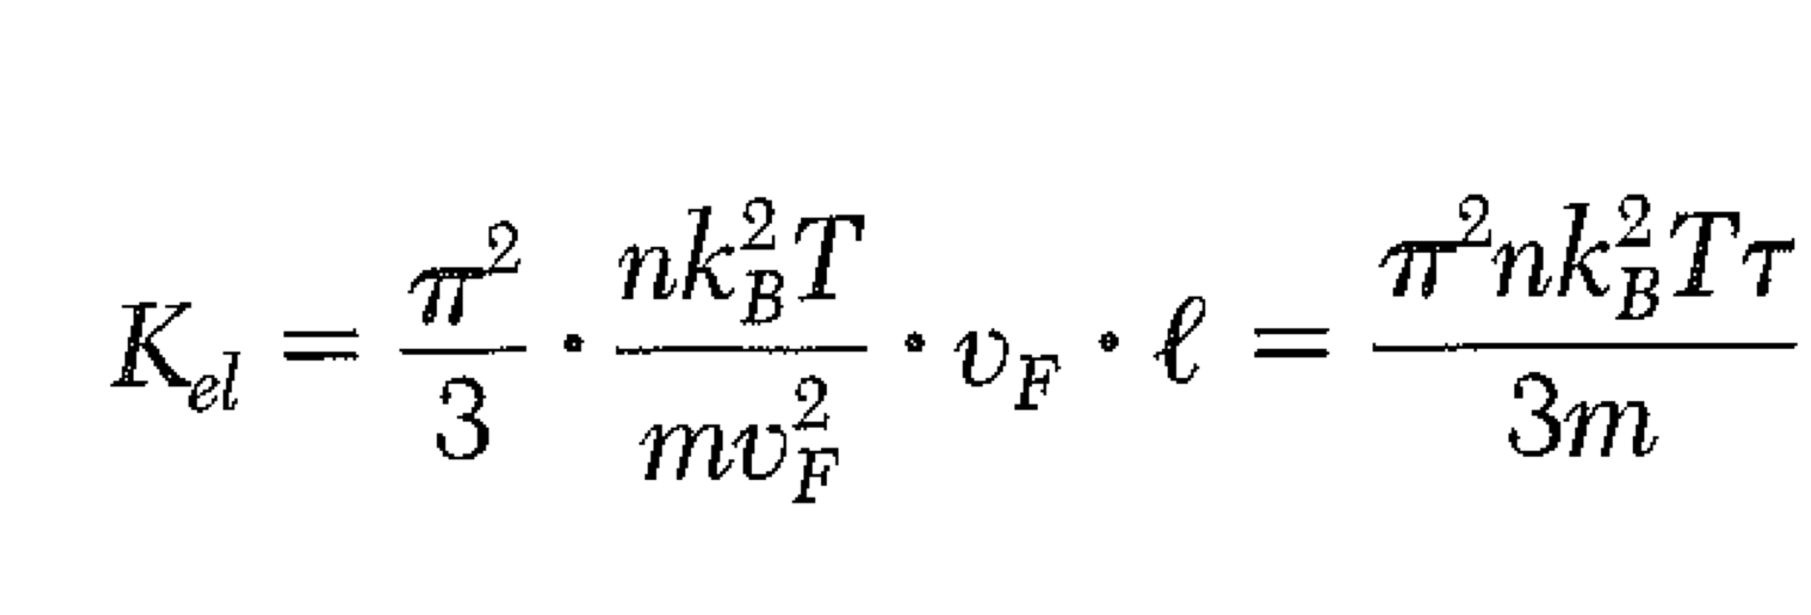
Electronic Thermal Conductivity
Thermal conductivity of a gas
For electrons, the velocity is the Fermi velocity. (FAST!)
The scattering length l is the Fermi velocity x τ. Thus
(From difficult integral over fermi distribution)
Most heat is conducted by electrons, not phonons, in metals.

Slide 12
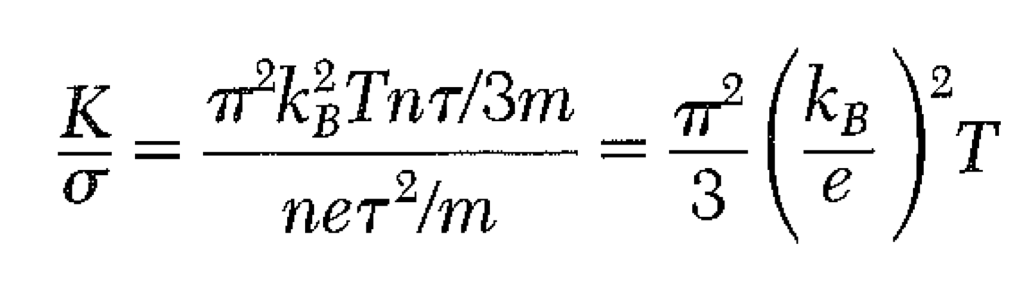
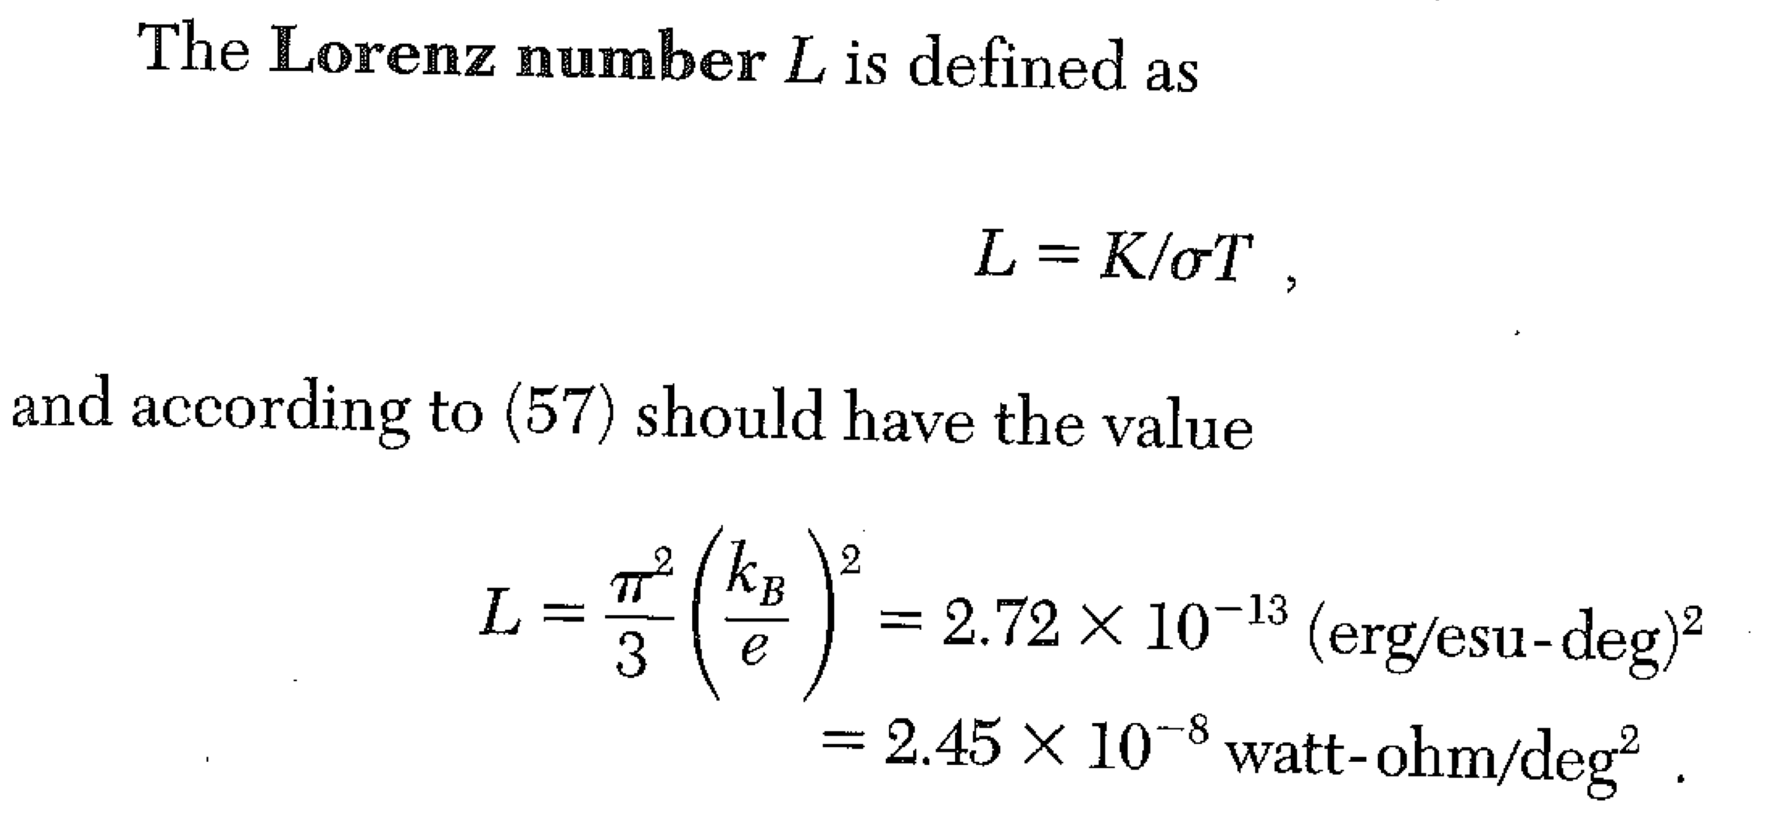
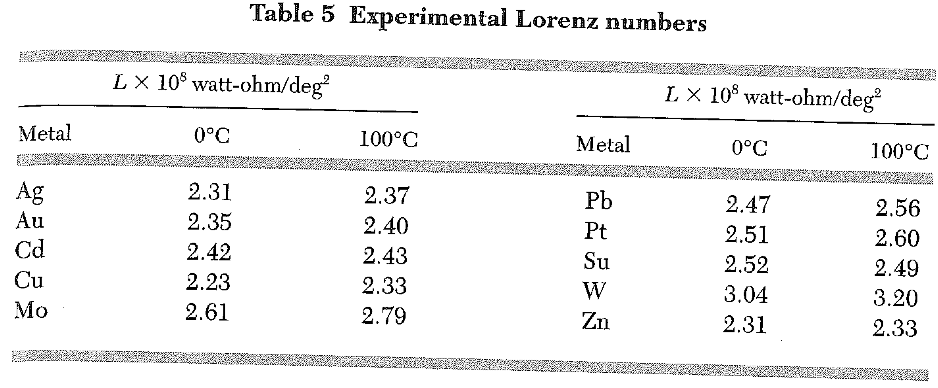
First strong support for the electron gas model:
Ratio of thermal conductivity to electrical conductivity is independent of specific metal – Wiedemann-Franz law.
typo

Slide 13
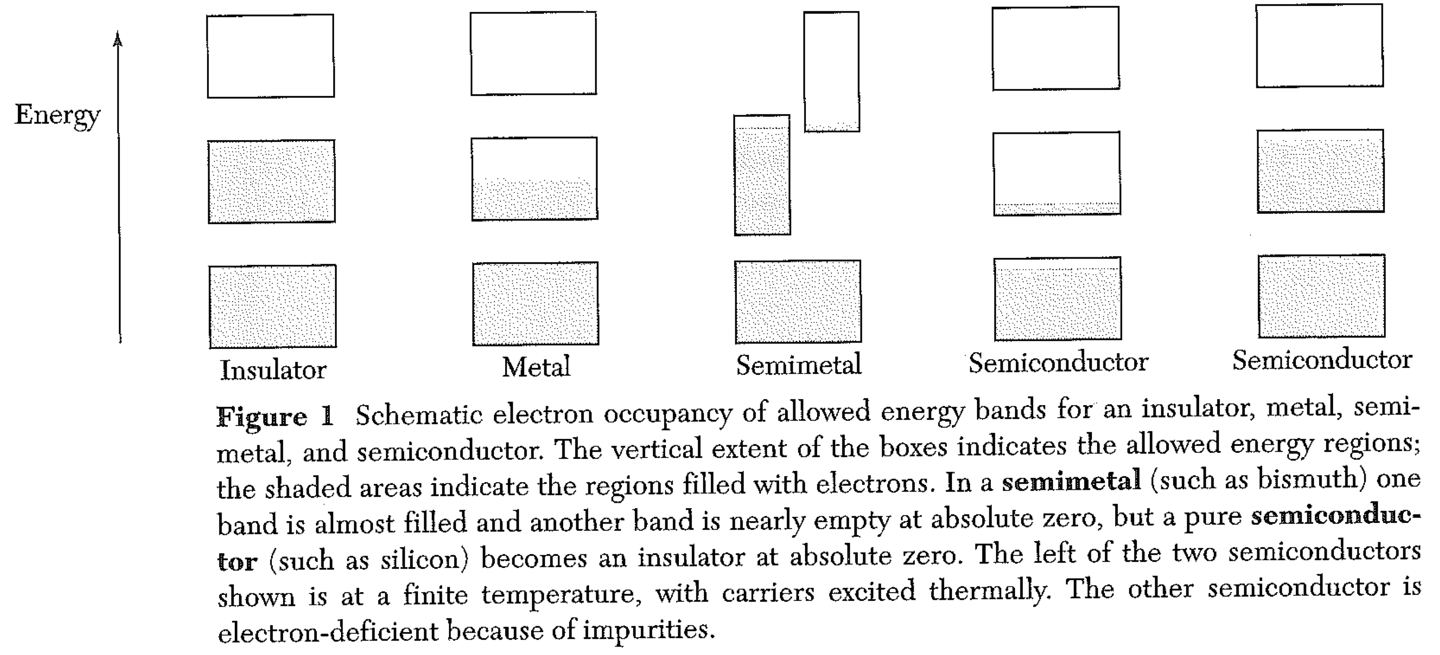
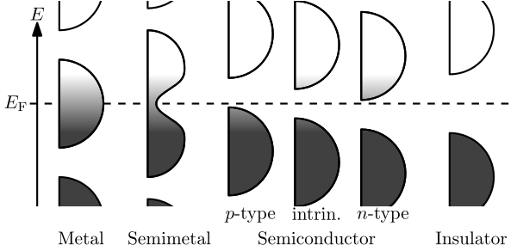
Chapter 7: Energy Bands

Slide 14
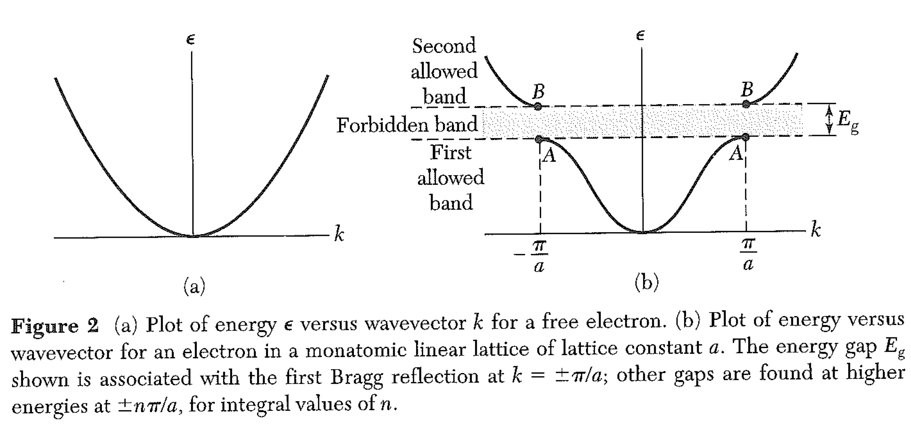
Band Gaps
Why is there an energy gap at the BZ boundary?

Slide 15
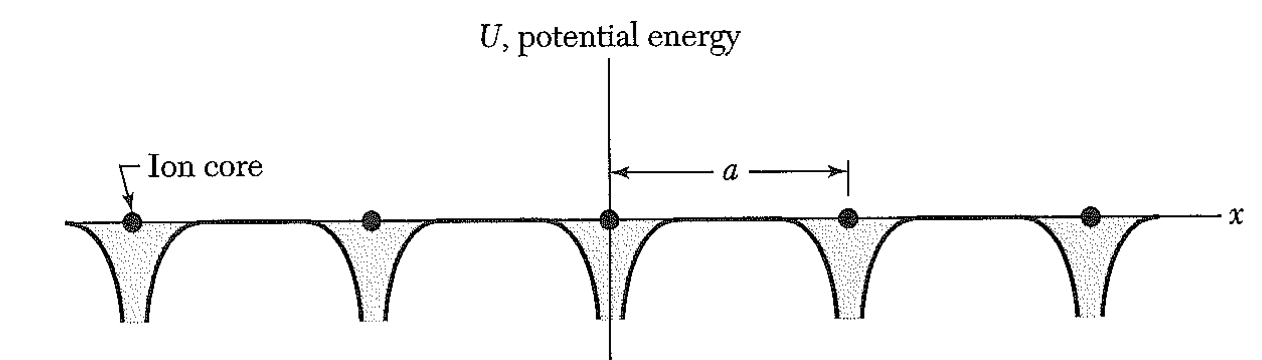
Band Gaps
Why is there an energy gap at the BZ boundary?
The ion core potential can be represented as a Fourier cosine series.
The electron waves at the BZ boundary are
Waves of this wavelength should diffract (reflect) and thus form standing waves.
We can make standing waves by a superposition of the ± waves above.
These are

Slide 16
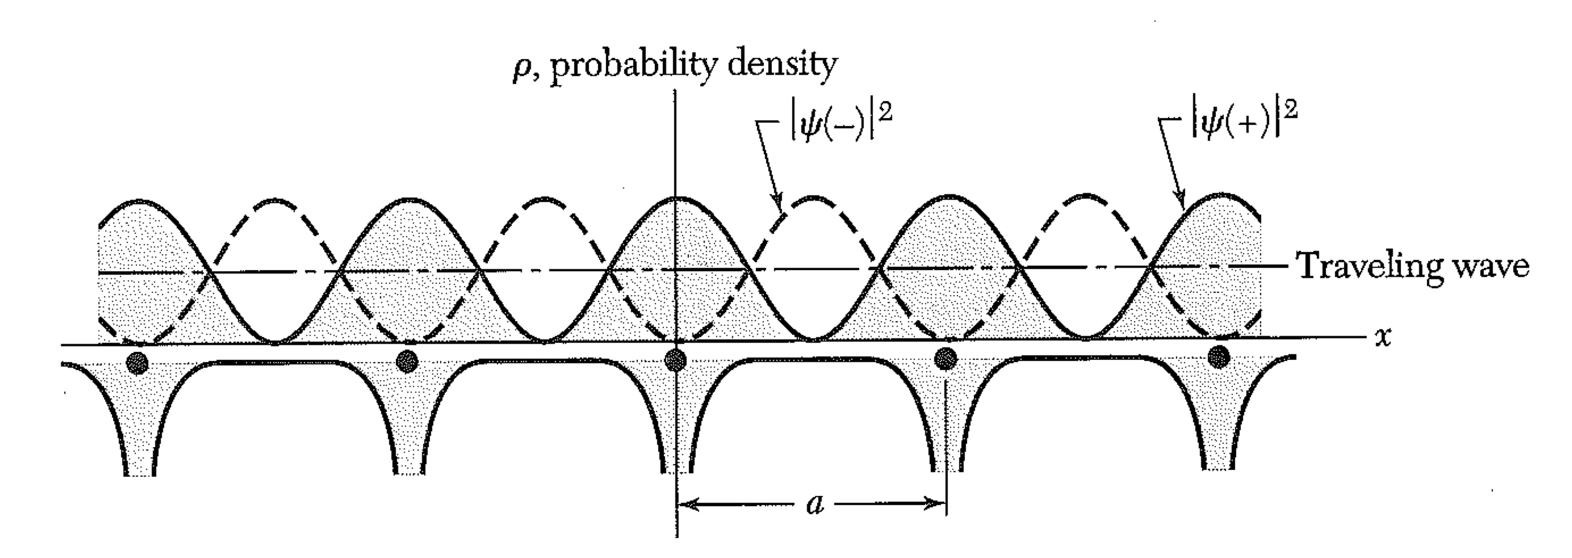
Band Gaps
The electron density is proportional to the square of the wavefunction.
The cosine wave has the electron density closer to the positive cores. This lowers the energy.
The sine wave has the electron density in between the positive cores. This raises the energy.

Slide 17
Band Gaps

Slide 18
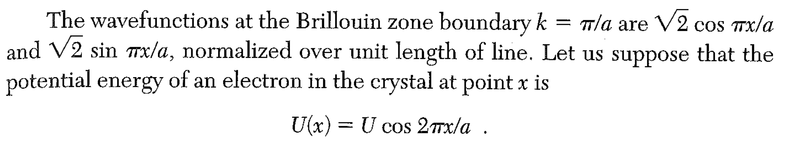
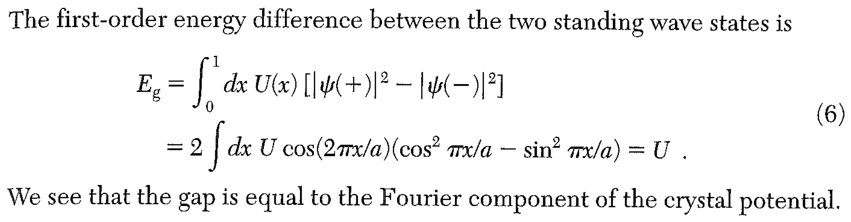
Note: U(x) may have other Fourier components, but they will not contribute.

Slide 19
Boardwork:
Suppose an element gives up two electrons when it makes a crystal. The number of states to hold all these electrons is equal to the number of states in the 1st BZ. (Why?)
Consider a cubic crystal. What is the energy of a free electron with a wavevector to the corner of the 1st BZ? What is the lowest energy of a free electron in the 2nd BZ? What is its wavevector?
If the unit cell size is a, what bandgap in energy would make this material an insulator?
How deep is the (Fourier cosine term in the) atomic potential, in eV?

Slide 20
Lecture 14
Last time:
Suppose an element gives up two electrons when it makes a crystal. The number of states to hold all these electrons is equal to the number of states in the 1st BZ. (Why?)
Consider a cubic crystal. What is the energy of a free electron with a wavevector to the corner of the 1st BZ? What is the lowest energy of a free electron in the 2nd BZ? What is its wavevector?
If the unit cell size is a, what bandgap in energy would make this material an insulator?
How deep is the (Fourier cosine term in the) atomic potential, in eV?
Using free electron wave functions and expectation values of the potential energy is called the NEARLY FREE ELECTRON MODEL.

Slide 21
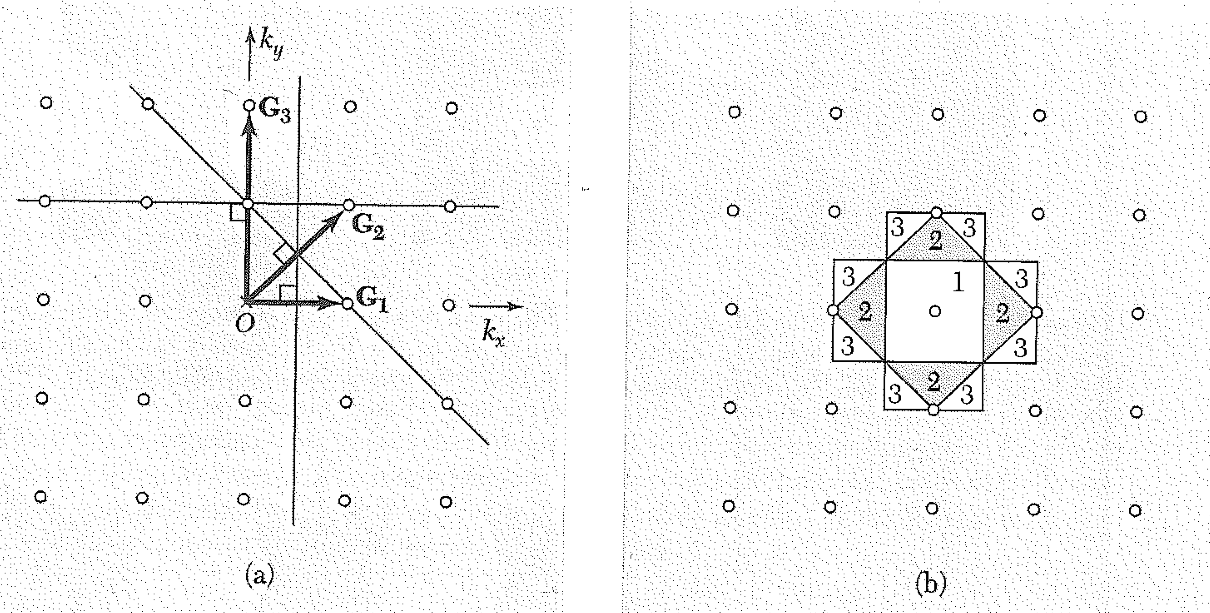
NEARLY FREE ELECTRON MODEL. - Review of BZs
Where are the 2nd, 3rd, 4th etc. BZs?

Slide 22
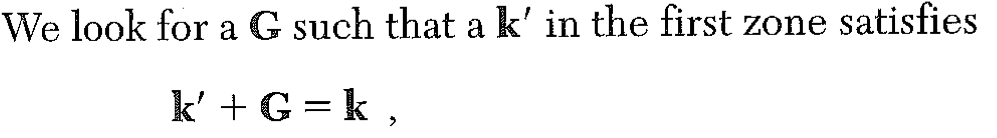
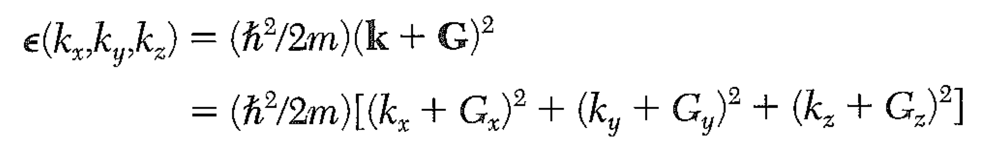
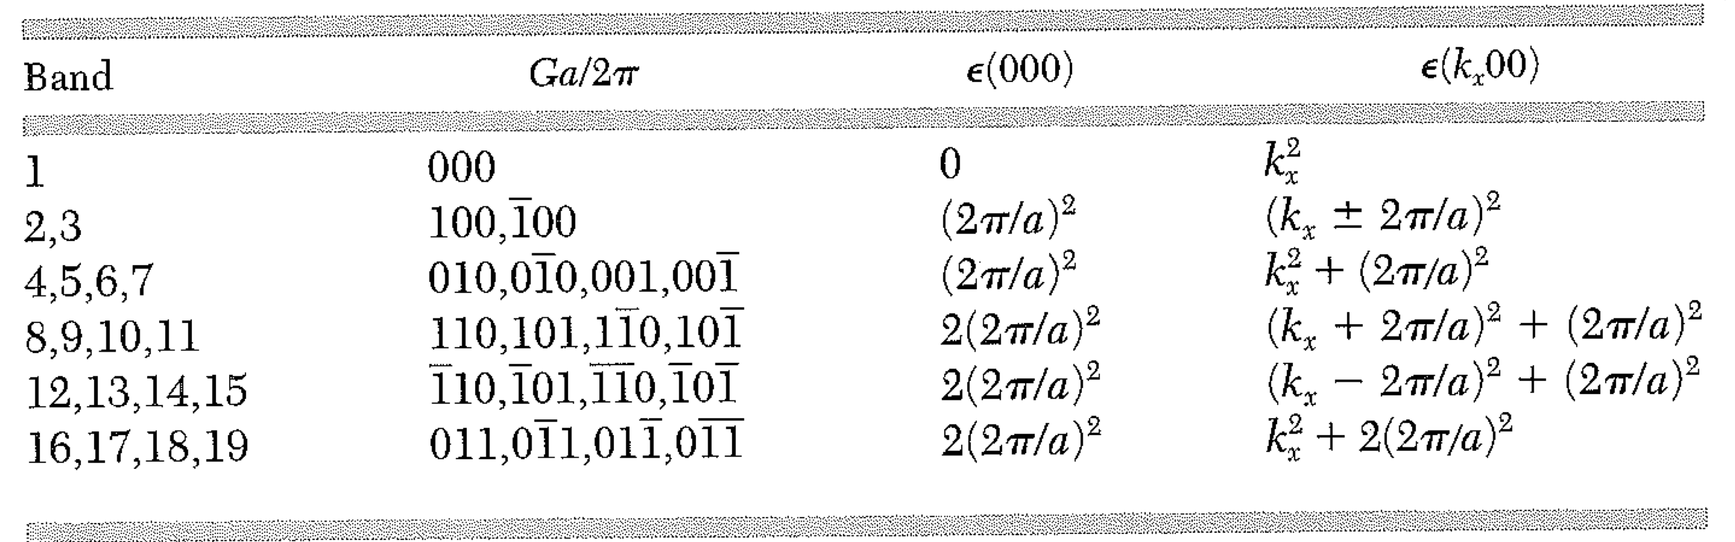
Reduced Zone Scheme for Plotting Electron Bands
- Plot all parts of the dispersion curve in the first zone.
We will plot the energy of electron with wavevector k at wavevector k’
FREE ELECTRON MODEL:
The energy of the electron is
(we’ve removed the prime… k is the 1st zone k.)
Example: simple cubic lattice. First, write down a table with different small Gs.

Slide 23
Reduced Zone Scheme
Example: simple cubic lattice. First, write down a table with different small Gs.
Then, write down an expression for the kinetic energy of the electron in each zone.
Here, we will plot the bands vs k_{x} … k_{y} and k_{z} are zero.
It also helps to put in the table the energy at the center of the band, where k_{x} = 0.

Slide 24
Reduced Zone Scheme
Example: simple cubic lattice. First, write down a table with different small Gs.
Then, write down an expression for the kinetic energy of the electron in each zone.
Here, we will plot the bands vs k_{x} … k_{y} and k_{z} are zero.
It also helps to put in the table the energy at the center of the band, where k_{x} = 0.

Slide 25
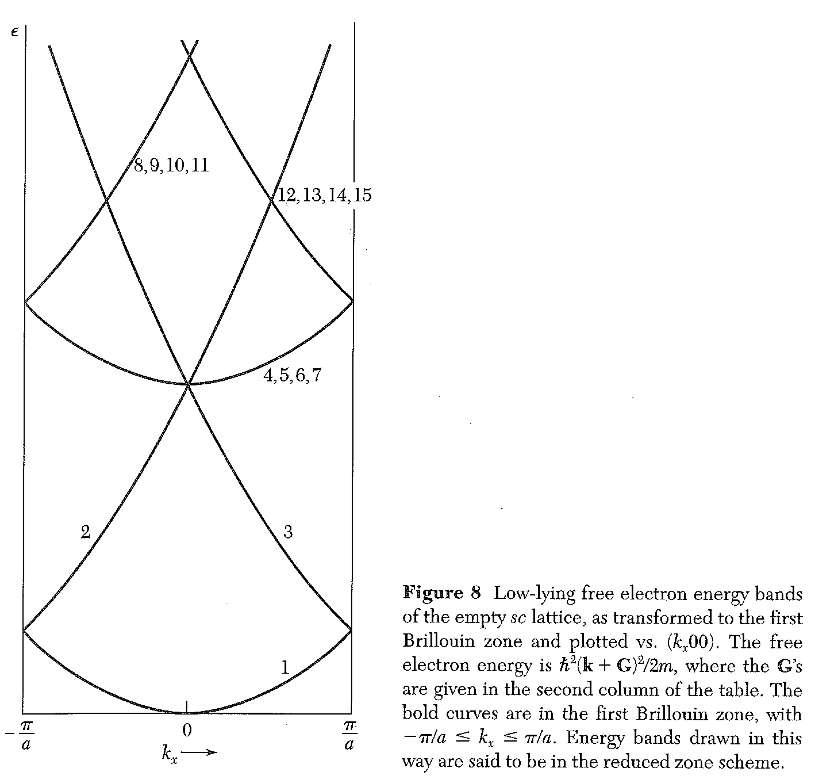
Reduced Zone Scheme
Finally, plot the bands described by the equations on the right hand column. These are the bands.

Slide 26
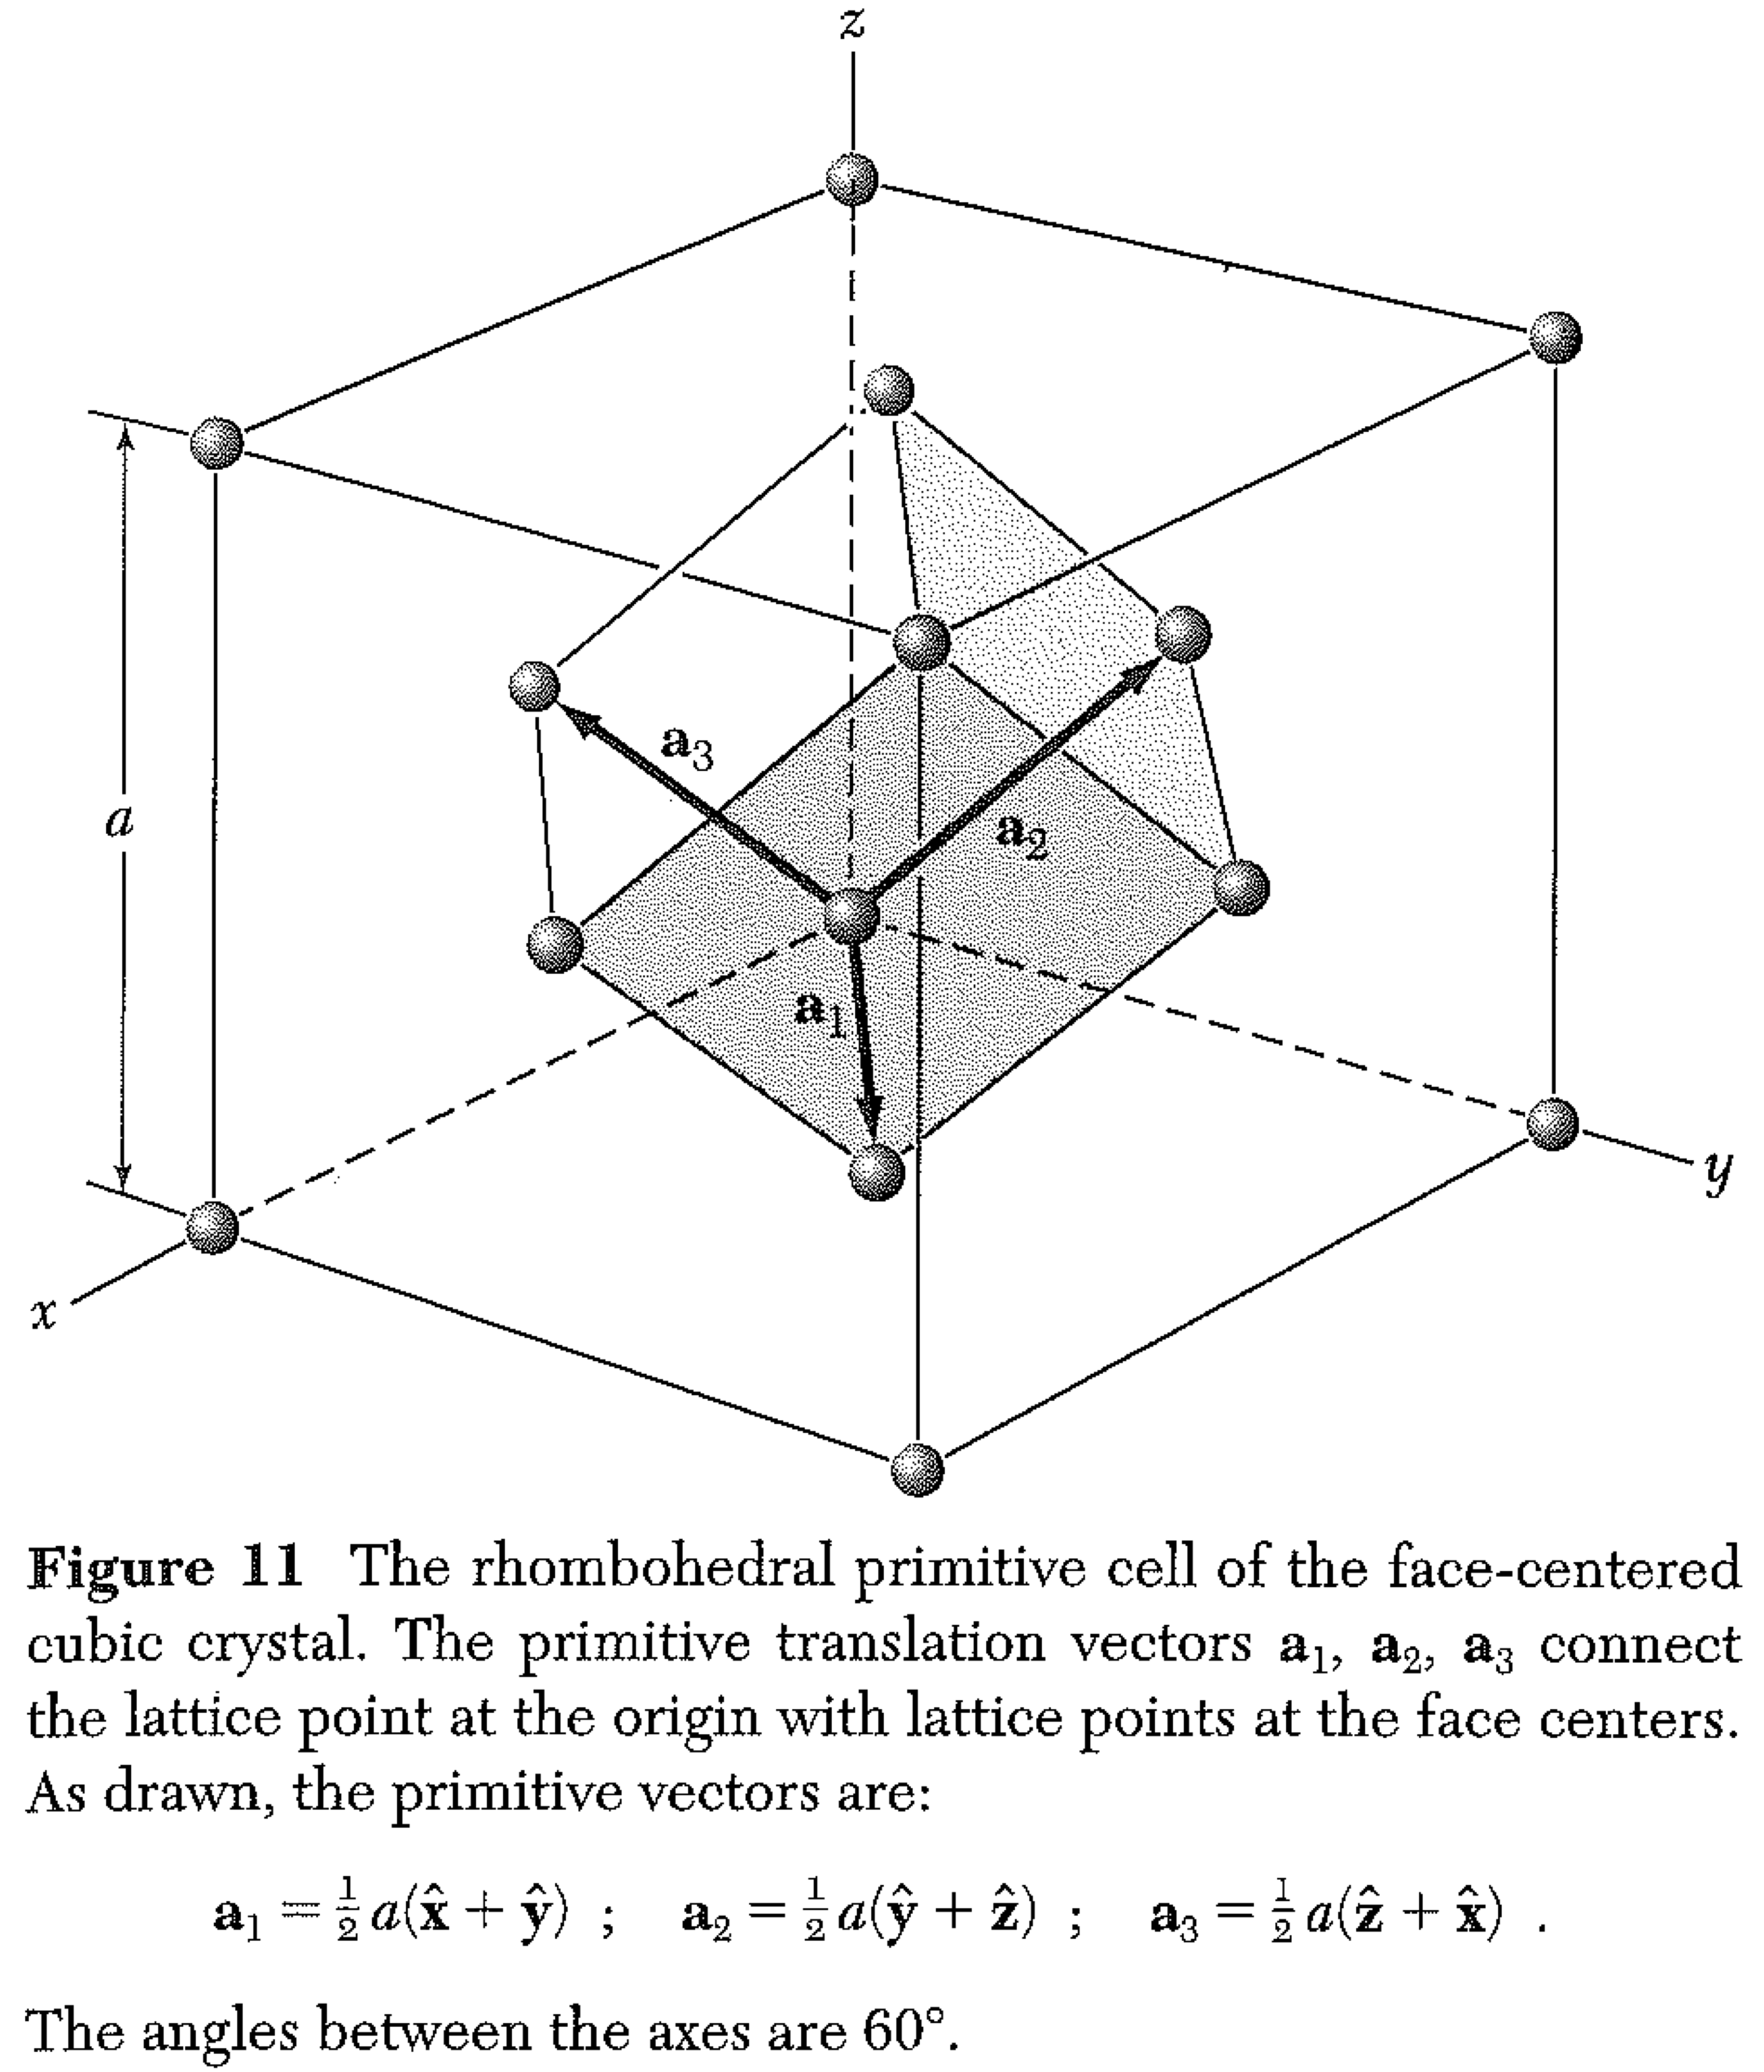
Reduced Zone Scheme - FCC Primitive Lattice
If the lattice is not cubic, we have a somewhat more difficult challenge. Let’s work on the FCC lattice in the 1,1,1 direction. (Homework!)
1

Slide 27
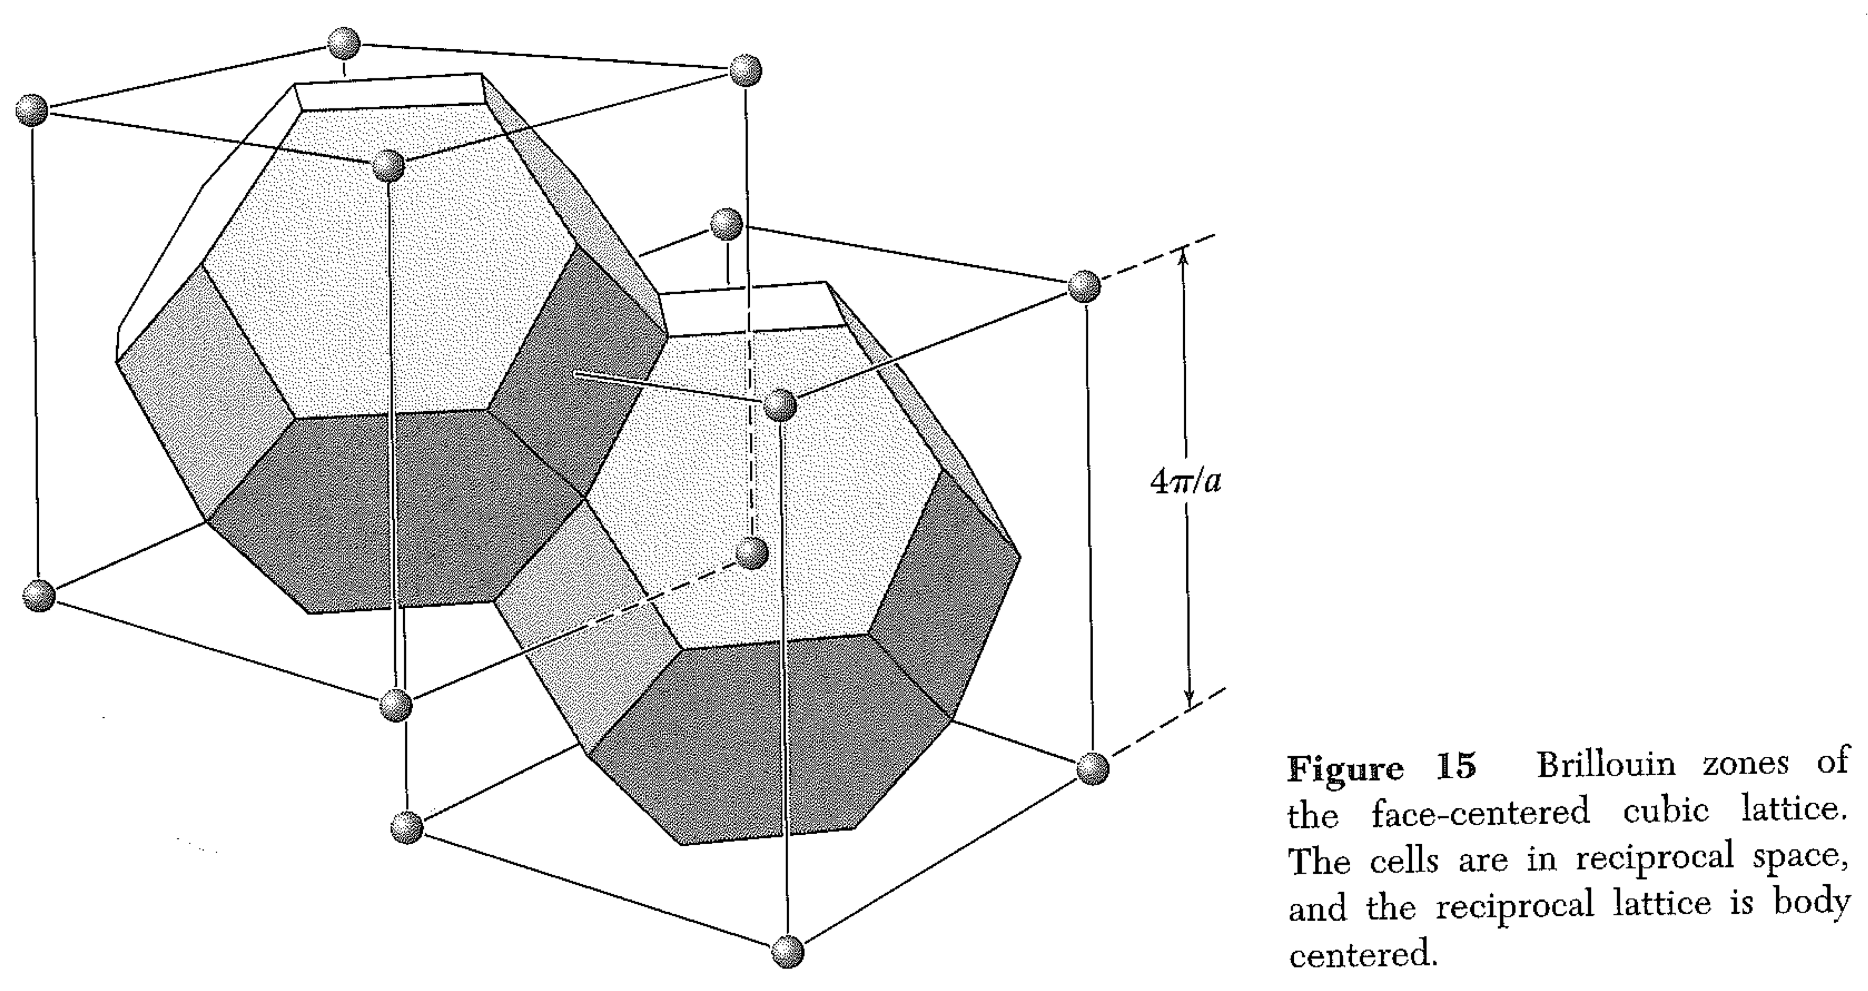
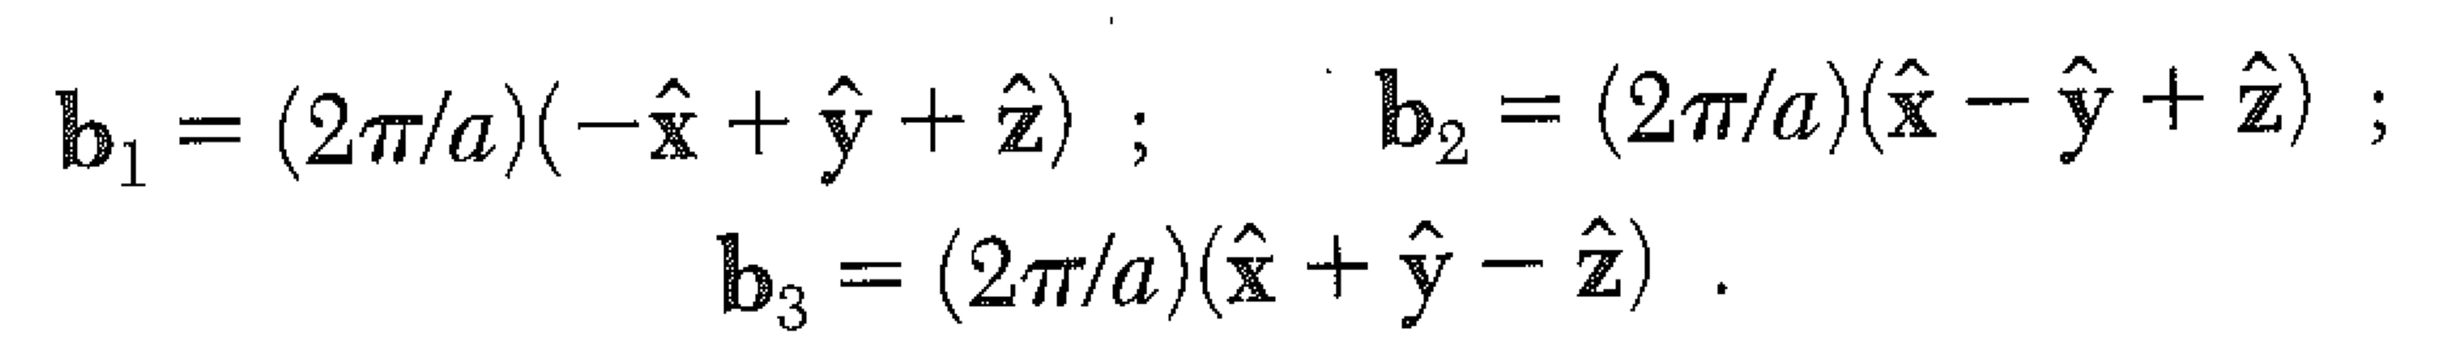
Reduced Zone Scheme - FCC Primitive Lattice
If the lattice is not cubic, we have a somewhat more difficult challenge. Let’s work on the FCC lattice in the 1,1,1 direction. (Homework!)
Boardwork: chose a small (nonzero) recip lat vector G [hkl].
Write down the kinetic energy of a free electron with wavevector K + G.
Recip lat vecs:
1

Slide 28
NEARLY FREE ELECTRON MODEL.
What is the amplitude of the cosine potential that makes a 2D divalent metal into a semi-metal?
The lattice is square, side length 10 angstroms. (This is large.)

Slide 29
In the nearly free electron model, would compressing a crystal be more likely to turn it from an insulator to a conductor,
or from a conductor to an insulator?
What does the picture look like for an anisotropic crystal?

Slide 30
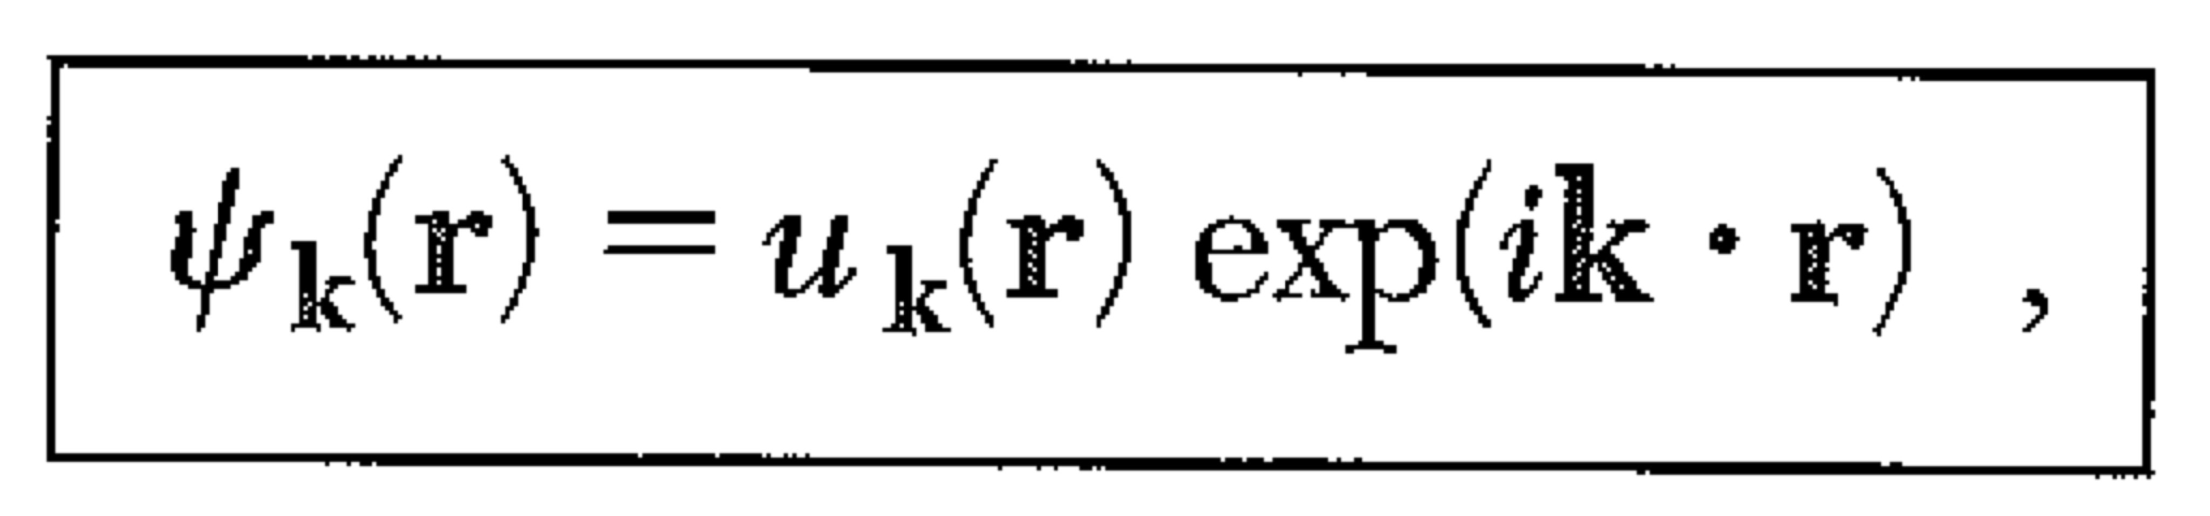
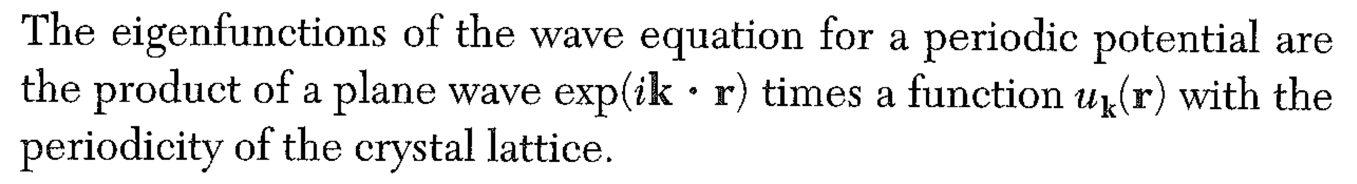
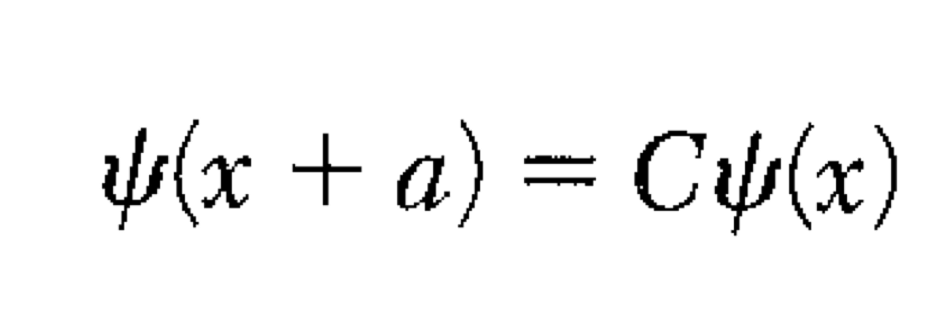
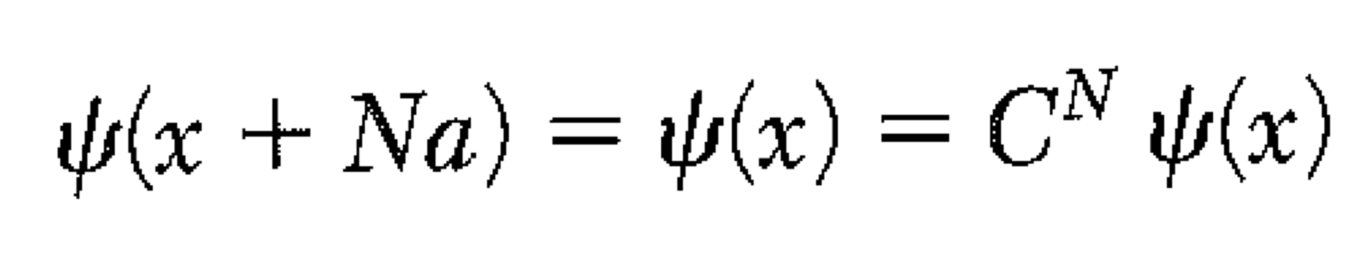
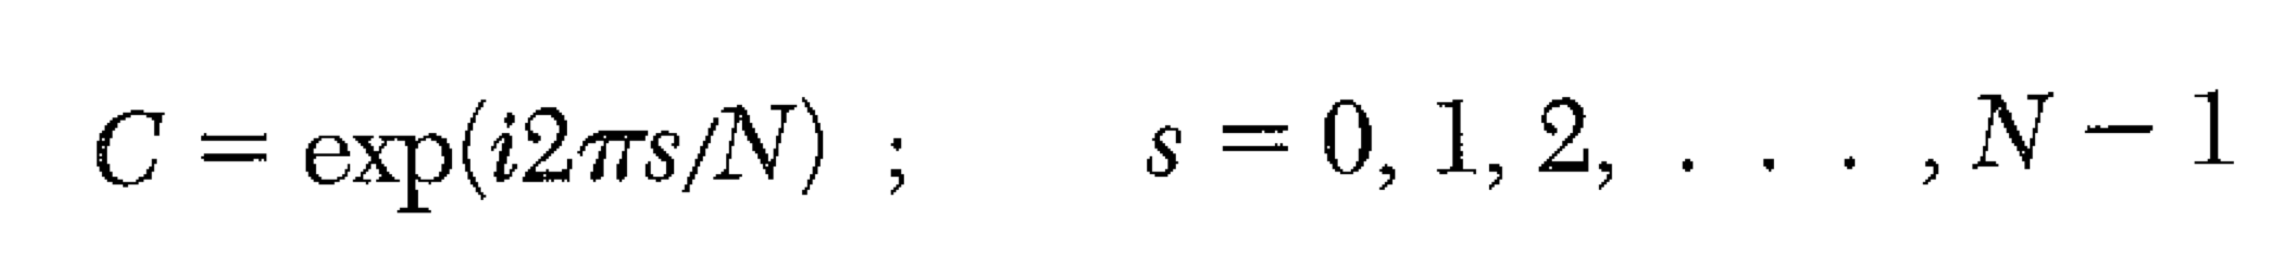
The free electron standing wave and the traveling wave are not eigenstates.
To find the exact eigenstates, we will use the Bloch Theorem.
Apply periodic boundary conditions, and seek solutions.
In other words, C is an operator that translates the wave by one unit cell.
With PBC, if we apply C N times, we get back the original wave.

Slide 31
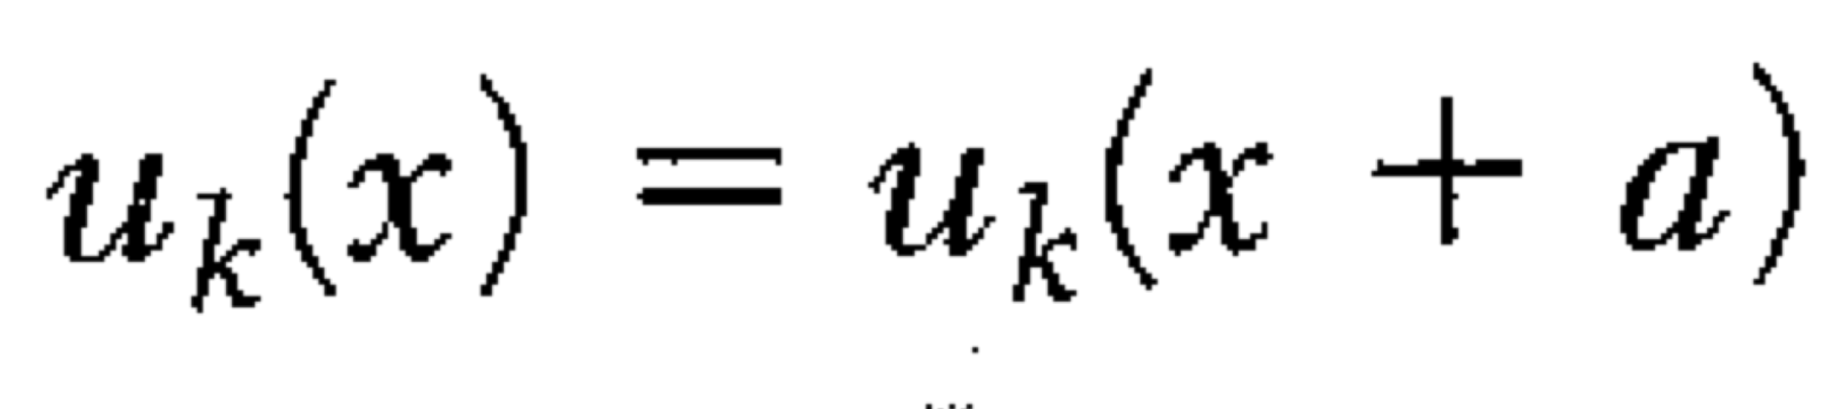

In other words, C is an operator that translates the wave by one unit cell.
With PBC, if we apply C N times, we get back the original wave.
IF:
Then
Will have the form required so that there is a meaningful translation operator.
In the limit of large N, the plane wave can have any wavelength.
This is a symmetry argument… nothing much QM.

Slide 32








Kronig – Penney Model
Note: K ≠ k. The Bloch k relates to the change in phase of the wave from cell to cell.
Bloch
A,B,C,D chosen to make ψ and ψ’ continuous

Slide 33


Kronig – Penney Model
A,B,C,D chosen to make ψ and ψ’ continuous
At x = 0
At x=a
(Used solution for –b<x<0, translated by a+b)
Now, the exact amplitude of the wave is indeterminate, so this system of equations must be underdetermined, i.e. they must NOT be linearly independent, i.e. the 4x4 determinant must be zero.

Slide 34

Kronig – Penney Model
What a mess! Simpler if we let U₀ -> infinity, b -> 0. (Delta function potentials)
If we keep U₀*b finite, then Q²b is finite, we can write Q²ab/2 = P (def of P).
Q²>> K (of course! It’s infinity). Also Qb ~ 1/Q << 1.
sinh x = x for small x, cosh x = 1 for small x

Slide 35

Kronig – Penney Model – Delta function potentials
Plot of the left hand side of the KP equation.
There are no solutions if the LHS is not between ± 1.
These are the band gaps.

Slide 36

Kronig – Penney Model– Delta function potentials
Again: k is not the “real momentum” of the electron… it is the crystal momentum.
(The electron actually has real momentum = 0, though if you measured it you would get ±hK/(2*π))

