Slide 1
Solid State Physics
Lecture 11
HW 6: Chapter 6, 1-4
A few comments on normal modes.
We counted the density of phonon states (one state per 2π/L of k-space) using either fixed boundaries, or periodic boundary conditions (PBCs).
Are the “states” for each of these the same?
If not, what states are real phonons in real crystals?

Slide 2
A few comments on normal modes & phonons
We defined a phonon as a quantum of vibration, with energy h-bar omega.
We did this rather informally. (And we will keep it that way.)
FYI: the rigorous approach to phonons is to treat each normal mode as an independent (quantum) harmonic oscillator. Different eigenstates of the harmonic oscillator can be reached with raising and lowering operators. These operators can be combined to give the state number (phonon number).
A phonon is an eigenstate of the phonon number operator (and also of energy.)
It is not a “wave packet.”
These eigenstates are important because
They are what we count in statistical mechanics
Transitions between these states are used in “interactions”
(Compare with photons.)

Slide 3
A comment on anharmonic potentials – classical picture
Consider wave 1 and wave 2 in the same region of a crystal.
Let’s think about wave 1 being stationary, for the time being.
Wave 1 displaces the nucleii in their potential wells. If the well is harmonic, then wave 2 will see the same “spring constant” as if wave 1 were not present at all!
However, if the well is anharmonic, then the spring constant seen by wave 2 will be either stiffer or softer (if there is a cubic term) than in the absence of wave 1.
So wave 2 will “see” a grating of periodic elasticity changes.
Wave 2 can then diffract off this grating (creating wave 3!)
This is why bosonic excitations of harmonic potentials do not interact. (e.g. photons in vacuum.) But bosonic excitations of anharmonic potentials (phonons, photons in nonlinear crystals) do.

Slide 4
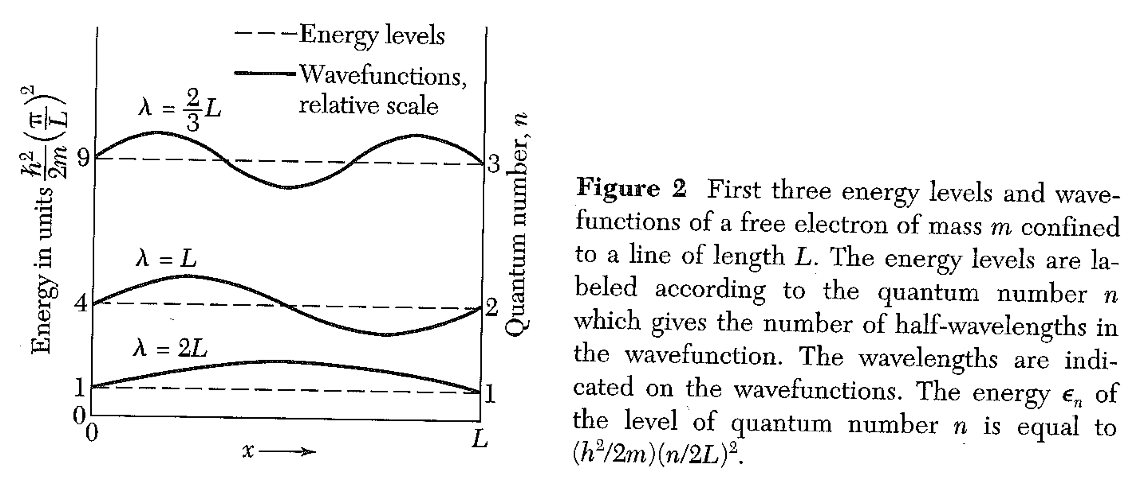
Free electron Fermi gas
Energy is “kinetic” – but expectation value of momentum = 0 (!)
Difference with phonons: there is no upper limit on k.

Slide 5
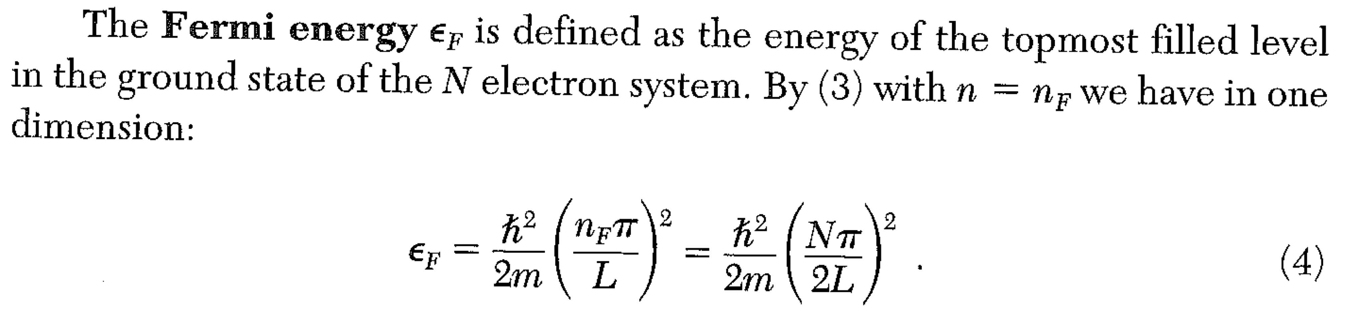
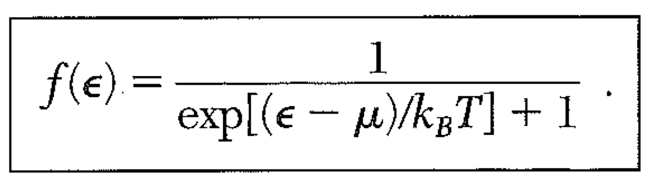
Free electron Fermi gas
Fermi-Dirac Distribution

Slide 6
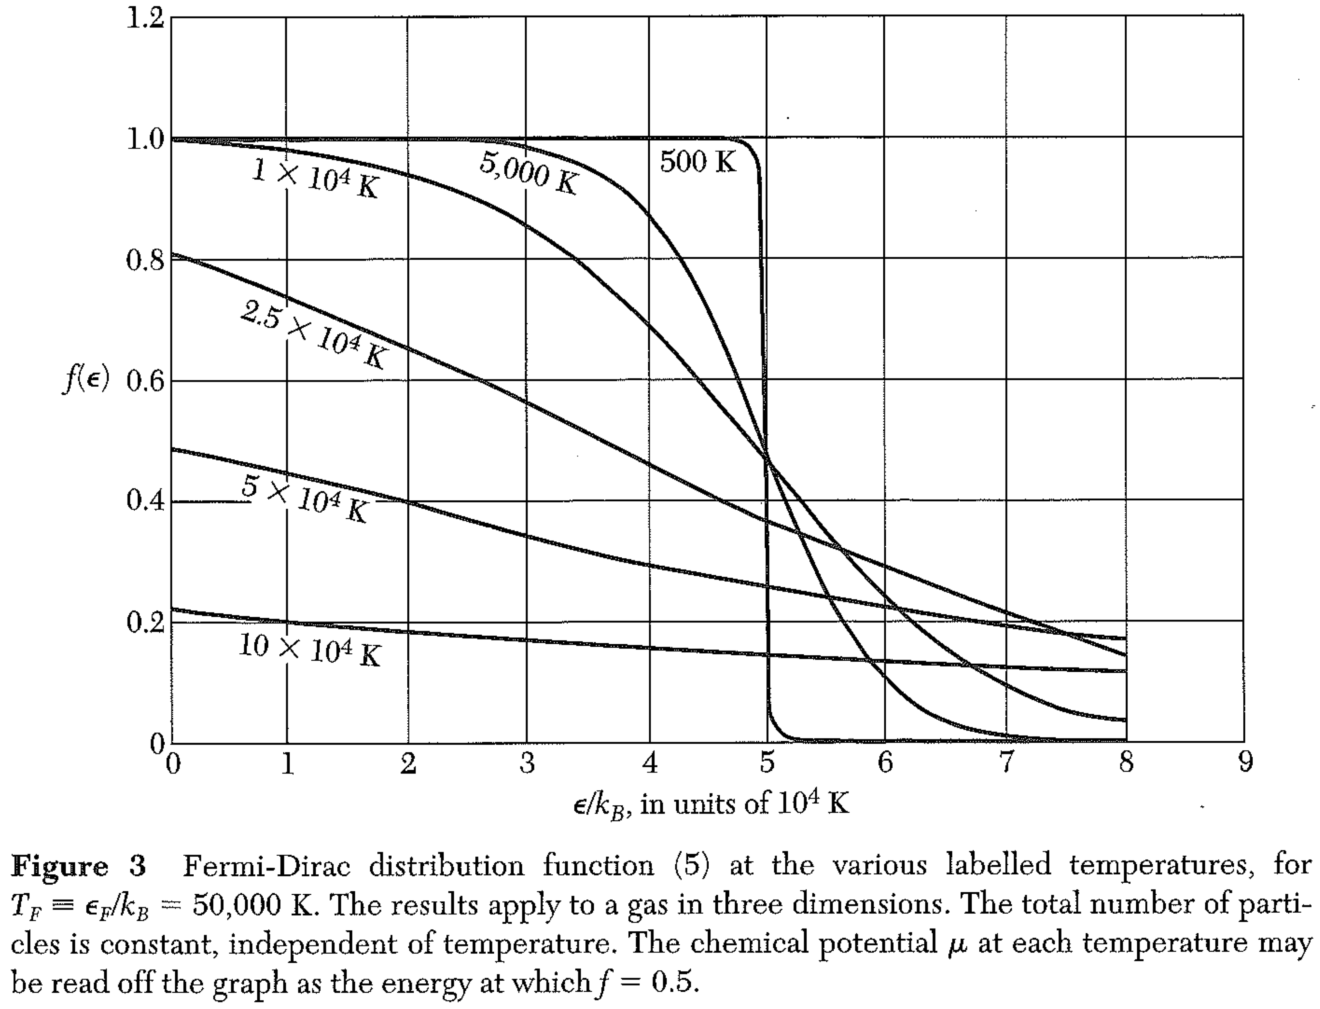
Free electron Fermi gas

Slide 7
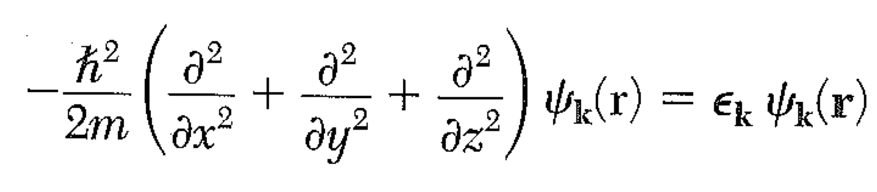
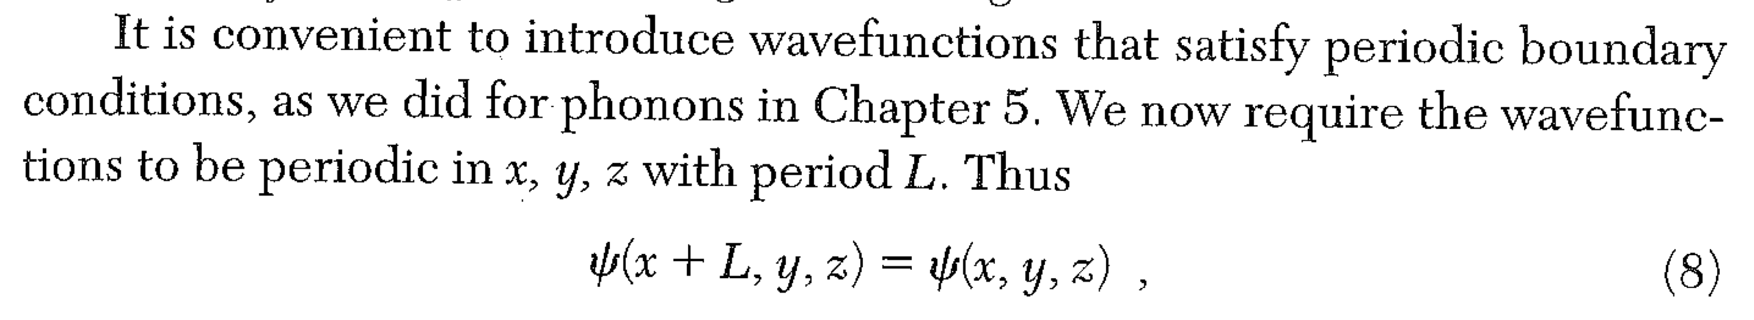
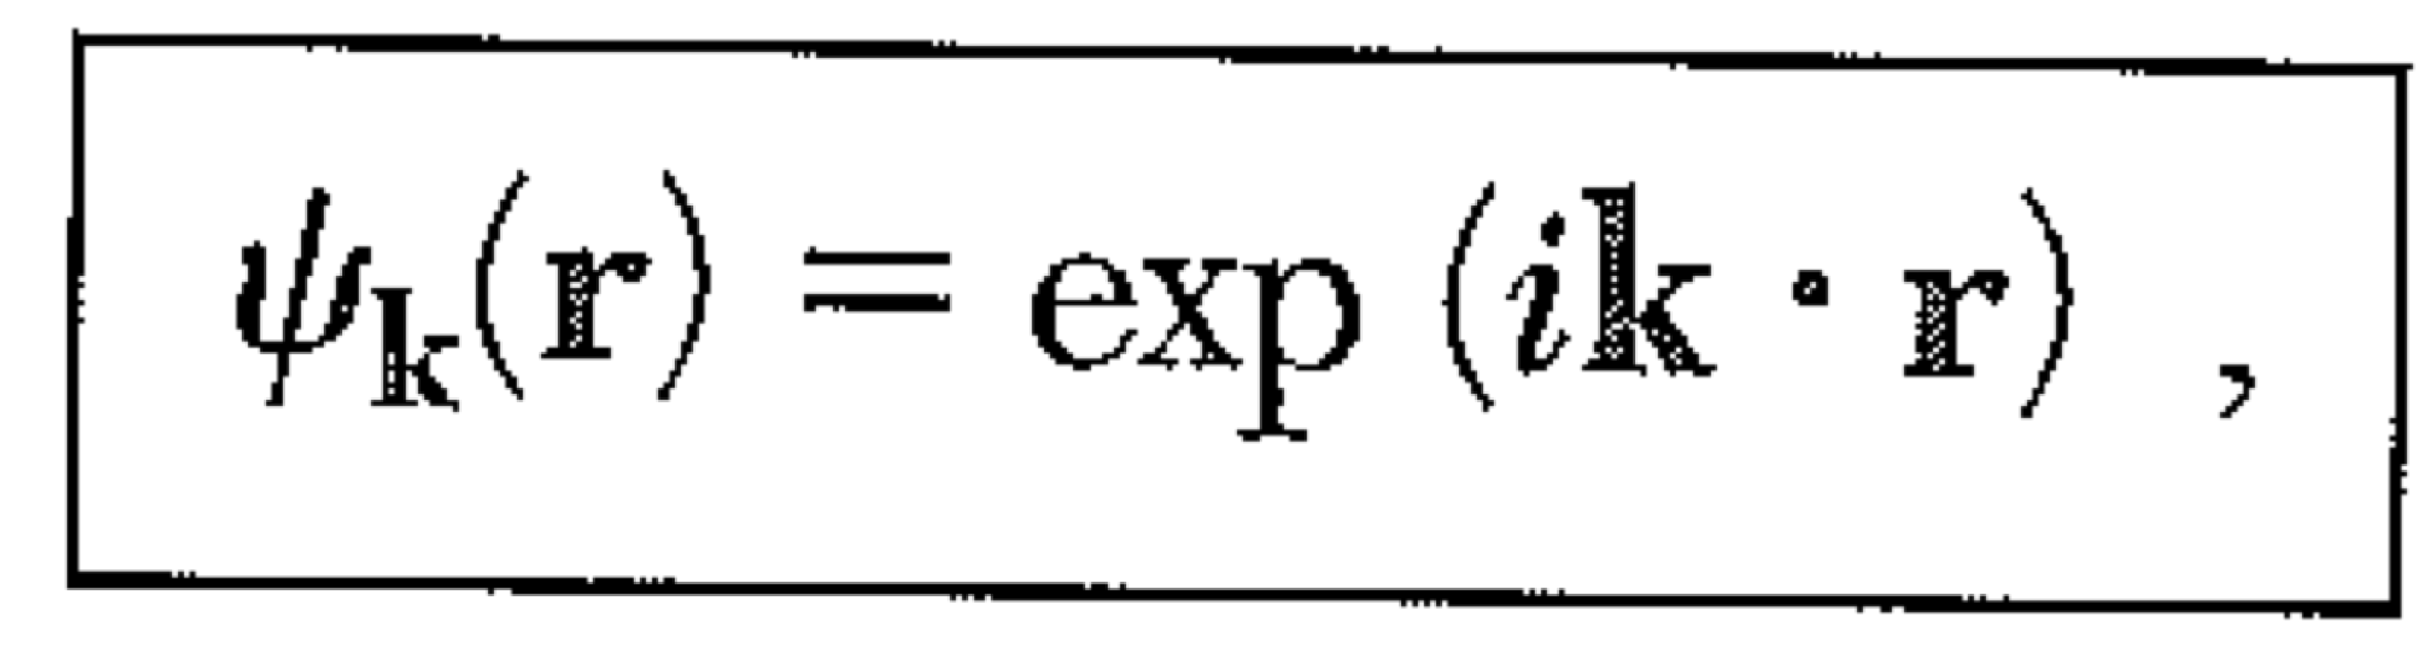
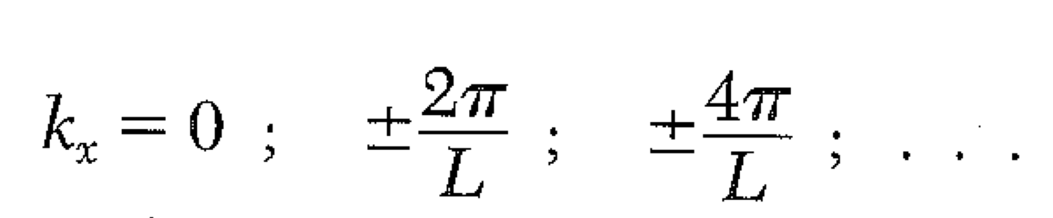
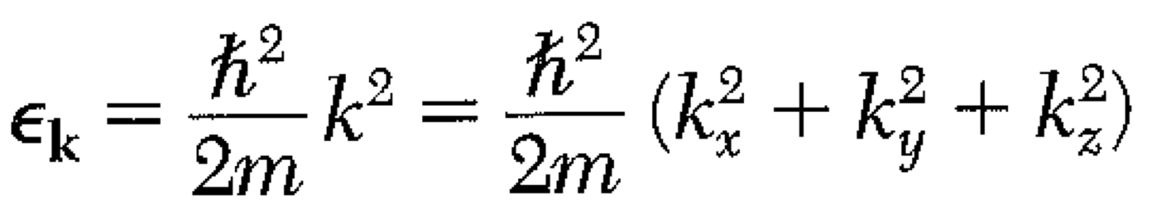
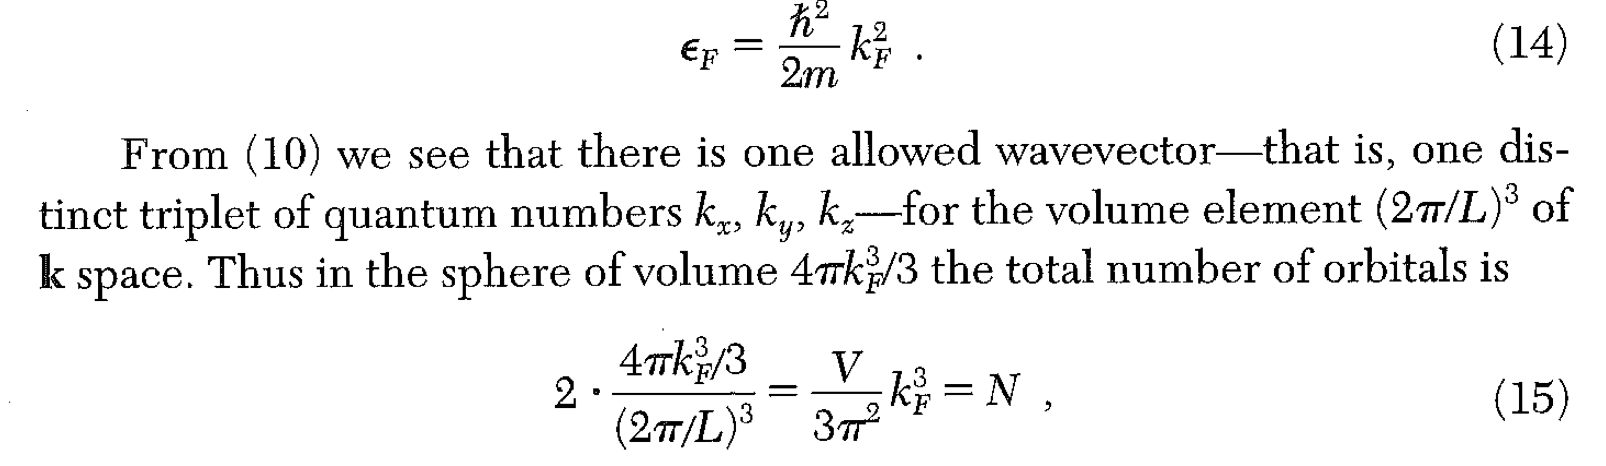
3D Fermi Gas
Schroedinger
Eigenstates of p, as well as E.

Slide 8
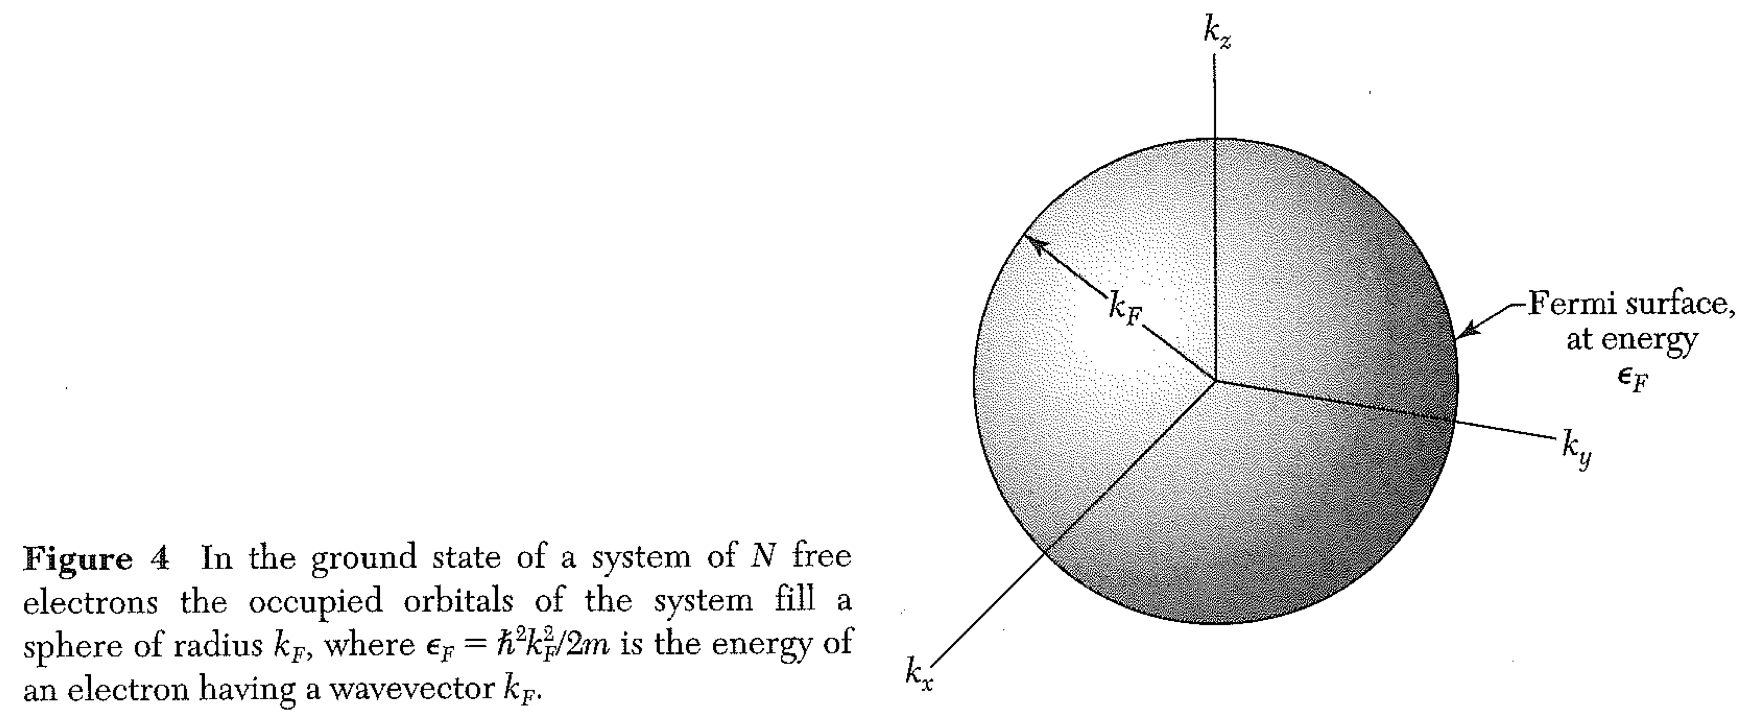
Real Fermi surfaces are not perfect spheres.

Slide 9
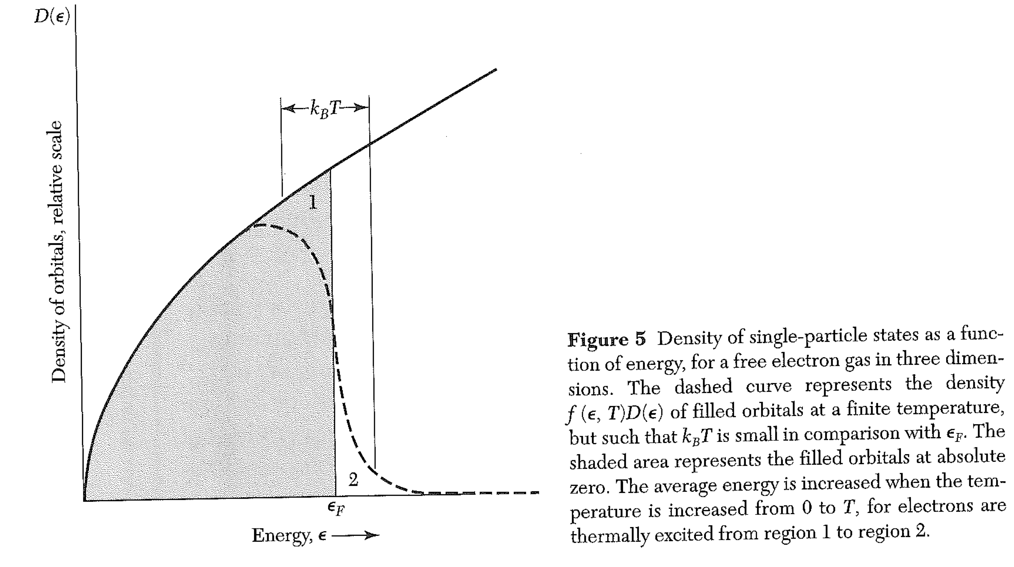
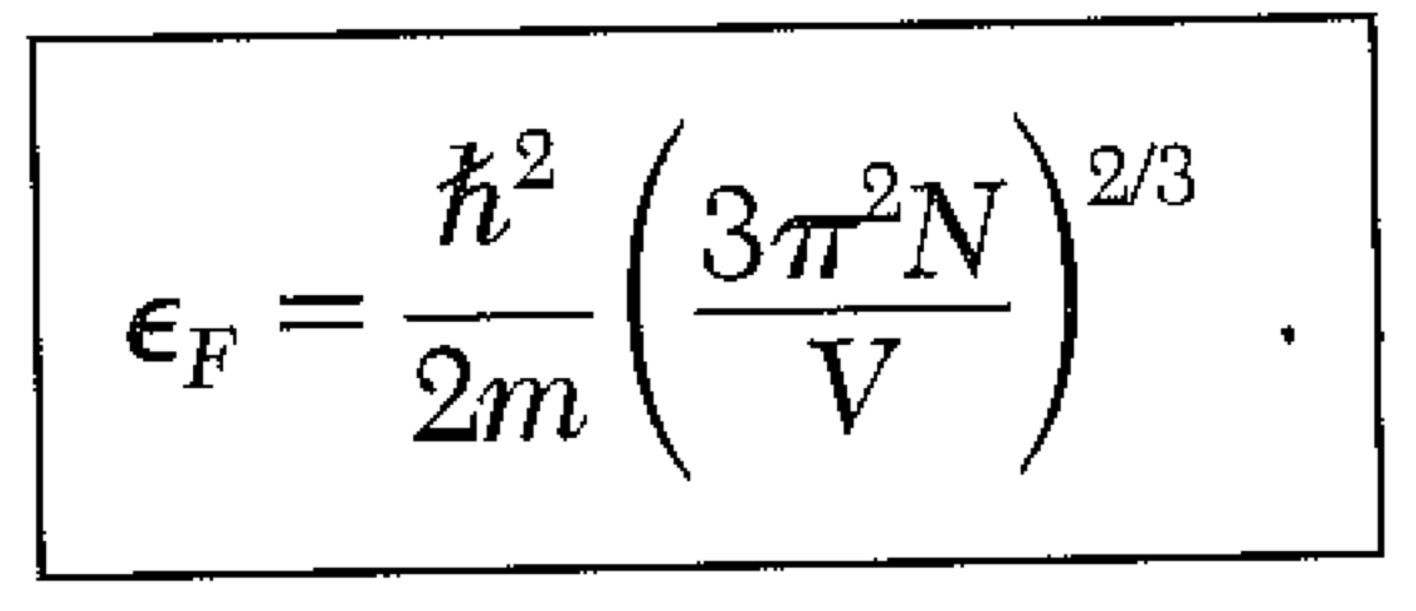
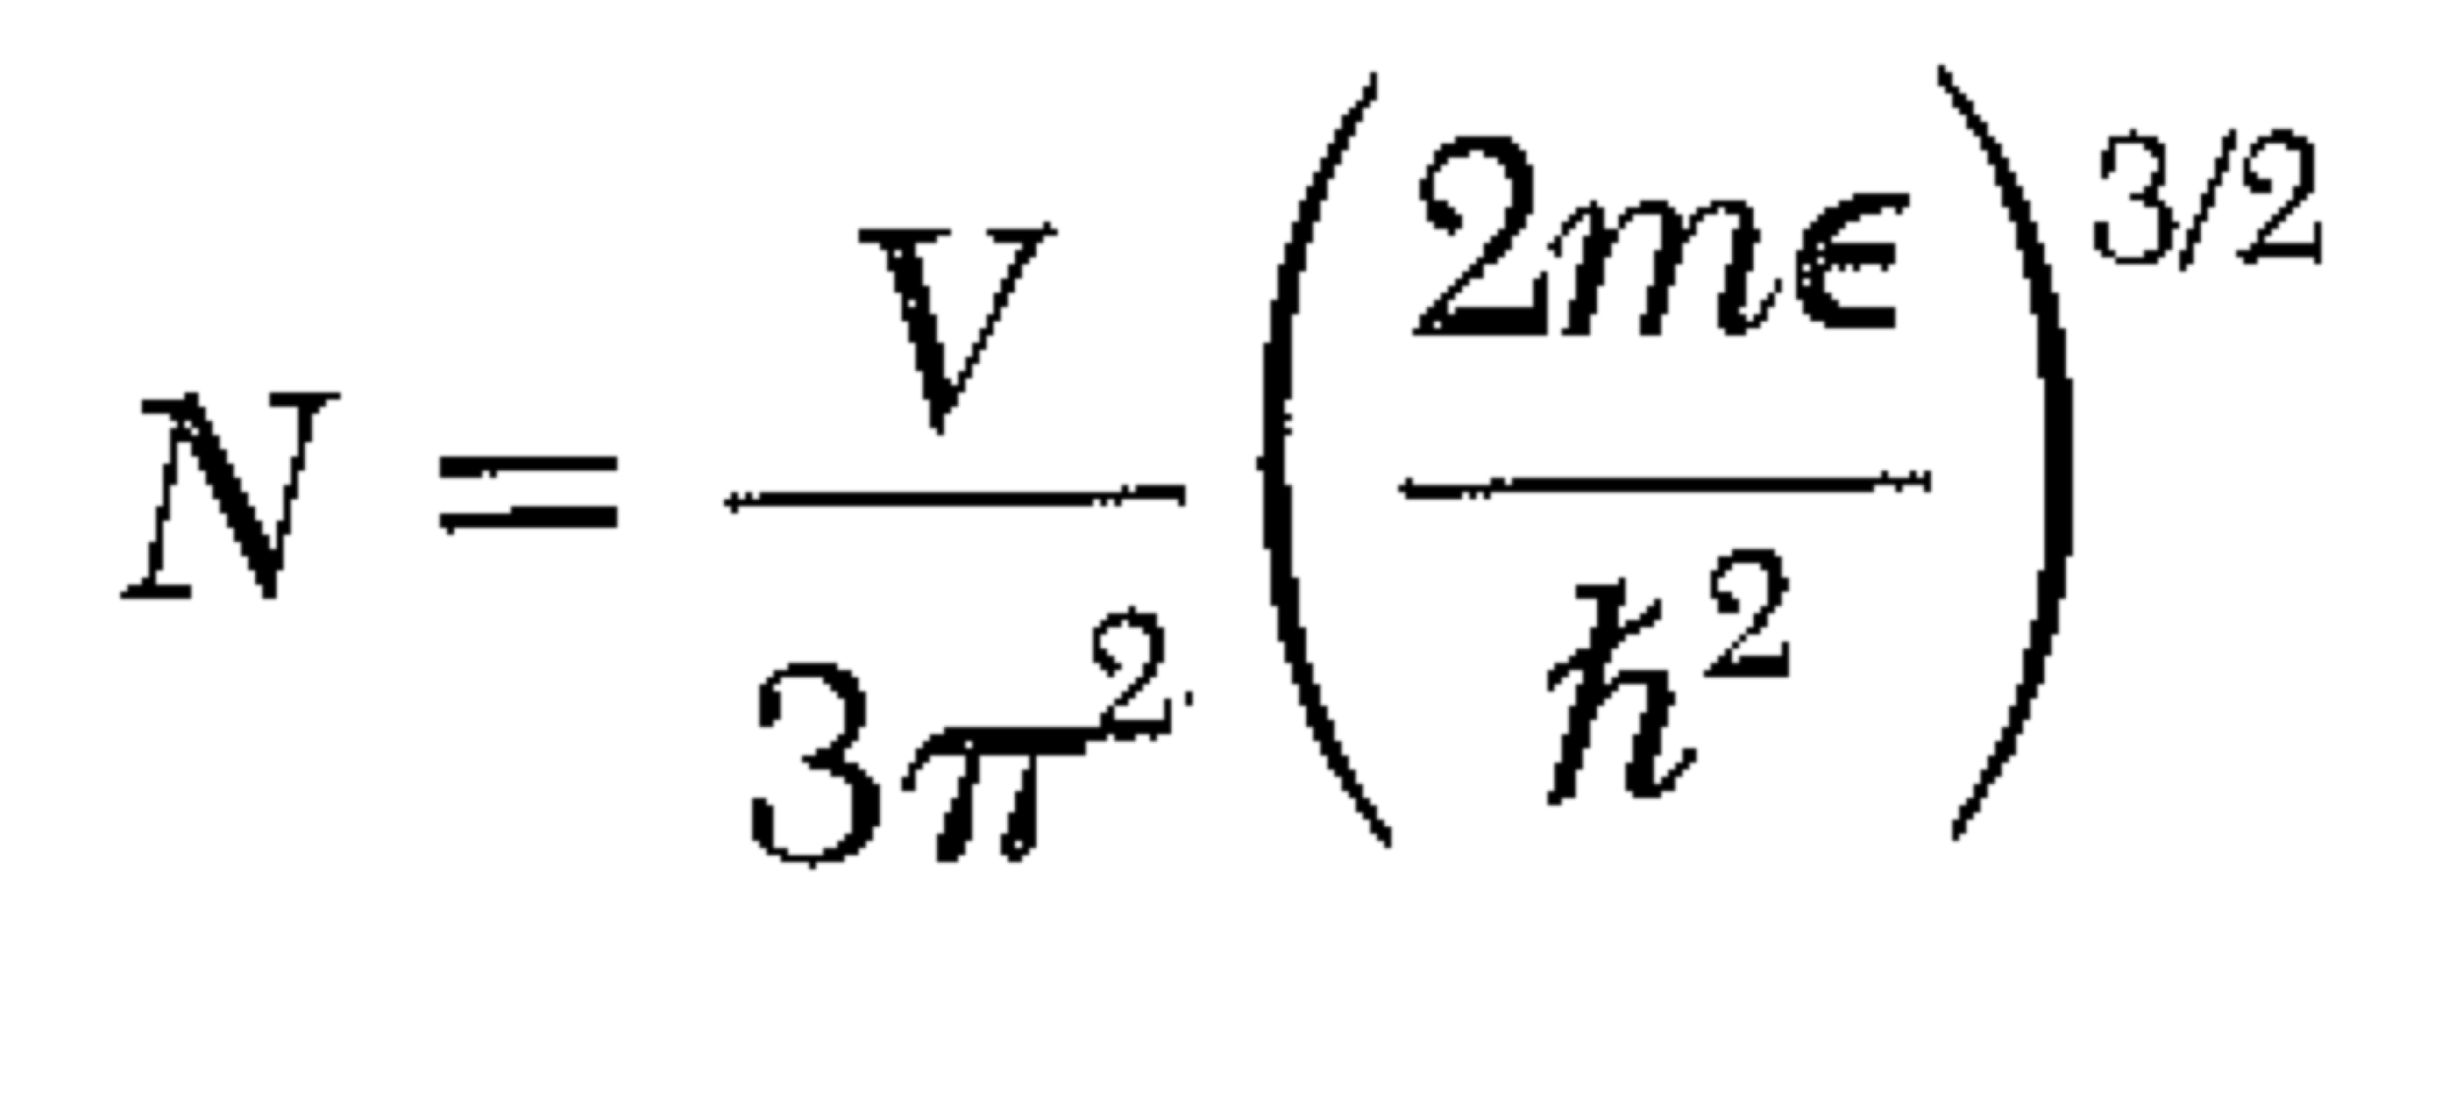
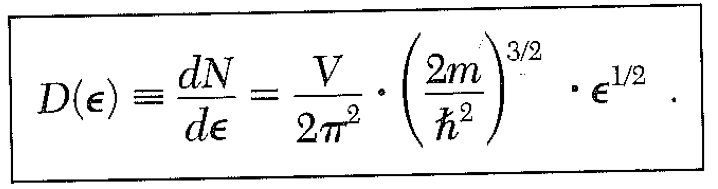
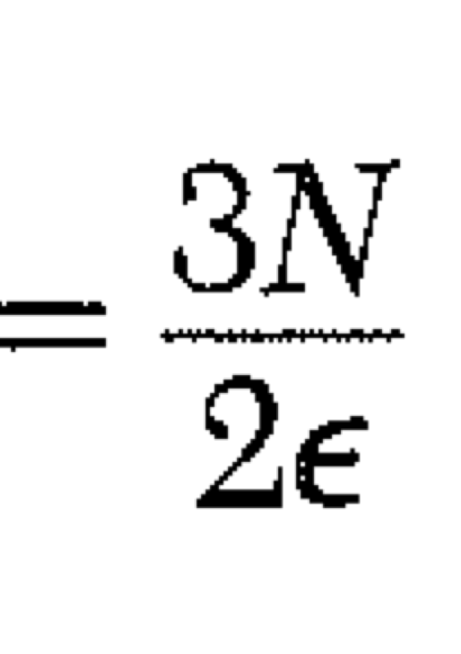
Density of states:

Slide 10
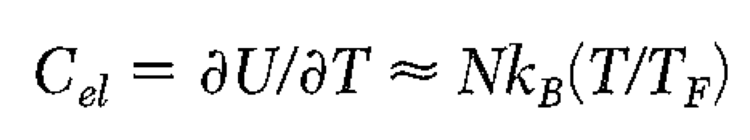
Heat Capacity – Back of the envelope
Electrons can’t go into occupied orbitals.
So… only electrons near the top of the Fermi sea can be thermally excited.
The number of electrons within kT of the Fermi energy
is NT/T_{f} . Each gets energy kT.
So U ~ NT/T_{f} x (kT)

Slide 11
Heat Capacity – detailed calculation
Key points:
At T low compared with T_{f}, the only electrons that are excitable are near the fermi surface. We can approximate the density of states as D(ε_{f}).
We can also take μ = ε_{f.}

Slide 12
Practice with Density of States
What is the density of states in 2D for phonons, with v indp of k?
What is the density of states in 2D for electrons?

Slide 13
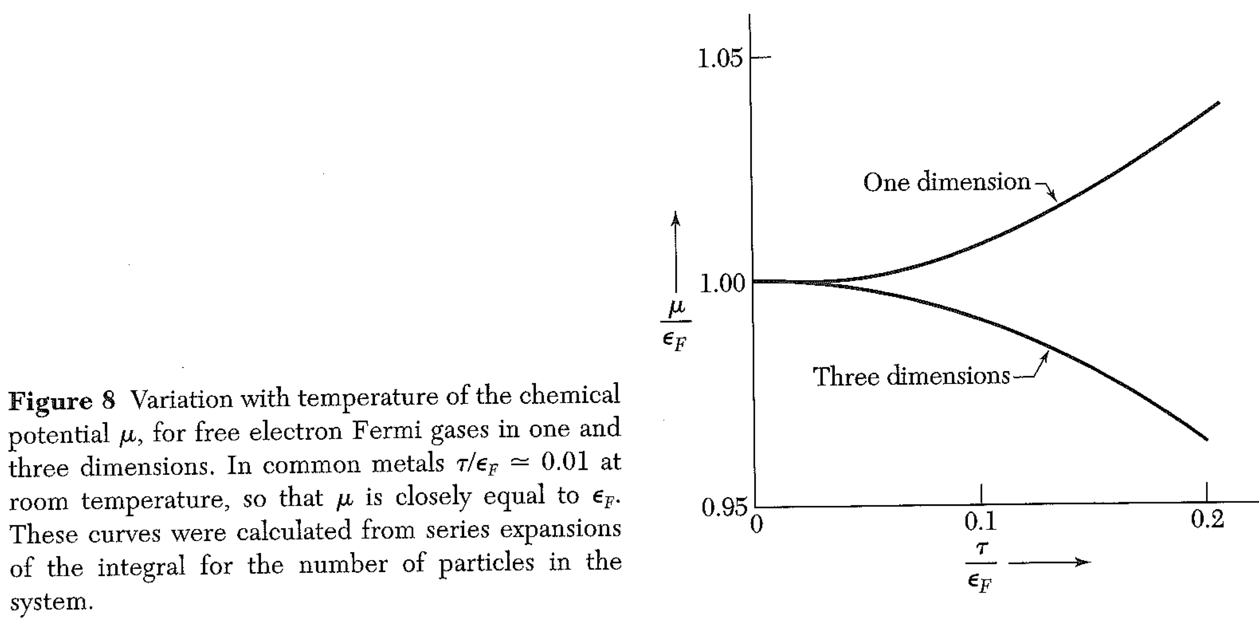
A little more about μ and the density of states (orbitals)

Slide 14
Practice with Density of States
The density of states for electrons in 2D is
What is the chemical potential (as a function of T)?
You will need the following definite integral:

Slide 15
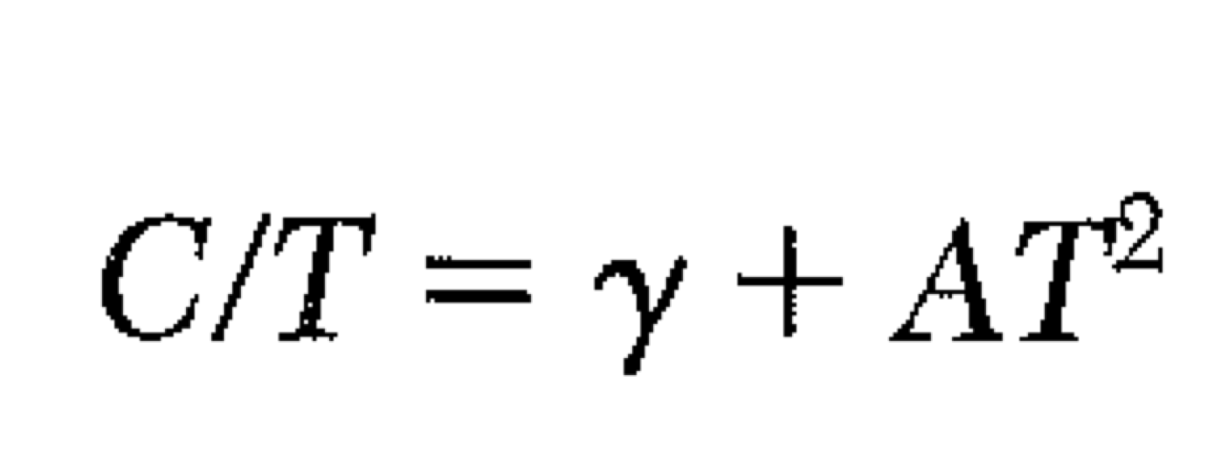
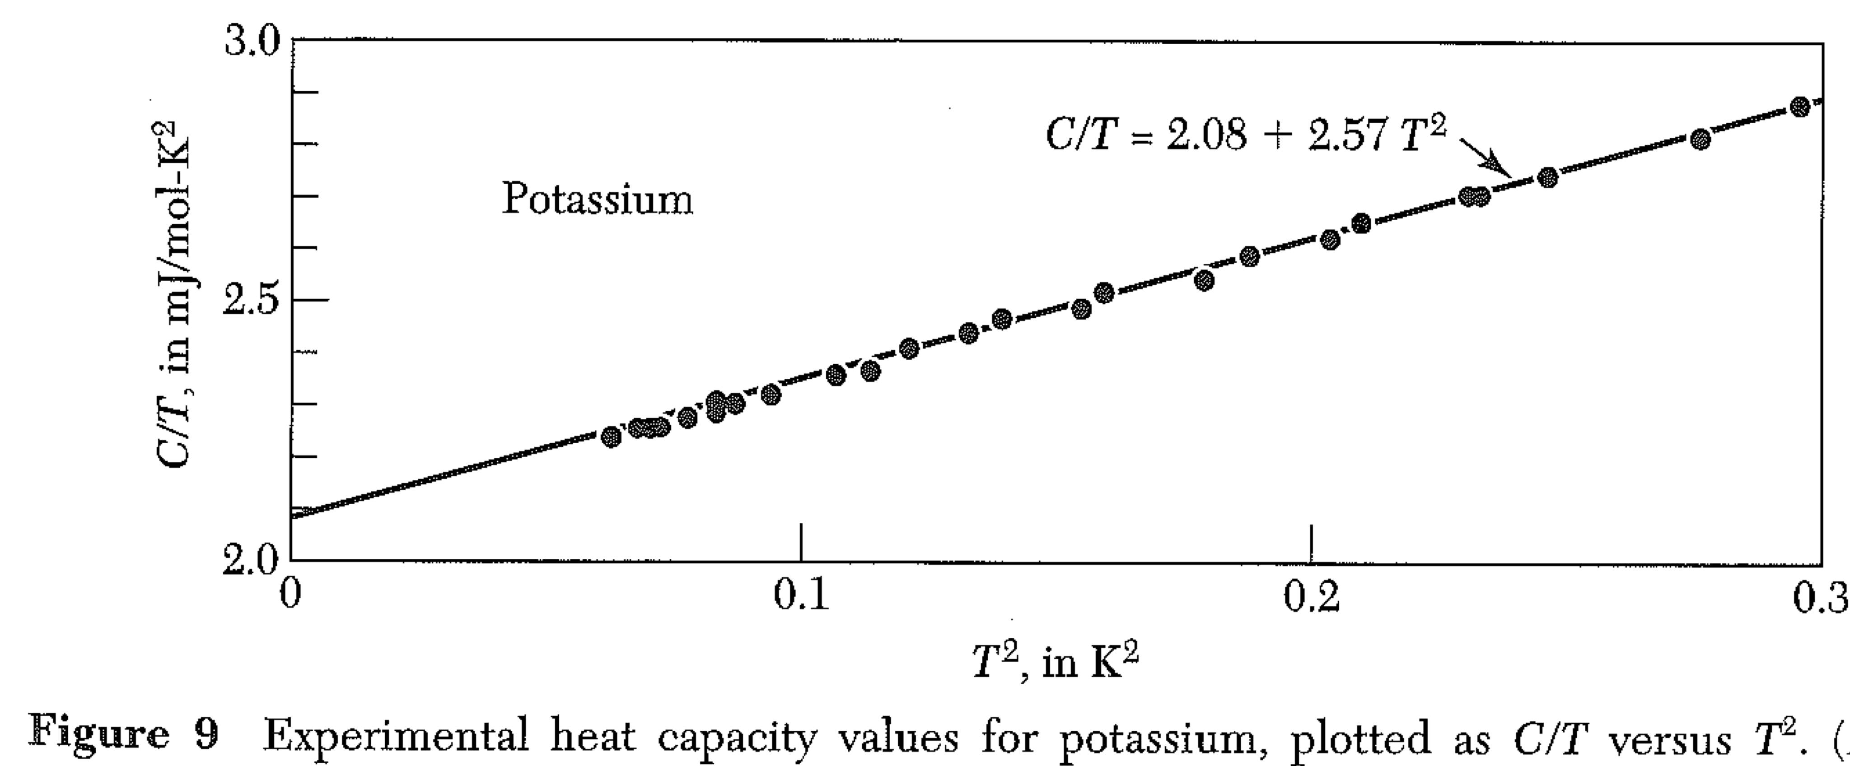
Electronic heat capacity varies like T in 3D. (What about other dimensions?)
T² from phonons

Slide 16
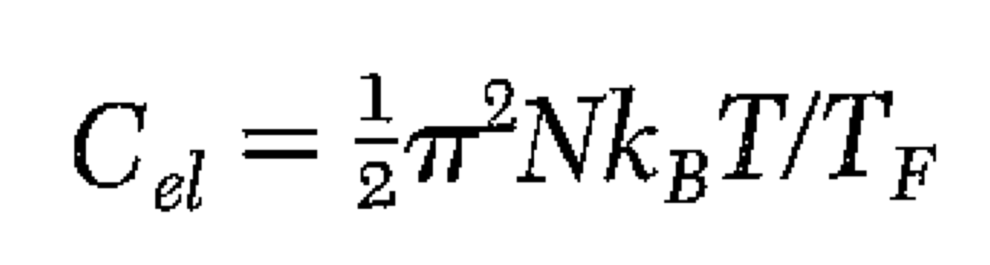
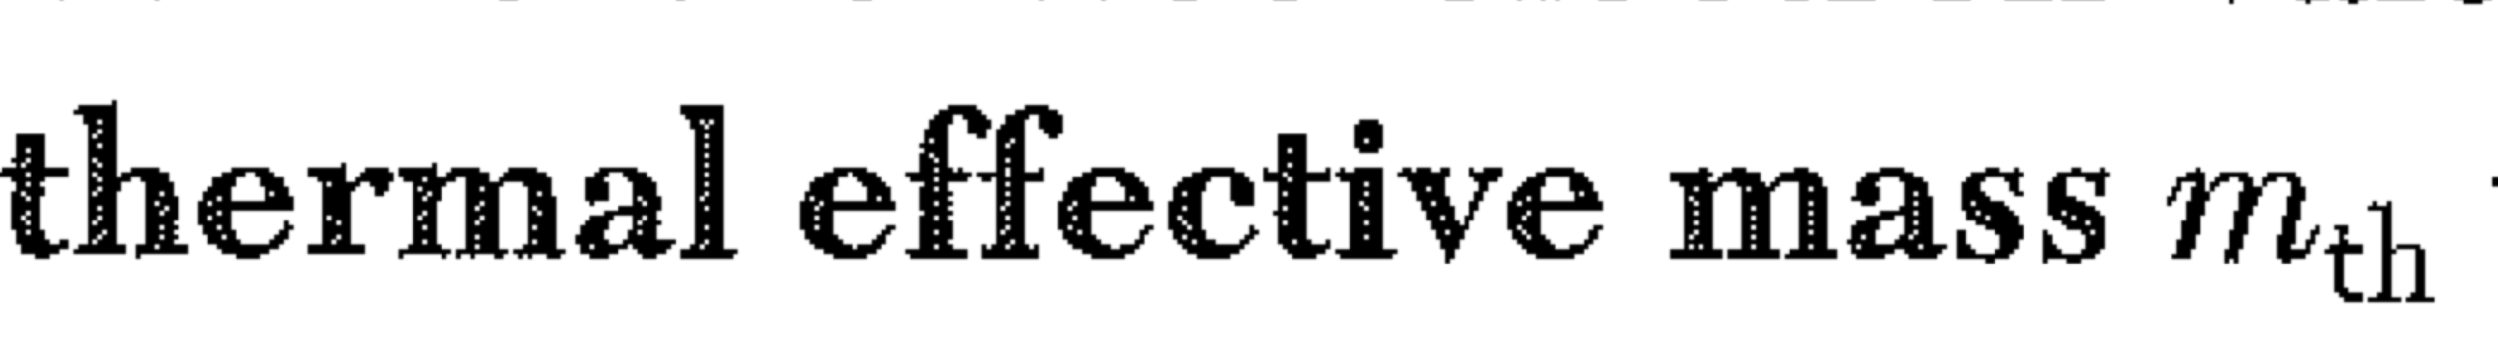
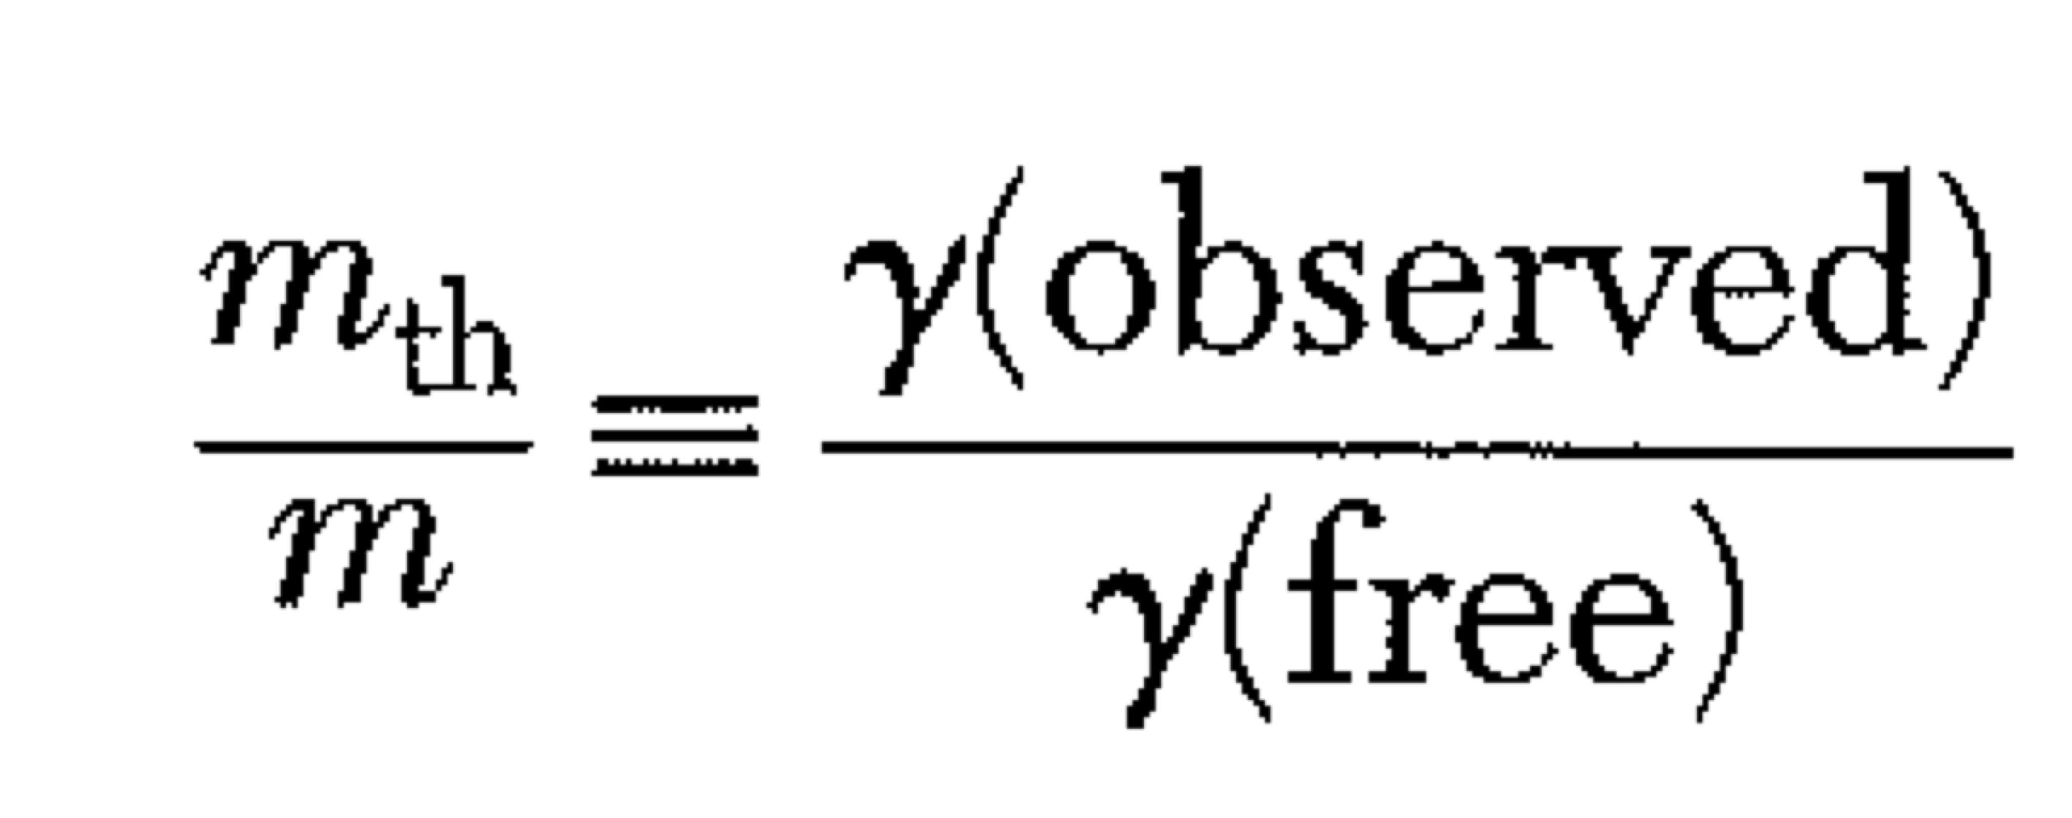
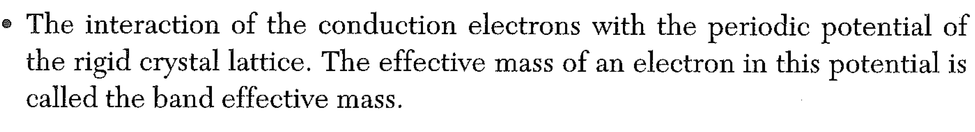
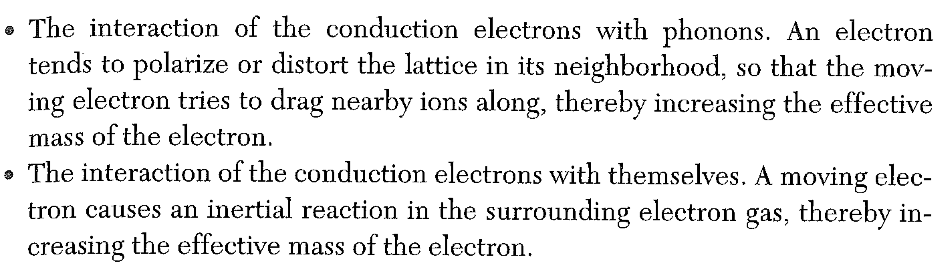
The prefactor can be calculated (with difficulty) from the FD distribution and the free electron model:
This doesn’t give a result that agrees with expt.

Slide 17
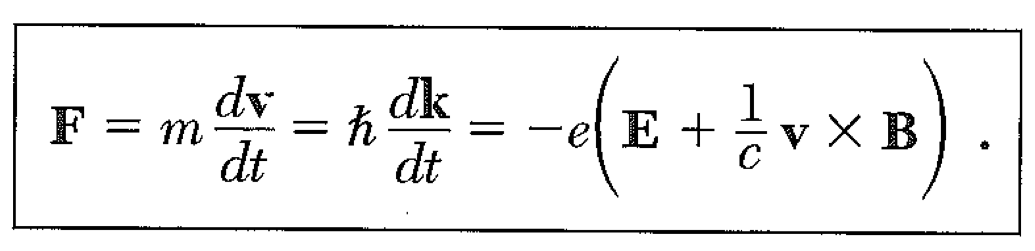
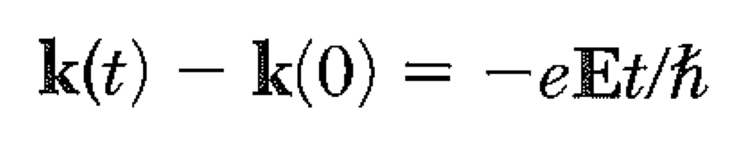
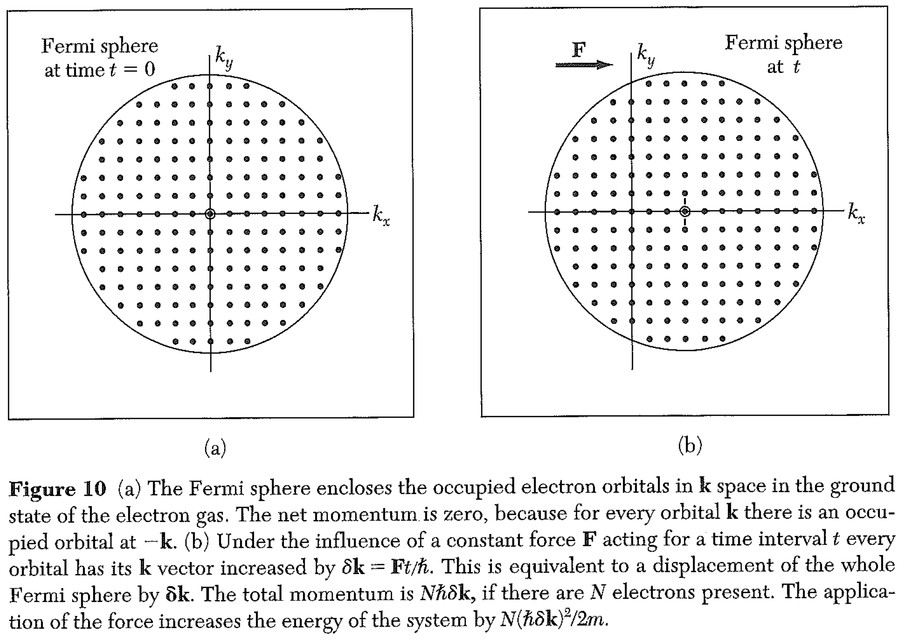
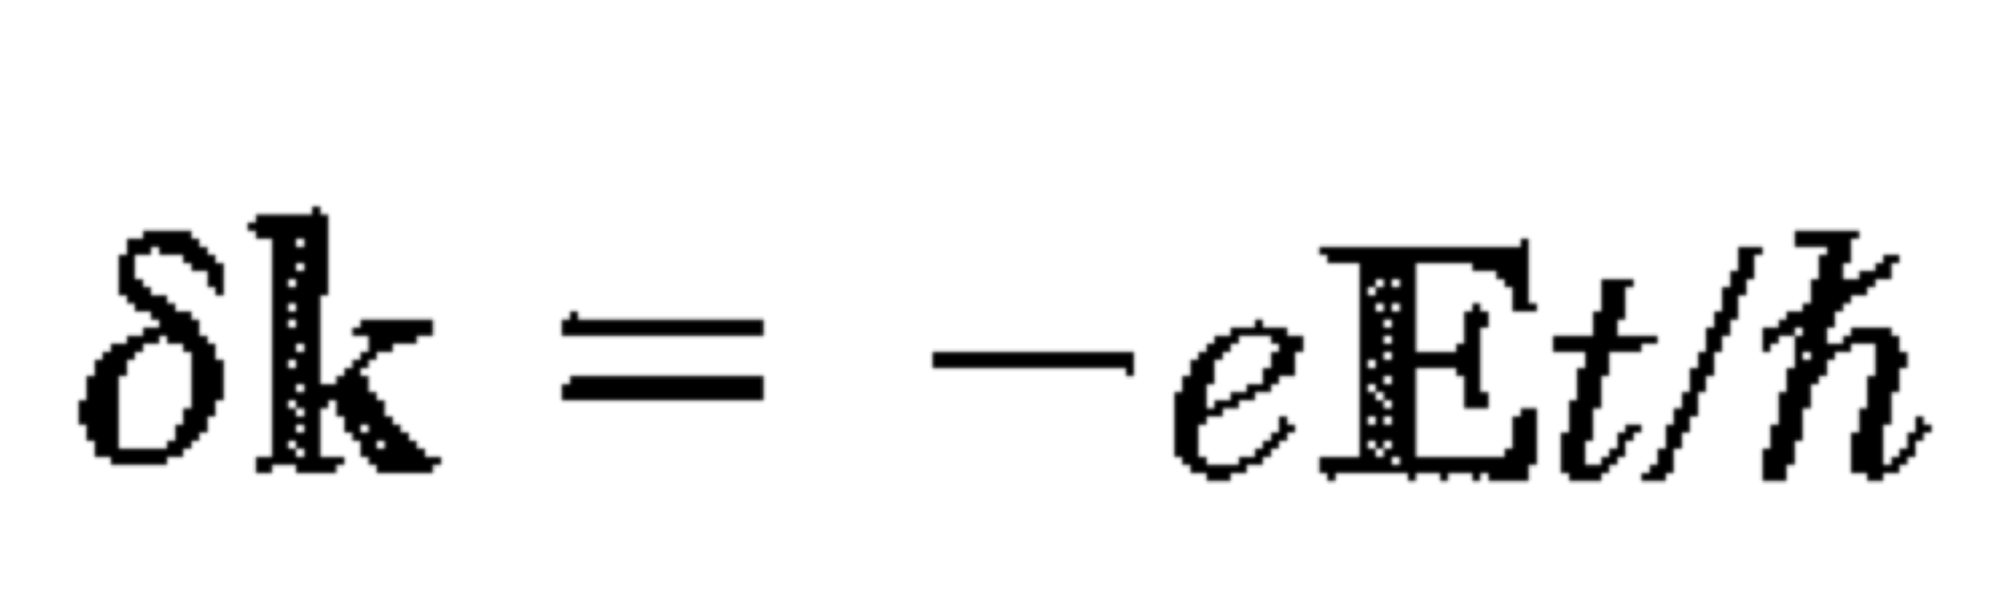
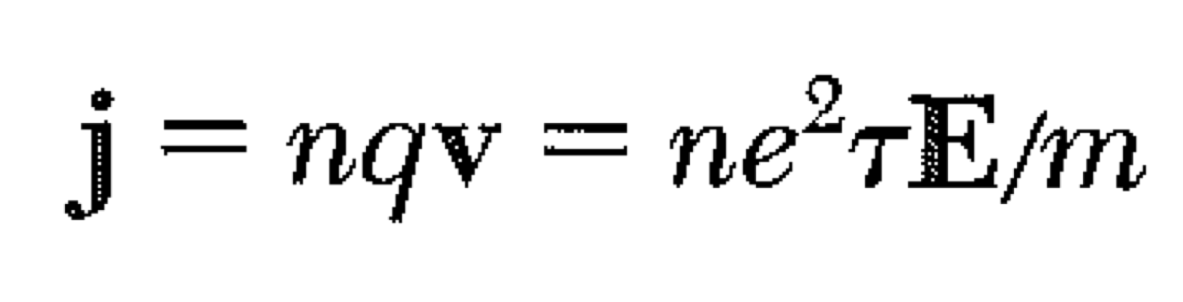
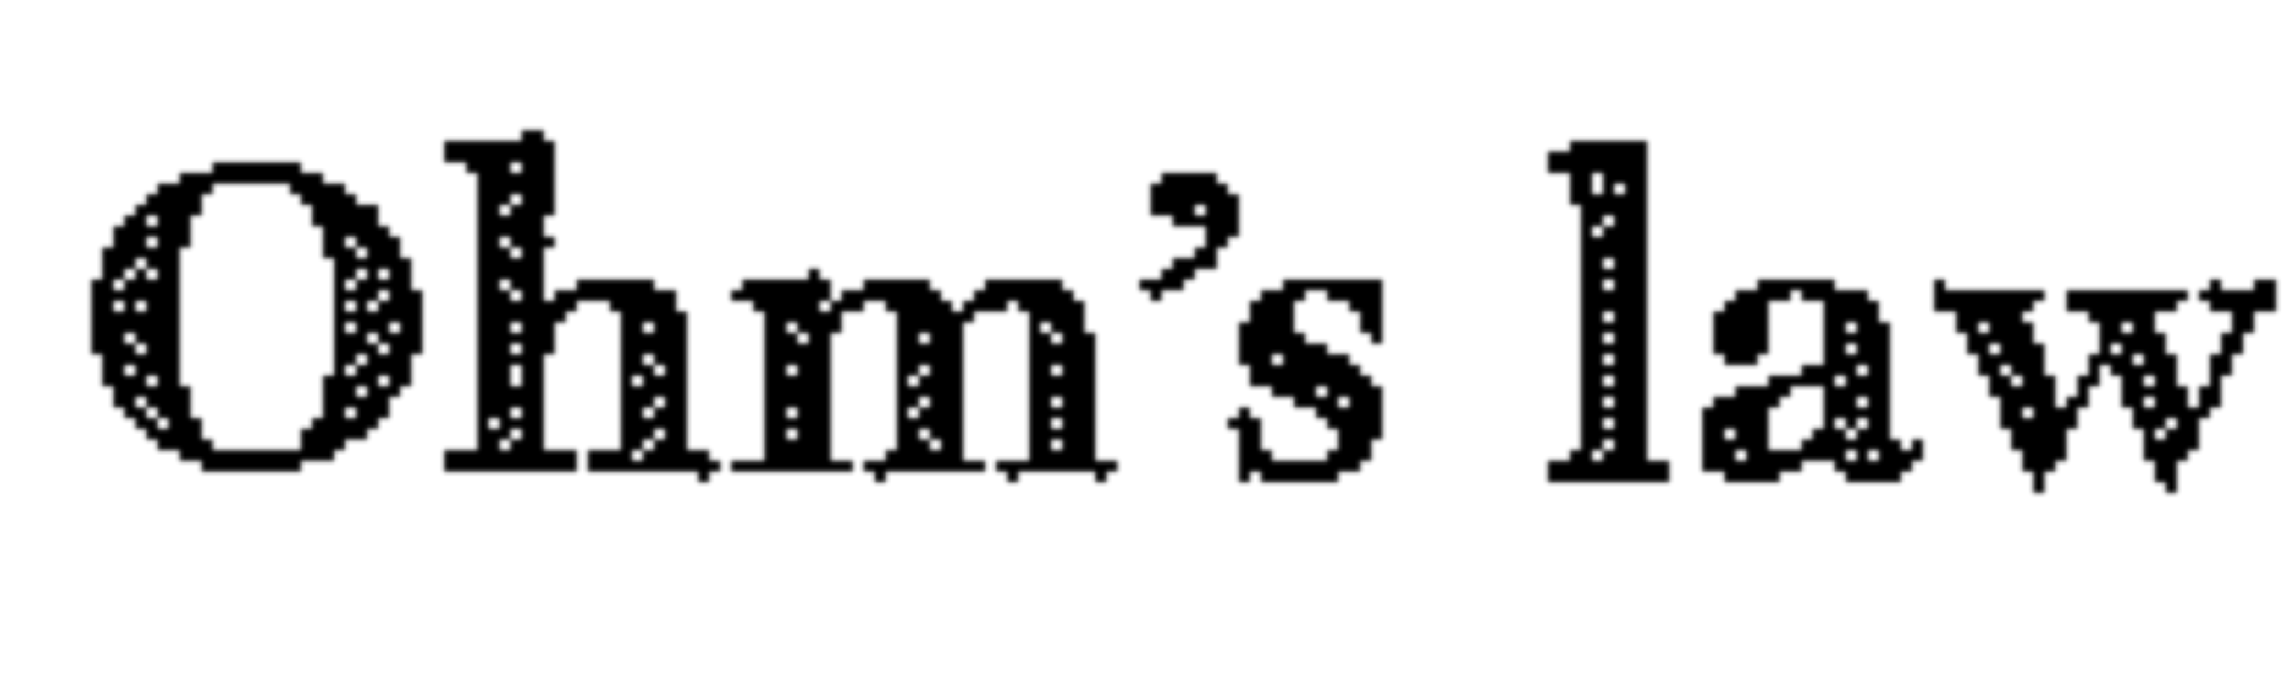
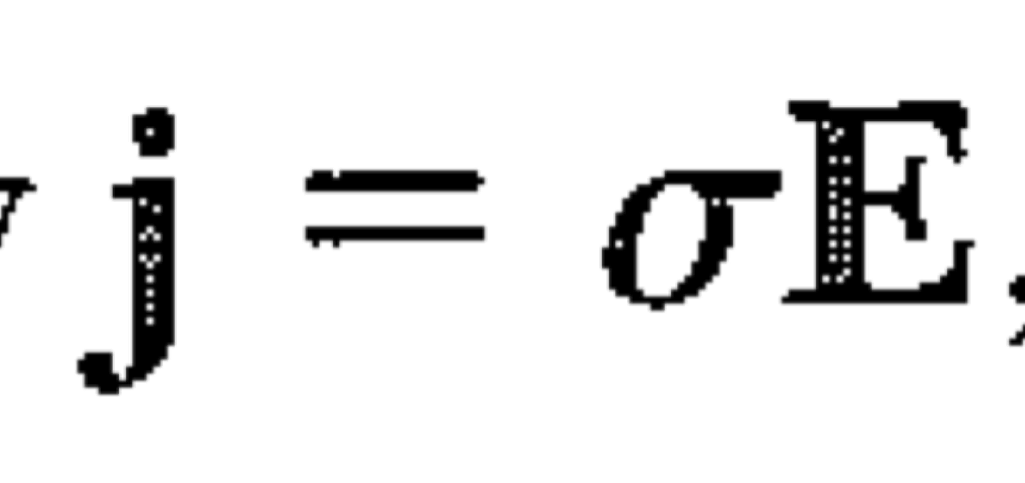
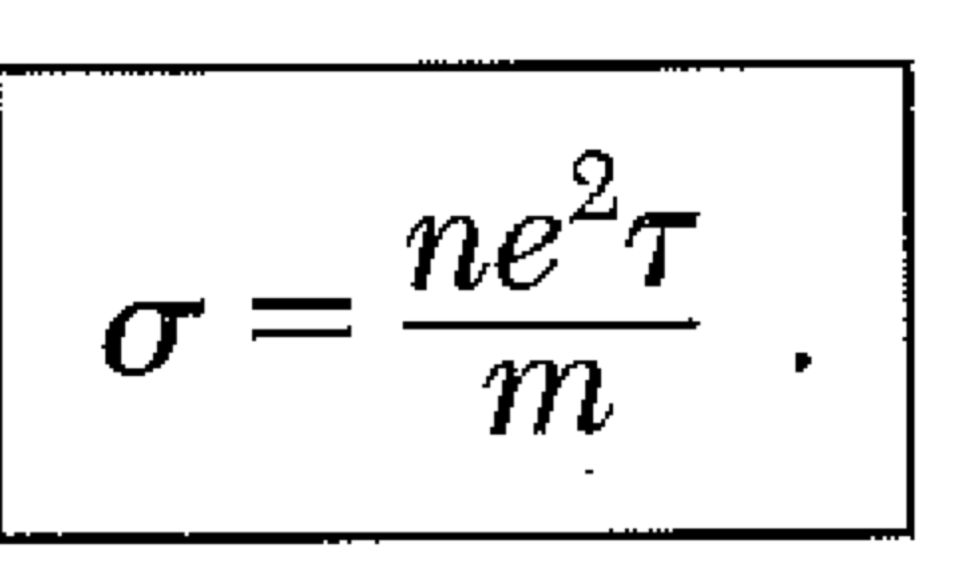
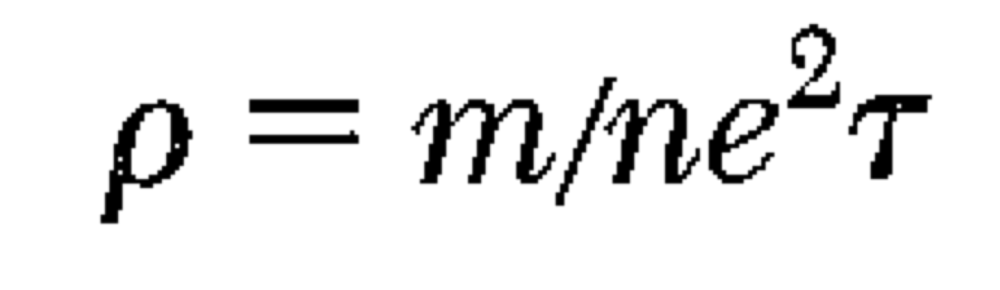
Electrical Conductivity
resistivity

Slide 18
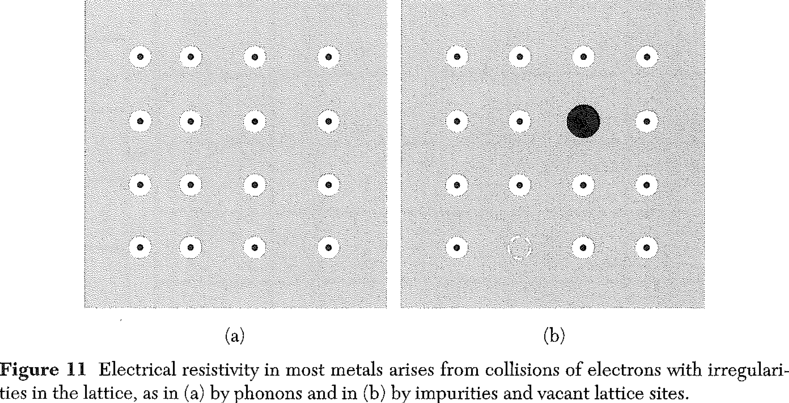
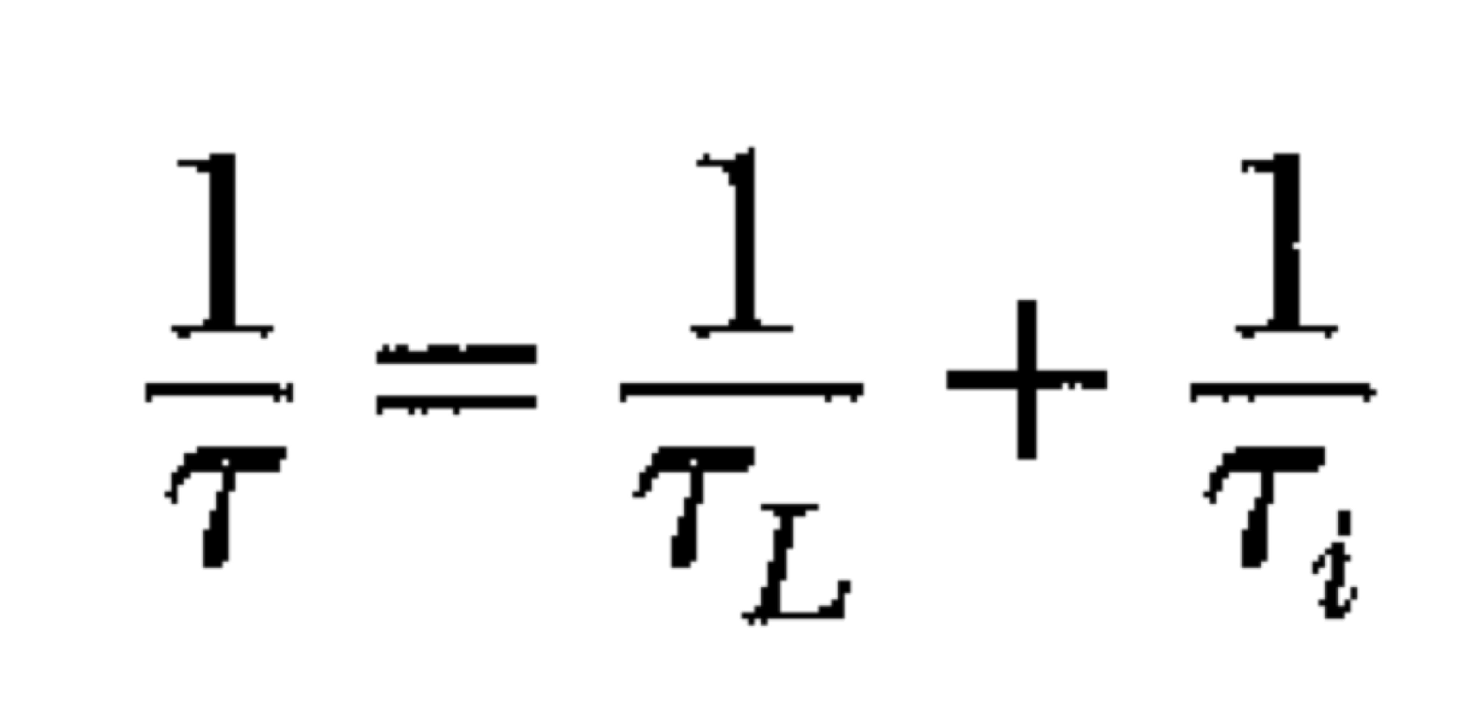
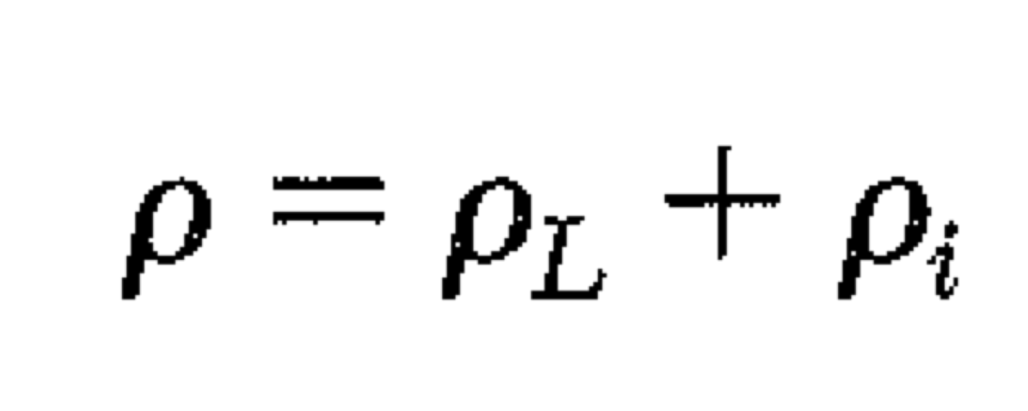
Electrical Conductivity
L = phonons, i = impurities

