Slide 1
The Forward Silicon Vertex Detector Upgrade
for the PHENIX Experiment at RHIC
Douglas Fields
University of New Mexico
Feb. 12, 2011

Slide 2
Talk Outline
Quick PHENIX overview
Physics Motivation
FVTX Design
Performance Simulations
Construction Status

Slide 3
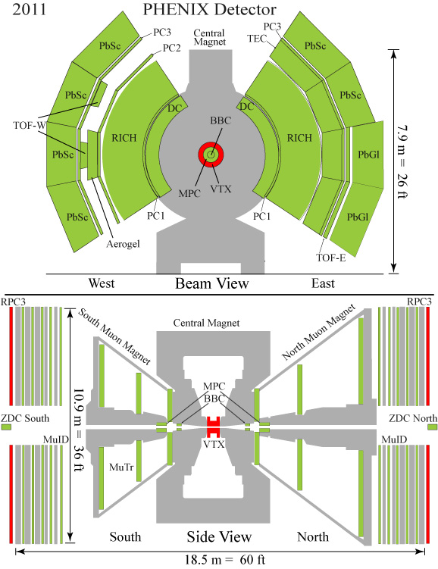
PHENIX Overview
Two Spectrometers
  Central Electron/Hadron with EM Calorimeter (also tags photons).
  Forward Muon with μ/π separation based on penetration depth
Event characterization detectors
  Reaction plane
  Centrality (BBC/ZDC)

Slide 4
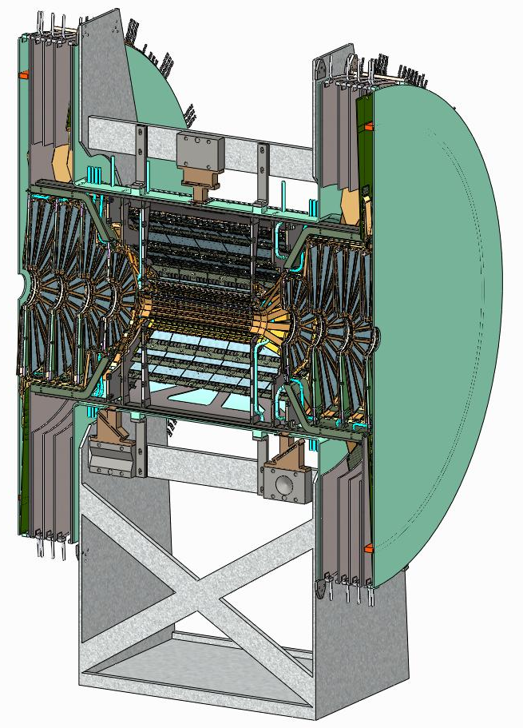
PHENIX Upgrade Vertex Trackers
VTX (Current run) +FVTX (Next run)

Slide 5
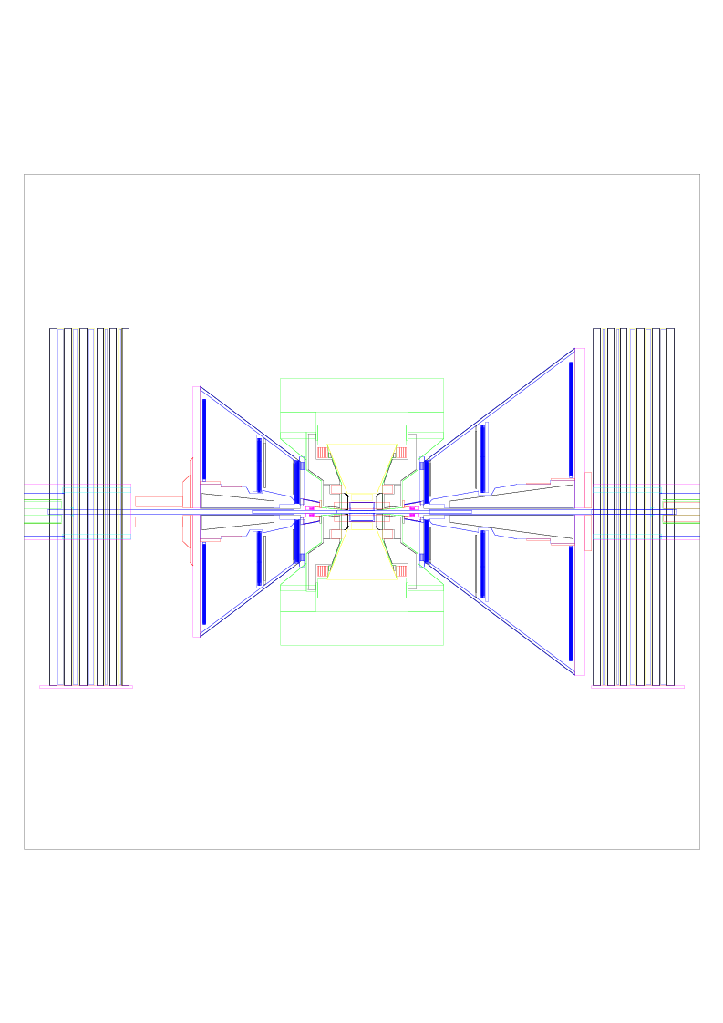
Why FVTX Detector for Muons?
Current Muon System :
  Initial absorber to reduce hadrons that reach the active detectors.
  Muon Tracking stations inside magnet to find tracks and measure momentum.
  Muon Identifier for μ/π separation, Lvl-1 trigger.
  ~1% “punch through”, ~1% decay into muon before absorber, ~1%*15% decay after the absorber.
Limitations :
  No way to discriminate π/Κ-->μ, D/B→μ, π/Κ punch-through.
  Mass resolution limited by absorber.
  Track isolation information lost by absorber.
η= 1.2
η = 2.4

Slide 6
Physics Motivation for FVTX
Measurements in p + p, d + Au and Au + Au Collisions
  Single Muons :
    Precision heavy flavor and hadron measurements.
    Separation of charm and beauty through semi-leptonic decay.
    Improve W background rejection.
  Di-Muons :
    Separation of J/ψ from ψ’ at forward rapidity.
    B→J/ψ, golden channel to measure B cross section.
    First Drell-Yan measurement.
Physics FVTX Can Access:
  Energy loss mechanism in hot dense medium (Heavy flavor R_{AA}, v₂).
  Cold nuclear effects ( Heavy flavor R_{dAu}).
  Gluon polarization ΔG/G (Heavy flavor A_{LL}).
  Sivers function, higher twist (Heavy flavor A_{N}).
  Crucial test of QCD non-universality (Drell-Yan A_{N}).

Slide 7
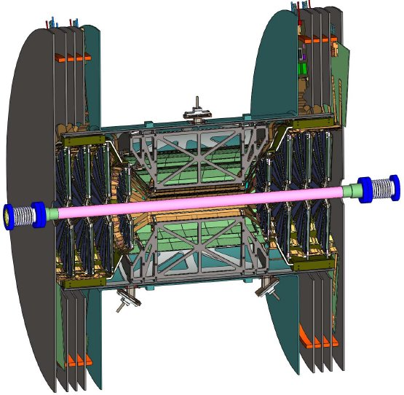
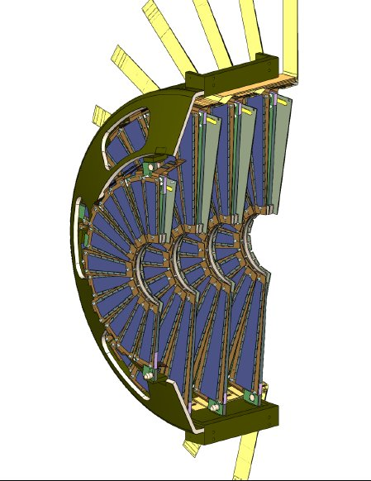
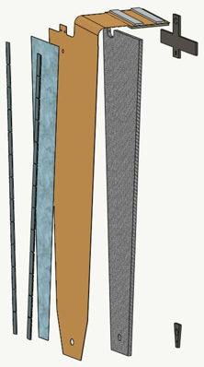
FVTX Geometrical Design
4 planes with overlapping sensors to give hermetic coverage in φ.
75 μm pitch strips, segmented in radial direction, with 3.75°staggered φ segmentation.
Tracks typically fire 2-3 strips in radial direction.
Material in active area: sensors, readout chips, polyamide readout cable, carbon backplane, various VTX materials, beryllium beam pipe.

Slide 8
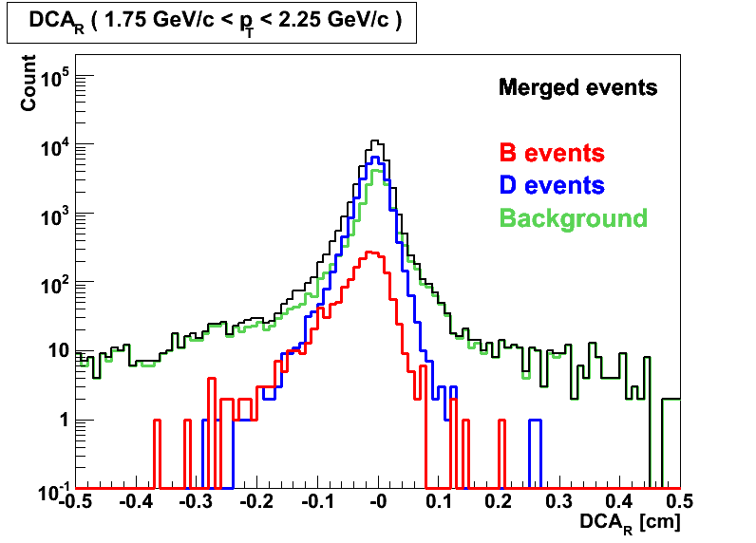
Simulation — Charm/Beauty separation by DCA_{R}
DCA_{R}(Distance of Closest Approach)
= impact parameter projected onto μ p_{T}.

Slide 9
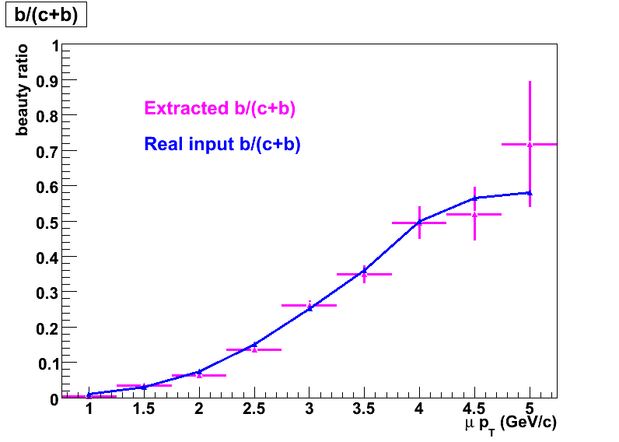
Beauty Charm ratio extraction
The b/(c+b) ratio was extracted from a sample which included c, b and background.
Re-scaled the error bar to PHENIX Run6pp statistics (10pb ⁻¹).
With 10 pb⁻¹ statistics
13 Jan 2010
9

Slide 10
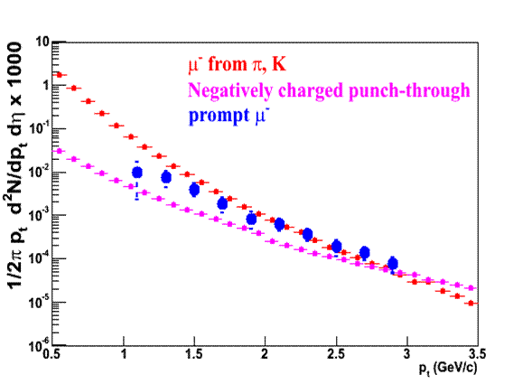
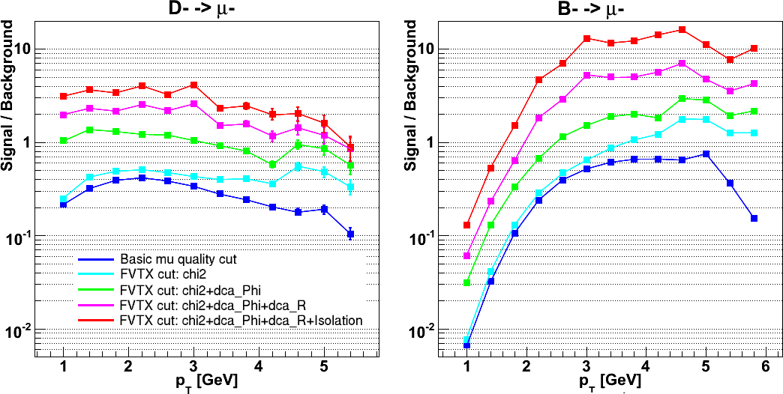
Improvement of Charm&Beauty / Background ratio
Real Data
Using FVTX related cuts to improve single/background
ratio in charm and beauty measurements
μ from D and B
FVTX S/B improvement
x 10 improvement

Slide 11
R_{AA} and A_{LL} measurements
Heavy Flavor nuclear modification factor (R_{AA}) in heavy ion collisions
Heavy Flavor double spin asymmetry A_{LL} measurement in p+p collisions

Slide 12
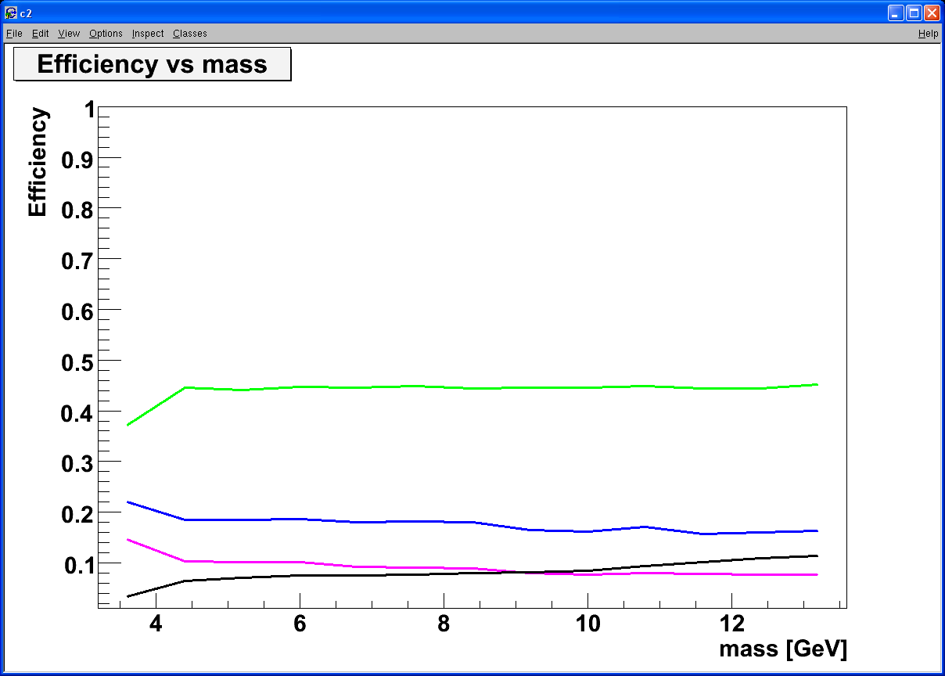
Drell-Yan measurements
Heavy flavor background
Drell Yan
Drell Yan
ϒ-states
J/Ψ
charm
charm
beauty
beauty
combinatorial background
4 GeV < M < 10 GeV
b-background: use FVTX
DCA < 1 σ cut:
Increase DY/bb ~ 5

Slide 13
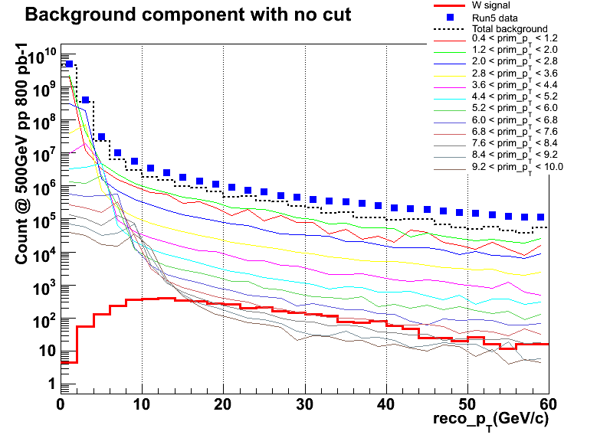
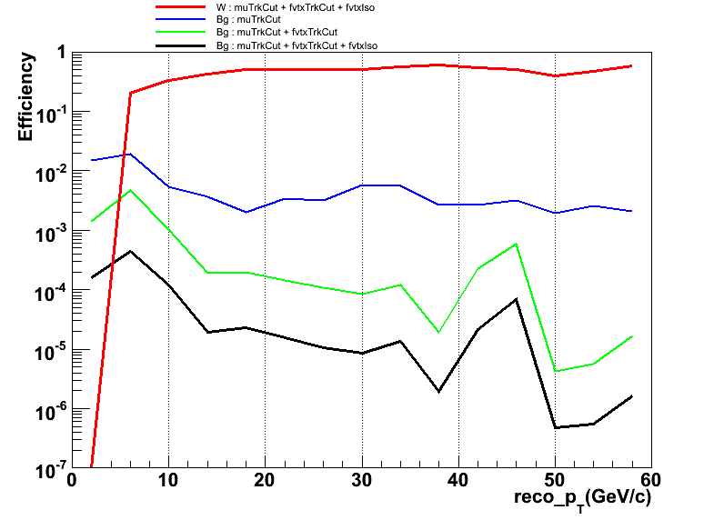
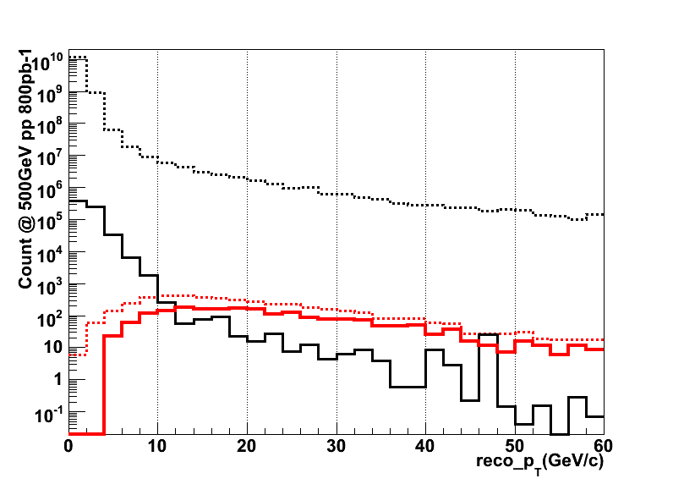
W Background Offline Rejection
Single muon spectrum contributions from:
W-->μX,
Hadron punch-throughs, decays,
Mis-reconstructed hadrons.
Tight MuTr cuts plus FVTX cuts improve signal:background by ~10⁵
Simulated signal, background
W, all cuts
Tight MuTr Cuts
Background before cuts
FVTX χ²
W before/after cuts
Isolation
Background after cuts

Slide 14
FVTX Status

Slide 15
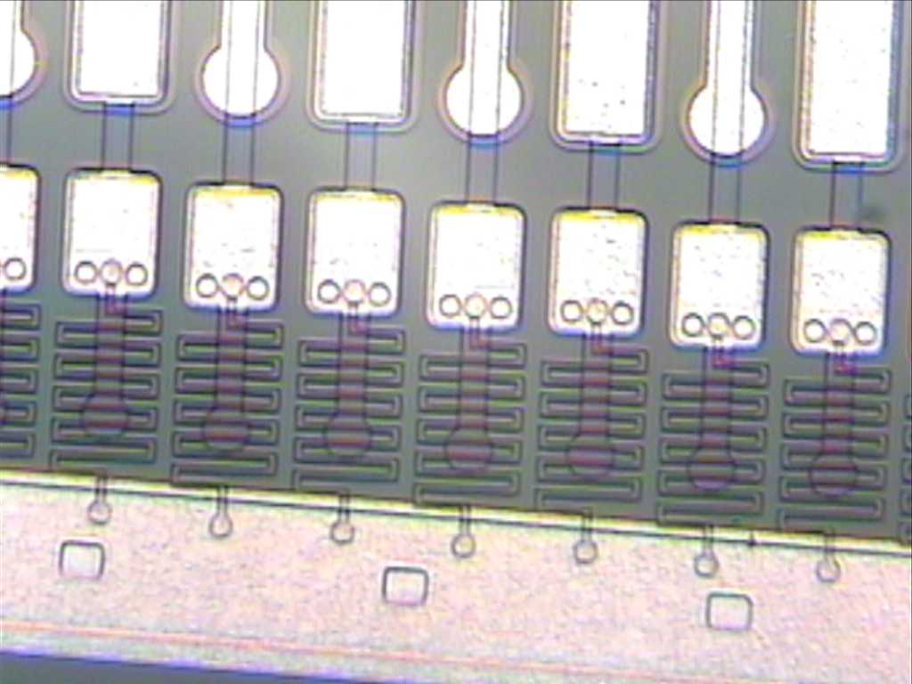
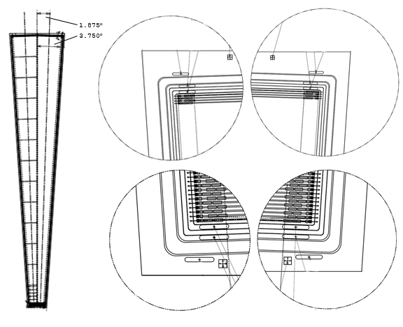
FVTX Sensors [Hamamatsu]
400 x p on n mini-strip sensors, 75 μm pitch spacing x 3.75º
1664 (640) strips per column for large (small) sensors
AC-coupled to readout.
Bias connected to strips via ~1.5MΩ polysilicon resistor.

Slide 16
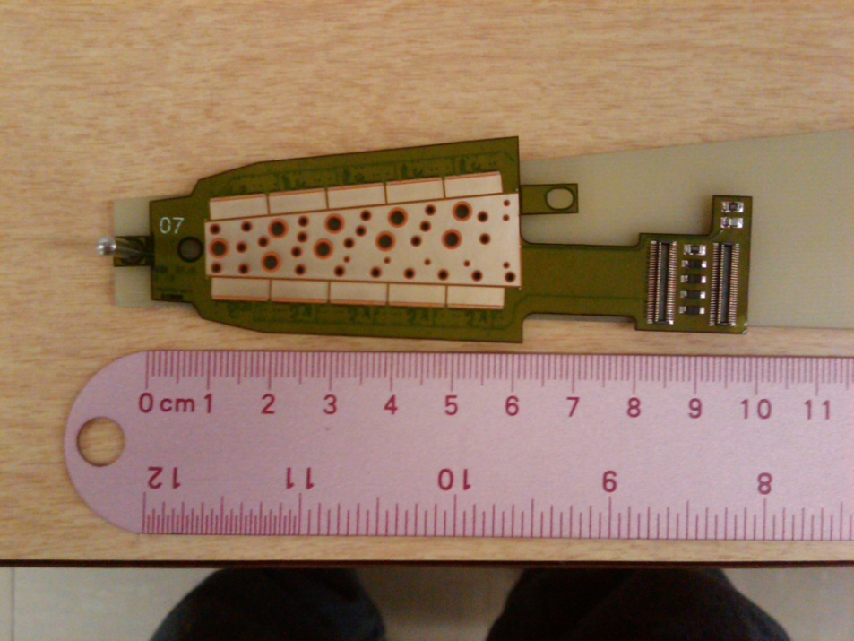
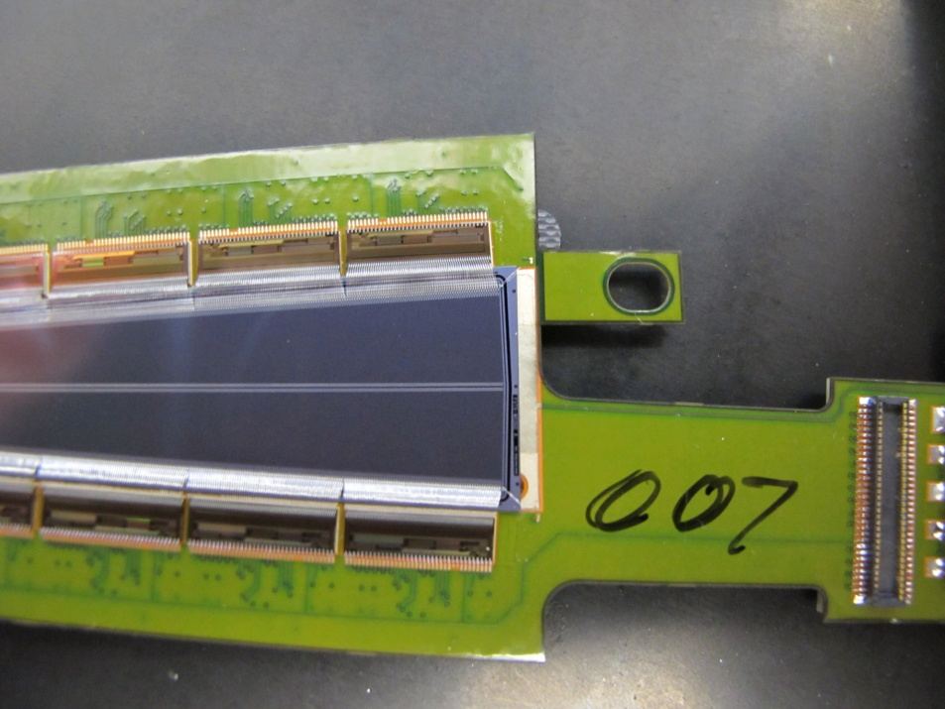
FVTX High-Density Interface [Dyconex/MSE]
7-layer polyimide readout cable, carbon (cooling) backplane.
Input (power, ground, slow control, clock, sensor bias, calibration).
Output (serial out).
Some production issues (delays).

Slide 17
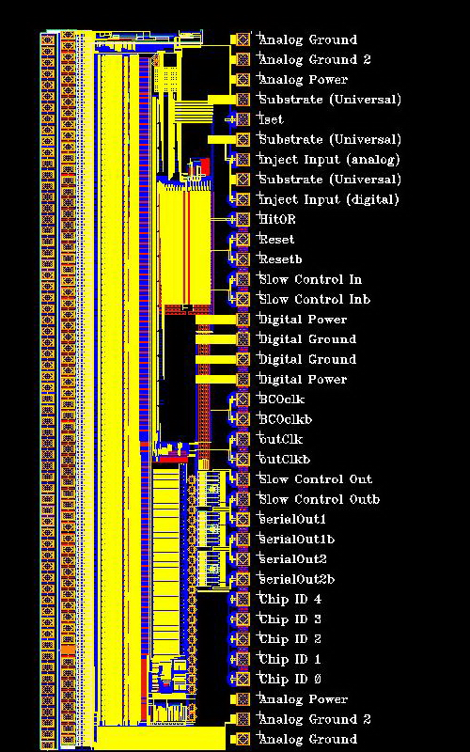
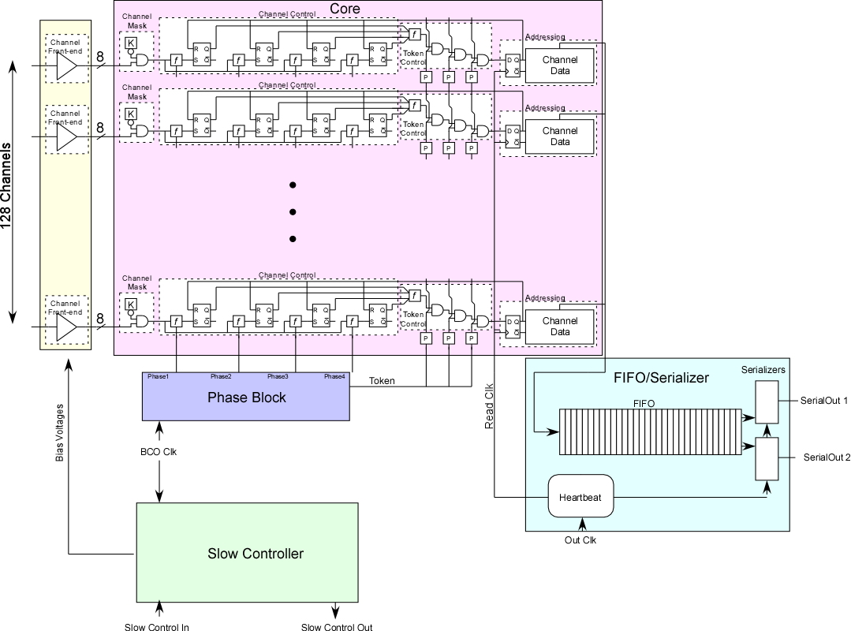
FVTX Read-out Chips (FPHX) [FNAL]
2.720 mm x 9.148 mm x 320 microns (after thinning).
128 channels of programmable integrator, shaper and comparator with channel mask.
3-bit ADC resolution using 8 comparators.
Serial output on two LVDS pairs.

Slide 18
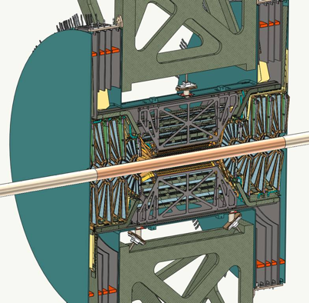
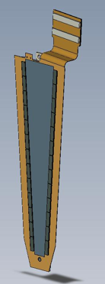
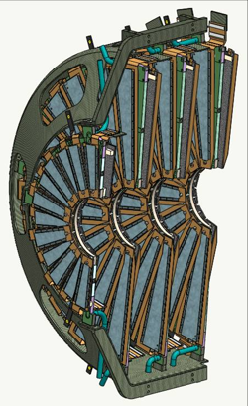
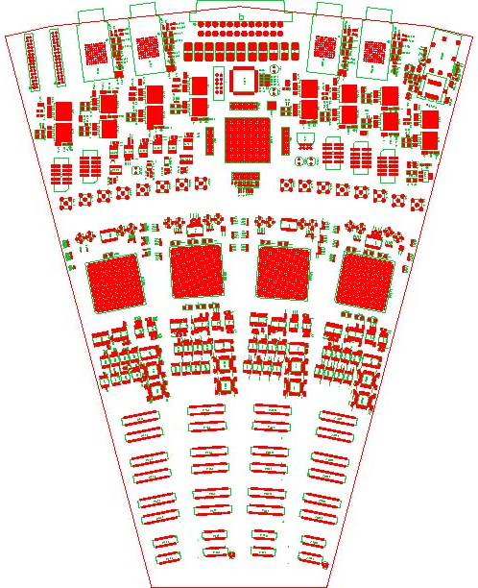

FVTX Electrical Design
Data push FPHX readout chip
High density interconnect cable
ROC (big wheel area in IR)
FEM (VME crate in CH)
PHENIX DCMs
HDI
sensor
FPHX
FEM, Counting House
ROC, Interaction Region

Slide 19
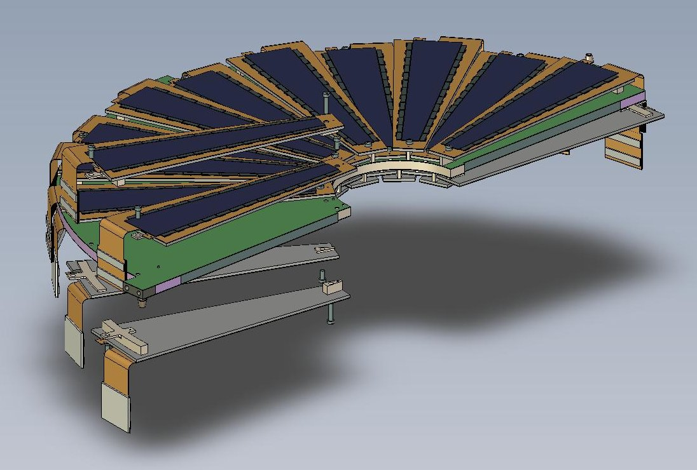
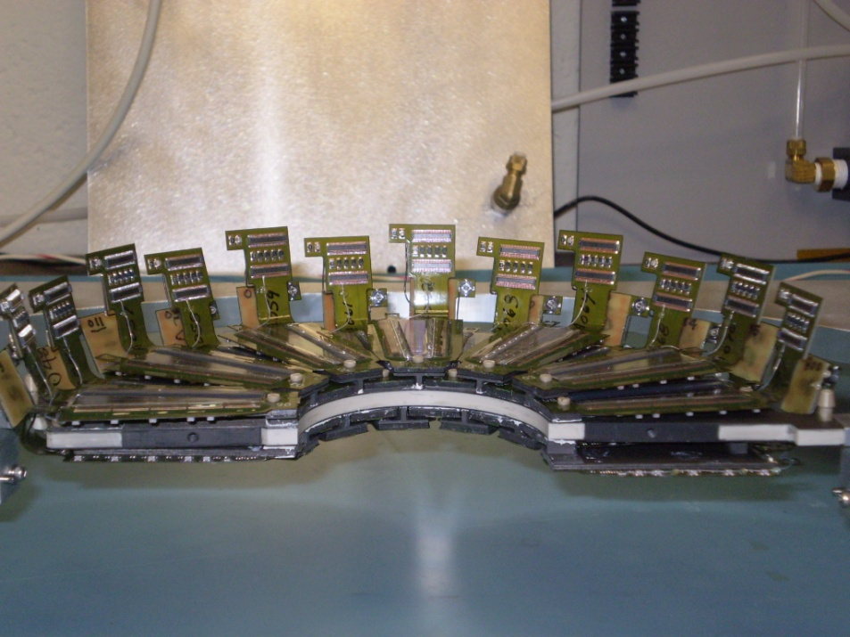
FVTX Disk [LBNL]
Carbon composite disks with cooling channels.
All small wedges assembled.
Two small disks assembled.

Slide 20
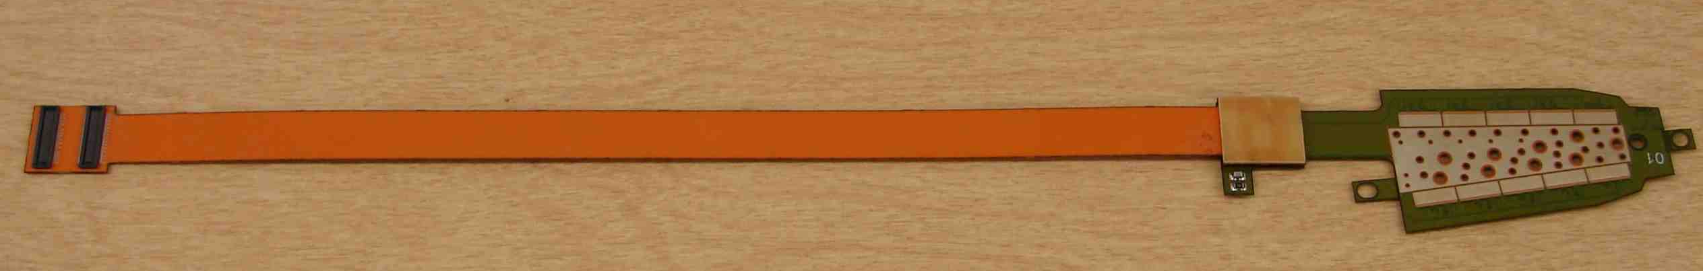
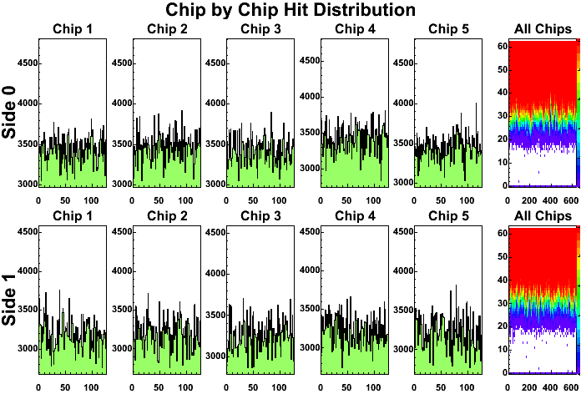
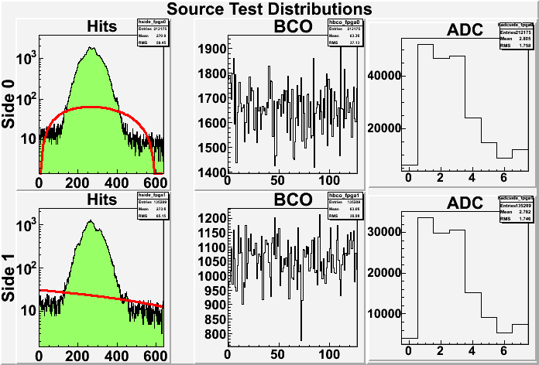
FVTX Tests
Each completed wedge is tested without and with a source.

Slide 21
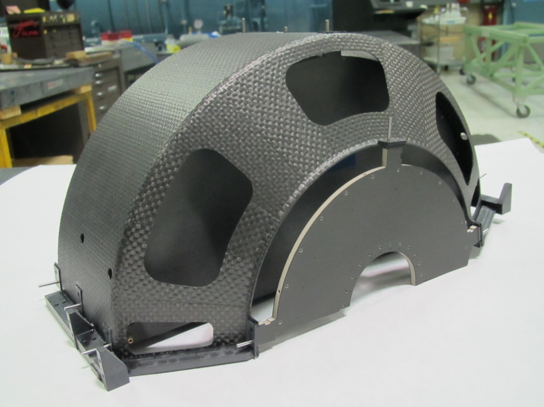
FVTX Cages [LBNL]
Carbon composite.

Slide 22
Summary and Outlook
The PHENIX Forward Silicon Vertex Detector provides good vertex resolution.
FVTX upgrade significantly improves hadronic background rejection for leptons (μ) physics observables.
The improvements in the measurements enable us to access more interesting physics in heavy-ion as well as the proton spin.
Detector is planned to be put into operation in 2011.

