Slide 1
Transverse Spin Physics at PHENIX
Douglas Fields
(University of New Mexico)
For the PHENIX Collaboration

Slide 2
Motivation for Spin
The proton has a rather complicated structure.
Spin is a useful handle to dissect the proton.
DIS experiments found that quarks carry ~30% of proton spin.
Not surprising, after all:
  Relativistic effects
  Pion cloud
  OGE interactions
  All convert quark spin to quark orbital angular momentum.
Myhrera & Thomas arXiv:0709.4067v1
Thomas arXiv:0803.2775v1

Slide 3
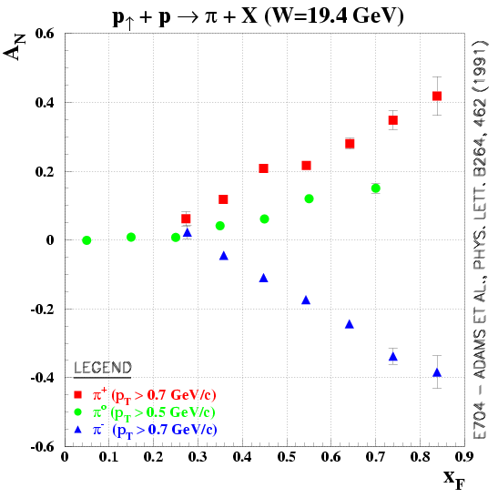
Motivation for Transverse Spin
Transverse spin effects were supposed to be small in the high energy limit…
But, large asymmetries were seen in the early 90’s.
left
right

Slide 4
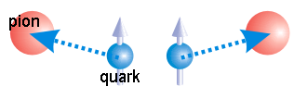
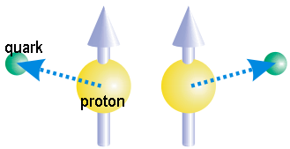
Transversity vs. Orbital Angular Momentum
Two ways to get to the transverse spin structure:
  Measure the transverse spin (transversity usually in conjunction with Collins).
  Measure observables linked to orbital angular momentum (Sivers, k_{T} asymmetry).

Slide 5
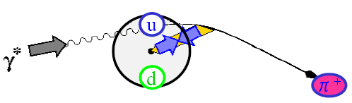
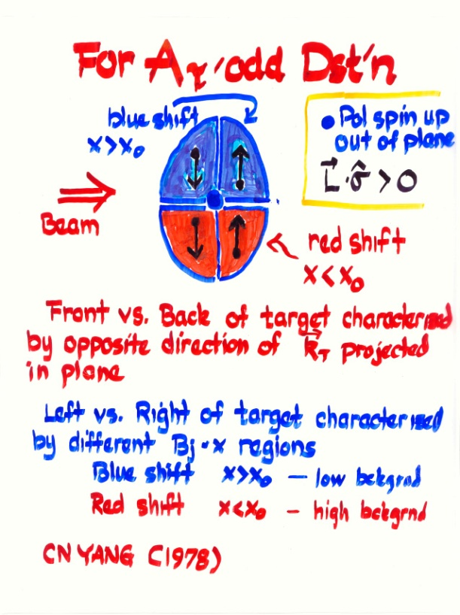
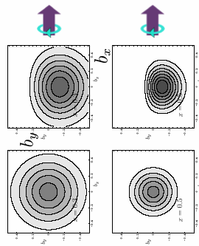
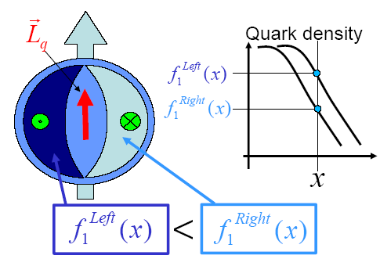
Observables sensitive to Orbital Angular Momentum
Sivers function

Slide 6
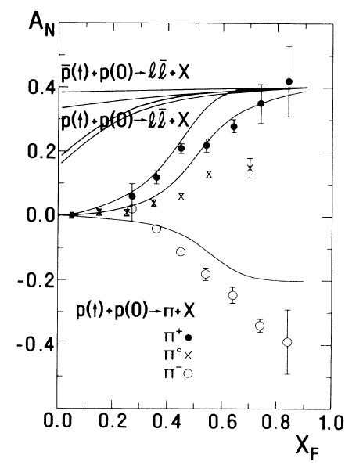
Observables sensitive to Orbital Angular Momentum
There is a long history of trying to explain SSA’s with orbital motion.
  C.Boros, et al., PRL 70 p1751 (1993).
  q-qbar annihilation of orbiting valence quarks.

Slide 7
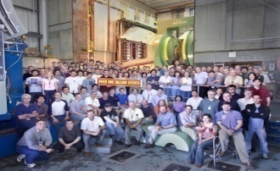
RHIC Spin
Absolute Polarimeter (H jet)
RHIC pC Polarimeters
Siberian Snakes
PHOBOS
BRAHMS & PP2PP
L_{max} ~ 3.5x1031 cm⁻² s⁻¹
Siberian Snakes
Acceleration of polarized protons between 25 and 250 GeV
PHENIX
Polarization ~65%
Spin Flipper
STAR
Spin Rotators
Partial Snake
Helical Partial
Snake
Strong Snake
LINAC
AGS
200 MeV Polarimeter
BOOSTER
Rf Dipole
AGS Internal Polarimeter
AGS pC Polarimeter

Slide 8
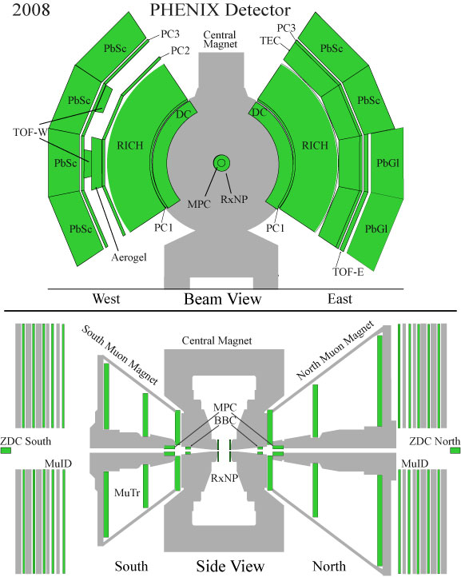
PHENIX
|η| < 0.35, φ = 2 x π/2
Tracking:
  Drift Chamber, Pad Chambers
Electromagnetic Calorimeter (PbSc or PbGl) with fine granularity (10x10 mrad)
RICH
  EMCal-RICH Trigger
  e/h separation p<5 GeV
  π ID 5<p<16 GeV
TOF
  85 ps resolution
  π/k separation for pT<2.8 GeV/c,
  Proton ID for pT<5 GeV/c
  With Aerogel, separation up to pT ~8GeV/c
TEC
  e/h separation for pT< GeV/c,
Muon arms
  Muon identification and tracking
Beam-Beam counter (BBC)
  Charged particles 3.0 < |η| < 3.9
  Minimum Bias Trigger, Luminosity
  Event vertex and time t₀
Zero Degree Calorimeter (ZDC)
  Neutral particles in 2mrad cone around beam axis
  Event vertex and time
  Local polarimetry
  Independent luminosity measurement
(~1.1 < | η | < 2.4)

Slide 9

PHENIX Acceptance
Slides to follow refer generally to one of the following acceptances of PHENIX.
Note that the acceptances determine very different kinematics and hence, processes that contribute to a signal.
P_{T}
CENTRAL
MUON
MPC
BBC
Kinematic Coverage @ 200GeV
ZDC
0 1 2 3 4 5 6
Pseudorapidity

Slide 10
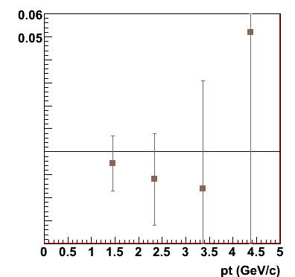
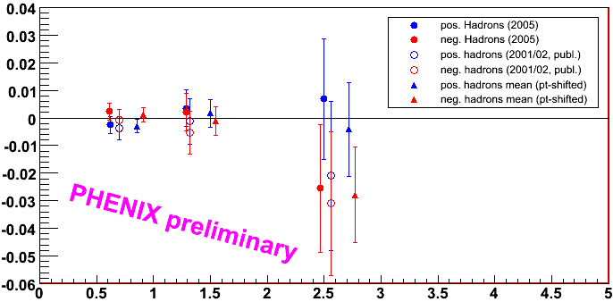
A_{N} in Hadrons (Central)
A_{N} is 0 within 1% → interesting contrast with forward π
May provide information on gluon-Sivers effect.
gg and qg processes are dominant.
Transversity effect is suppressed.
π⁰ (2001/02)

Slide 11
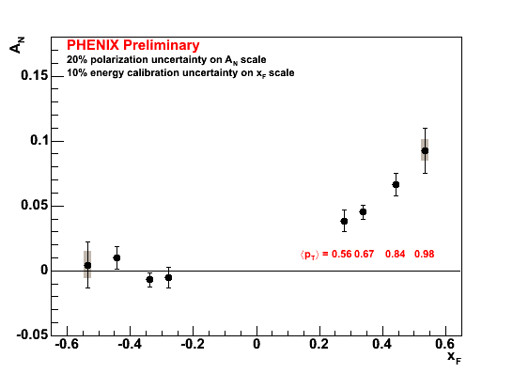

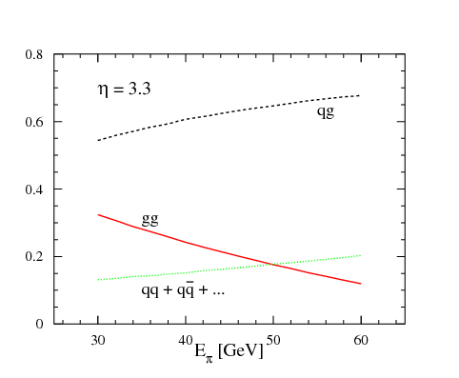
A_{N} in π⁰ (MPC)
p↑+p→π⁰+X at √s=62.4 GeV
Asymmetry seen in positive x_{F}, but not in negative x_{F.}
Large asymmetries at forward x_{F} → Valence quark effect?
3.0<η<4.0
process contribution to π⁰, η=3.3, √s=200 GeV
PLB 603,173 (2004)

Slide 12
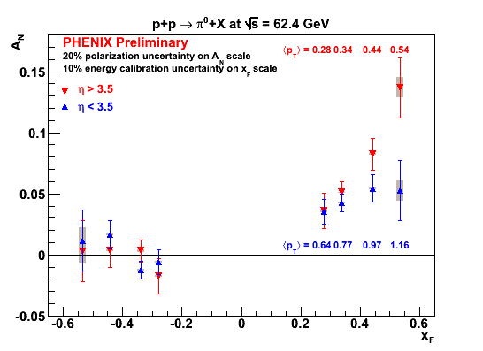
A_{N} in π⁰ (MPC)
p↑+p→π⁰+X at √s=62.4 GeV
Asymmetry seen in positive x_{F}, but not in negative x_{F.}
Large asymmetries at forward x_{F} → Valence quark effect?
x_{F}, p_{T}, √s, and η dependence provide quantitative tests for theories.
4 days of data!

Slide 13
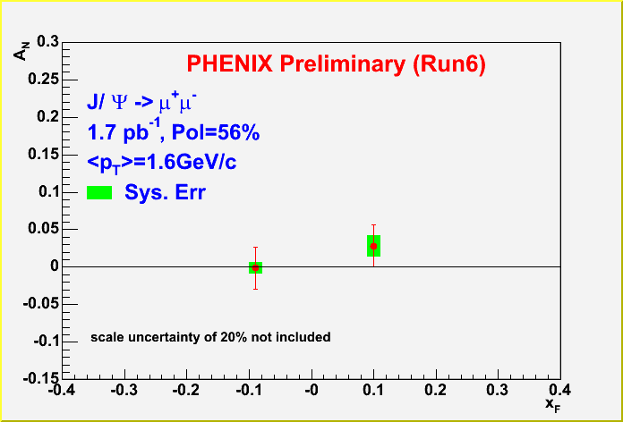
A_{N} in J/Ψ (Muon Arms)
Sensitive to gluon Sivers function.

Slide 14
A_{N} in J/Ψ (Muon Arms)
Sensitive to gluon Sivers function.
Open charm theory prediction available from Anselmino et al., but…
J/ψ production mechanism affects asymmetry (Feng Yuan, arXiv:0801.4357v1)

Slide 15
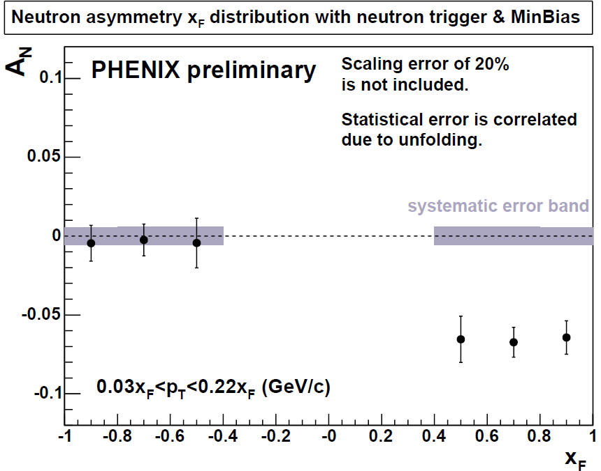
A_{N} in Neutrons (ZDC)
Forward neutron asymmetry is used to determine our polarization direction, but also is interesting physics.
Have examined the xF dependence of the asymmetry and the cross-section.

Slide 16
k_{T} Asymmetry
•×: Beam momenta
Like helicities
Jet 2 w/<k_{T}>=0
Partonic orbital angular momentum leads to rotation of partons correlated with the proton spin vector
This leads to different p_{T} imbalances (p_{T}-kicks) of jet pairs in semiclassical models
Can be measured by measuring helicity dependence of <k_{T}²>
Peripheral Collisions
Larger
Jet 1
Jet 2
Net p_{T} kick
Integrate over b, left
with some residual k_{T}
Jet 2 w/<k_{T}>=0
Central Collisions
Smaller
Jet 2
Jet 1
For details on jet see: Phys. Rev. D 74, 072002 (2006)

Slide 17
k_{T} Asymmetry
•×: Beam momenta
Unlike helicities
Jet 2 w/<k_{T}>=0
Partonic orbital angular momentum leads to rotation of partons correlated with the proton spin vector
This leads to different p_{T} imbalances (p_{T}-kicks) of jet pairs in semiclassical models
Can be measured by measuring helicity dependence of <k_{T}²>
Jet 2
Peripheral Collisions
Smaller
Jet 1
Net p_{T} kick
Integrate over b, left
with different residual k_{T}
Jet 2 w/<k_{T}>=0
Central Collisions
Larger
Jet 2
Jet 1
For details see: Phys. Rev. D 74, 072002 (2006)

Slide 18
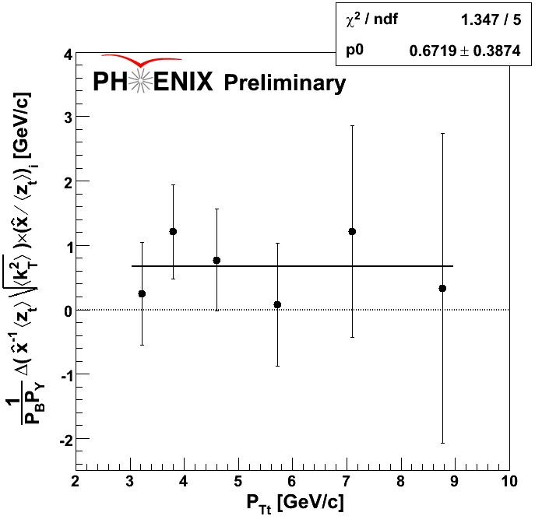
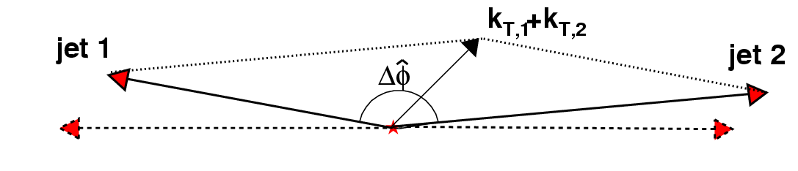
k_{T} Asymmetry (Central)
Spin-correlated transverse momentum (orbital angular momentum) may contribute to jet k_{T}. (Meng Ta-chung et al., Phys. Rev. D40, 1989)
Possible helicity dependence.
Final analysis soon.
Run-5

Slide 19
Upcoming…
Sivers via A_{N} in di-jets in central arm and MPC.
Transversity via Interference Fragmentation Function analysis.

Slide 20
Summary
PHENIX is exploring the transverse spin effects at RHIC energies in all accessible kinematic regions.
A truly “global” analysis of spin asymmetries should include all (not just A_{LL}) effects.
More data is needed to come to a well-constrained understanding of the interplay between the spin and orbital structure of the nucleon.

