Slide 1
Double Helicity Dependence of Jet Properties
Douglas Fields
University of New Mexico

Slide 2
But First…
Second in series:
http://panda.unm.edu/Fields/PartonOrbital.html

Slide 3
Workshop Wish List
Model calculation to estimate effects of TMD-moments evolution
Identify observables to isolate off-diagonal elements of q-g correlators
Bridge BFKL and Collins-Soper evolution equations
Model calculation to check transverse spin sum rule
Explain soft factor in TMD factorization (connections to low-x physics?)
Does integration of TMDs give back integrated PDFs?
Is there any definition of OAM for which TMD provide constraints?
Manifestly gauge-invariant definition of JM OAM decomposition
Gluon polarization on the lattice
What are the physical meanings to magnitude and sign of each TMD?
(transverse-spin) Drell-Yan measurements (with various hadron combinations)
Can we trust DSS? -> COMPASS data on fragmentation (multiplicities)
TMD fragmentation functions from e+e-
Polarize anti-protons
DDVCS

Slide 4

What is (L or L)?

Slide 5
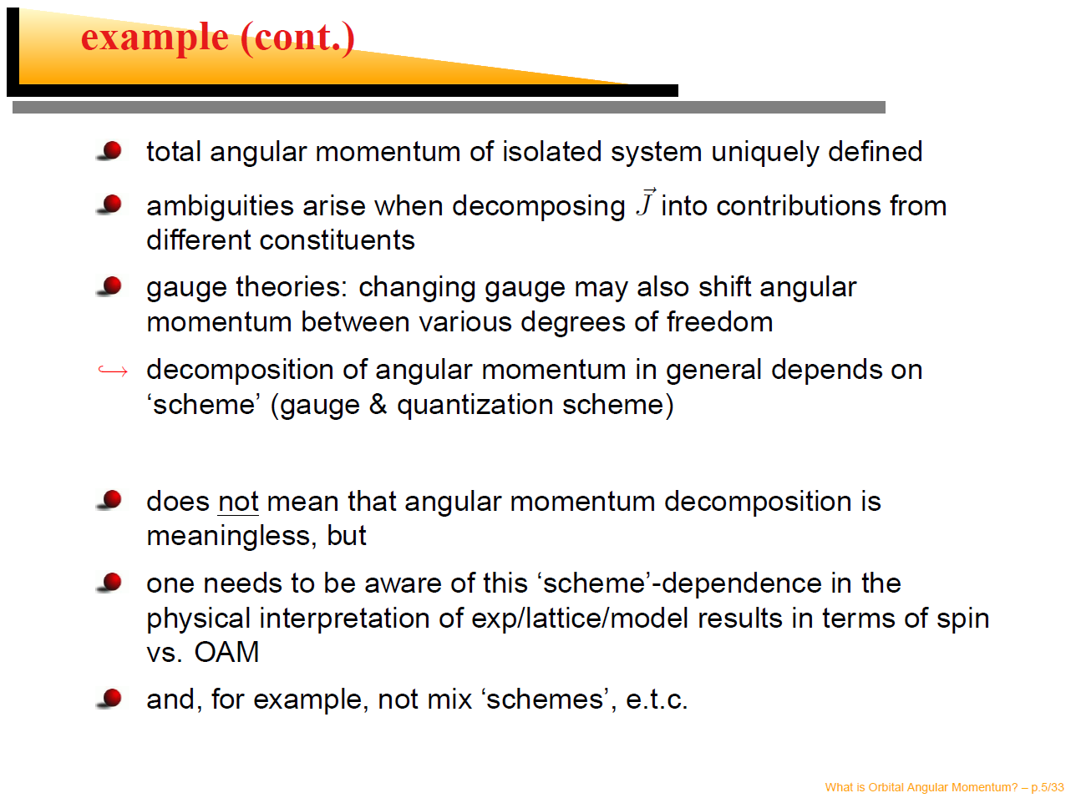

Slide 6
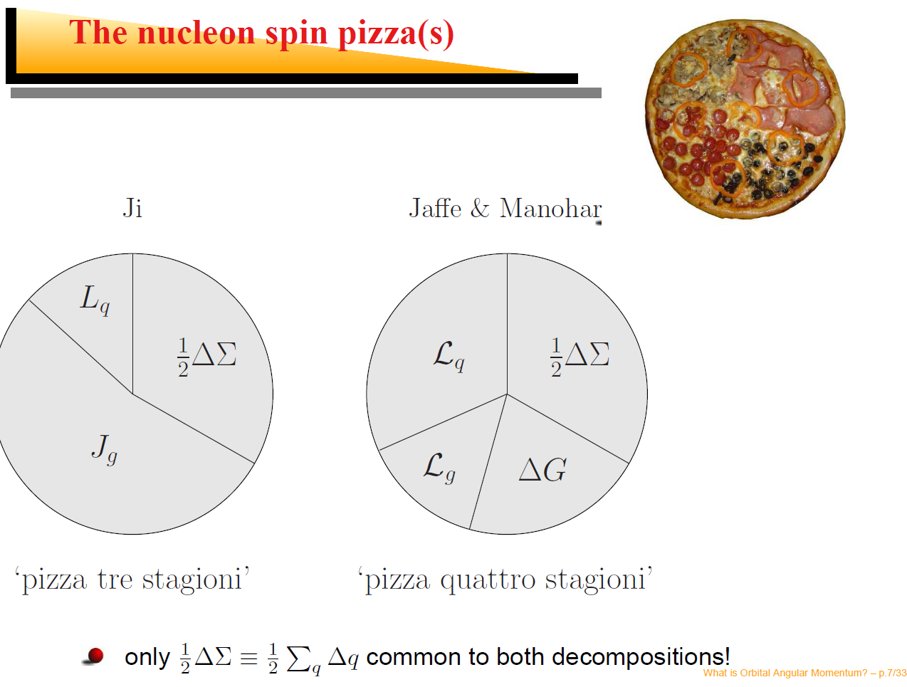

Slide 7
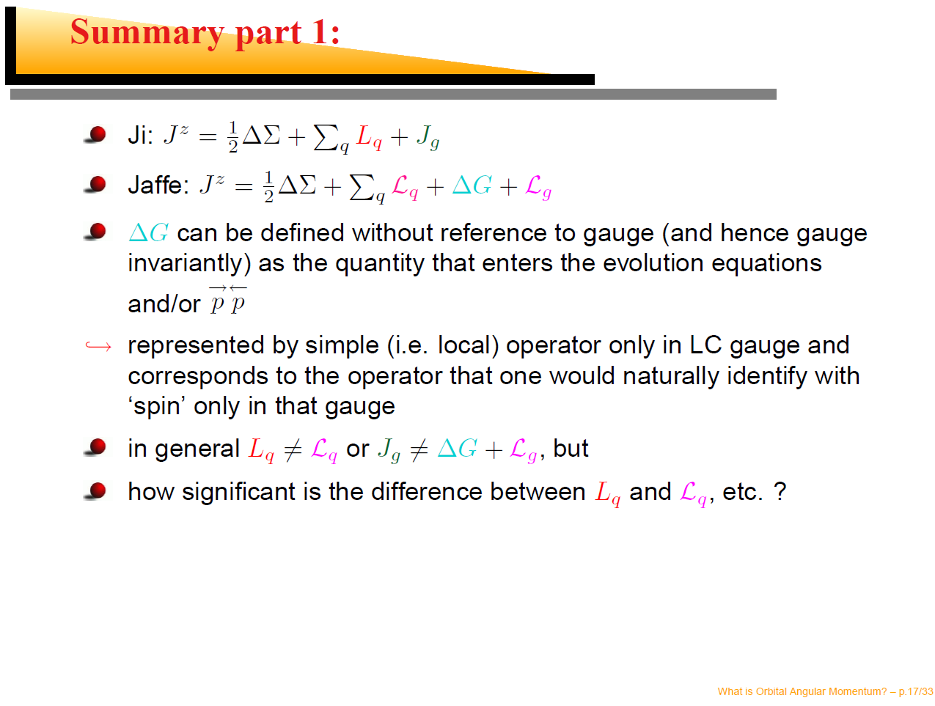

Slide 8
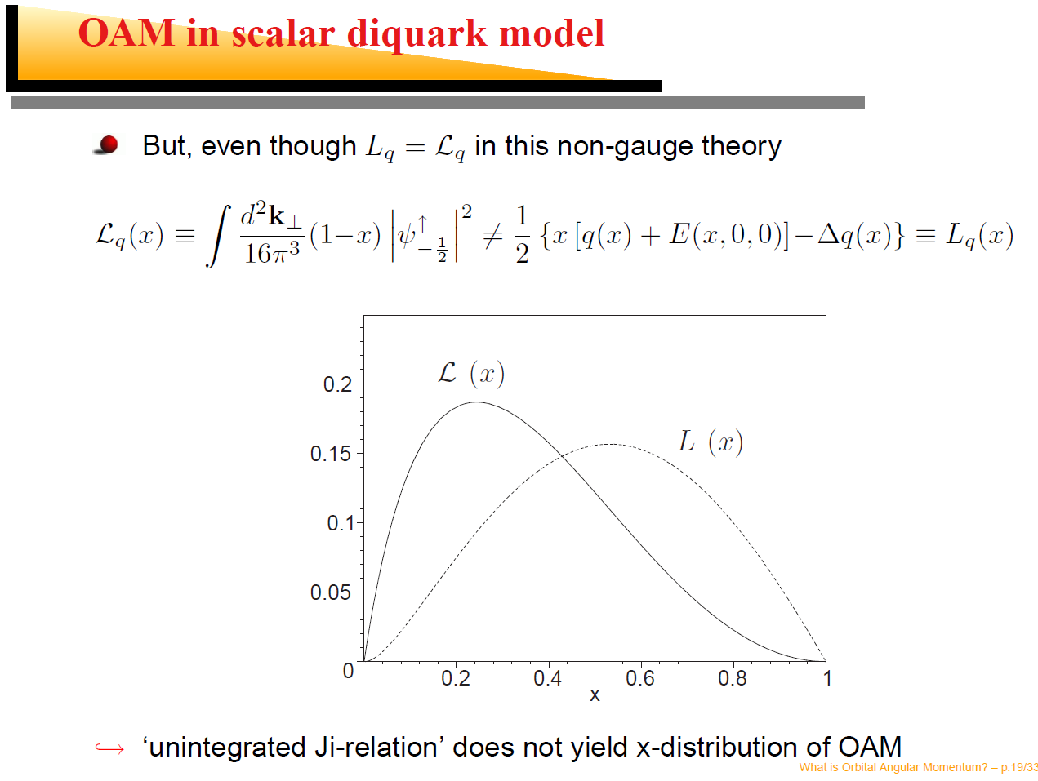

Slide 9
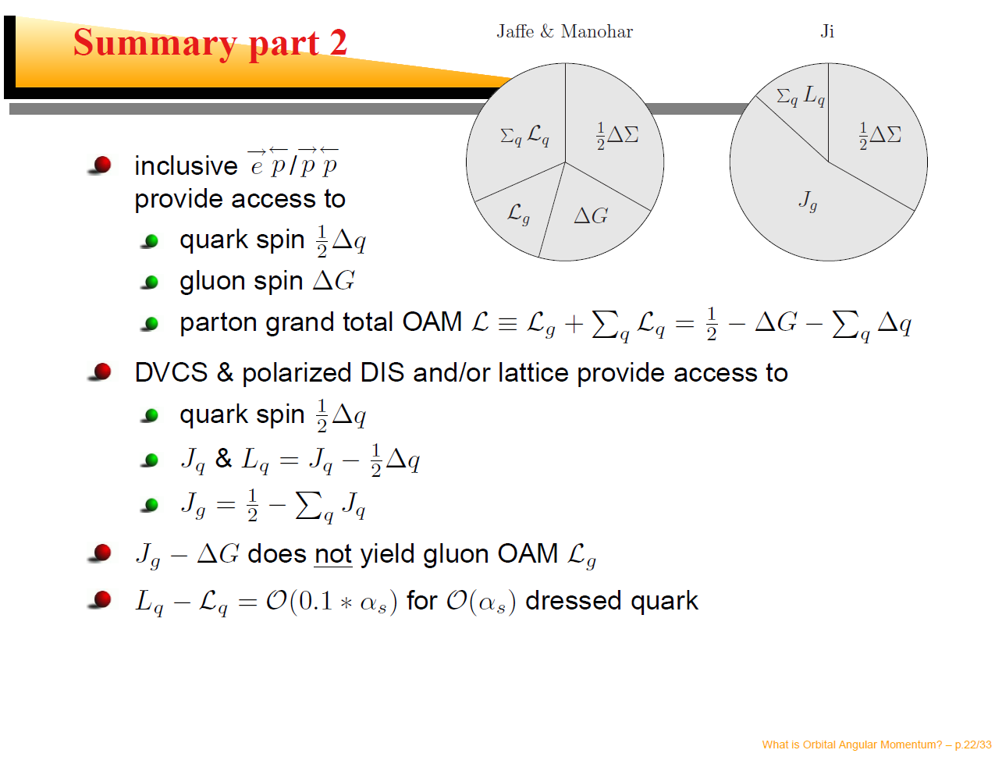

Slide 10
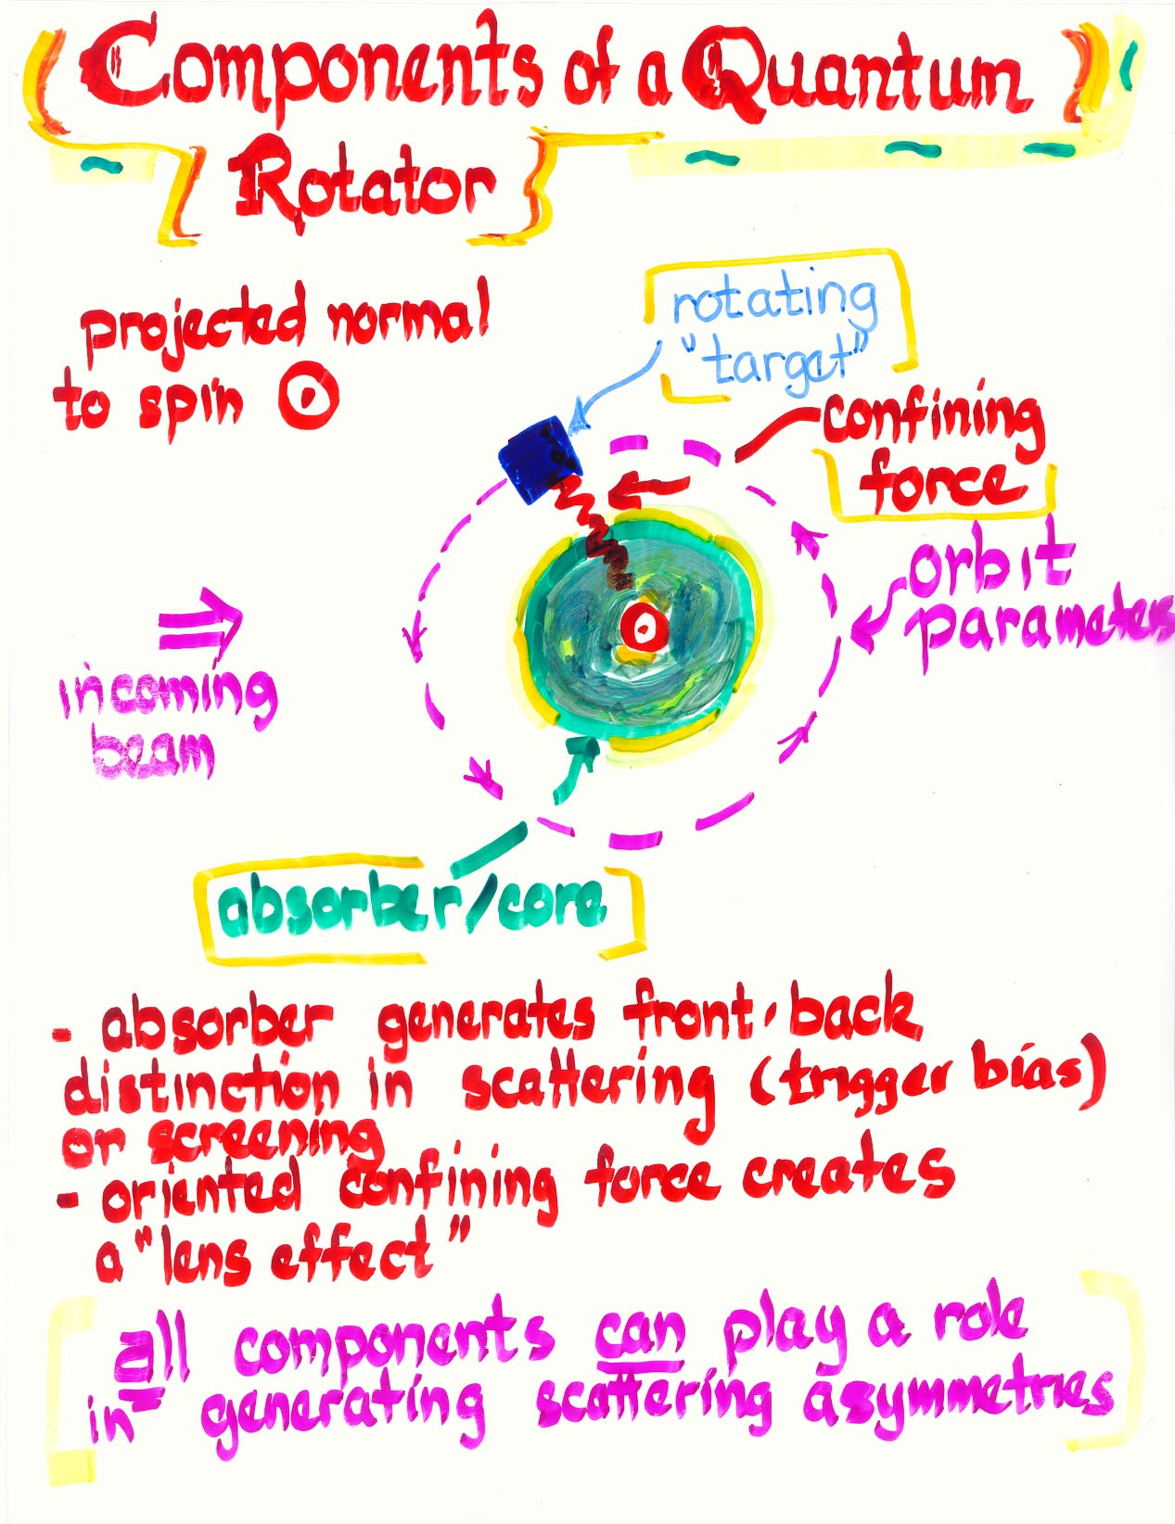
In Defense of Semi-classical Arguments
Nice conceptual picture from D. Sivers (talk given at UNM/RBRC Workshop on Parton Orbital Angular Momentum).
Summary:
  Sivers effect requires orbital motion.
  Is process dependent.
I would like to just follow this conceptual picture to see where it may lead.

Slide 11
Sivers Effect
No Sivers Effect
without interaction
with absorber.

Slide 12
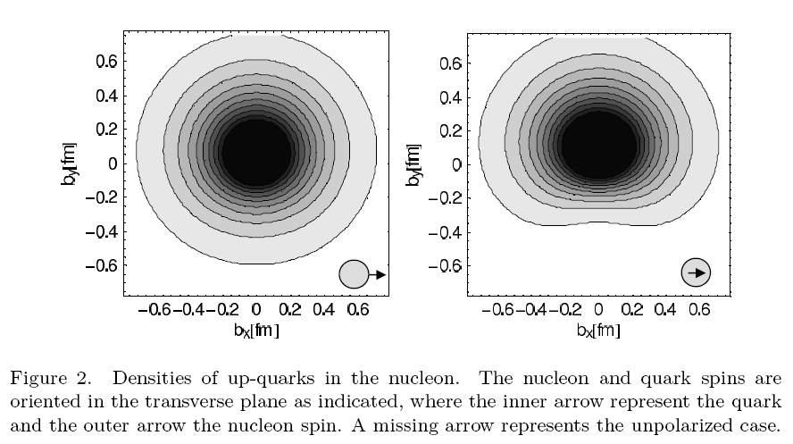
Spatial asymmetries
P.H. Hägler, et. al.

Slide 13
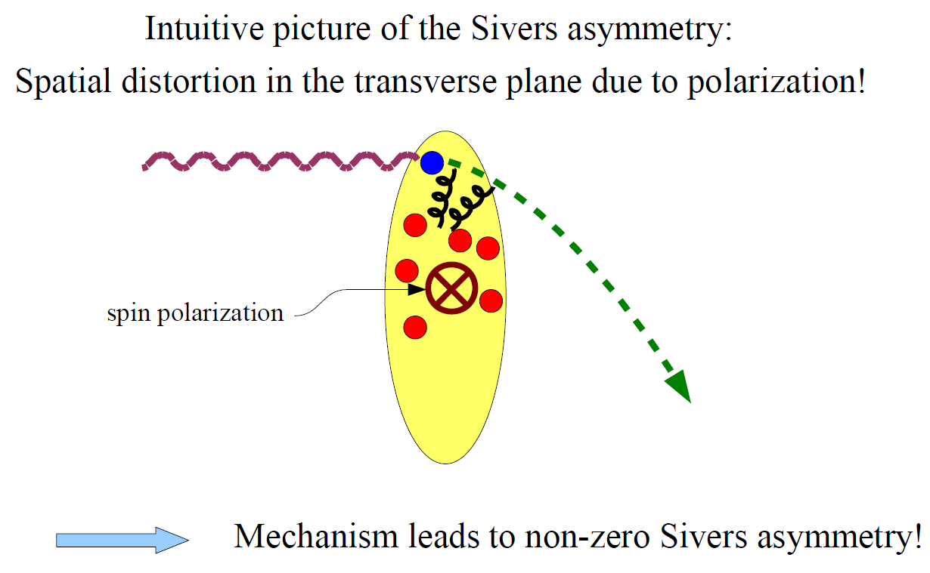
Leads to more formal approach…

Slide 14
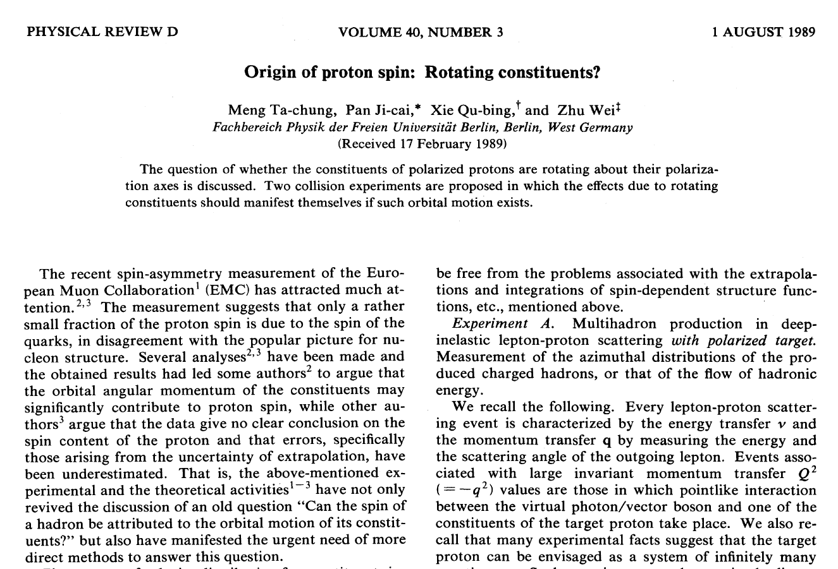
Meng Paper

Slide 15
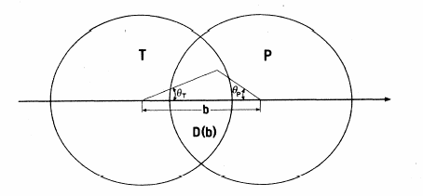
“Experiment B”
Drell-Yan pair production in polarized p+p collisions.
(Meng Ta-Chung et al. Phys. Rev. D 1989)
Like Helicity
Averaging over D(b):
k_{PR}
k_{TR}
Integrating over impact parameter b:
Un-like Helicity
k_{PR}
k_{TR}

Slide 16
Mechanism for .
Same Helicity
Peripheral Collisions
Larger
Peripheral Collisions
Larger
Measure jet
Integrate over b, left
with some residual k_{T}
Central Collisions
Smaller

Slide 17
Mechanism for .
Opposite Helicity
Peripheral Collisions
Smaller
Integrate over b, left
with some different
residual k_{T}
Central Collisions
Larger

Slide 18


From Meng Ta-Chung et al.
Phys Rev. D40, p769, (1989)
Total transverse momentum squared
of partons
For a particular impact parameter, b, the average transverse momentum
k_{PR}
k_{TR}
Where, is the product of the Jacobian and the density profile of partons, and D(b) is the overlap region.

Slide 19



From Meng Ta-Chung et al.
Phys Rev. D40, p769, (1989)
Like Helicity
We can now helicity separate:
b
The constant terms in p_{t} cancel and we have
k_{PR}
k_{TR}
Un-like Helicity
k_{PR}
We can then average over the impact parameter
k_{TR}

Slide 20



From Meng Ta-Chung et al.
Phys Rev. D40, p769, (1989)
This paper makes the following assumptions:
  Uniform spherical density F(b,θ_{P},θ_{T})
  k_{PR}~k_{TR}~k_{R} (no dependence on b, θ_{P}, θ_{T}.)
Then,
Evaluated numerically

Slide 21
Our Model
Use different transverse density distributions to get p_{t} kick from coherent spin-dependent motion:

Slide 22
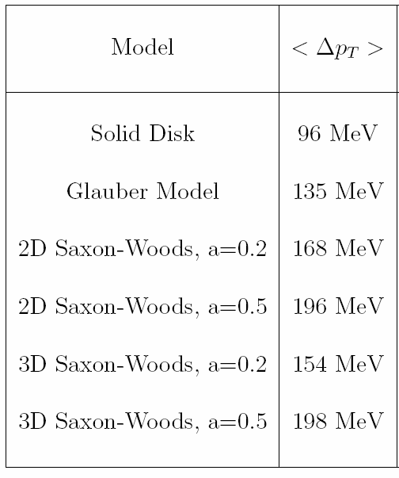
Our Model Results
Basically independent of transverse density distribution.
Ranges from 0.3 to 0.6 times the initial momentum.
Very crude – would like suggestions to improve.

Slide 23
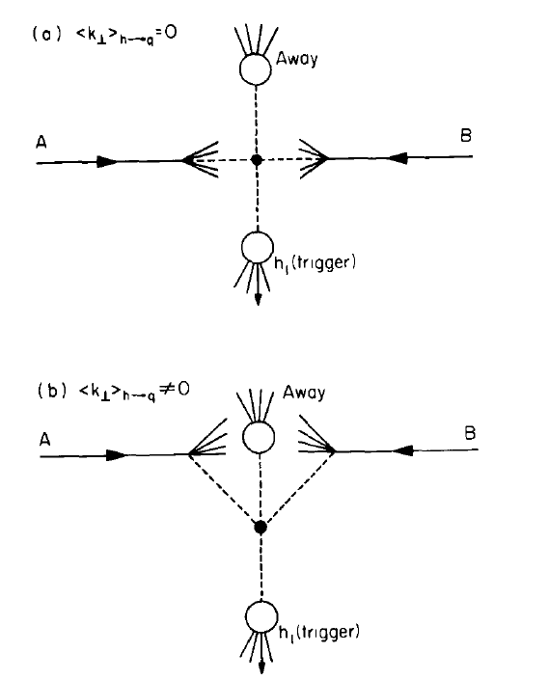
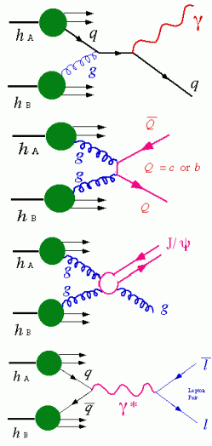
What is the origin of jet k_{T}?
Intrinsic (Confinement) k_{T} ≈ 200 MeV/c
Soft QCD radiation.
An example - J/ψ production.
Extra gluon kick
⟨p_{T}⟩_{J/ψ} =1.8±0.23±0.16 GeV/c
Phys. Rev. Lett. 92, 051802, (2004).
Breaks collinear factorization

Slide 24
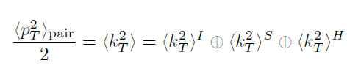
Origin of Jet k_{T}
Net transverse momentum of a di-hadron pair in a factorization ansatz
k_{T}
Di-hadron p_{T}
I = initial – fermi motion of the confined partons, initial-state gluon radiation…
S = soft – one or several soft gluons emitted
H = hard – final-state radiation (three-jet)…
Another Possibility:
Spin-correlated transverse momentum – partonic orbital angular momentum
Can examine the helicity dependence of each term:

Slide 25
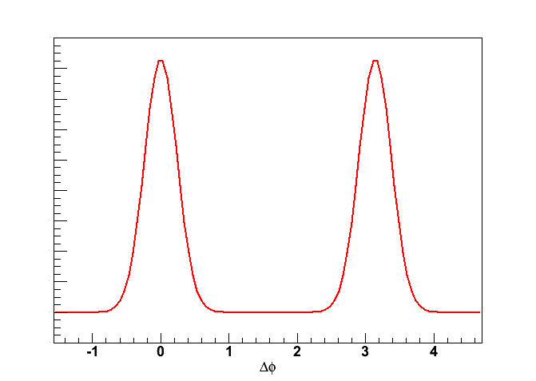
Measuring jet k_{T} – di-hadron correlation
Intra-jet pairs angular width : σ_{near} → ⟨j_{T}⟩
Inter-jet pairs angular width : σ_{far} → ⟨j_{T}⟩
Zero k_{T}
p_{Ta}
p_{Tt}
^
^
p_{Ta}
p_{Tt}
j_{Ty}

Slide 26
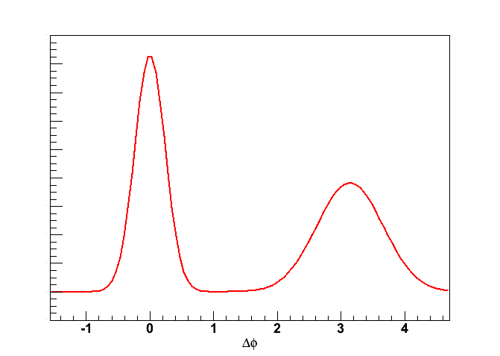
Measuring jet k_{T} – di-hadron correlation
Intra-jet pairs angular width : σ_{near} → ⟨j_{T}⟩
Inter-jet pairs angular width : σ_{far} → ⟨j_{T}⟩
⊕ ⟨k_{T}⟩
p_{Ta}
Zero k_{T}
Non-Zero k_{T}
^
p_{Tt}
p_{Ta}
^
p_{Tt}
k_{Ty}
j_{Ty}

Slide 27
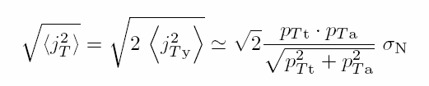

Jet Kinematics
p_{Ta}
^
p_{Tt}
p_{Ta}
^
p_{out}
p_{Tt}
k_{Ty}
j_{Ty}
p_{Tt}
For details, see PRD 74,
072002 (2006)

Slide 28
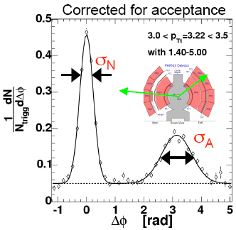
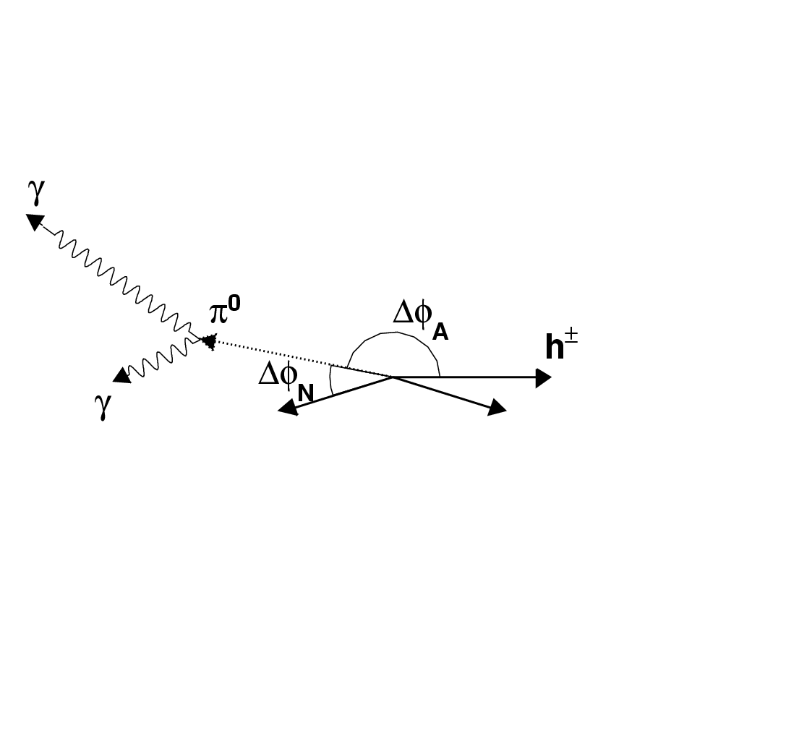
Measuring jet k_{T} – di-hadron correlation
πº- h± azimuthal correlation
Trigger on a particle, e.g. πº, with transverse momentum p_{Tt}. Measure azimuthal angular distribution w.r.t. the azimuth of associated (charged) particle with transverse momentum p_{Ta}. The strong same and away side peaks in p-p collisions indicate di-jet origin from hard scattering partons.

Slide 29
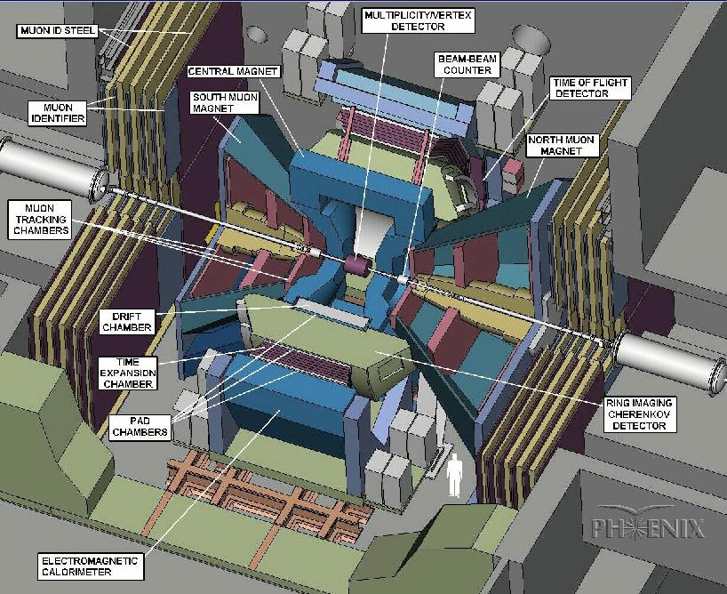
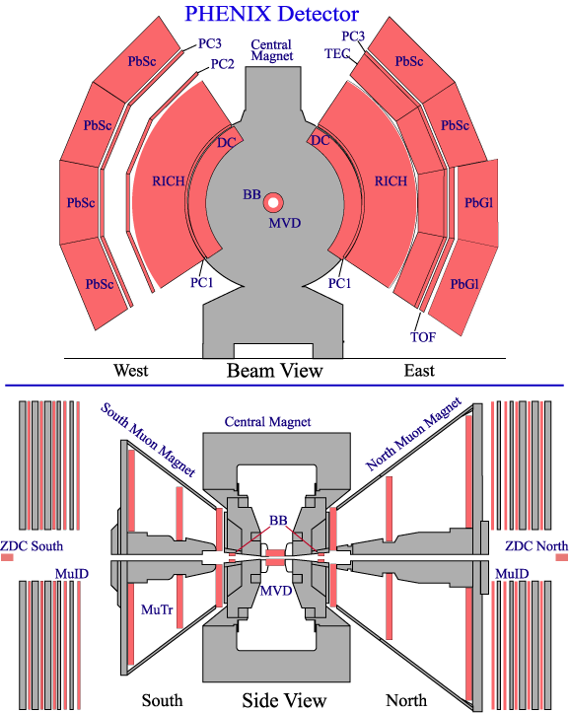
PHENIX Detector
Philosophy:
High resolution at the cost of acceptance
High rate capable DAQ
Excellent trigger capability for rare events
Central Arms:
|η|<0.35, Δϕ=2×90⁰
Charged particle ID and tracking; photon ID. EM Calorimetry.
Muon Arm:
1.2<|η|<2.4
Muon ID and tracking.
Global Detectors
Collision trigger
Collision vertex characterization
Relative luminosity
Local Polarimetry

Slide 30
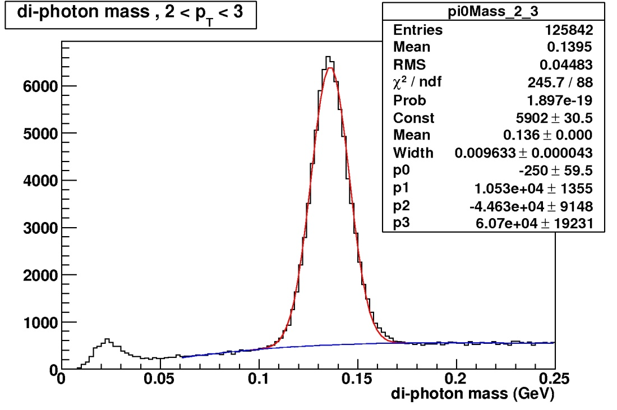
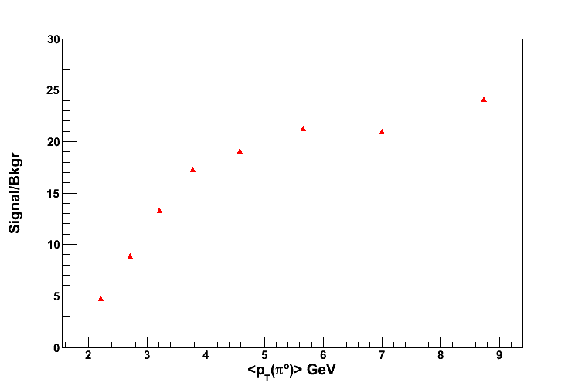
π° Identificaton
π° → γ+γ
The pions are selected within
M_{π◦} ±2.0σ_{π◦}
Photon trigger:
EMCal cluster energy > 1.4 GeV
The mass, M_{π◦}, and the width, σ_{π◦} , are determined by fitting the di-photon mass spectrum with gaus+pol3.

Slide 31
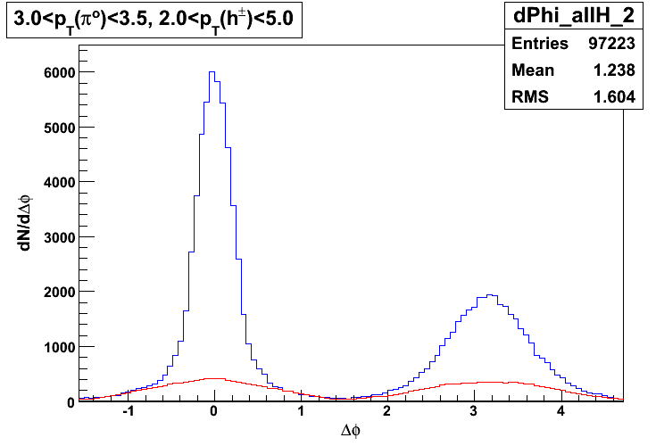
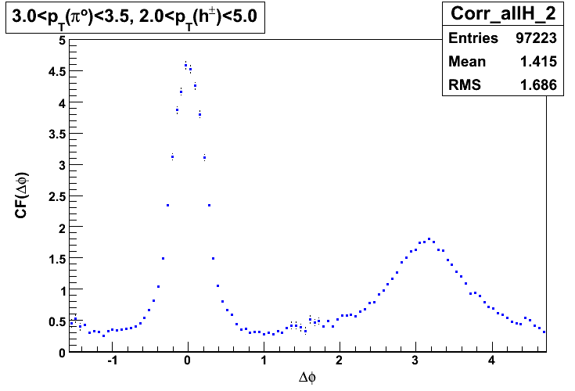
Correlation Function
Blue – real (raw Δφ)
Red – background (mixed events)

Slide 32
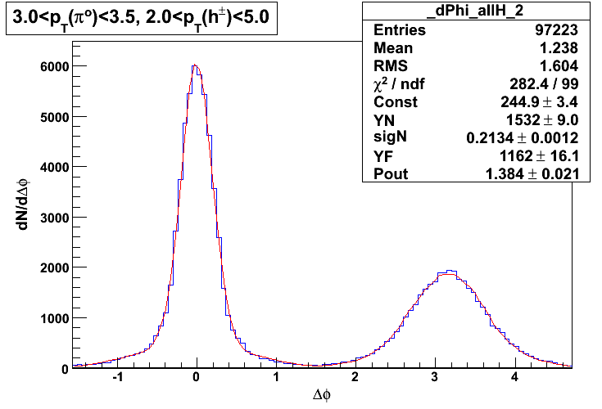
Fit Function
Blue – real (raw Δφ)
Red – Fit from above equation

Slide 33
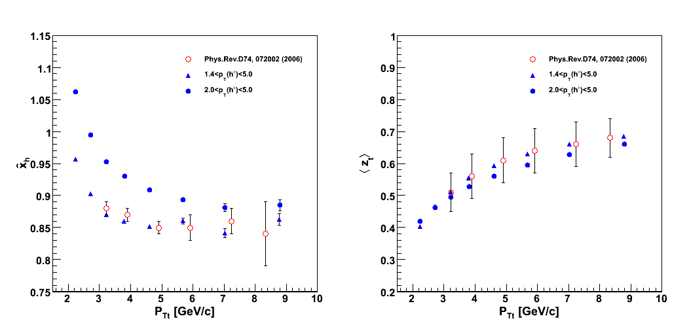
Need <z_{t}> and x_{h}
<k²_{T}> asymmetry results are not sensitive to this x_{h} and <z_{t}> values – only needed to set the scale.
^
^
x_{h} and <z_{t}> are determined through a combined analysis of the π° inclusive cross section and using jet fragmentation function measured in e⁺e⁻ collisions. Ref. PRD 74, 072002 (2006)

Slide 34
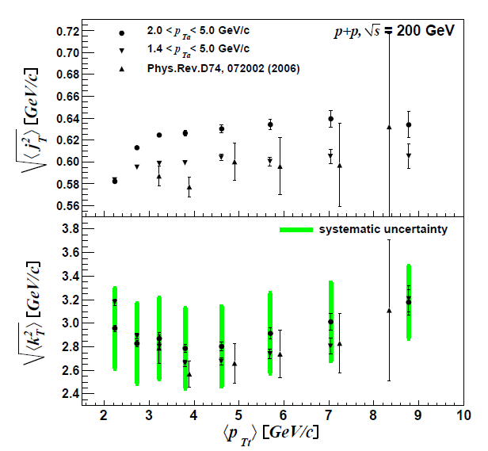
k_{T} results for unpolarized case

Slide 35
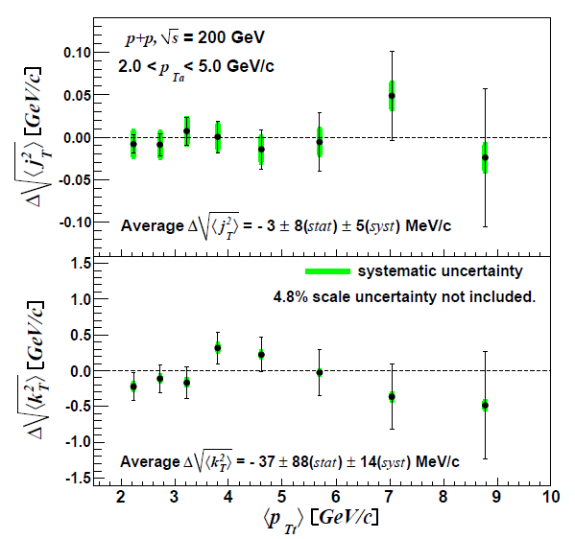
Preliminary Results
Take the difference Like – Unlike helicities
Normalized by beam polarizations
<j²_{T} > asymmetry (-3 ± 8(stat) ± 5(syst) MeV out of ~630 MeV unpolarized)
<k²_{T} > asymmetry also small (-37 ± 88(stat) ± 14(syst) MeV out of ~2.8 GeV unpolarized).

Slide 36

Interpretation
The first term can be related in the “Meng conjecture” to partonic transverse momentum:
where c^{ij} give the initial state weights and W^{ij} give the impact parameter weighting.
Since PYTHIA studies show that the final state studied here is dominated by gg scattering (~50%),
We can interpret this as a constraint on the gluon orbital angular momentum.
Consistent with previous (Sivers) measurements, and complimentary, since one naïvely needs no initial or final state interactions (although Sivers measures orbital in transversely polarized proton).

Slide 37
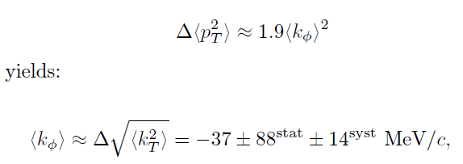
Relating to Meng…

Slide 38
Summary
We have an analysis tool – di-hadron azimuthal correlations - that allows us to measure k_{T}.
We are studying this in helicity-sorted collisions to see if there is a spin-dependent, coherent component of k_{T}.
In our kinematic range, we find Δj_{T} ^{RMS} = -3 ± 8(stat) ± 5(syst) MeV, and Δk_{T} ^{RMS} = -37 ± 88 ± 14(syst) MeV.
While this is consistent with other measurements related to gluon OAM, the connection to parton OAM needs theoretical guidance!

