Slide 1
Step Dynamics in Homogeneous Crystal Growth
Matthew Koppa

Slide 2
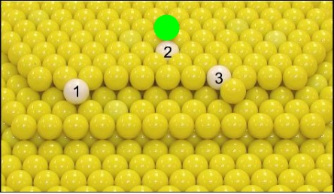
Many possibilities exist for an adatom diffusing over a terrace edge
1
Notes:
Mention the three possibilities shown
Mention Schwoebel-Ehrlich barrier

Slide 3
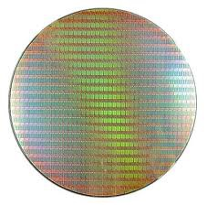
Study of crystal growth in homogeneous systems is relevant to many areas of current research
2
Microfabrication processes are at nanometer scales
Many of these devices are manufactured by growing crystals of a single element
Experimental results will provide a benchmark for theoretical models

Slide 4
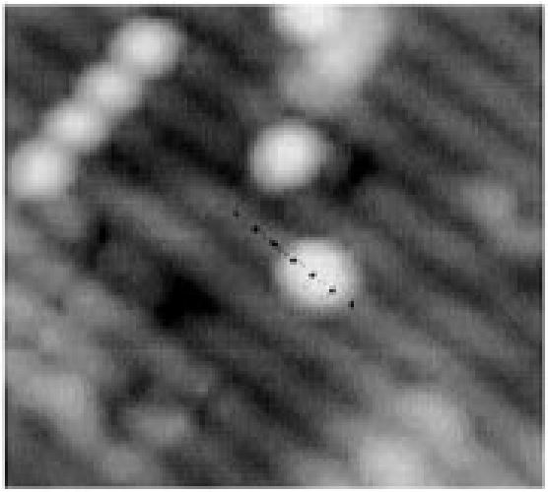
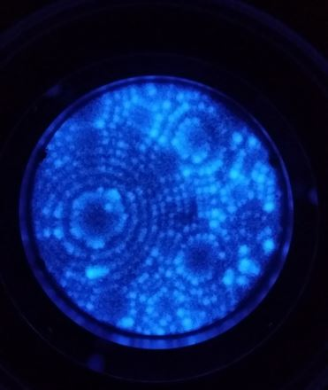
Study of diffusion at this level requires microscopy with atomic resolution
3
B.S. Swartzentruber, Phys. Rev. Lett. 76, 459 (1996).
Notes:
Si dimer on an Si substrate (001) plane. Atom tracker STM image, black dots indicate lattice sites where the dimer hopped to
Right: FIM image of Ir that was taken with our FIM. Unsure of orientation ( figure that out by Monday)

Slide 5
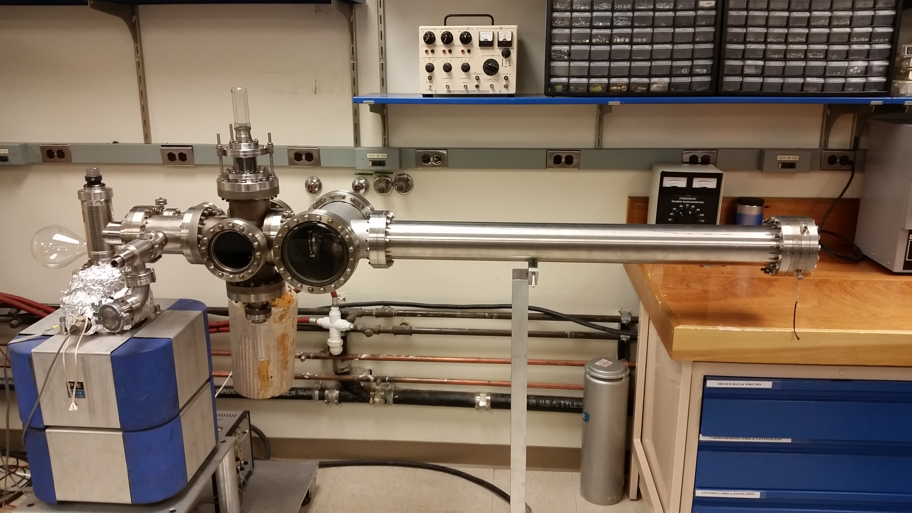
Field ion microscope (FIM) is well suited for the study of adatom diffusion
4
Notes:
Why? Atomic resolution allows imaging of surface
specimen preparation naturally leads to the creation of many terrace edges (Rather than diffusion in a channel)
Single atom can be desorbed from the surface for analysis
Instrument can distinguish mass-to-charge ratio for the desorbed atom revealing it's identity
Segway, but before the specifics let's begin by discussing the theory of the FIM

Slide 6
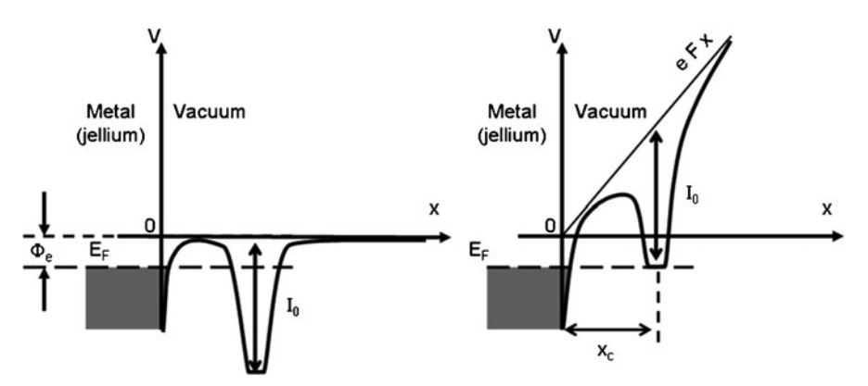
Field ionization and field evaporation require high electric fields
5
B. Gault et al., Atom Probe Microscopy, (Springer-Verlag, New York, NY, 2012)
Notes:
Mention the axes. This is a graph of the potential energy of an electron in an atom, when the atom is near the surface of a metal
left is no field and right is field. Left, No possibility of tunneling because there are no available states to tunnel to
right, a large electric field raises the potential of the atom such that the electron can tunnel to an accessible state near the fermi level
Write this slide up carefully

Slide 7
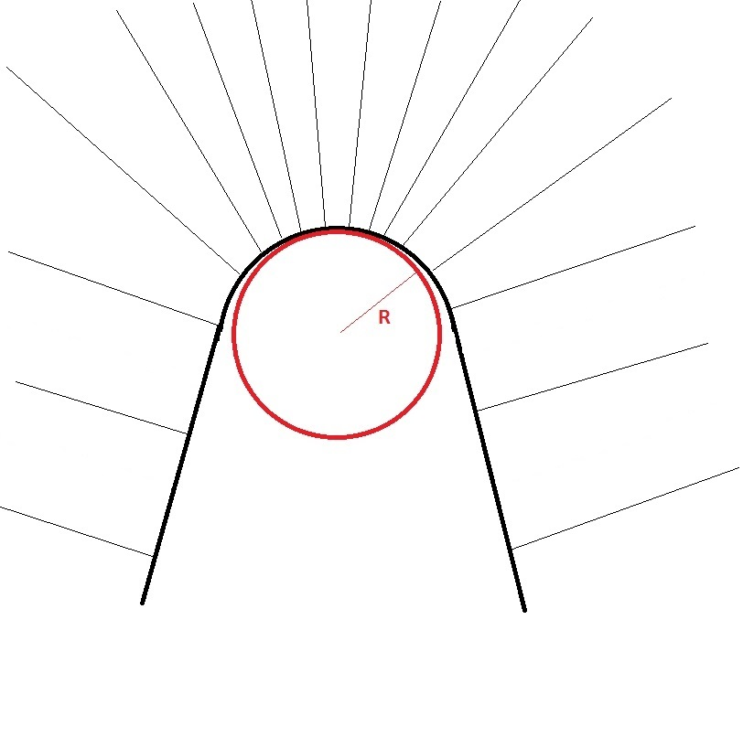
To produce a large electric field, specimens are shaped into needles
6
The tip of the needle is ~100 nm across
Electric field largest in regions with smallest radius of curvature
Electric field in the region of tip is ~1 V/Å
Notes:
First mention the roughing done by electrochemical polishing.
Mention that the tip is fine polished in situ by field evaporation.
The tip is the metal from the previous slide. E-field is created by raising the dc voltage of the tip, segway: smash cut to...

Slide 8
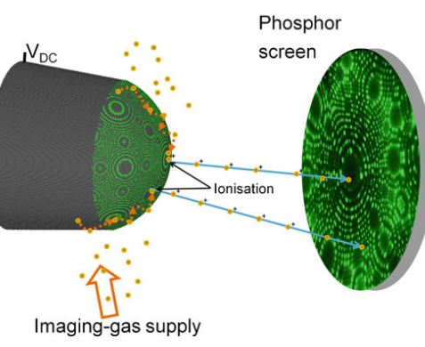
Positive ions allow the specimen to be imaged
7
Imaging gas ions are accelerated nearly normal to the surface
Collection of ions by microchannel plates allows specimen to be imaged at atomic resolution
B. Gault et al., Atom Probe Microscopy, (Springer-Verlag, New York, NY, 2012)

Slide 9
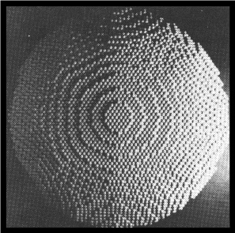
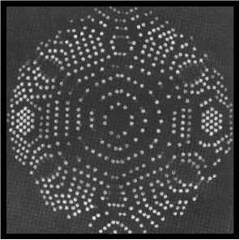
Most protruding atoms create brightest spots
8
Ball model of a body centered cubic (BCC) crystal, (011) oriented, such as tungsten.
Outermost "atoms" painted with phosphorescent paint

Slide 10
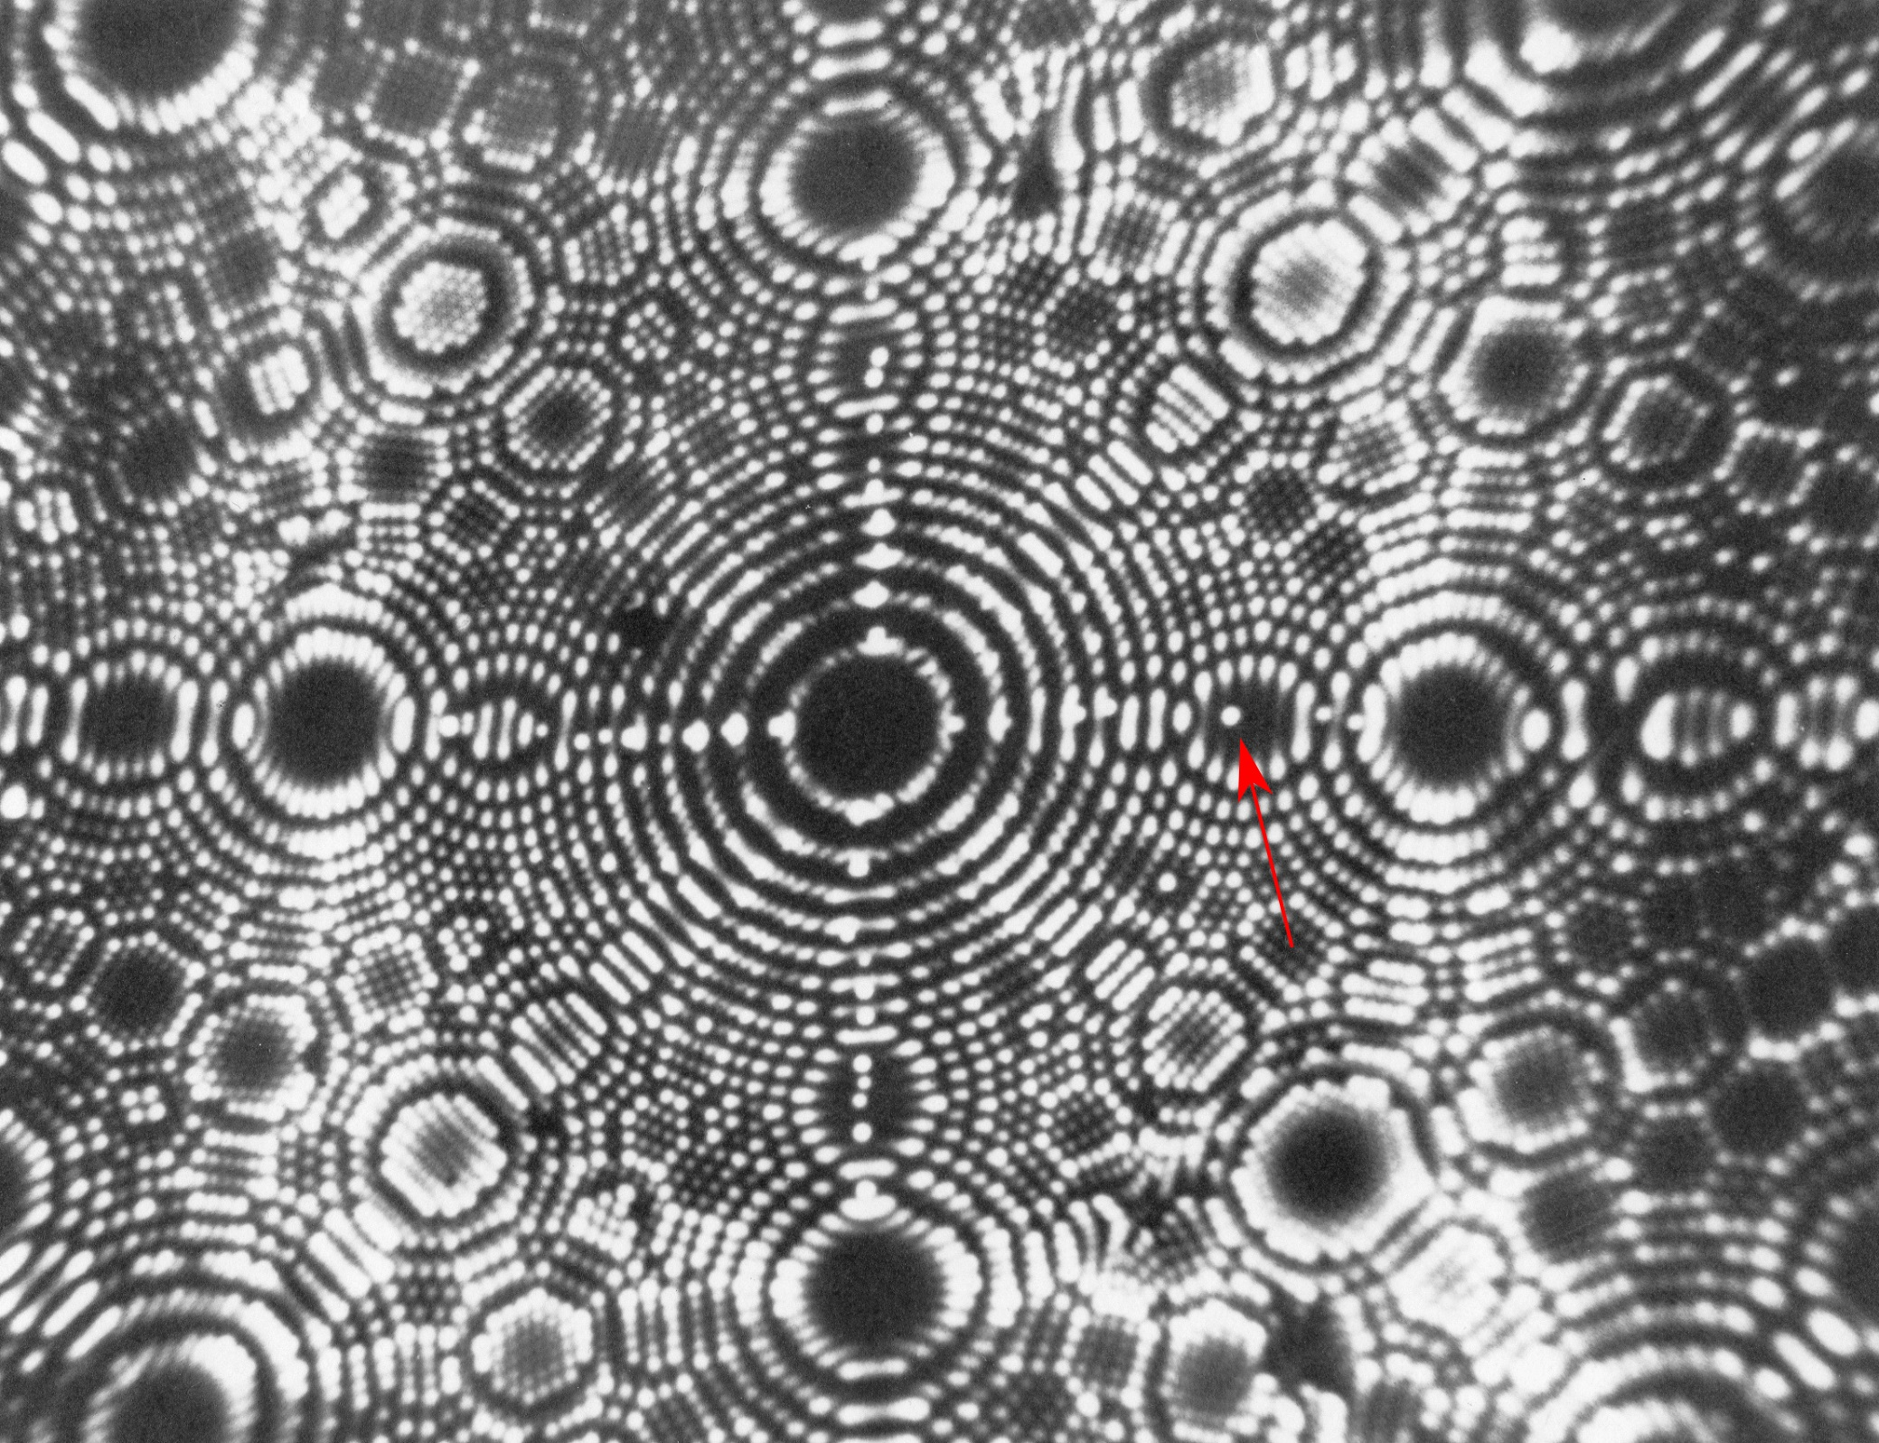
Field ion micrograph of iridium, a face centered cubic crystal (FCC), (100) oriented
9
Courtesy of J. Panitz

Slide 11
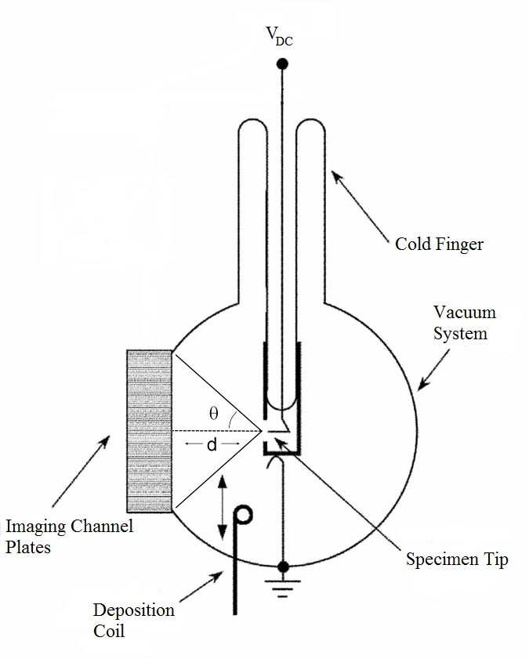
Diagram of the essential features of a field ion microscope
10
Notes:
Tip is mounted here. This is effectively every part of the FIM. Mention that this is purely schematic because it is a glass vaccuum system.
1. tip is mounted in UHV. Imaging gas in injected into the system. Reason for this is to create a large mean free path for the ions to travel to channel plates
Need to write up the total description for this slide
Mention the reasons for cooling (stopping diffusion, steadying the jitter for resolution, reducing lateral component of velocity for imaging ion)
Mention the deposition coil.
Why use a vacuum system?( Mean free path, no contaminants.)

Slide 12
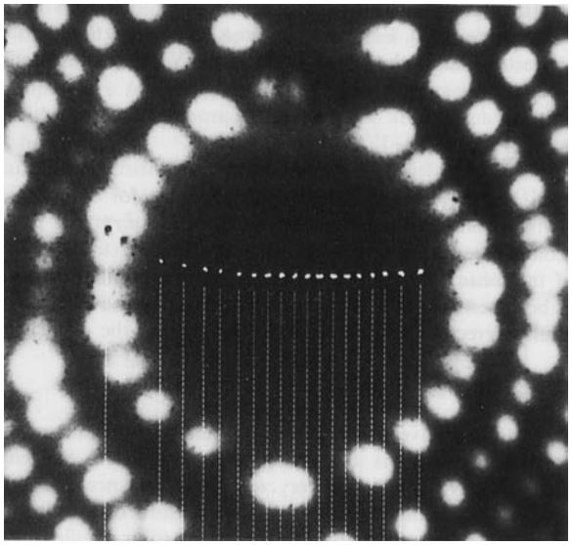
Diffusion studies in heterogeneous systems have been carried out using the FIM
11
Diffusion of Rh on W
G. Antczak and G. Ehrlich, Surface Diffusion: Metals, Metal Atoms, and Clusters, (Cambridge University Press, Cambridge, 2010).

Slide 13
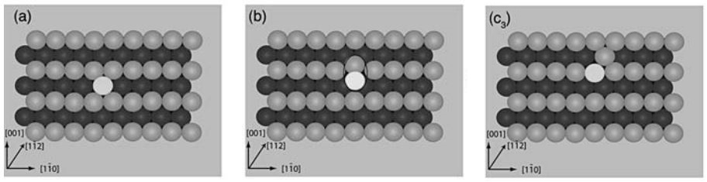
Exchange-mediated diffusion has been observed in heterogeneous systems
12
G. Antczak and G. Ehrlich, Surface Diffusion: Metals, Metal Atoms, and Clusters, (Cambridge University Press, Cambridge, 2010).

Slide 14
Diffusion and step dynamics in homogeneous systems are more difficult to observe
13
Cannot distinguish exchange processes in systems with identical adatom and substrate atoms
Chemical nature of diffusing adatom affects step dynamics
Behavior of homogeneous adatoms should not be inferred from the heterogeneous case

Slide 15
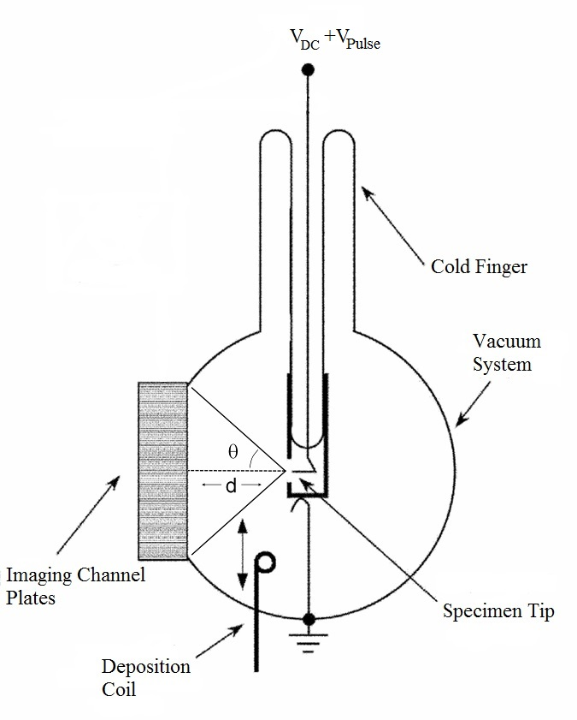
Atom probe allows measurement of mass-to-charge ratio of individual atoms via time-of-flight mass spectrometry
14

Slide 16
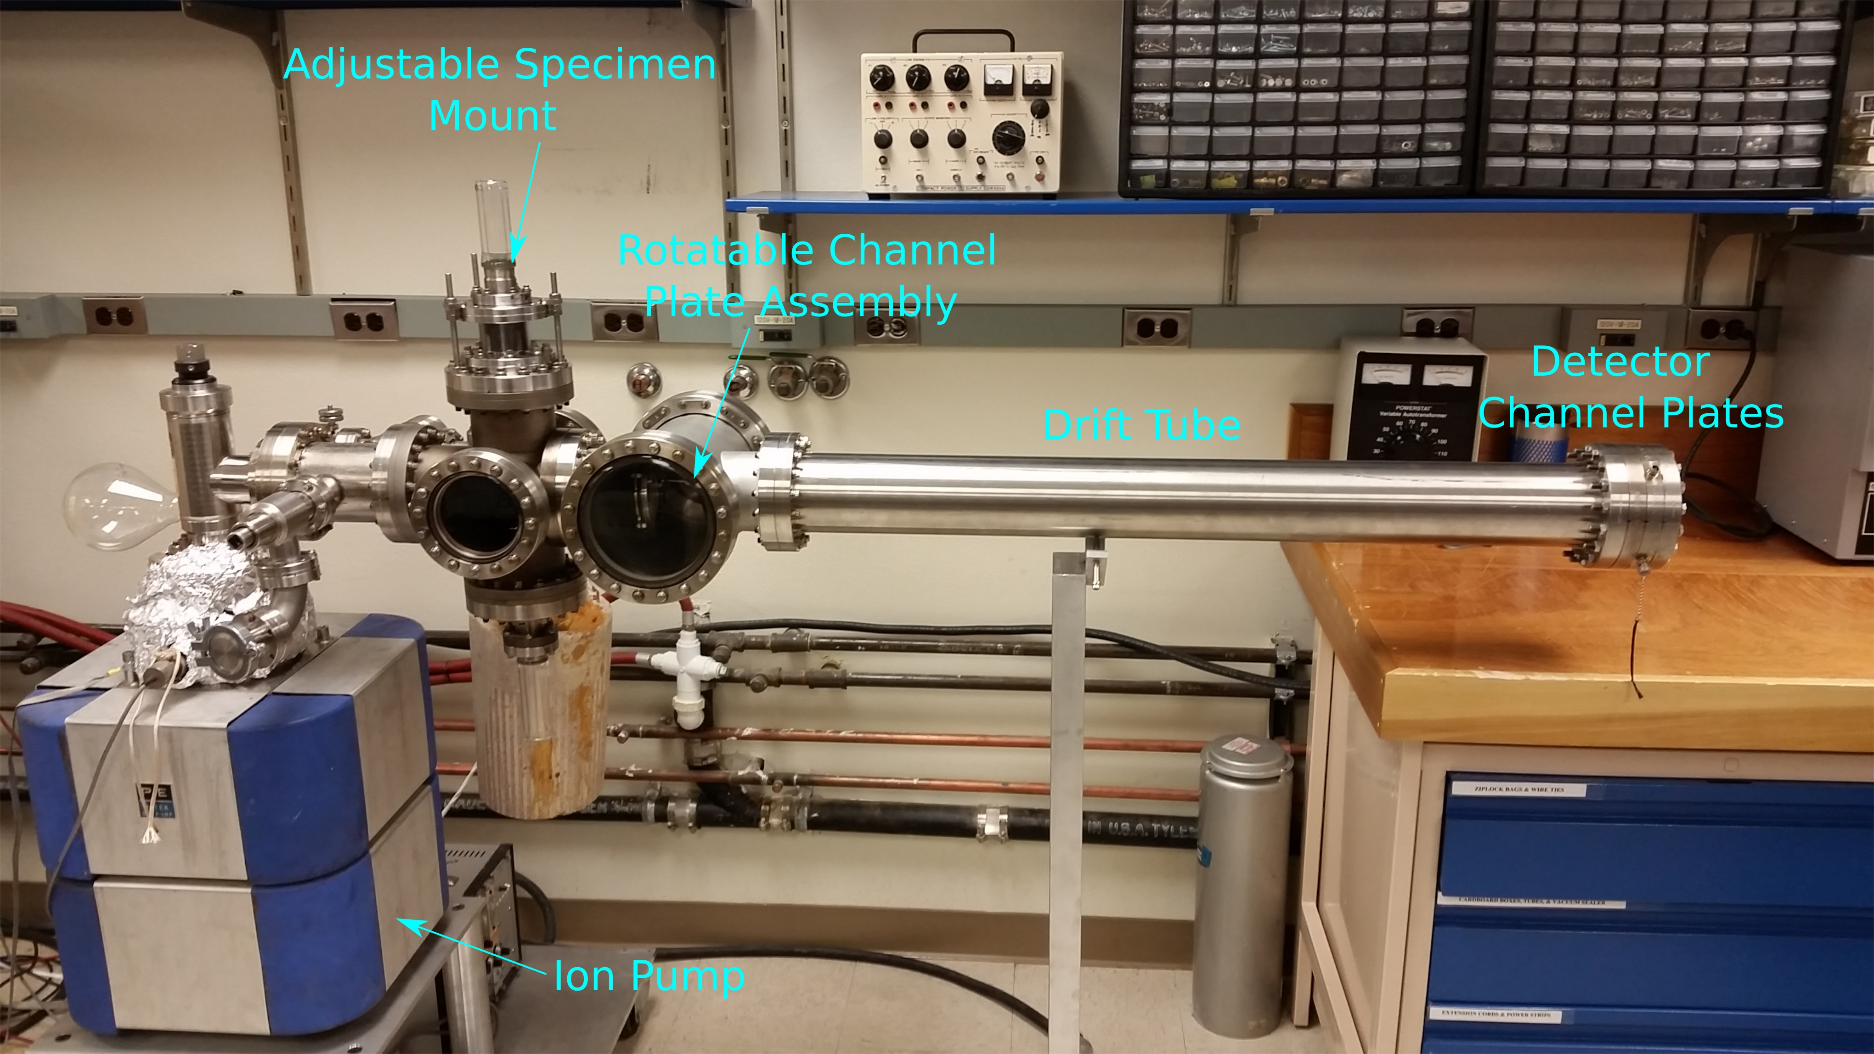
Working version of atom probe is complete
15

Slide 17
Adatom location determined using FIM
16

Slide 18
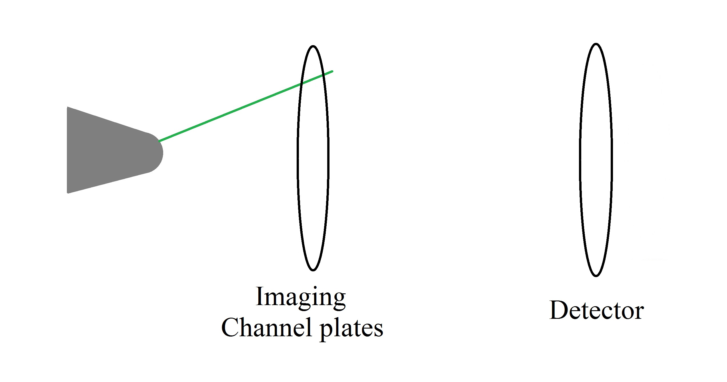
Adatoms of interest may be off-center
17

Slide 19
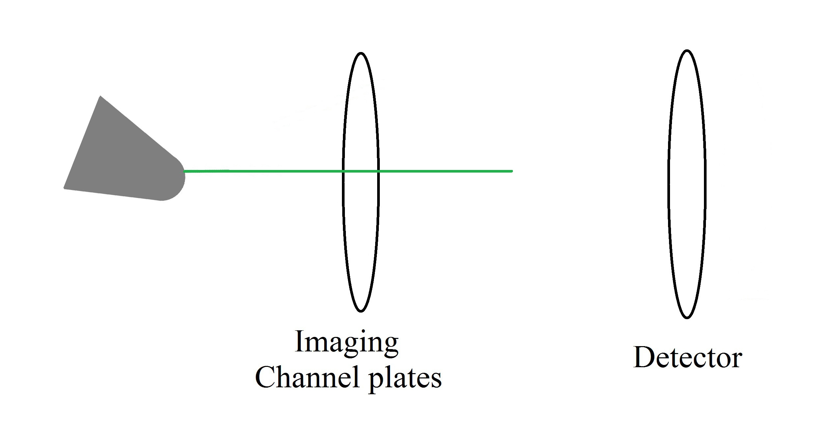
Adjustable specimen mount allows adatom to be aligned with detector
18

Slide 20
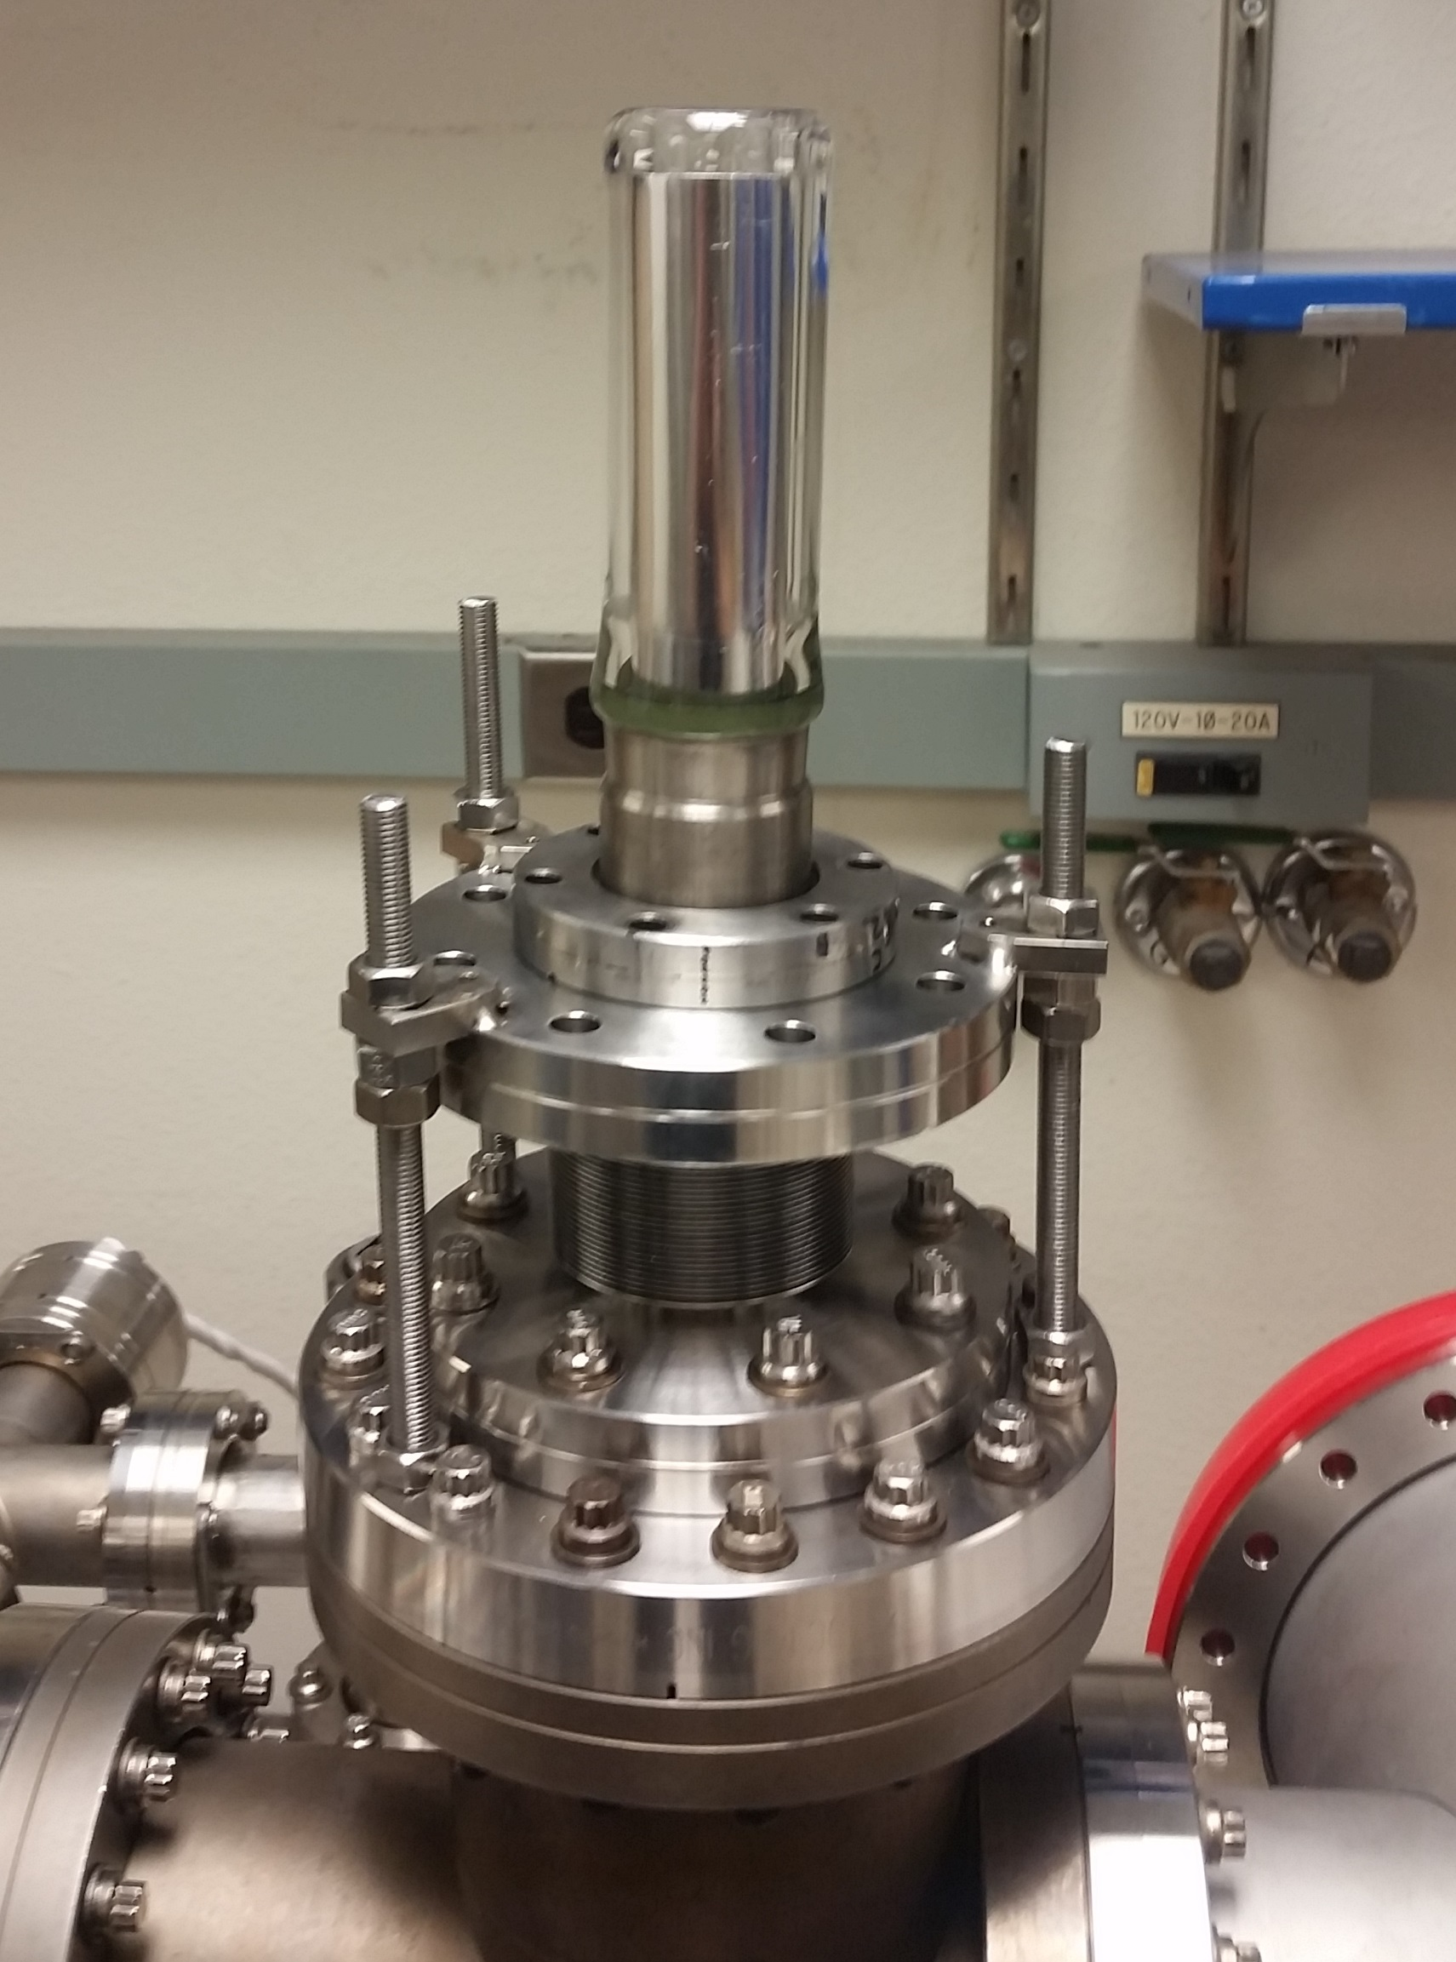
Custom designed specimen mount has been manufactured and is installed on the system
19
Cold finger attaches to a welded bellows that can be adjusted to ensure adatom of interest is sent to detector

Slide 21
Time of flight mass spectrometer
20
Atom of interest is field-evaporated and sent down drift tube
Mass-to-charge ratio distinguishes the identity of desorbed atom

Slide 22
Procedure for studying adatom diffusion
21
Vacuum system is baked out to achieve ultra high vacuum pressures (~10^-10 torr)
Specimen tip is cooled to liquid nitrogen temperatures to stop diffusion
Adatoms are deposited onto tip
Imaging gas is backfilled into system
Tip is imaged using field ion microscope
Tip is heated to initiate diffusion
Tip is cooled to stop diffusion and image again

Slide 23
Procedure for studying adatom diffusion (cont.)
22
If an interesting diffusion step has occurred the imaging channel plates are rotated out of the way and the system is evacuated
Detector channel plates are turned on and monitored by a photomultiplier tube (PMT)
A voltage pulse is applied to the tip to desorb the adatom from the surface
An oscilloscope is triggered by the pulse and records (PMT) voltage allowing time of flight measurements

Slide 24
Use stable, isotopically enriched material to distinguish adatom/substrate atoms
23
W | Ir
180 < 1% | 191 37%
182 27% | 193 63%
183 14%
184 31%
186 28%
Available isotopes and isotopic abundance

Slide 25
Repeated experiments generate sufficient statistics for the experiment
24
Even for substrates with a near 50-50 isotopic abundance, e.g. Ir, multiple trials allow adatom identification with a confidence level of 1 in 10^3

Slide 26
Calculated time of flight measurements for 2+ and 3+ charge states of the stable isotopes of tungsten and iridium
25
Isotope | Abundance | Mass (u) | Time (microseconds), 2+ | Time (microseconds), 3+
W 180 | <1% | 179.95 | 8.84 | 7.22
W 182 | 27% | 181.95 | 8.89 | 7.26
W183 | 14% | 182.95 | 8.92 | 7.28
W184 | 31% | 183.95 | 8.94 | 7.30
W186 | 28% | 185.95 | 8.99 | 7.34
Ir 191 | 37% | 190.96 | 9.11 | 7.44
Ir 193 | 63% | 192.96 | 9.16 | 7.48

Slide 27
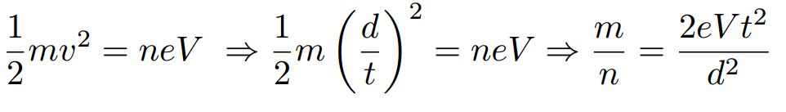
Equation for finding mass-to-charge ratio from time of flight measurement from energy considerations
26

Slide 28
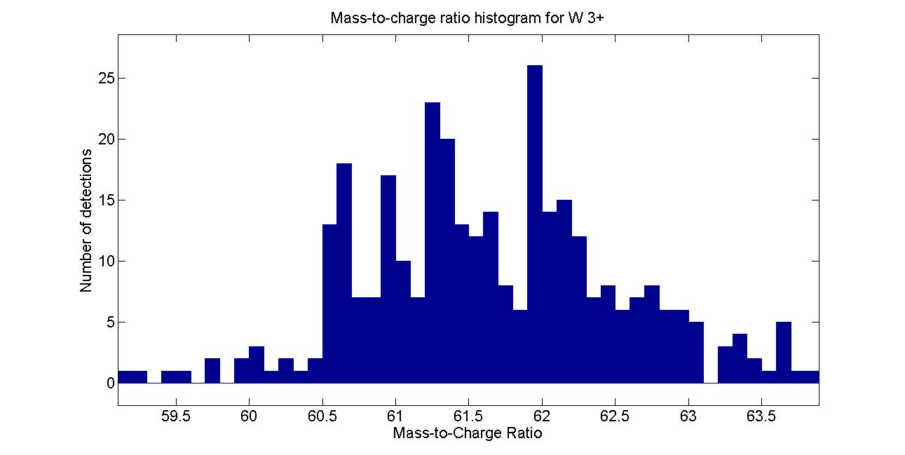
Early results show the viability of the current atom probe
27

Slide 29
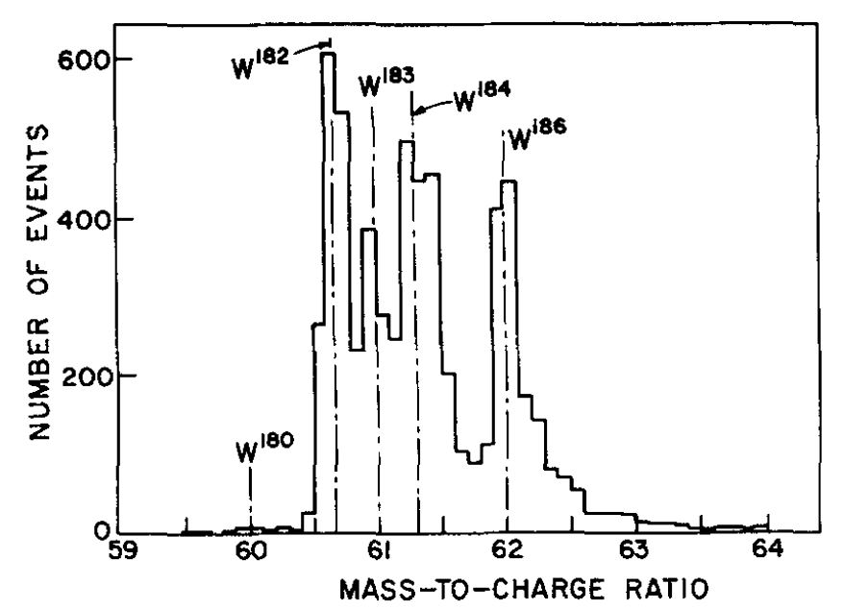
Comparison with previously measured spectrum shows good agreement
28
A. Wagner et al., Rev. Sci. Instrum. 46, 1032 (1975).

Slide 30
Many aspects of diffusion and step dynamics will be investigated
29
Diffusion along step edges
Dependence of step diffusion on particular crystallographic directions
Dependence of diffusion on terrace spacing

Slide 31
Future instrument modifications may allow for investigation of non-equilibrium conditions
30
Using Joule heating the adatom reaches an equilibrium state between viewings
Pulsed laser heating could reveal intermediate steps

Slide 32
Proposed project timeline
31
Tasks | Months during project
Construct atom probe | 1-6
Study adatom diffusion | 7-12
Investigate step dynamics | 7-12
Incorporate Laser heating | 13-15
Investigate step dynamics with and without laser heating | 13-24
Investigate possible step-step interactions | 25-36

